Slide 1

Hybrid Application Monitoring (AppDynamics)
Digital Journey Overview
Maturity Assessment Report

Slide 2
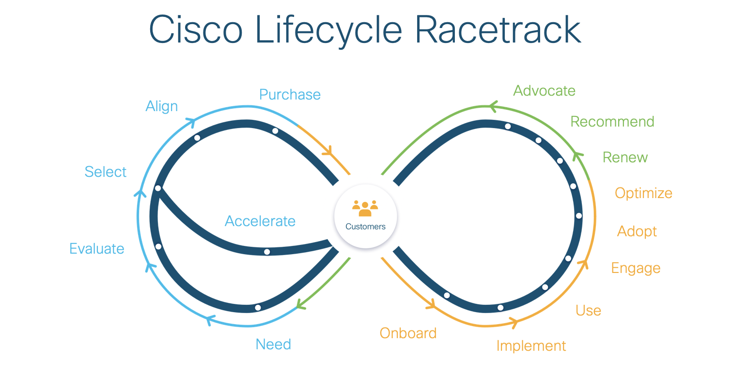

Slide 3
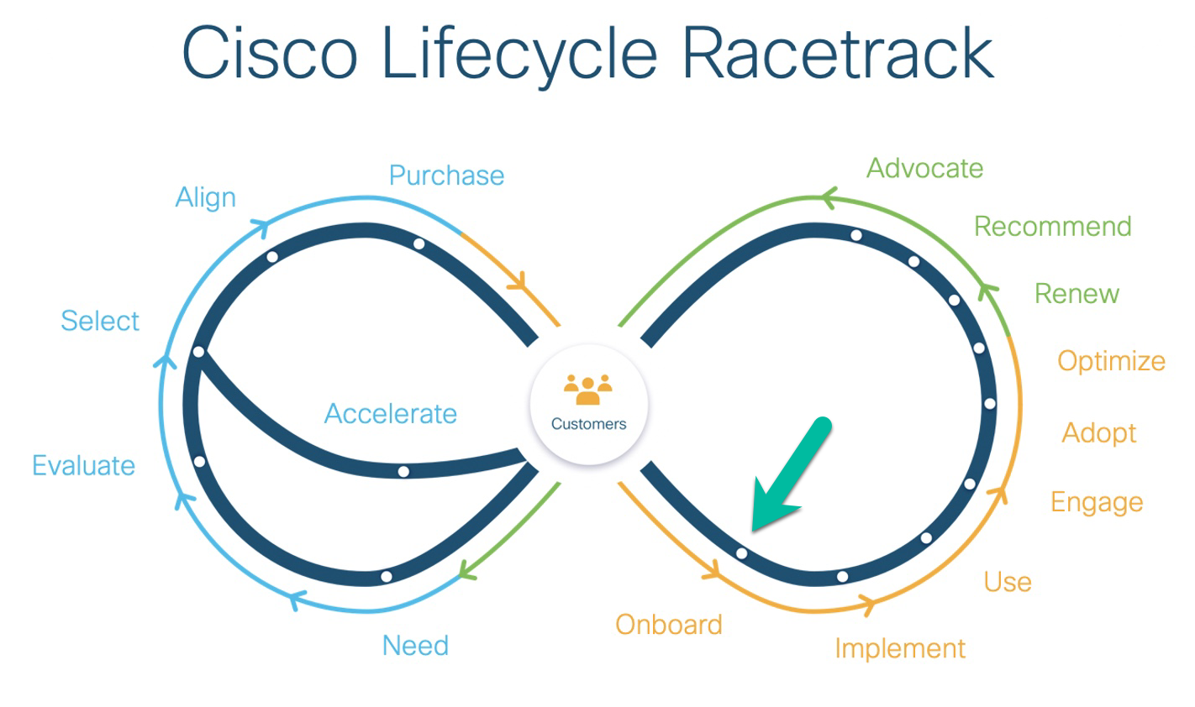
Hybrid Application Monitoring Pitstop: Onboard
*** see the next page for feedback on health checks best practices

Slide 4
Pitstop: Onboard resources and documents

Slide 5
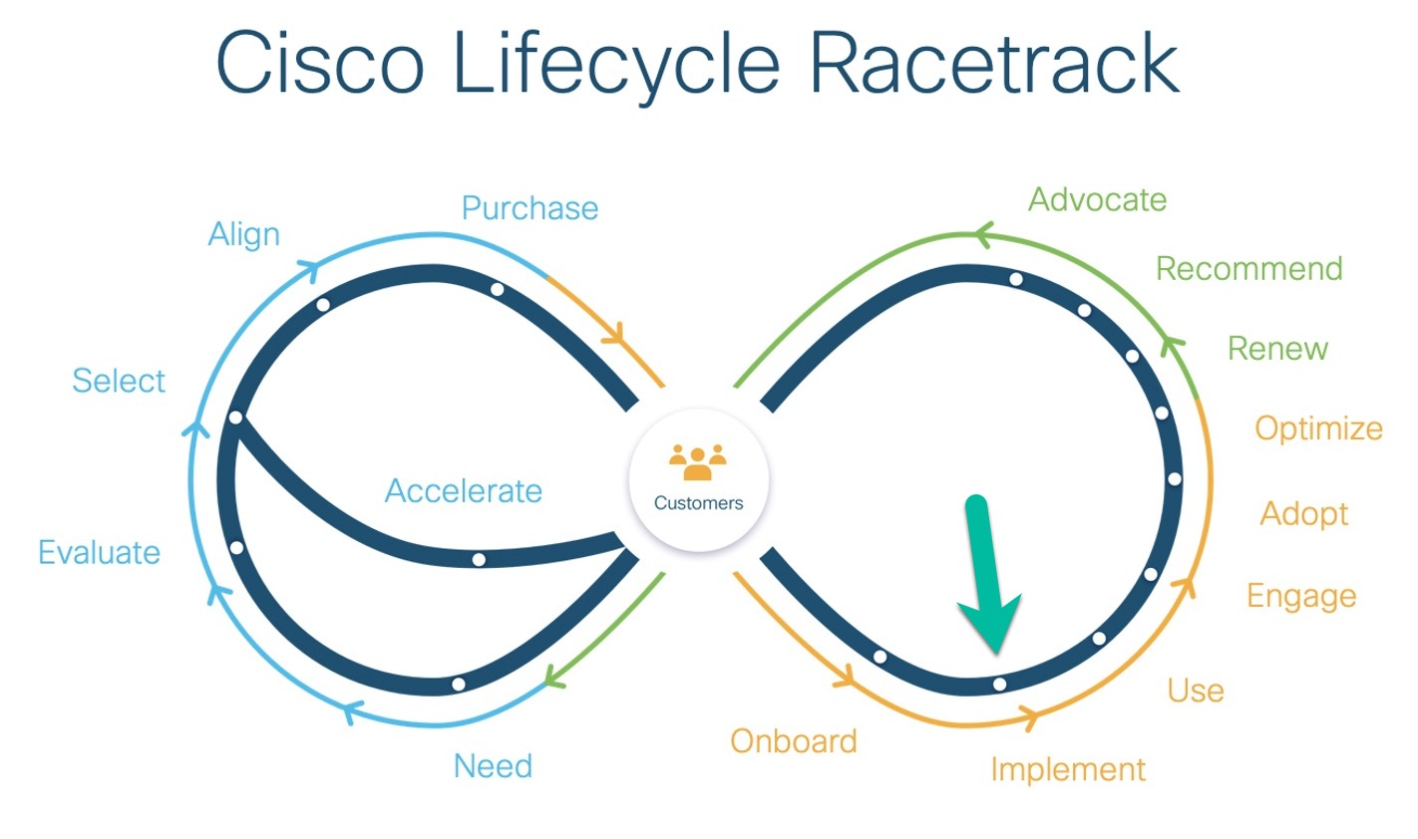
Hybrid Application Monitoring Pitstop: Implement
*** see the next page for feedback on health checks best practices

Slide 6
Pitstop: Implement has failed health check best-practices

Slide 7
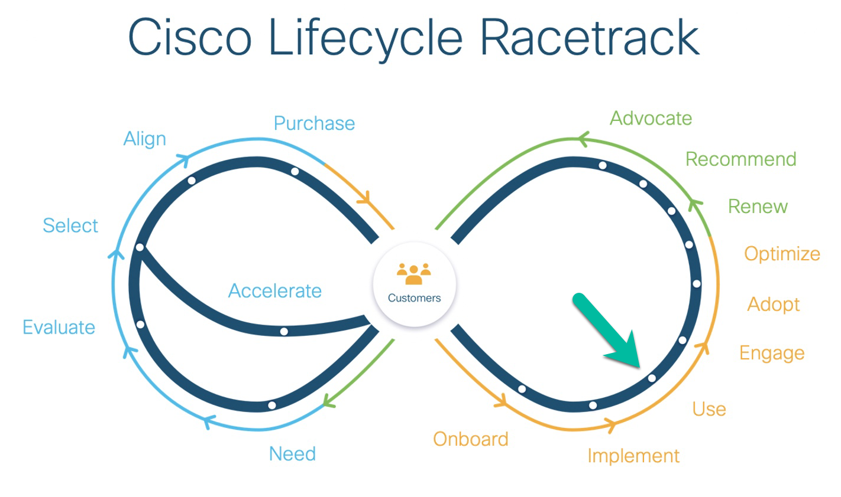
Hybrid Application Monitoring Pitstop: Use
*** see the next page for feedback on health checks best practices

Slide 8
Pitstop: Use has failed health check best-practices

Slide 9
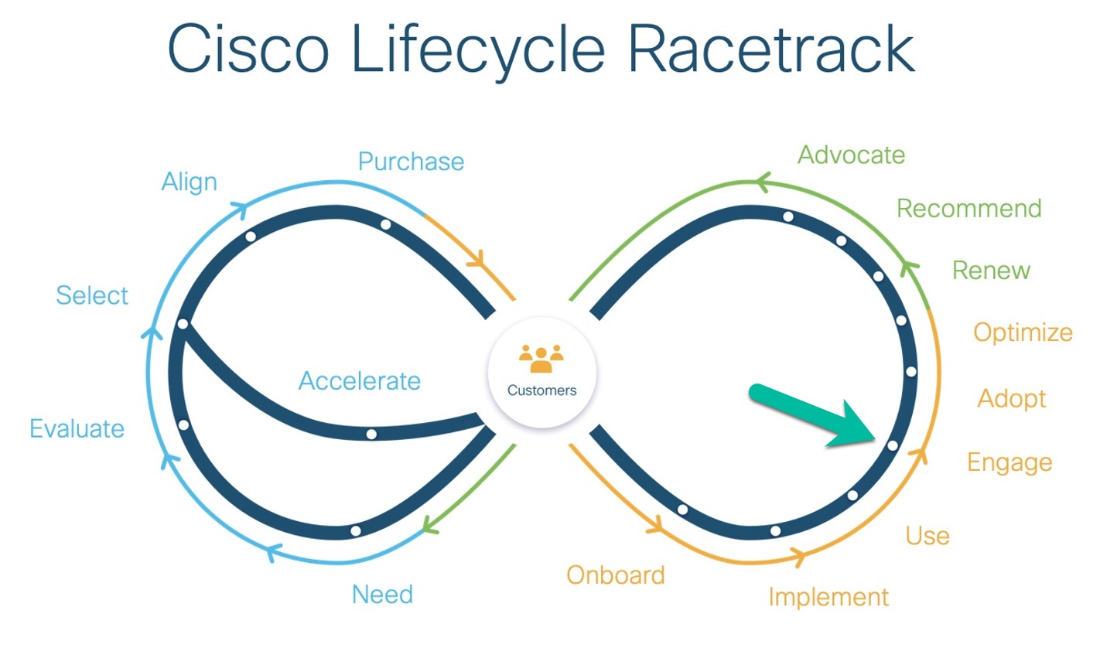
Hybrid Application Monitoring Pitstop: Engage
*** see the next page for feedback on health checks best practices

Slide 10
Pitstop: Engage has failed health check best-practices

Slide 11
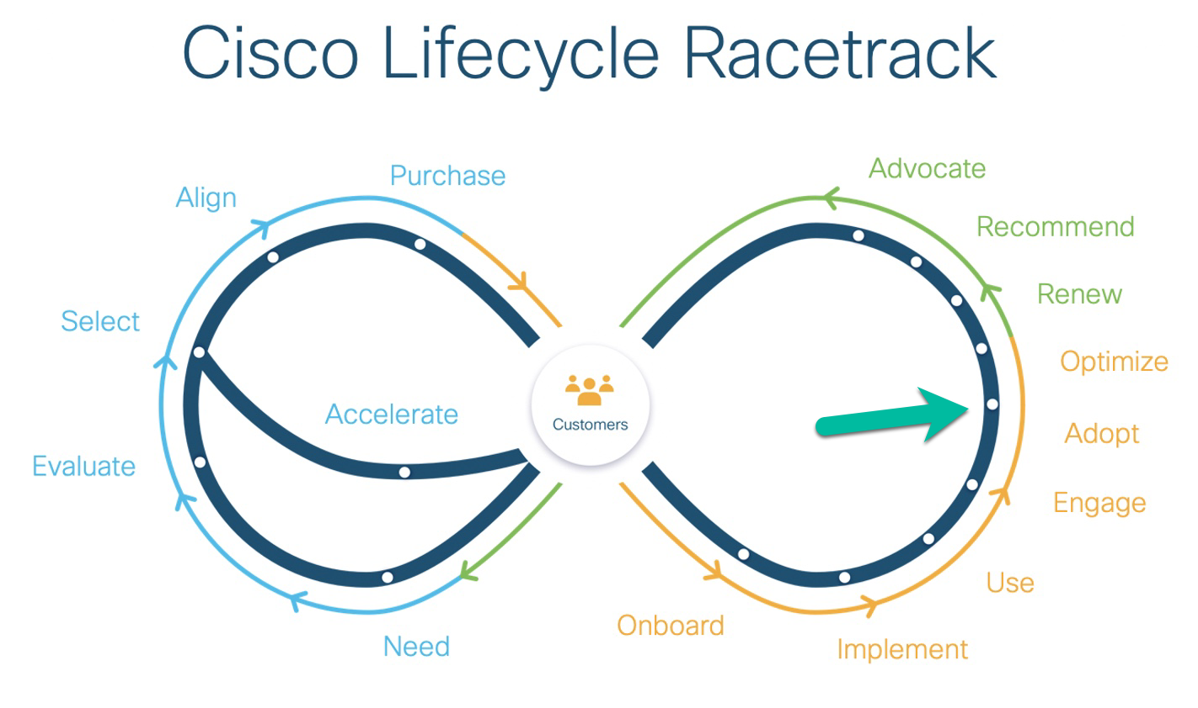
Hybrid Application Monitoring Pitstop: Adopt
*** see the next page for feedback on health checks best practices

Slide 12
Pitstop: Adopt has failed health check best-practices

Slide 13
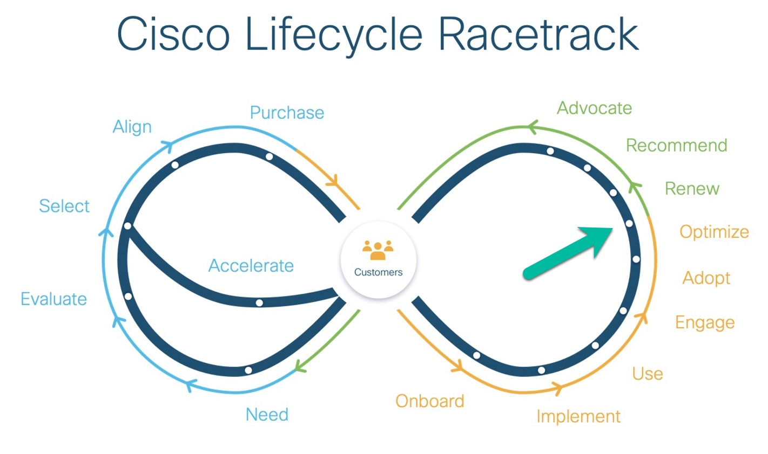
Hybrid Application Monitoring Pitstop: Optimize
*** see the next page for feedback on health checks best practices

Slide 14
Pitstop: Optimize has failed health check best-practices

