Slide 1

Hybrid Application Monitoring (AppDynamics)
Digital Journey Overview
Maturity Assessment Report **
** This report is used for Hybrid Application Monitoring Use Case purchased under the Hybrid Application Monitoring SKU.

Slide 2
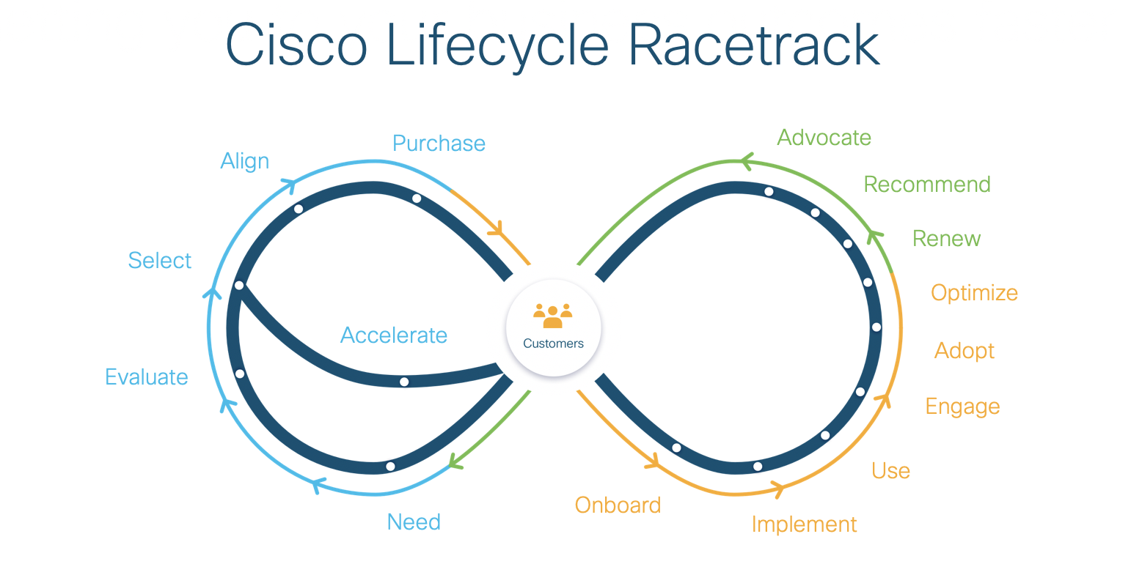

Slide 3
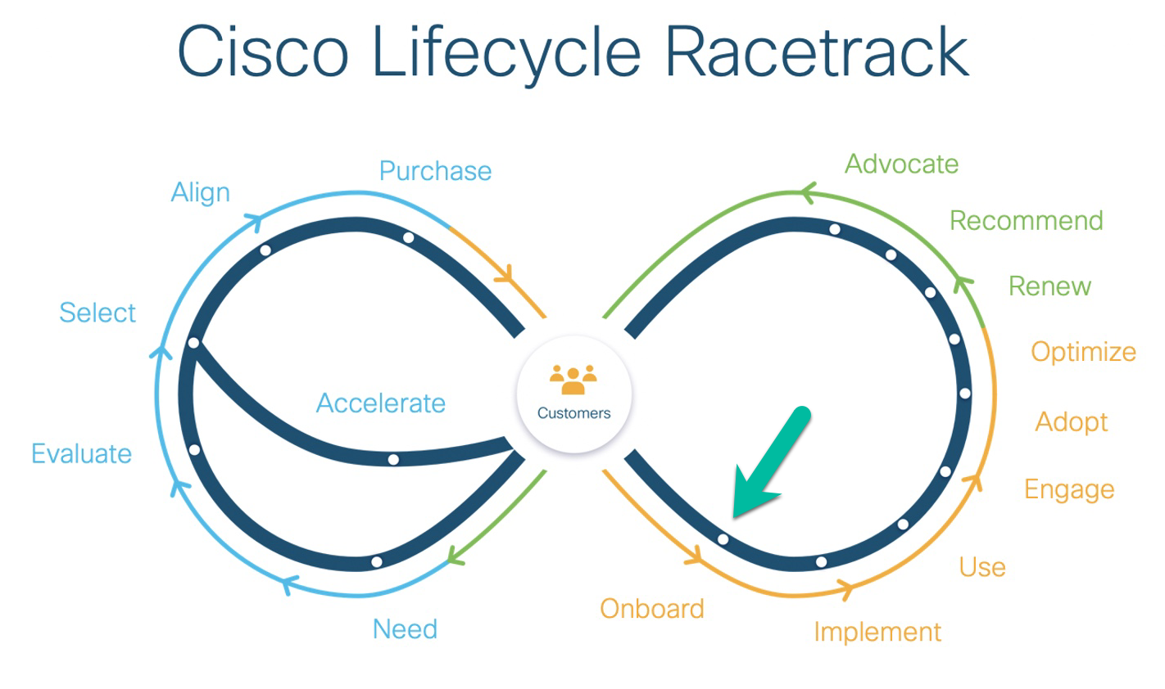
Hybrid Application Monitoring Pitstop: Onboard
*** see the next page for feedback on health checks best practices

Slide 4
Pitstop: Onboard resources and documents. These are the primary recommendations to pass health checks for the Onboard pitstop.

Slide 5
Pitstop: Onboard resources and documents. These are the secondary recommendations to improve the quality of instrumentation further.
There are no secondary recommendations available for this Pitstop. Please consult the primary recommendations on the prior slide.

Slide 6
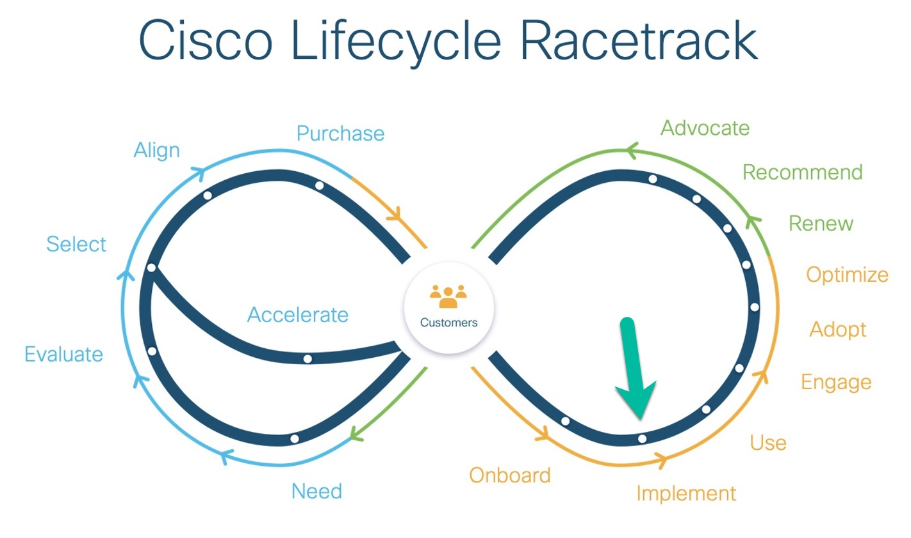
Hybrid Application Monitoring Pitstop: Implement
*** see the next page for feedback on health checks best practices

Slide 7
Pitstop: Implement resource and document links. These are the primary recommendations to pass health checks for the Implement pitstop.

Slide 8
Pitstop: Implement resource and document links. These are the secondary recommendations to improve the quality of instrumentation further.
There are no secondary recommendations available for this Pitstop. Please consult the primary recommendations on the prior slide.

Slide 9
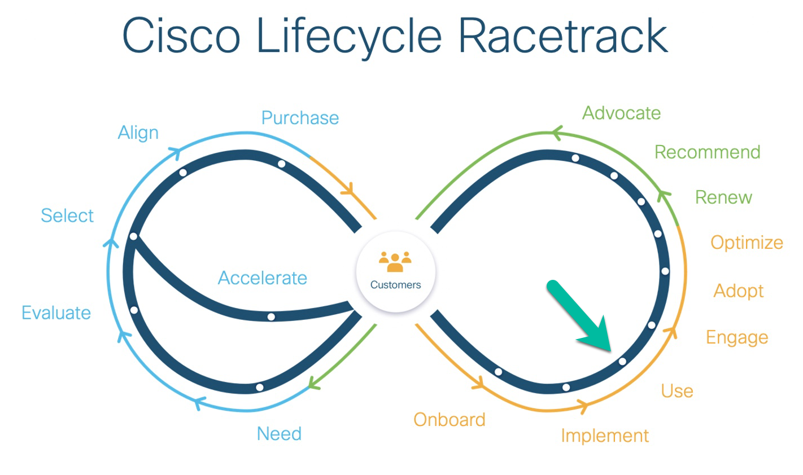
Hybrid Application Monitoring Pitstop: Use
*** see the next page for feedback on health checks best practices

Slide 10
Pitstop: Use resource and document links. These are the primary recommendations to pass health checks for the Use pitstop.

Slide 11
Pitstop: Use resource and document links. These are the secondary recommendations to improve the quality of instrumentation further.
There are no secondary recommendations available for this Pitstop. Please consult the primary recommendations on the prior slide.

Slide 12
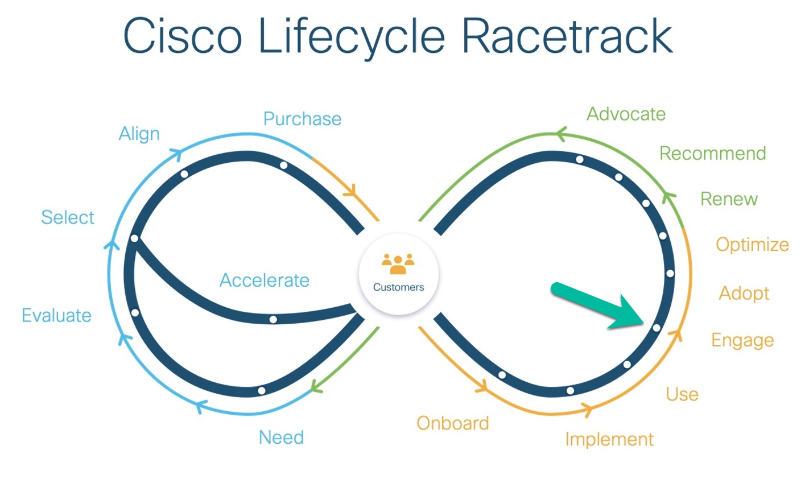
Hybrid Application Monitoring Pitstop: Engage
*** see the next page for feedback on health checks best practices

Slide 13
Pitstop: Engage resource and document links. These are the primary recommendations to pass health checks for the Engage pitstop

Slide 14
Pitstop: Engage resource and document links. These are the secondary recommendations to improve the quality of instrumentation further.
There are no secondary recommendations available for this Pitstop. Please consult the primary recommendations on the prior slide.

Slide 15
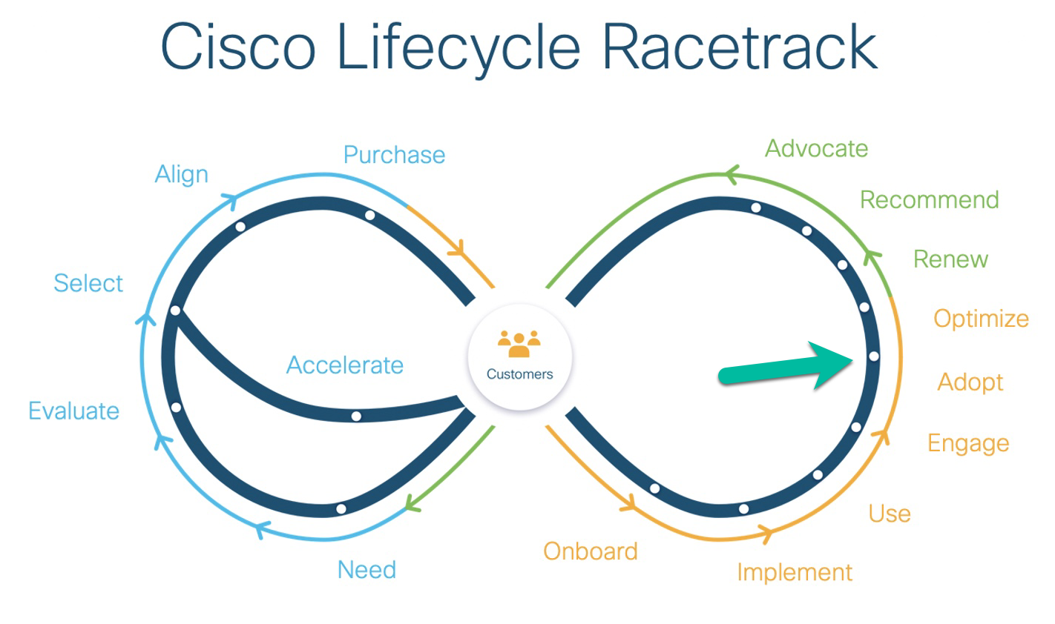
Hybrid Application Monitoring Pitstop: Adopt
*** see the next page for feedback on health checks best practices

Slide 16
Pitstop: Adopt resource and document links. These are the primary recommendations to pass health checks for the Adopt pitstop

Slide 17
Pitstop: Adopt resource and document links. These are the secondary recommendations to improve the quality of instrumentation further.
There are no secondary recommendations available for this Pitstop. Please consult the primary recommendations on the prior slide.

Slide 18
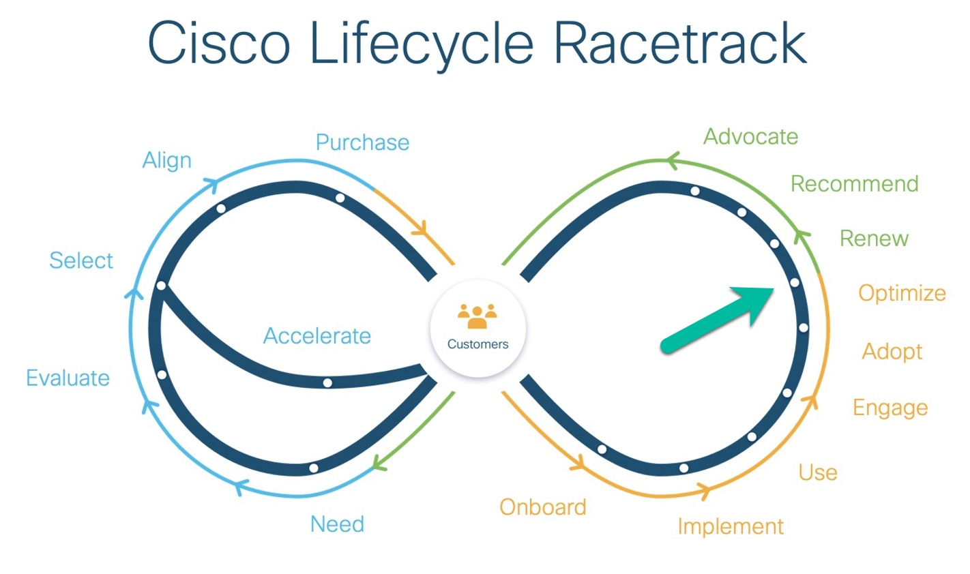
Hybrid Application Monitoring Pitstop: Optimize
*** see the next page for feedback on health checks best practices

Slide 19
Pitstop: Optimize resource and document links. These are the primary recommendations to pass health checks for the Optimize pitstop

Slide 20
Pitstop: Optimize resource and document links. These are the secondary recommendations to further improve the quality of instrumentation.
There are no secondary recommendations available for this Pitstop. Please consult the primary recommendations on the prior slide.

