Slide 1


Experience so far…building an app for Diagnosing Dementia in Care Home settings
DiADeM
3:00 – 3:30pm – Colin Sloane

Slide 2
What will be covered in this session
Why DiADeM? What is it?
Code4Health/LiveCode/App in a Day
Apperta Foundation Challenge
Open EHR
Progress to date
Challenges and lessons Learned

Slide 3
Why DiADeM? What is it?
DiADeM is a tool aimed for diagnosing of advanced dementia in people who are in care homes where a formal referral to memory services is rarely desirable and could be distressing for them.
Reports estimate that between 70% and 80% of care home residents have dementia and that many do not have a formal diagnosis
Some care home residents with advanced dementia and/or frailty, may currently be denied a diagnosis due to difficulty attending a memory service clinic.
A Diagnosis enables access to appropriate support, care planning and in some cases, treatment
Can give the person with dementia the opportunity to share with family members and other carers their preferences for future care

Slide 4
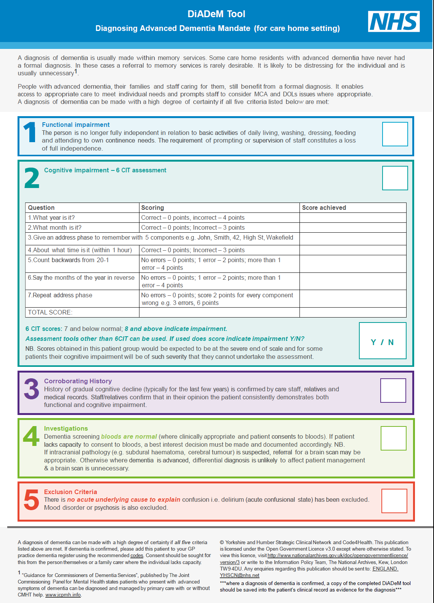
The
Paper Based DiADeM Tool
A diagnosis of dementia can be made with a high degree of certainty if all five criteria listed are met

Slide 5
Code4Health/LiveCode/App in a Day
How we came across Code4Health and the app in a day training etc?
  NHS England Newsletter March 2015
  NHS Code4Health Programme Launched 2015 UK e-health Week
  Call for ‘communities of interest’ we answered the call
  An opportunity to use E –Health Technology to improve DiADeM
10 Clinical Network staff did ‘app in a day’ training
Livecode used to develop prototype DiADeM app

Slide 6
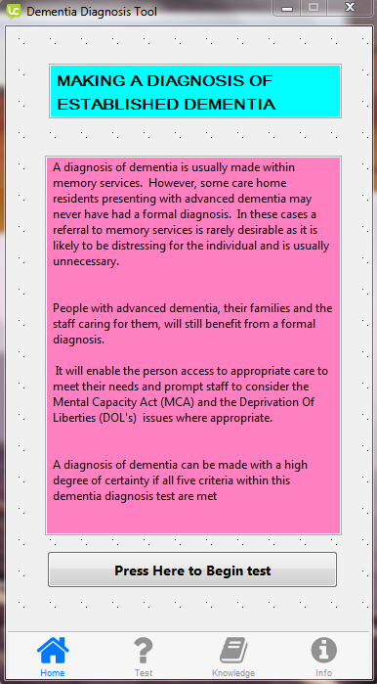
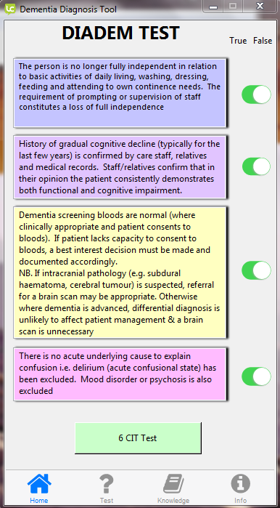
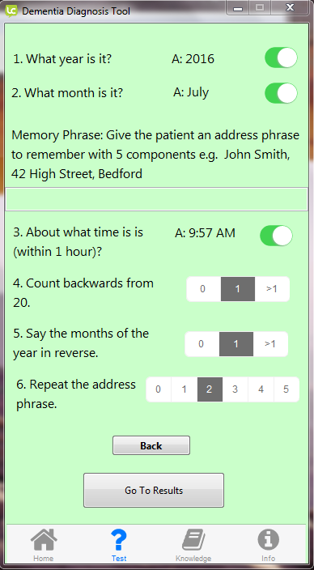
Prototype DiADeM app

Slide 7
Apperta Foundation Challenge
YH SCN successful entry in the Apperta Foundation Challenge
Now have Developer support - Application Insight.
Open EHR
Took part in Open EHR training
Shared DiADeM concept
DiADeM Project now on Open EHR
Elements of tool saved as architypes (6 CIT, GP COG etc)

Slide 8
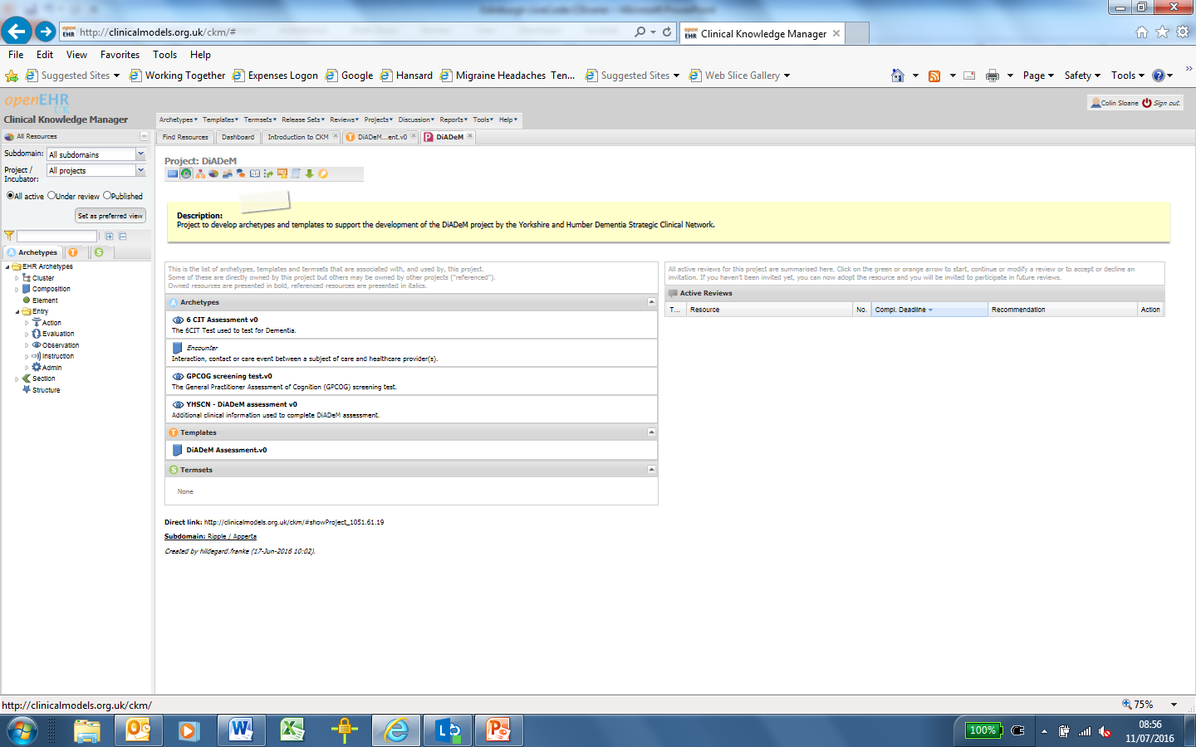
Open EHR and CKM
http://clinicalmodels.org.uk/ckm

Slide 9
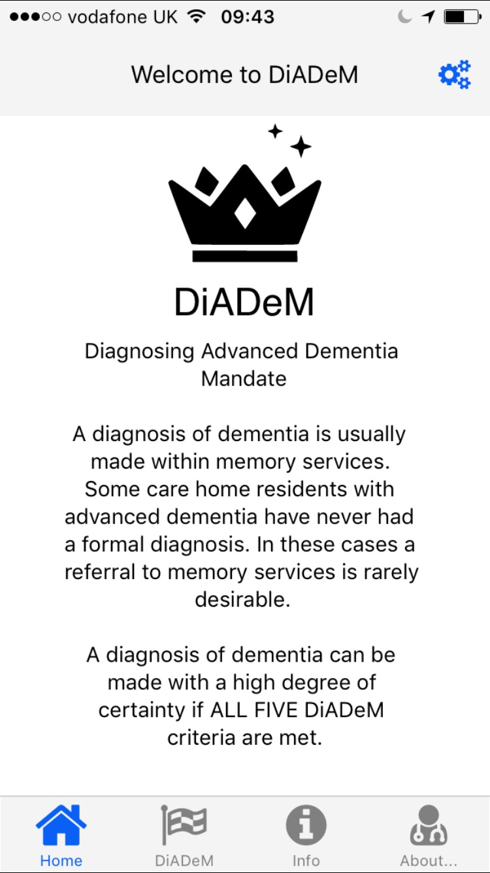
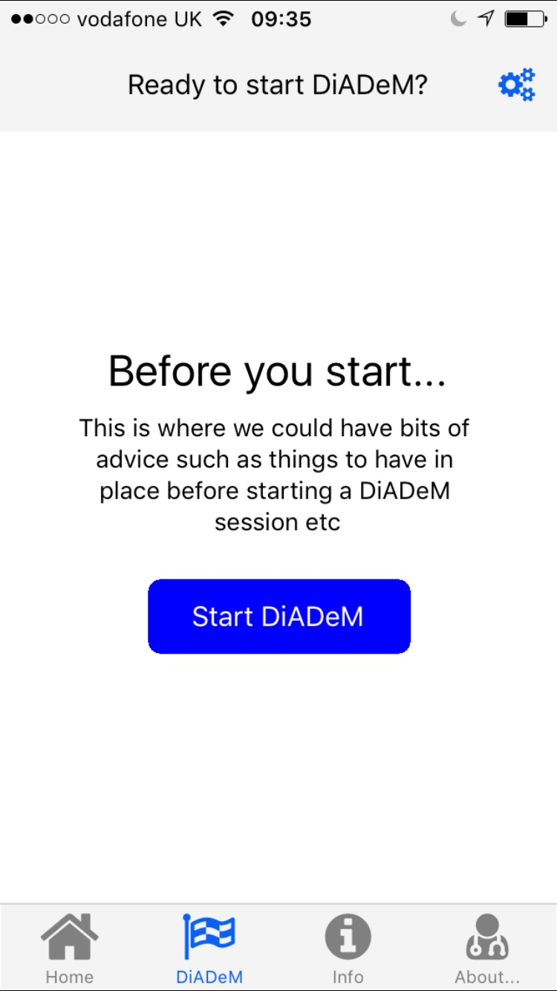
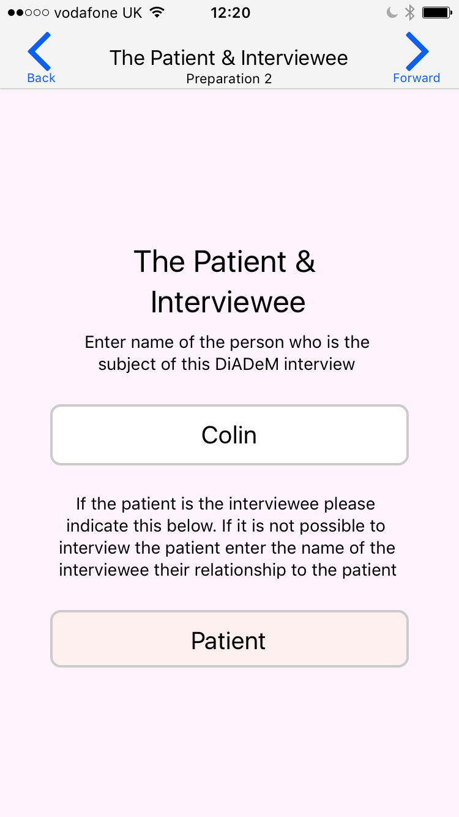
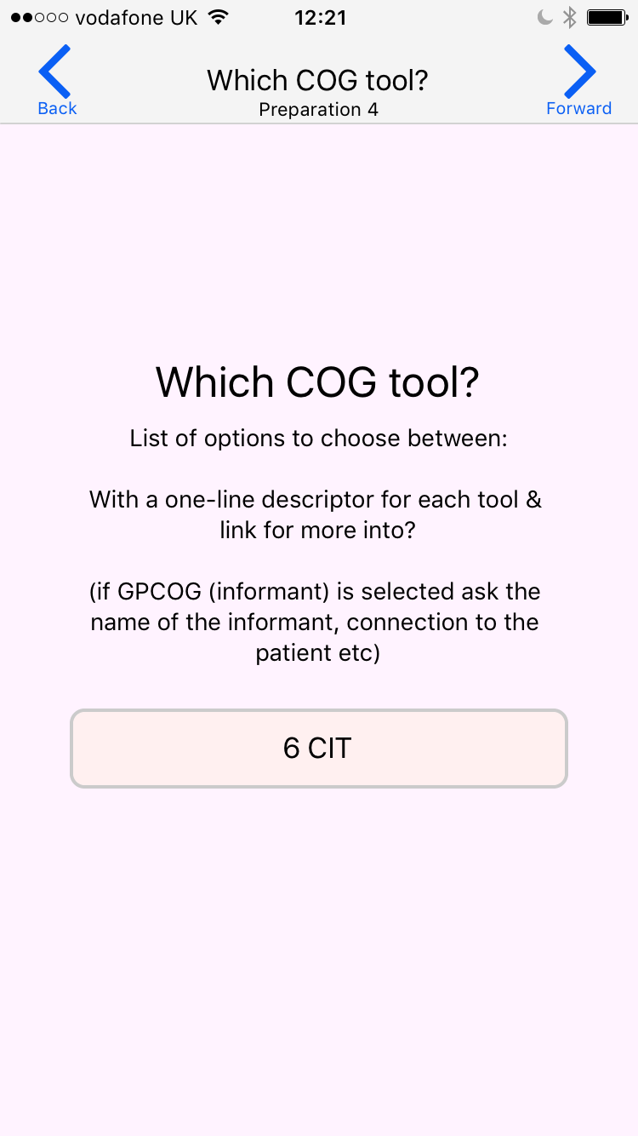
DiADeM App Progress to date

Slide 10
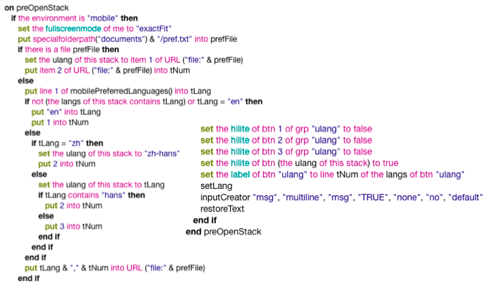
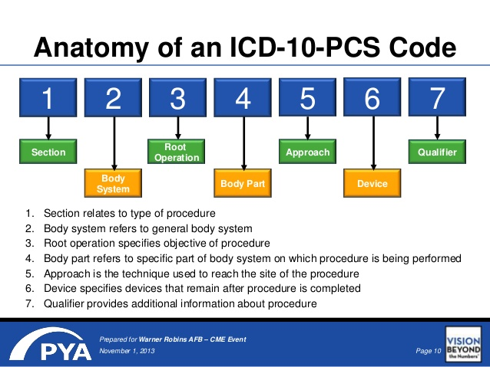
Challenges and lessons Learned
Working together
Clinicians v’s Coders
Coders v’s Clinicians
ICD 10 Code

Slide 11


Challenges and lessons Learned
Working together
Generally Health Professionals
DONT KNOW coding
Generally Coders DON’T KNOW Health Services
KEEP AN OPEN MIND!!

Slide 12
Thank You for Listening
Please feel free to contact me
colinsloane@nhs.net

