Slide 1










What is a CDR?
the openEHR eHealth
platform
#LCED16
Ian McNicoll
Co-chair openEHR Foundation freshEHR Clinical Informatics Ltd.
August 2016

Slide 2

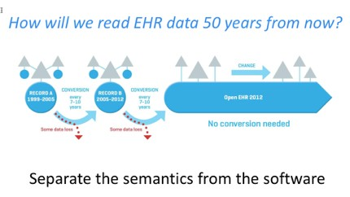
openEHR - key goal
Provide open specifications for an eHealth platform
keeping the data in any openEHR system completely interoperable
regardless of programming language
regardless of human language
regardless of internal database technology

Slide 3


Slide 4

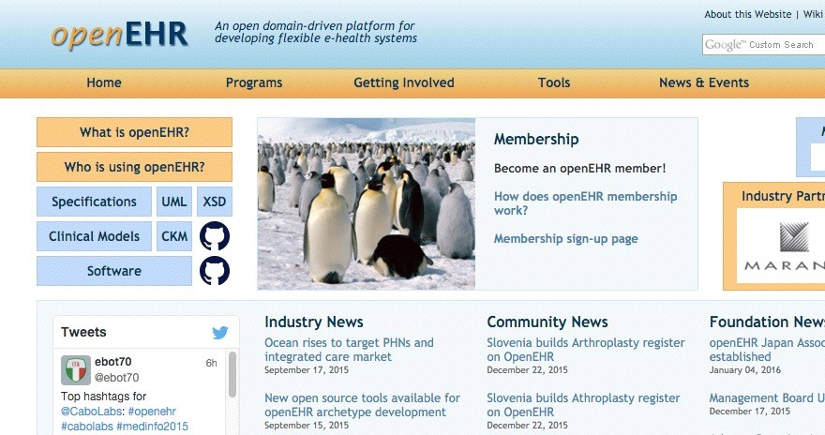
www.openehr.org

Slide 5




















‘CDR’-based architecture
App
App
App
open Information Model

Slide 6




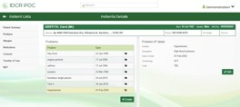

‘CDR’-based architecture
open Information Model

Slide 7
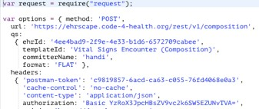

‘CDR’-based architecture
openEHR Rest API + AQL

Slide 8


‘CDR’-based architecture
openEHR Rest API + AQL
openEHR CDR

Slide 9
‘CDR’-based architecture
openEHR Rest API + AQL
openEHR CDR

Slide 10
‘CDR’-based architecture
openEHR Rest API + AQL
openEHR CDR

Slide 11

‘CDR’-based architecture
openEHR Rest API + AQL
openEHR CDR

Slide 12


‘CDR’-based architecture
openEHR Rest API + AQL
openEHR CDR

Slide 13
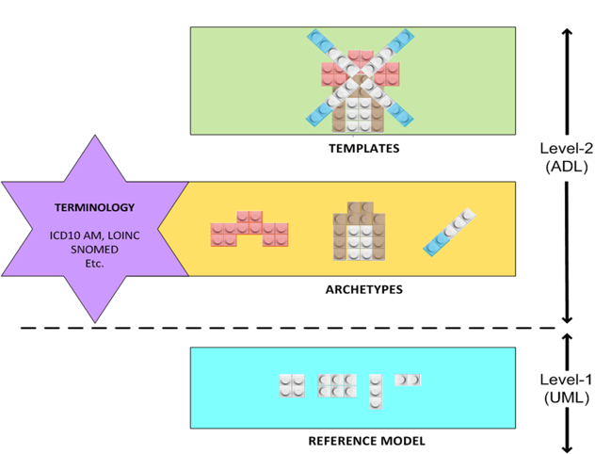
Two-level information modelling

Slide 14
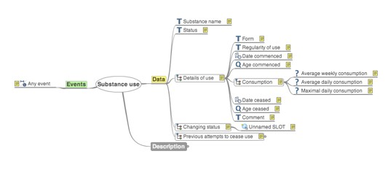
openEHR: Archetypes
open source computable models of discrete clinical concepts
Familiar components of a health record
Blood pressure, Body weight Medication order, Family history Urea, Creatinine results
‘Maximal dataset’
Capture as many clinical perspectives as possible

Slide 15

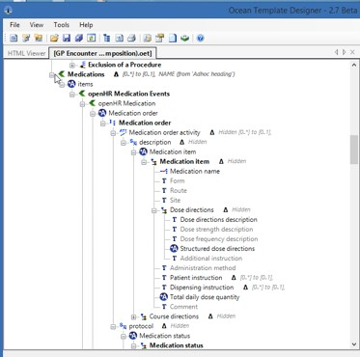
openEHR: Templates
Templates deliver the datasets by aggregating archetypes together
Key clinical endpoint and start point for generation of technical artefacts
i.e. openEHR archetypes and templates can be used directly
Class libraries, Message schema GUI skeletons, API Profiles

Slide 16

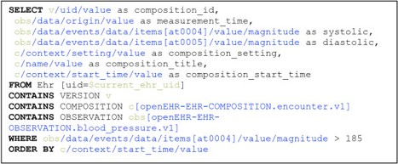
AQL: Information-model querying
Information model querying, independent of the actual database querying
vendor/technology neutral querying
To query an openEHR system you only have to know which archetypes are in use.

Slide 17

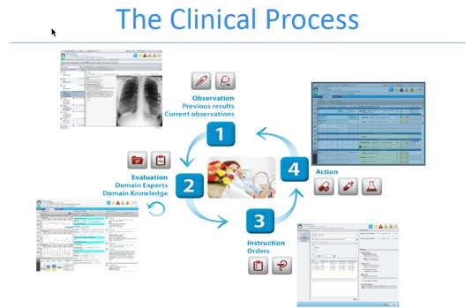

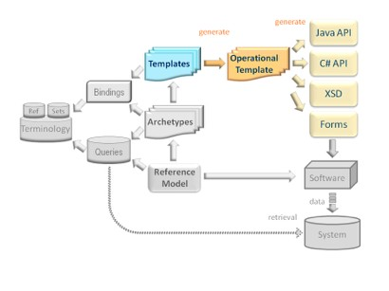
Clinical Information models factory

Slide 18
‘open platform’ architecture
App
App
App
open Information Model

Slide 19
‘open platform’ architecture
open Information Model

Slide 20
‘open platform’ architecture
openEHR Rest API + AQL

Slide 21
‘open platform’ architecture
openEHR Rest API + AQL
openEHR CDR

Slide 22
‘open platform’ architecture
openEHR Rest API + AQL
openEHR CDR

Slide 23
‘open platform’ architecture
openEHR Rest API + AQL
openEHR CDR

Slide 24
‘open platform’ architecture
openEHR Rest API + AQL
openEHR CDR

Slide 25
‘open platform’ architecture
openEHR Rest API + AQL
openEHR CDR

Slide 26








The good news…
You do not have to build your own openEHR back- end ‘CDR’…
over 10 providers of openEHR CDR services
the APIs are compact and easy to use once you understand the basic concepts

Slide 27

























SMARTPlatforms Pluggable Webapp API
HL7 FHIR
Clinical Content Exchange NHS API
Clinical leadership PRSB
Detailed Clinical Content Development
Archetype+ SNOMED Clinical Content definitions
Non openEHR systems
‘inVivo’ Datastore API
HSCIC
Terminology Centre

Slide 28
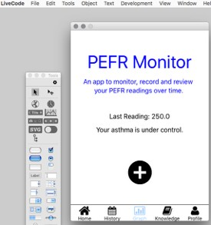

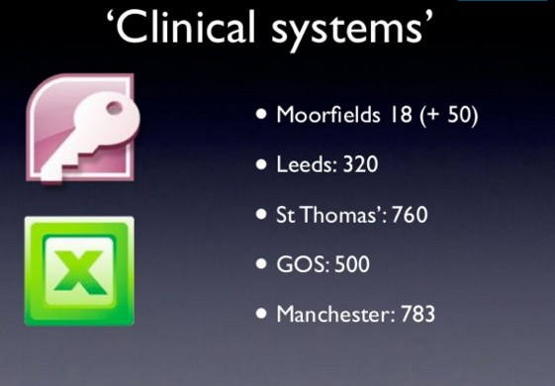


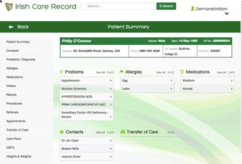
‘feral’ systems

Slide 29

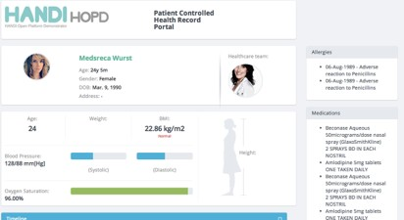

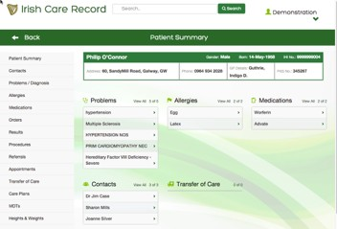
openEHR CDR summary
Designed for storing and querying rich clinical dataset
New content is defined directly by clinicians and can be immediately uploaded into the clinical data repository
Vendor-neutral data models Technology-neutral data models
Vendor-neutral data querying Technology-neutral data querying

