Slide 1
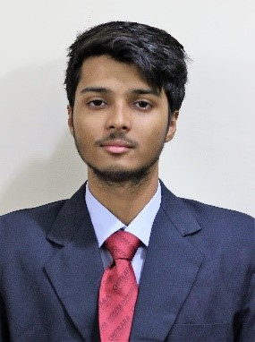
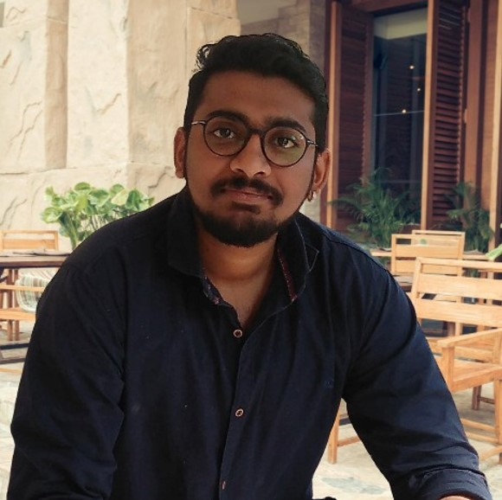
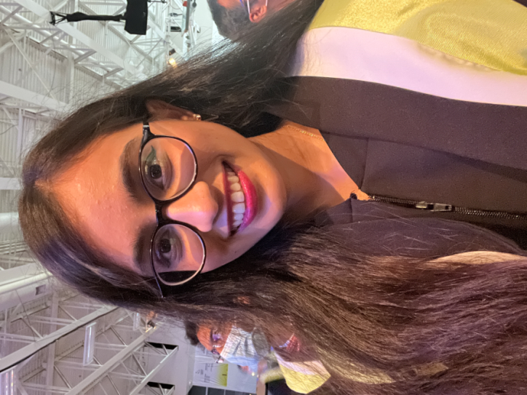
Presented By Group#04
MAPD 714 – iOS Development
Assignment 4
ToDo List App – Part 1 – Create the app UI
Ajay Shrivastav
301284668
Apeksha Parmar
301205325
Brijen Jayeshbhai Shah
301271637

