Slide 1

Annamacharya Institute of Technology and Sciences, Rajampet
Department of Artificial Intelligence and Machine Learning
“Analyzing Customer Feedback on Amazon to Reveal Sentiment Trends using Machine Learning”
Project Team:
A. Lakshmi Narayana (21701A3322)
S. Mahammad Khaja Juber (21701A3325)
V. Pavan Kumar (22705A3305)
Y. Mothilal Yadav (21701A3329)
G. Siva Karthik (21701A3342)
Under the esteemed guidance of
Dr. Swarna Surekha, M.Tech, Ph.D
Associate Professor
Dept. of AIML

Slide 2
Contents
Abstract
Introduction
Literature Survey
Existing System
Proposed System
Architecture
Techniques & Methods Used
Libraries Used
Algorithm & Models Used
Results
Conclusion & Future Work
References

Slide 3
Abstract
Amazon reviews offer valuable customer insights, but manual analysis is slow and inefficient. This project, “Analyzing Customer Feedback on Amazon to Reveal Sentiment Trends using Machine Learning,” automates review classification by topic (product or service) and sentiment (positive, negative, neutral) using the Multinomial Naïve Bayes classifier, achieving 80% to 90% accuracy. It features an interactive dashboard that supports Amazon URL scraping and CSV/XLSX uploads. The system detects review type, predicts sentiment, and presents results through dynamic charts, sentiment scorecards, and downloadable reports. This streamlined solution demonstrates the power of machine learning for fast, multi-level sentiment analysis.

Slide 4
Introduction
Social Media and E-Commerce Integration: Social media drives online markets, making e-commerce shopping convenient.
Role of Customer Feedback: Feedback (reviews, ratings, etc.) influences buying decisions and improves products/services.
Challenges of Manual Feedback Analysis: Huge feedback volumes make manual analysis impractical, needing ML solutions.
Sentiment Analysis Overview: NLP classifies feedback into positive, neutral, or negative to uncover trends.
Applications and Importance of Sentiment Analysis: It improves products, services, and decisions in both commercial and non-commercial sectors.

Slide 5
Vision of the Project
Understanding Customer Sentiment
Improving Product and Service Quality
Enhancing E-commerce Decision Making
Use of AI for Automation & Improved efficiency
Enhancing Business Insights

Slide 6
Literature Survey
Paper Title | Year | Authors | Model Used | Key Focus | Disadvantages
Analyzing Public Sentiment on the Amazon Website: A GSK-Based Double Path Transformer Network Approach for Sentiment Analysis | 2023 | Dr. B. N. Jagadesh, Ramesh Vatambeti | GSK-Based Double Path Transformer | Transformer-based sentiment analysis on Amazon reviews | High computational cost, requires large-scale training data
Sentiment Analysis Based on RoBERTa for Amazon Review: An Empirical Study on Decision Making | 2024 | Xinli Guo | RoBERTa | Advanced NLP trends | No model comparison, lacks fake review detection
Sentiment Analysis of Amazon Product Reviews | 2023 | Beiyu Xu, Hongwu Gan, Xinyue Sun, Xiaoying Shao | Random Forest, Naive Bayes, SVM | ML Model Performance | Traditional ML limitations
Aspect Category Learning and Sentimental Analysis Using Weakly Supervised Learning | 2023 | Kalpa Subbaih, Bharath Kumar Bolla | BiLSTM, CNN-BiLSTM, CNN-LSTM | Aspect and sentiment classification | Potential labeling inaccuracies due to weak supervision
Sentiment Analysis of Amazon Product Reviews Using Hybrid Rule-Based Approach | 2022 | A. Dadhich, B. Thankachan | Hybrid Rule-Based Model | Hybrid rule-based sentiment classification | Lacks scalability and generalization to larger datasets
Sentiment Analysis of Amazon Product Reviews Using NLP Techniques | 2022 | Y. Xiao, C. Qi, H. Leng | NLP-based ML models | NLP techniques for sentiment classification | Lacks deep learning comparisons and scalability

Slide 7
Existing Systems
1. Sentiment Analysis Based on RoBERTa for Amazon Review: An Empirical Study on Decision Making (2024)
Authors: Xinli Guo
Summary:
  Utilizes RoBERTa, a transformer-based model, for sentiment analysis on Amazon reviews.
  Explores sentiment patterns and trends with advanced NLP models.
  Highlights principles like electronic word of mouth (eWOM) and confirmation bias.
  Aims to provide insights for marketing strategies and decision-making.
Disadvantages:
  Focuses only on RoBERTa without comparing with other deep learning models.
  Lacks investigation into fake reviews or cross-domain sentiment analysis.

Slide 8
2. Cross-Domain Consumer Review Analysis (2025)
Authors: Aditya Pandey, Kunal Joshi
Summary:
  Analyzes reviews across Amazon, Yelp, Steam, and IMDb.
  Uses Hadoop and Spark for large-scale review data processing.
  Identifies sentiment trends across different domains.
Disadvantages:
  Lacks a strong focus on Amazon-specific sentiment analysis.
  No mention of handling fake or biased reviews.
3. Impact of Sentiment Analysis in Fake Review Detection (2025)
Authors: Amira Yousif, James Buckley
Summary:
  Investigates the role of sentiment analysis in detecting fake reviews.
  Reviews ten existing research papers to compare methodologies.
  Identifies challenges in evaluating sentiment scores for fake feedback detection.
Disadvantages:
  Focuses more on reviewing past studies than presenting a new methodology.
  Lacks implementation or experimental validation of proposed techniques.

Slide 9
Proposed System
The proposed system leverages a Naive Bayes Classifier for sentiment analysis of Amazon reviews.
The model aims to improve accuracy, scalability, and efficiency in processing large volumes of customer feedback.
It focuses on automating the categorization of feedback through multi-class classification.

Slide 10
Advantages
Improved Efficiency: Automates sentiment classification, saving time.
Cost-Effective: Naïve Bayes requires lower computation than deep learning models.
Business Insights: Helps companies understand customer sentiment trends.
Suitable for Pre-Processing Techniques: Works perfectly with TF-IDF and BoW feature extraction.
Performs Well on Short Texts: Amazon reviews are short text data, and Naïve Bayes works best on short texts where feature independence assumptions hold.
Scalable & interpretable: for large datasets without requiring GPUs.

Slide 11
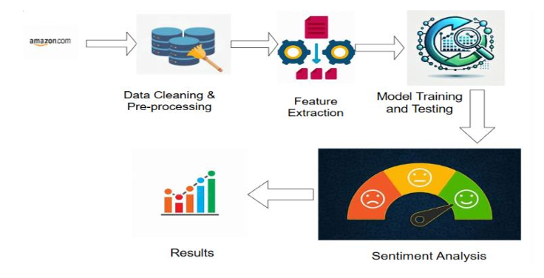
Fig: Sentiment Analysis Workflow

Slide 12
Architecture and Workflow
Data Collection: Reviews are gathered, stored in CSV format, and imported for analysis.
Exploratory Data Analysis (EDA): Patterns in data, such as star rating distributions, are analyzed for insights.
Data Preprocessing: Cleaning and transforming text for feature extraction and modeling.
Feature Extraction: Using TF-IDF and GloVe for converting textual data into numerical vectors suitable for the classifier.
Model Training and Testing:
Training: 70–80% of the data is used for training.
Testing: 20–30% is used for validation and performance evaluation.

Slide 13
Techniques & Methods Used:
"In our project, we apply several NLP preprocessing techniques to clean and prepare Amazon reviews for sentiment analysis. Here's how each step contributes to our model:"
1️⃣ Tokenization – Splits text into individual words or tokens.
For example, “Great product!” becomes [‘Great’, ‘product’, ‘!’]. This helps in processing text efficiently.
2️⃣ Stop Words Removal – Eliminates common words like “the”, “is”, “and” that do not contribute to sentiment analysis. This reduces noise in the dataset.
3️⃣ Stemming & Lemmatization – Both convert words to their base form.
Stemming: “running” → “run” (rule-based, may lose meaning).
Lemmatization: “better” → “good” (dictionary-based, more accurate).
We use Lemmatization for better contextual understanding.

Slide 14
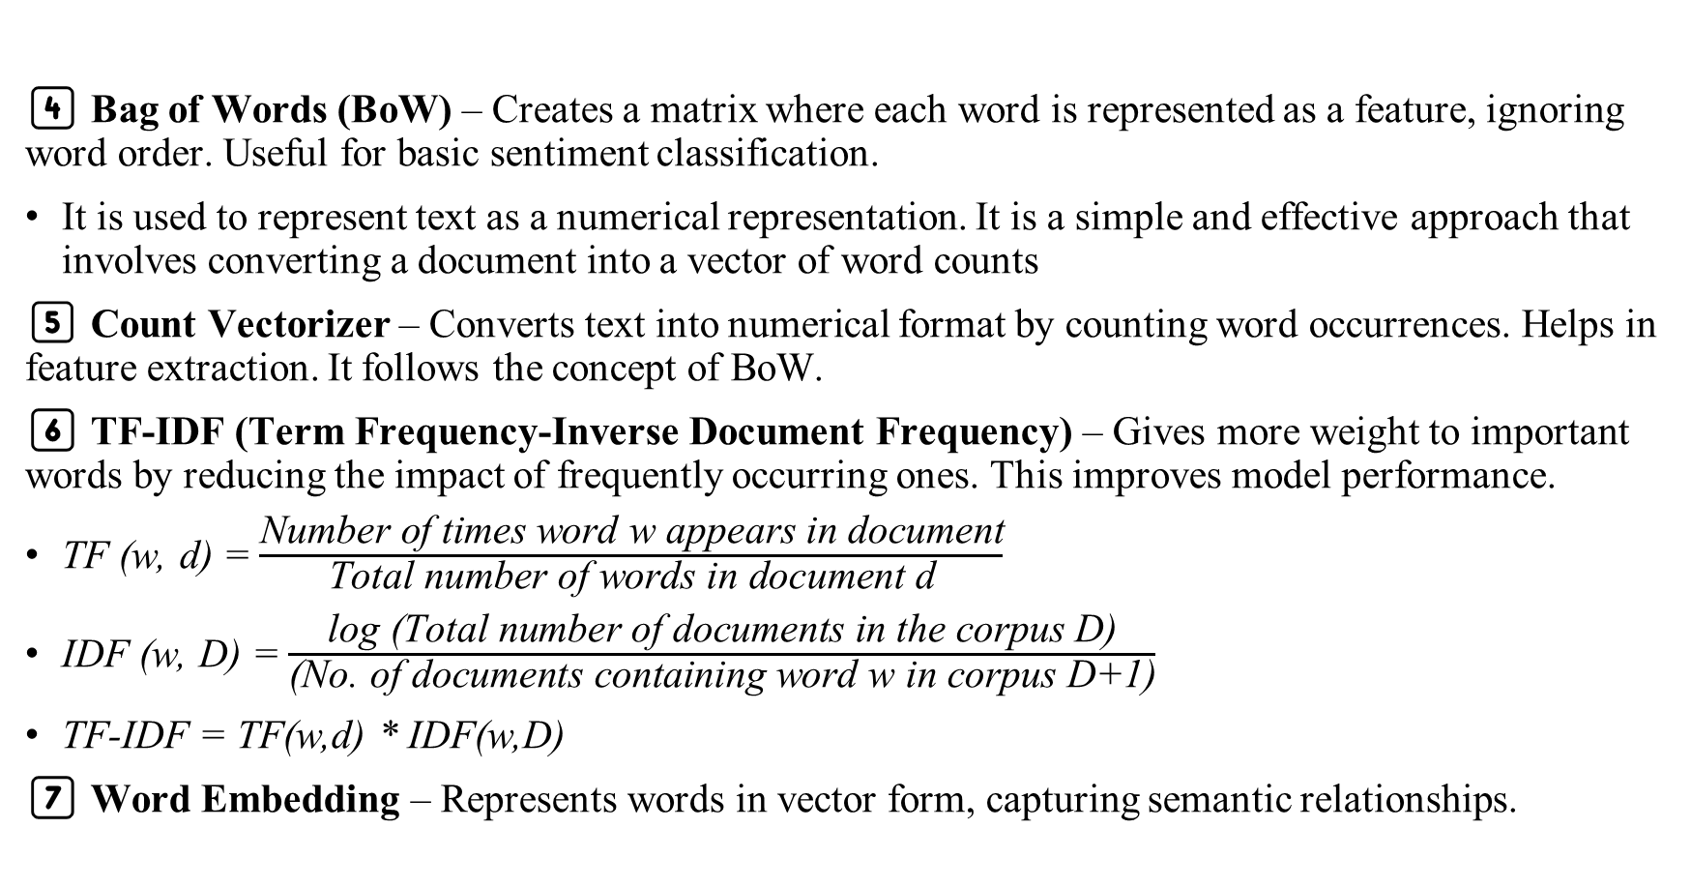
4️⃣ Bag of Words (BoW) – Creates a matrix where each word is represented as a feature, ignoring word order. Useful for basic sentiment classification.
It is used to represent text as a numerical representation. It is a simple and effective approach that involves converting a document into a vector of word counts
5️⃣ Count Vectorizer – Converts text into numerical format by counting word occurrences. Helps in feature extraction. It follows the concept of BoW.
6️⃣ TF-IDF (Term Frequency-Inverse Document Frequency) – Gives more weight to important words by reducing the impact of frequently occurring ones. This improves model performance.
TF (w, d) = $\frac{\text{Number} \text{of} \text{times} \text{word} \text{w} \text{appears} \text{in} \text{document}}{ \text{Total} \text{number} \text{of} \text{words} \text{in} \text{document} \text{d} }$
IDF (w, D) = $\frac{\text{log}\text{ (}\text{Total} \text{number} \text{of} \text{documents} \text{in} \text{the} \text{corpus} \text{D}\text{)}}{\text{(}\text{No}\text{. }\text{of} \text{documents} \text{containing} \text{word} \text{w} \text{in} \text{corpus} \text{D}\text{+1)}}$
TF-IDF = TF(w,d) * IDF(w,D)
7️⃣ Word Embedding – Represents words in vector form, capturing semantic relationships.

Slide 15
Libraries Used
1. Data Handling & Manipulation:
🔹 pandas – Dataset Handling & Preprocessing
Loads the Amazon reviews dataset (read_csv()).
Cleans data by handling missing values (dropna(), fillna()).
Applies text transformations before analysis (apply(), str.lower()).
🔹 NumPy – Numerical Computation
Manages multi-dimensional arrays for text features.
Optimizes TF-IDF, BoW, and Word2Vec computations.
Enables efficient probability calculations for Naïve Bayes.
🔹 matplotlib.pyplot – Data Visualization
Plots star ratings distribution using histograms.
Visualizes sentiment classification results.
Displays model accuracy and performance metrics.
🔹 seaborn – Advanced Statistical Visualization
Creates heatmaps to show feature correlations.
Uses count plots for sentiment distribution.
Enhances visual aesthetics for easy interpretation.

Slide 16
2. Text Preprocessing (NLP)
re (Regular Expressions) – For cleaning text (removing URLs, symbols, punctuation).
nltk (Natural Language Toolkit)
  stopwords – Removes unnecessary words (e.g., "the", "and").
  word_tokenize – Splits sentences into words.
  PorterStemmer – Reduces words to their root form (stemming).
  WordNetLemmatizer – Converts words to their base form (lemmatization).
3. Feature Extraction
sklearn.feature_extraction.text
  TfidfVectorizer – Converts text into numerical TF-IDF representation.
  CountVectorizer – Creates a Bag-of-Words (BoW) representation.

Slide 17
4. Model Training & Evaluation
sklearn.model_selection
Used for splitting the dataset into training and testing sets.
Method found in the document:
  train_test_split() – Divides the dataset into training (70-80%) and testing (20-30%).
sklearn.naive_bayes
Used for sentiment classification using Naïve Bayes.
Method found in the document:
  MultinomialNB() – Trains the model on text-based data.
sklearn.metrics
Used for evaluating model performance.
Methods found in the document:
  accuracy_score() – Computes classification accuracy.
  precision_score(), recall_score(), f1_score() – Measures model performance.
  confusion_matrix() – Displays classification results in a matrix format.

Slide 19
Model Used: MultinomialNB()
MultinomialNB() is a classification algorithm from scikit- learn's sklearn.naive_bayes module, primarily used for
text classification problems, including sentiment analysis, spam filtering, and document categorization.
How MultinomialNB() Works:
Probabilistic Model – Uses Bayes' Theorem to calculate the probability of a given text belonging to a category
(e.g., positive, negative, neutral sentiment).
Multinomial Distribution – Assumes that word occurrences in a document follow a multinomial distribution, making it suitable for text data where features (words) are represented as word frequency counts or TF-IDF scores.
Conditional Independence – Assumes that features (words) are independent given the class, which simplifies computation and makes training faster and efficient.
Formula used in Naïve Bayes: P(𝑚|𝑛) = [𝑃(𝑛|𝑚)𝑃(𝑚)]/𝑃(𝑛)
For Amazon sentiment analysis, MultinomialNB() is the best choice because:
– Fast, scalable, and requires less data.
– Works perfectly with TF-IDF and BoW feature extraction.
– Performs well on short, structured text data like product reviews.
– Lower computational cost compared to deep learning models like BERT or Bi-LSTM

Slide 20
Why MultinomialNB is preferred over others?
Model | Accuracy | Speed | Computational Cost | Interpretability | Handling Large Data
MultinomialNB | ✅ High (80-90%) | ✅ Very Fast | ✅ Low | ✅ Easy to Interpret | ⚠️ Not ideal for deep text understanding
Logistic Regression | ✅ Moderate (80-85%) | ✅ Fast | ✅ Low | ✅ Good Interpretability | ⚠️ Struggles with complex text relationships
Random Forest | ✅ Moderate (85-90%) | ⚠️ Slow | ❌ High (computationally expensive) | ⚠️ Hard to Interpret | ✅ Handles large datasets better than Naïve Bayes
Bi-LSTM (Deep Learning) | ✅ Very High (90-95%) | ❌ Very Slow | ❌ Very High (GPU Required) | ❌ Hard to Interpret | ✅ Handles sequential dependencies well
BERT (Transformer-based) | 🔥 State-of-the-art (95-98%) | ❌ Very Slow | ❌ Extremely High (GPU Required) | ❌ Complex to Interpret | ✅ Handles deep contextual meaning

Slide 22
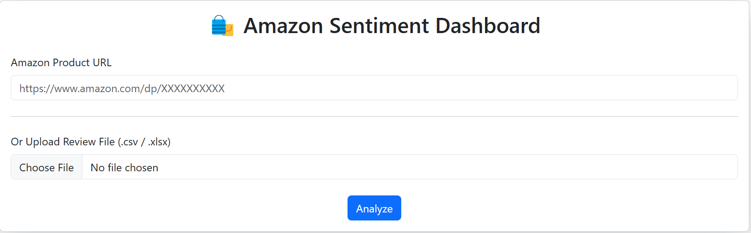
Results

Slide 23
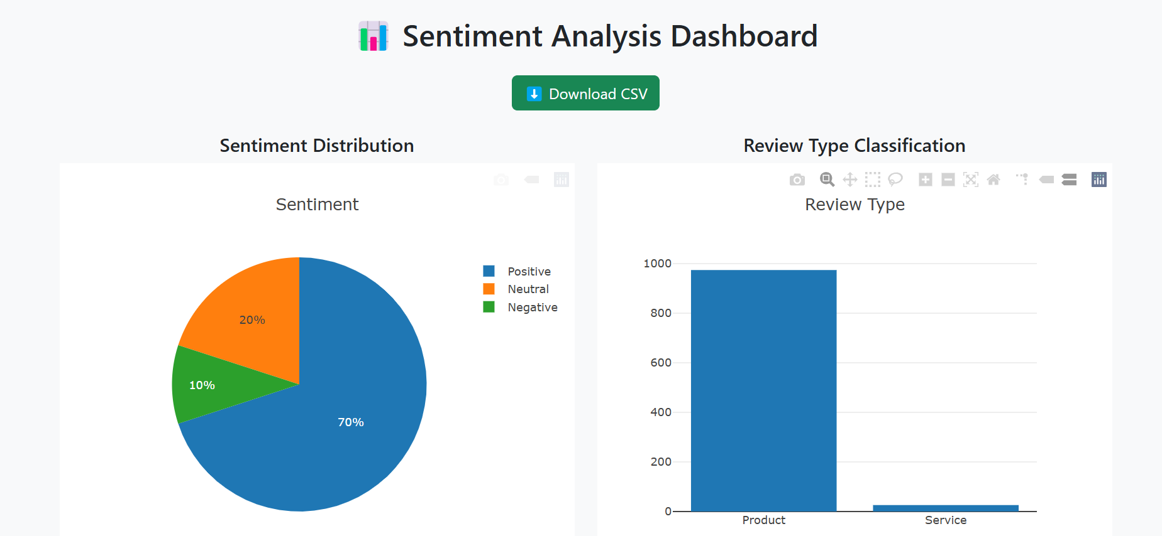

Slide 24
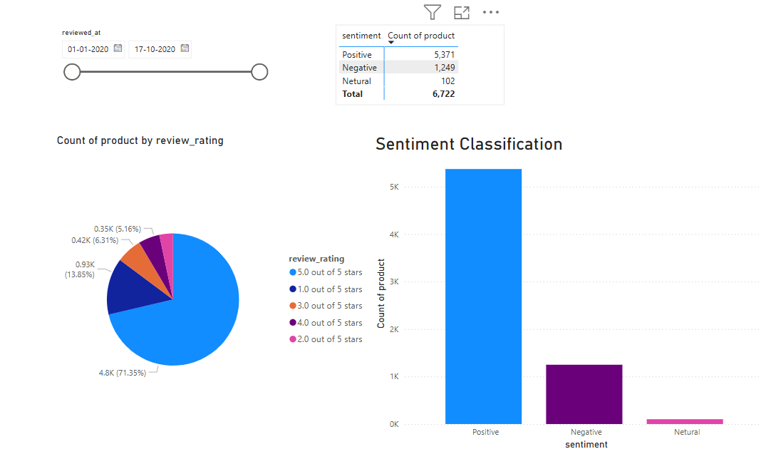
Power BI Dashboard for one plus phone purchase reviews

Slide 25
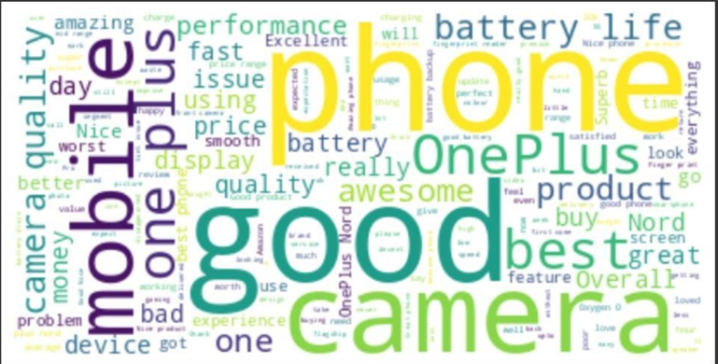
Model Name | Accuracy | Precision | Recall | F1-measure
Naive Bayes Classifier | 87% | 85% | 87% | 87%
Performance of Naïve bayes Classifier
Word Cloud Visualization

Slide 26
Conclusion & Future Work
This project offers a smart, interactive dashboard designed to analyze Amazon customer reviews using machine learning and natural language processing techniques. Users can either input a product URL or upload a review file in CSV/XLSX format. The system then automatically processes the data, predicts the sentiment (positive, neutral, or negative), and classifies each review as either product or service-related based on specific keywords.
Future enhancements could include automated multi-page review scraping to gather a larger set of reviews from Amazon, improving data coverage and analysis depth. Additionally, expanding the system to support multilingual reviews would increase its usability across global markets.
Incorporating advanced deep learning models such as BERT or RoBERTa may significantly improve the accuracy and context-awareness of sentiment predictions. Other valuable additions include fake review detection, aspect-based sentiment analysis (e.g., detecting opinions on delivery, quality, or price), and real-time updates for live product monitoring.

Slide 27
References
Lella Kranthi Kumar, D. Siri, G. Uday Kiran, Venkata Nagaraju Thatha, Pamula Udayaraju, B. N. Jagadesh, and Ramesh Vatambeti, "Analyzing Public Sentiment on the Amazon Website: A GSK-Based Double Path Transformer Network Approach for Sentiment Analysis," IEEE Access, 2024, doi: 10.1109/ACCESS.2024.3368441. License: CC BY-NC-ND 4.0.
A. Dadhich and B. Thankachan, "Sentiment analysis of Amazon product reviews using hybrid rule-based approach," in Smart Systems: Innovations in Computing (SSIC), Springer, 2022, pp. 173–193, doi: 10.1007/978-981-16-2877-1_17.
T. K. Venkataraman and A. Jadhav, "Classifying the sentiment polarity of Amazon mobile phone reviews and their ratings," in Proc. AIP Conf., Jan. 2023, vol. 2523, no. 1, Art. no. 020123, doi: 10.1063/5.0110605.
A. Vollero, D. Sardanelli, and A. Siano, "Exploring the role of the Amazon effect on customer expectations: An analysis of user-generated content in consumer electronics retailing," J. Consum. Behav., vol. 22, no. 5, pp. 1062–1073, 2023, doi: 10.1002/cb.1969.
Madana Kumar Reddy, C., Krishna, J., "A Study on Predicting Skilled Employees Using Machine Learning Techniques," in Computational Intelligence in Machine Learning, ICCIML 2024, Lecture Notes in Electrical Engineering, vol. 1106, Springer, Singapore.
Sentiment Analysis Based on RoBERTa for Amazon Review: An Empirical Study on Decision Making Xinli Guo https://doi.org/10.48550/arXiv.2411.00796

Slide 28

Thank You

