Slide 1

Open Platform Accelerating
Enterprise Transformation
Keep it simple…
© 2020 SYNECTIKS. All Rights Reserved. Proprietary and Confidential.

Slide 2
Cloud Asset Management
Discovery | Add AWS/AZURE/GCP/Kubernetes accounts (role arn or access key based) | AWS /AZURE/ GCP/ Kubernetes asset lists
Provisioning | Account Provisioning | Cluster Provisioning | Service Provisioning | Self Service Provisioning
Analytics | Overall Cloud Consumption | Compliance Analytics | Billing Analytics
RBAC/ Multitenancy | Org wide Teams And Role
© 2020 SYNECTIKS. All Rights Reserved. Proprietary and Confidential.

Slide 3
Cross Cloud Monitoring
Dashboard Catalogue | AWS /AZURE/GCP Dashboards Lists with filters
Monitoring | Enable Performance / Logs / Trace Based Data Collection sources on ENV | Enable Monitoring on Discovered Assets from Dashboard Catalogue | AWS/AZURE/GCP/KUBE Explorer | App Centric Monitoring
Alerting | Alert Catalogue | Enable Alerting Rules | Alert Dashboards | Alerts Filter
Service Desk | Ticket Central | Alert Ticket Integration
Workflows | Service Desk & workflows integration
© 2020 SYNECTIKS. All Rights Reserved. Proprietary and Confidential.

Slide 4
Cloud Security & Compliance
Compliance Engine | Rule / Policy /Compliances | Compliance Collector | Compliance Reports / Dashboards | Alert Central | History
Rule Editor
© 2020 SYNECTIKS. All Rights Reserved. Proprietary and Confidential.

Slide 5
Tool Chain & Automation Central
Tool Chain Framework | Runbook/ Tools Catalogue | Operator Catalogue | Cloud Templates
© 2020 SYNECTIKS. All Rights Reserved. Proprietary and Confidential.

Slide 6
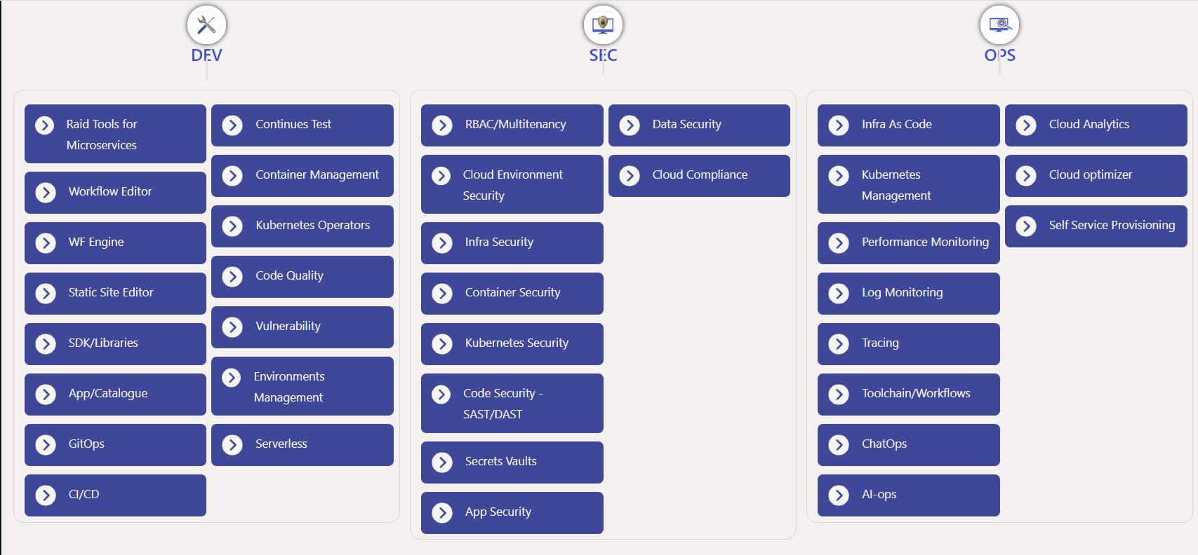
DevSecOps Tooling
© 2020 SYNECTIKS. All Rights Reserved. Proprietary and Confidential.

Slide 7
Common Modules
Performance Manager | Log Manager | Trace Manager | View Manager
App Catalogue | FSM
© 2020 SYNECTIKS. All Rights Reserved. Proprietary and Confidential.

Slide 8
Cloud Asset Management
Splunk | 17B/ 2B | Analytic product – vast coverage of DS – supports any – a very big ecosystem of small apps
Logic Monitor | 150M funding | Pure observability – Many integrations
Centilytics | 10M rev | Pure analytics and optimization Pros – Simple Approach / Cloud Security & AI-ML Cons – Chargeback/
Sumo logic | 150M | Rich Catalogues and dashboarding
LogDNA/ Loggly / instana / cloudmonix.. | Many small guys in 50M
Microservice focus + (Ready Made simple Perf/ava....Views) + Primarily solve SOA on multicloud env + Catalog Based very simple approach + Added Automation + Diagnostics
Segment – 50M like BC
+
© 2020 SYNECTIKS. All Rights Reserved. Proprietary and Confidential.

Slide 9
Cross cloud Monitoring + Container +Toolchain + Devsecops
Cross Cloud Monitoring -DataDog / ThousandEyes / Appdynamics / New Relic / Sumologic /
Container Management Platform -Rancher / Openshift /
DevSecOps Platform - Gitlab
© 2020 SYNECTIKS. All Rights Reserved. Proprietary and Confidential.

Slide 10
Investments
Additional Budget
Existing Team Improvement | Current Projected Diff Manoj –- 1.2 L/M 1.8 L/M 60K/M Shahbaz – 72K/M 1.2L/M 50k/M Akbar – 55K/M 90k/M 35K/M Sidesh – 45K/M 65K/M 20K/M Papu – 250K/M 375K/M 125K/M Zakir – 60k | 3.15L/m | Cloud Analytics --- App Blocks -- Procurement Application – EMS App (defer) – Kubernetes Services - | COGS = $280K + $20k=$300k/Y + $50K (current Loss) Increased MRR - $30K/m Increased Product Value = $1.5M in 1 year
Extension | Jasmin – 2 Sets Manoj – 2 Sets | 3L/m 3L/m
New Guys | 1 L5 - 2 Sets Cloud Automation 2 Tech Writer -- | 4L/m 3.5L/m 70k/m
Other | Tools Subscription – Figma --$1008/Y Trainings –$500/Y Cloud Expenses - $12000/Y Channel Memberships - $5000/Y | $20k/Y
UI -- Jasmin Team– 2.25 API – Manoj Team -1.8 PM – Akbar & Team -2.2 Lakhs Cloud – Shahbaz & Team-2.2 Lakhs Papu-2.5 Lakh Others – 1L Total -11.8 Lacs – $15.7k MRR- 843750 Rs - $11.25k 3.5 L deficit ( Outsourcing / Custom Solutioning…)
© 2020 SYNECTIKS. All Rights Reserved. Proprietary and Confidential.

