Slide 1

Delivering TAAS
Open Products Accelerating
Enterprise Transformation
Keep it simple…
© 2020 SYNECTIKS. All Rights Reserved. Proprietary and Confidential.

Slide 2
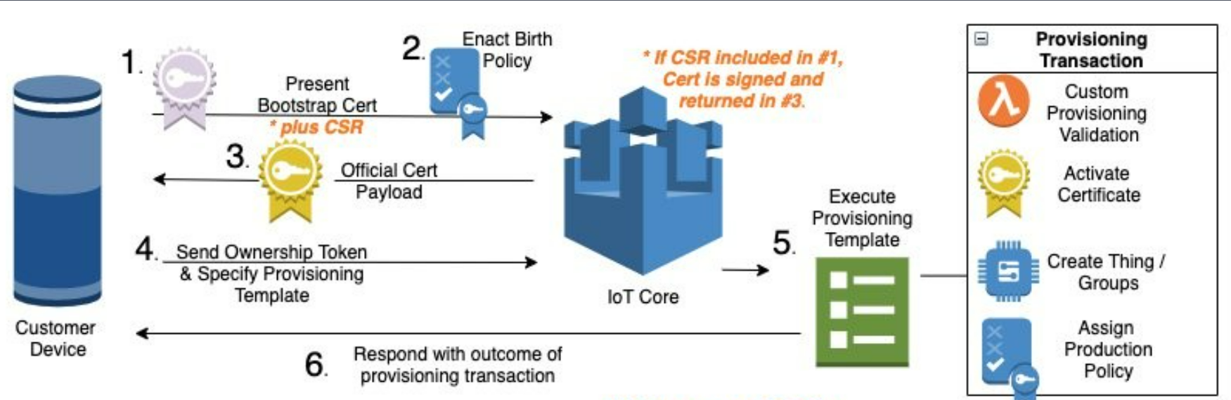
Device Registration in Cloud

Slide 3
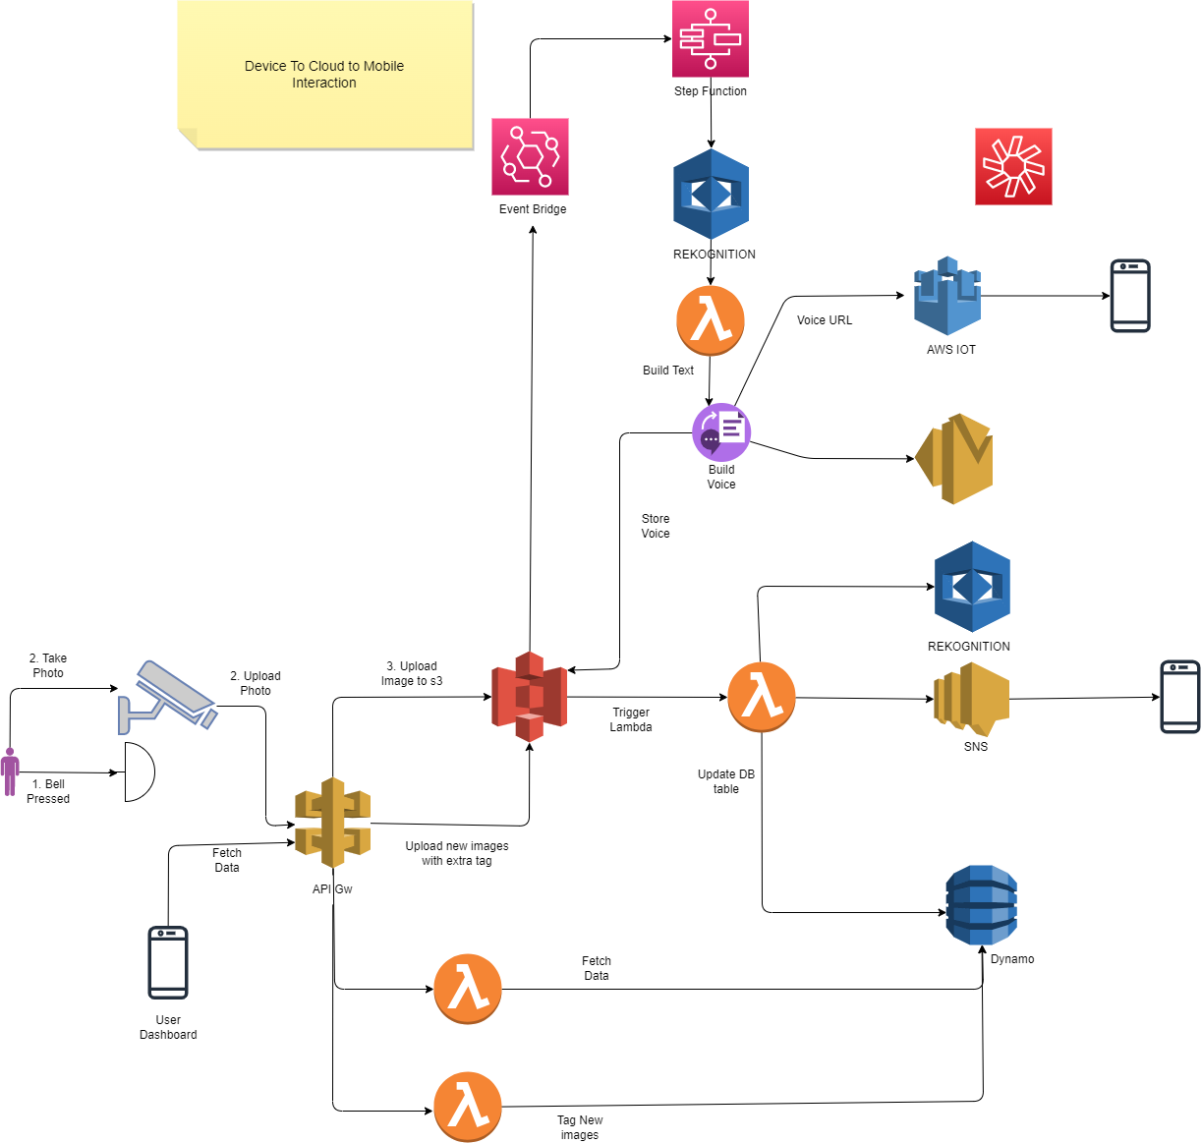

Slide 4
Associate Device to Specific End User

