Slide 1

Delivering TAAS (Transformation As A Service)
Open Products Accelerating
Enterprise Transformation
Keep it simple…
© 2020 SYNECTIKS. All Rights Reserved. Proprietary and Confidential.

Slide 2
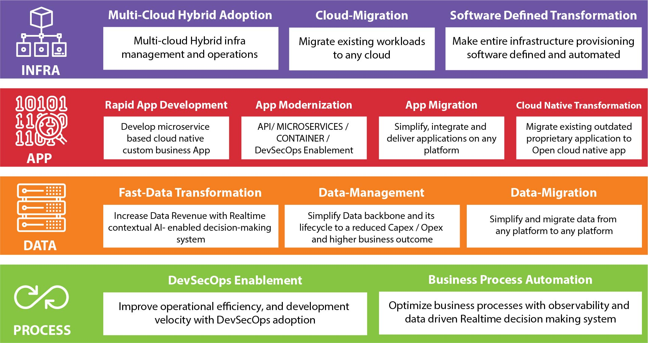
Capabilities

Slide 3
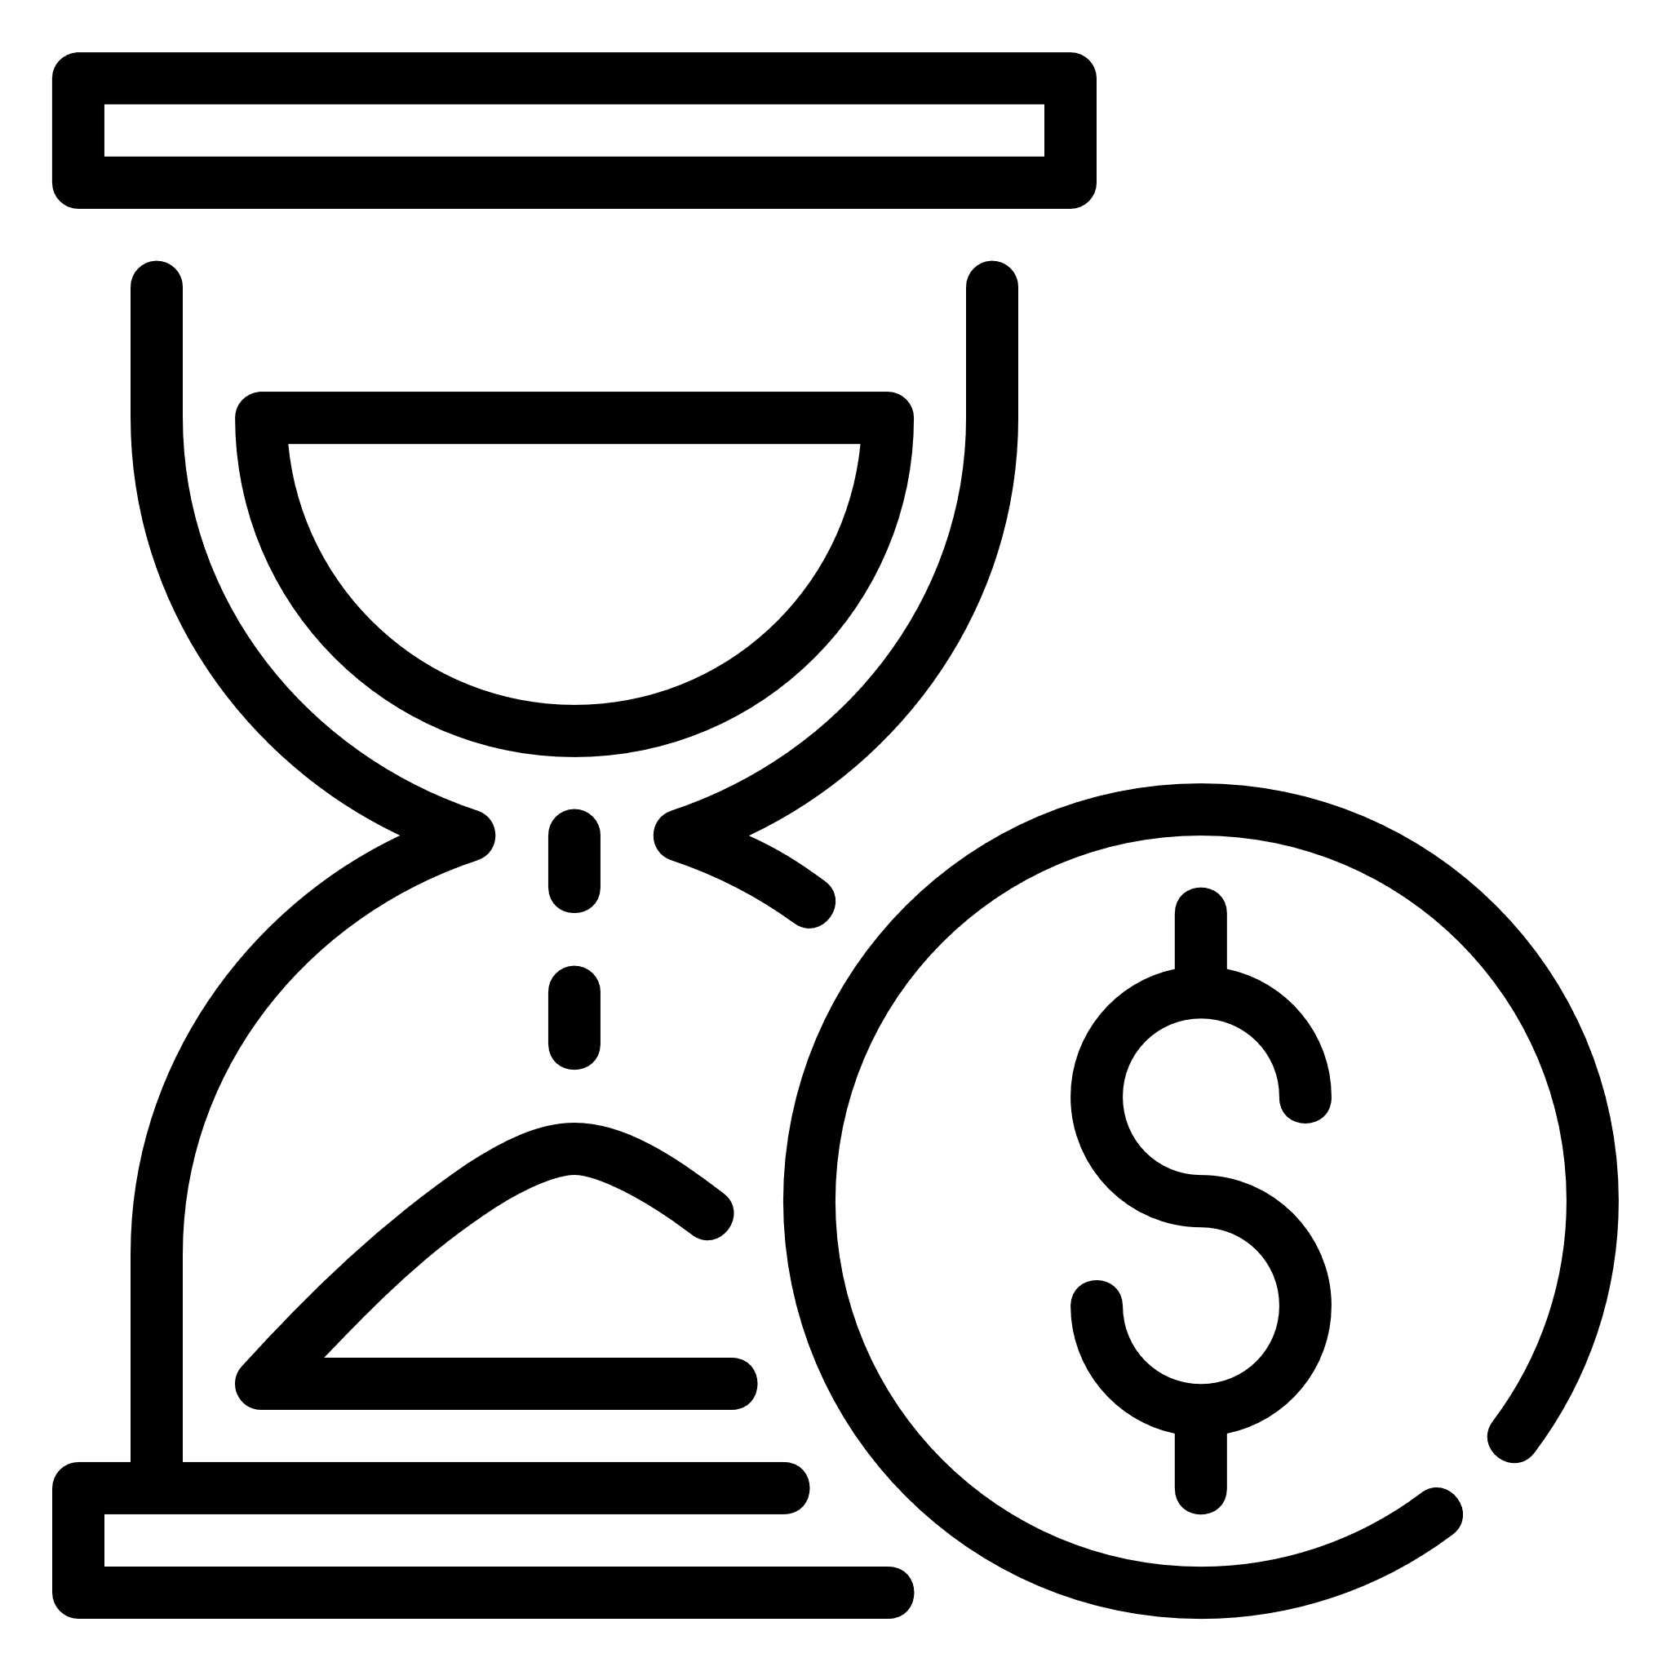



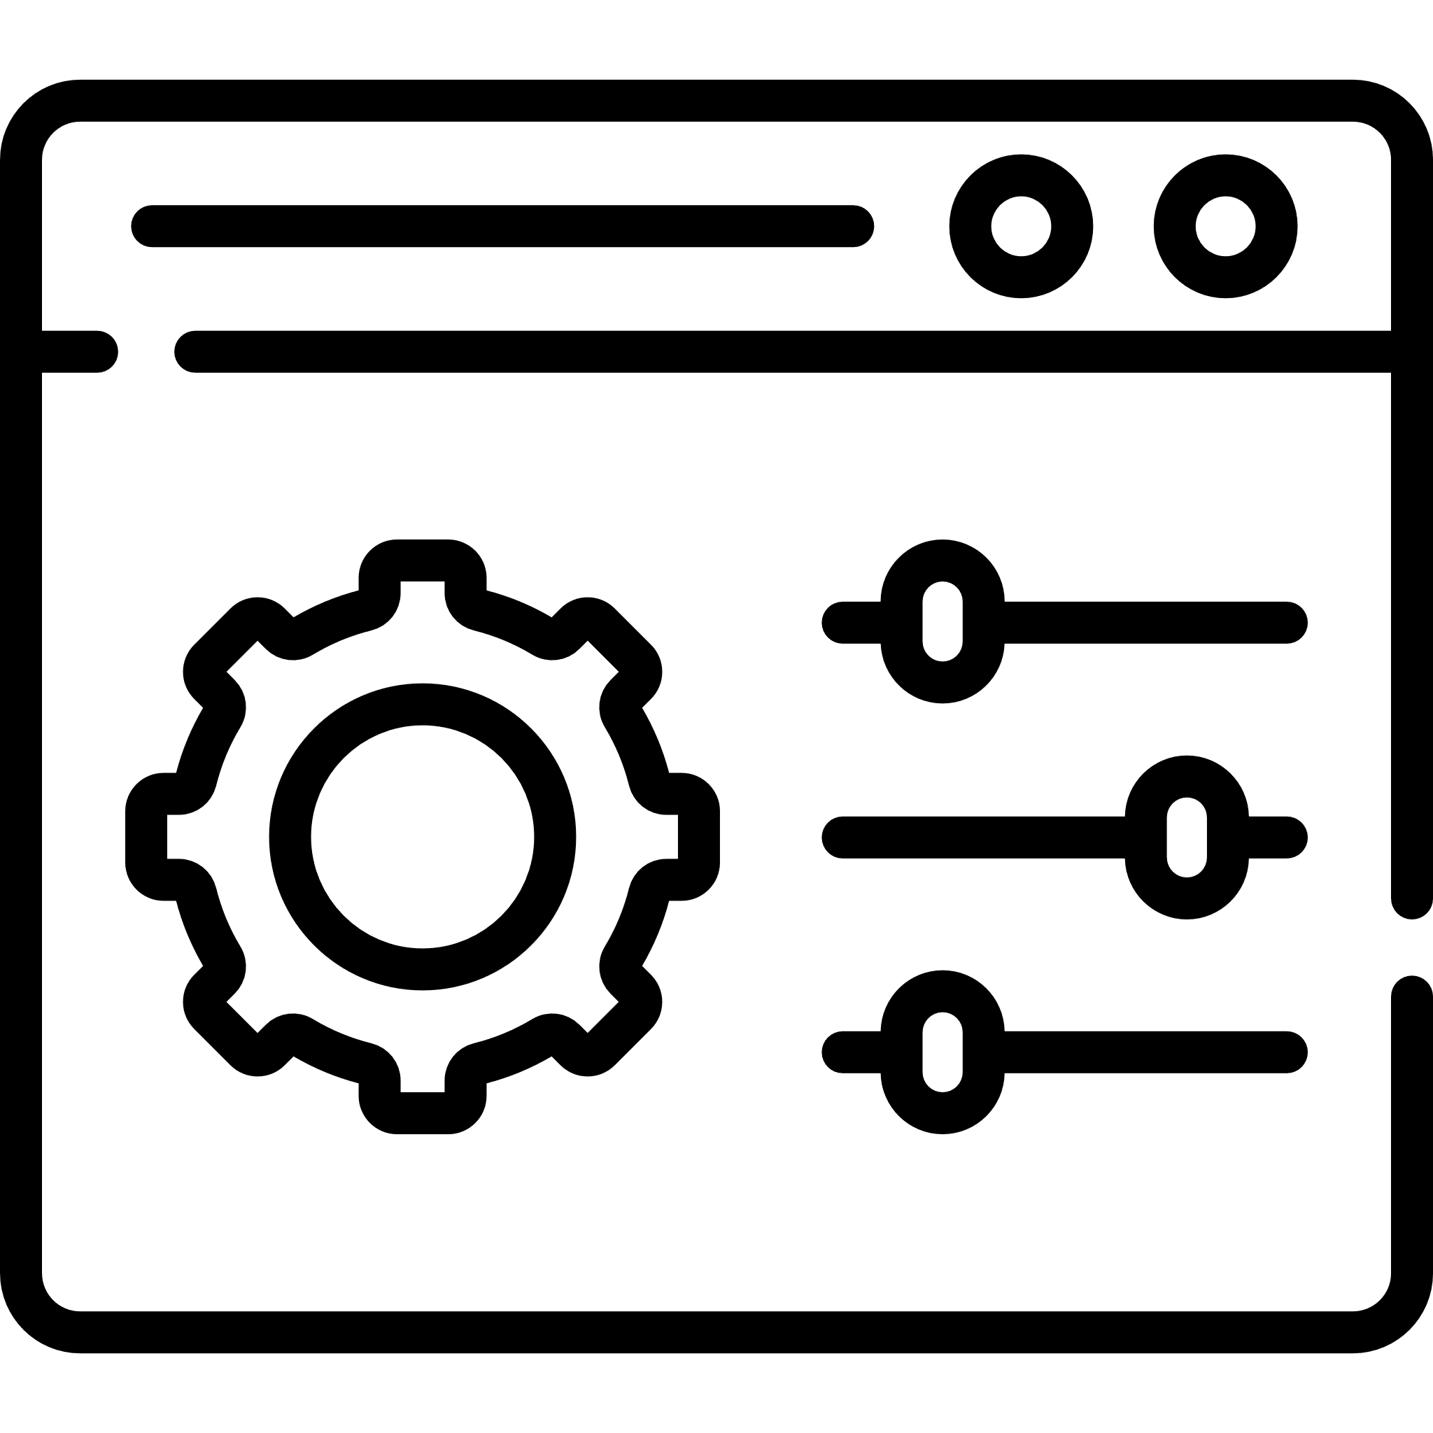

Differentiator
Time & Money
Experience
Expertise
Our open Product Driven Delivery
Model allows customers to
quickly build, deliver and
orchestrate cross cloud services
@50% time & cost
10+ Large Scale
Migration And Modernization
experience
Experience Team with a proven
track record of CloudOps delivery
enabled with DevSecOps
Capabilities
Long Term Retention
Single Control Panel
Compliance & Security
100% Customer Retention Rate
substantiated by excellent services
Xformation Product is a single
platform to manage all your
workloads distributed across
multiple clouds and boundaries
within a single control plane
Our compliance and security
assessment tools make sure
your hybrid cloud journey
meets your business compliance

Slide 4
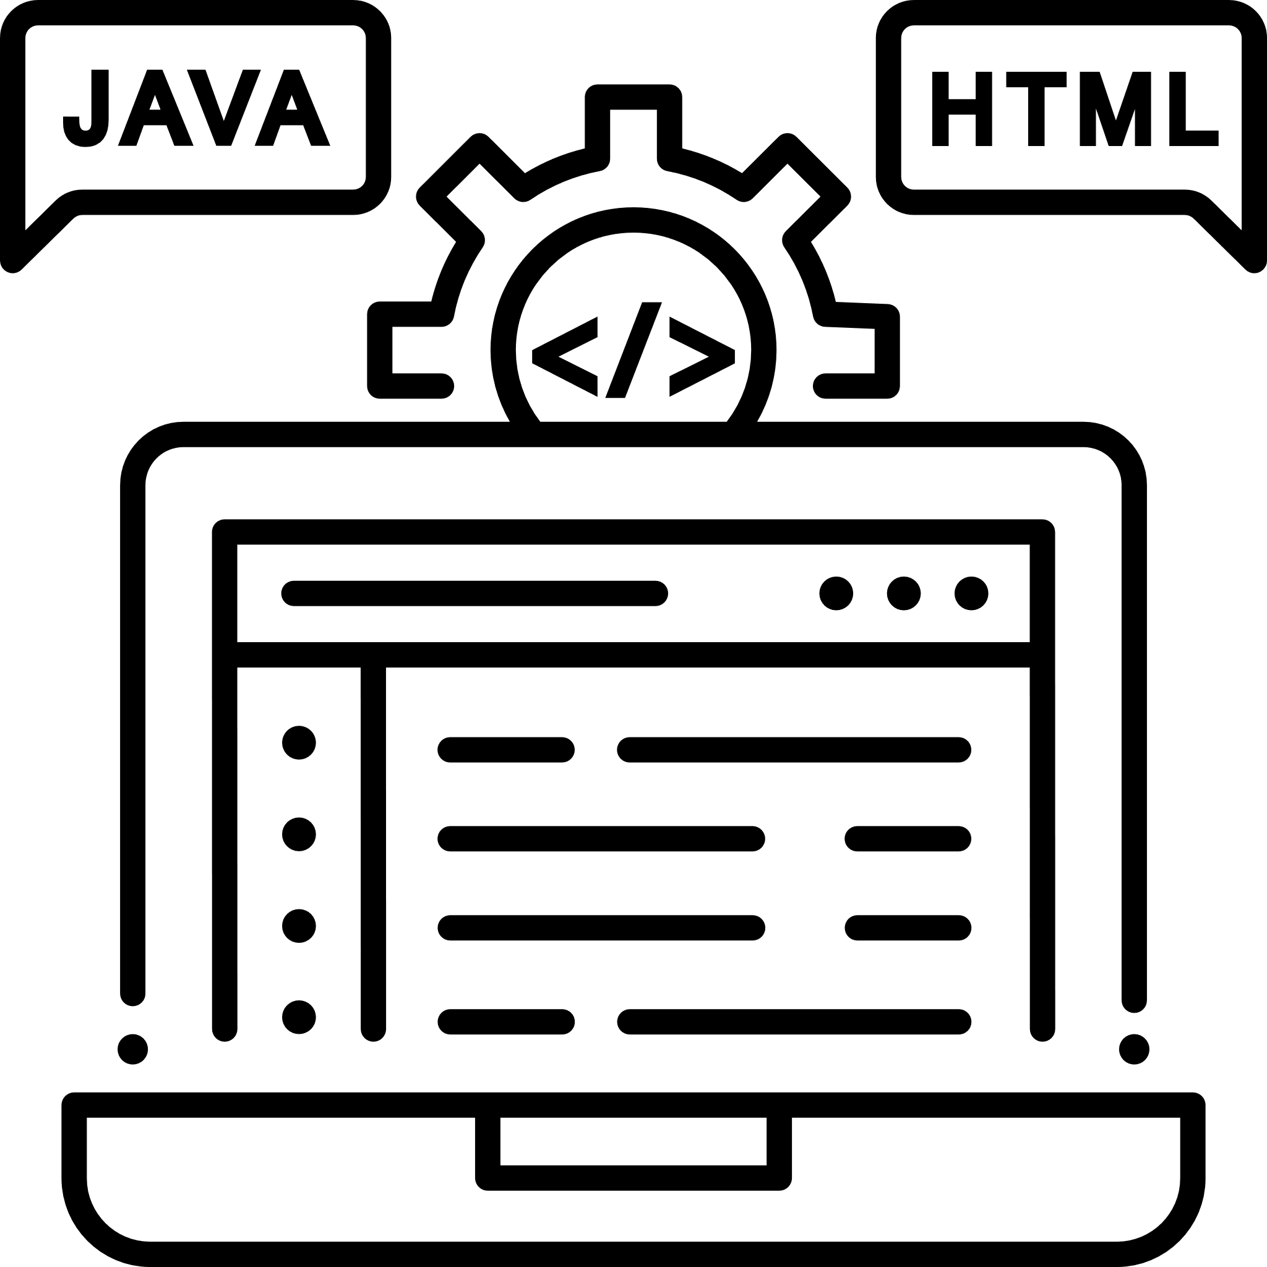


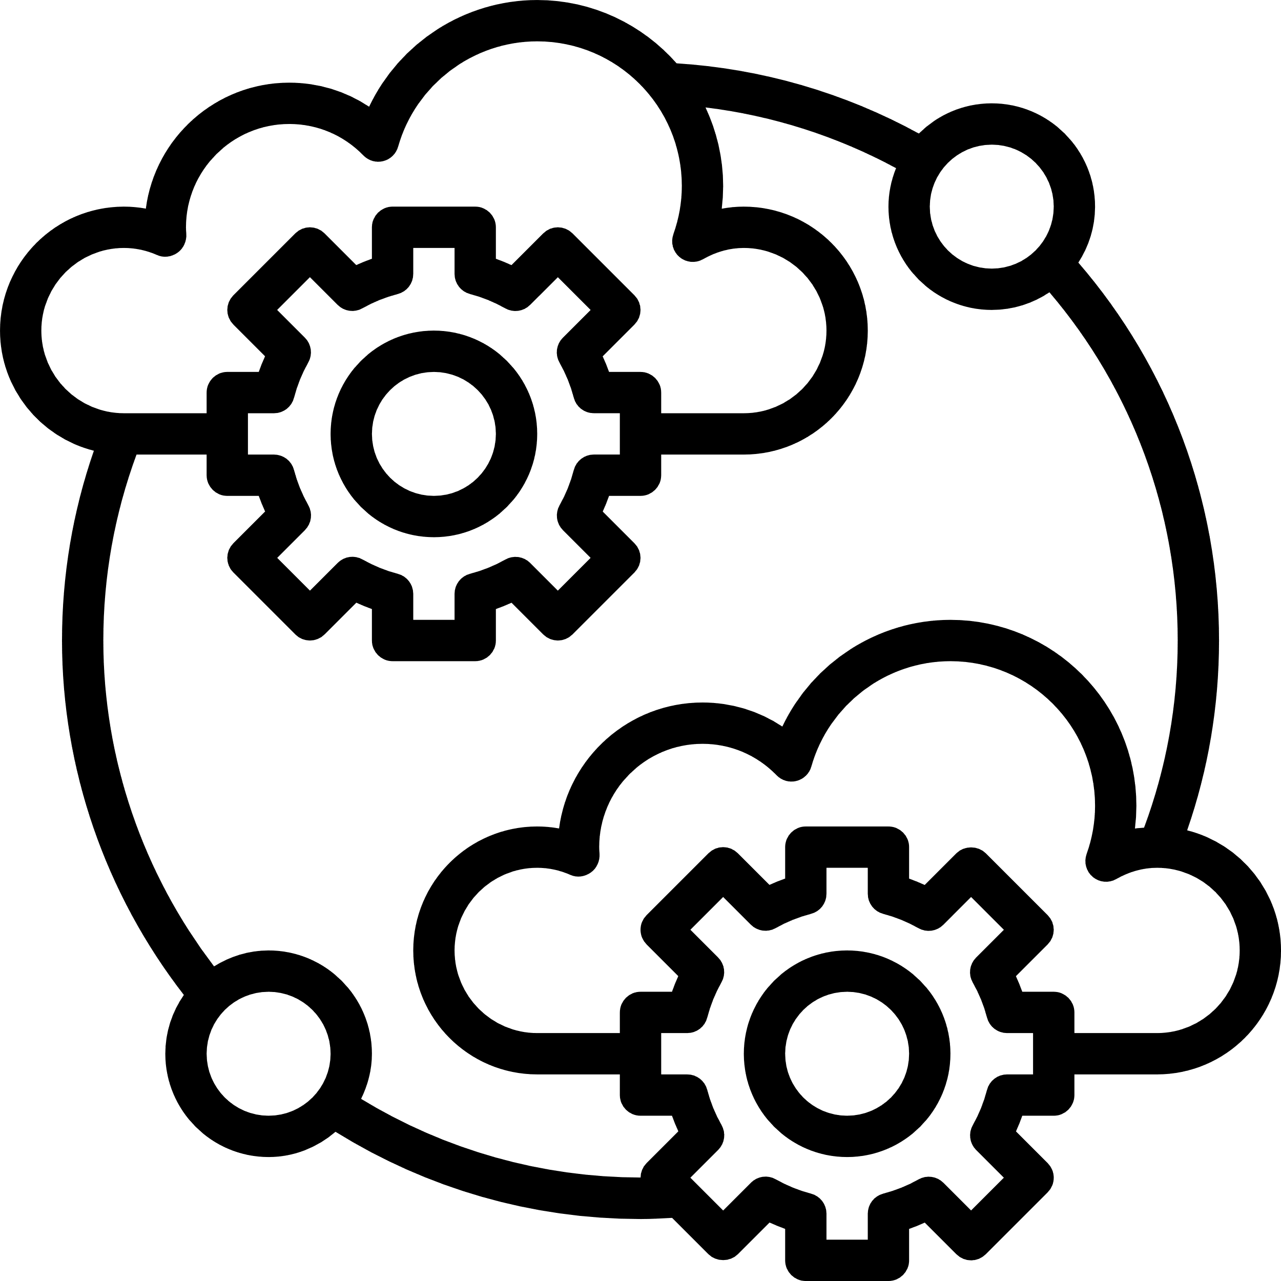

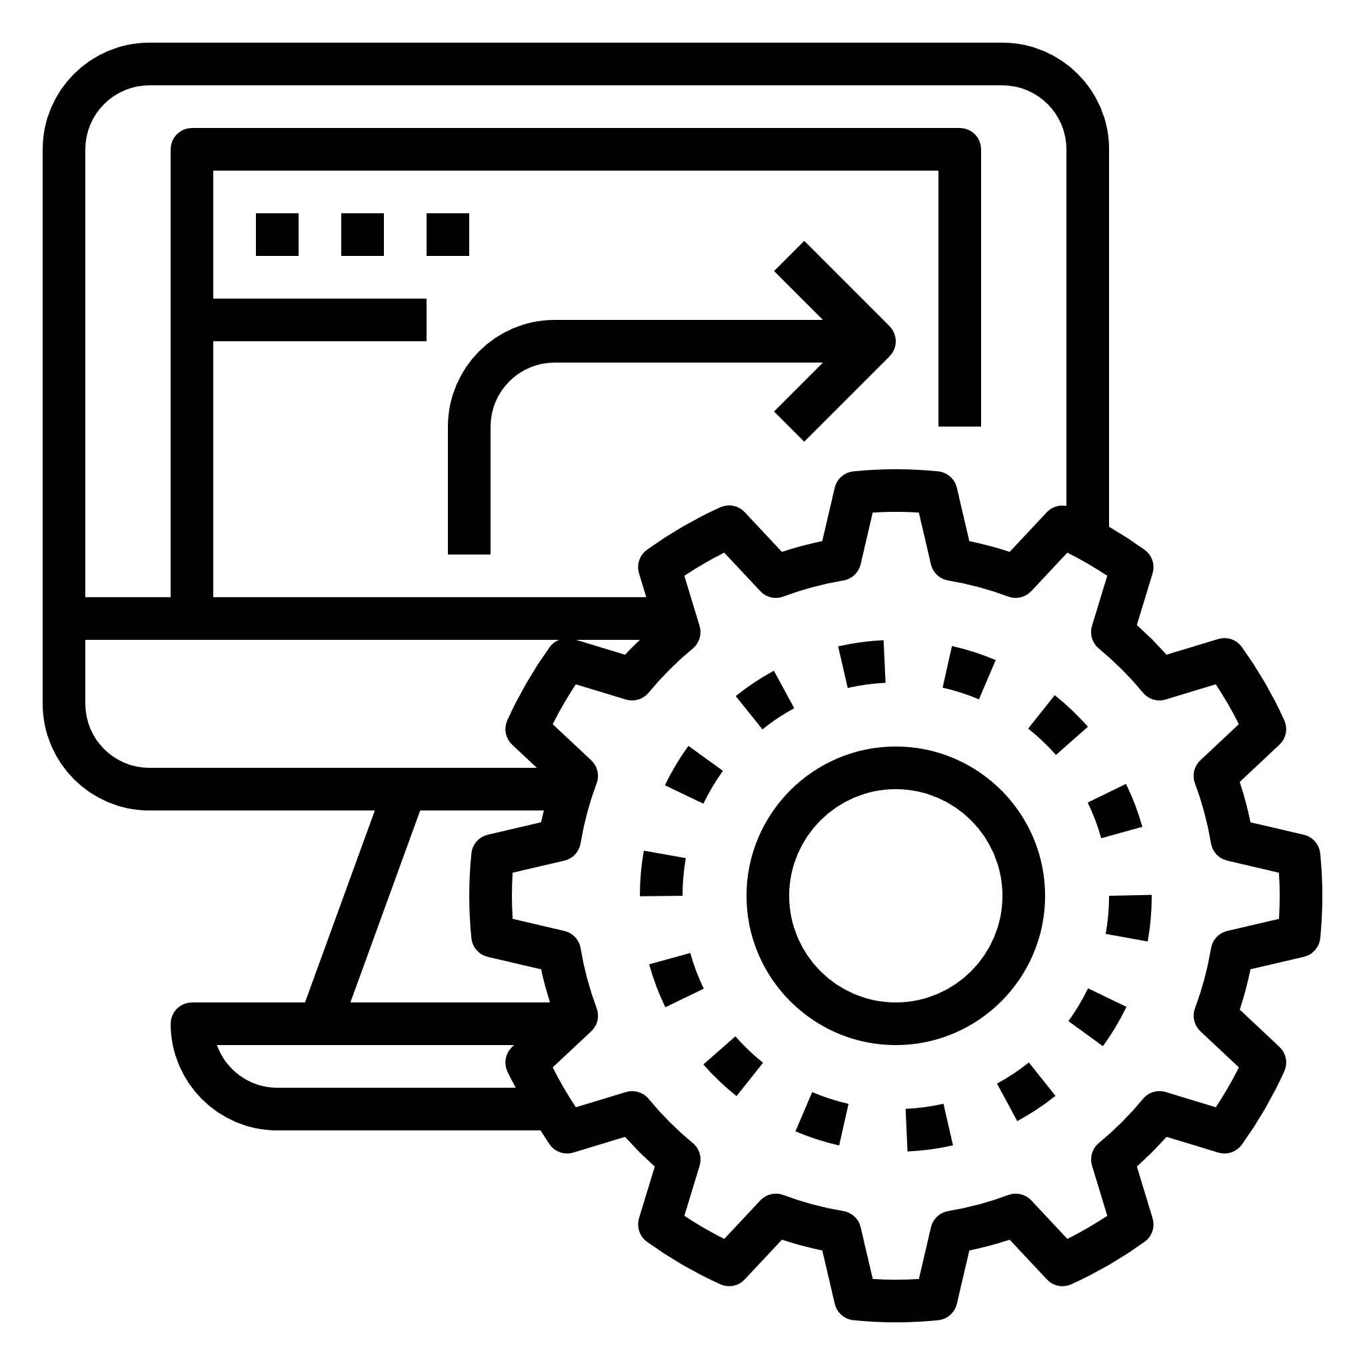
Differentiator
E2E Solution
Public Cloud Partnership
Open-Source Contribution
Single point of contact for
Application Migration,
Transformation and Integration
to cloud-native Apps services
Our advanced partnership
with major public cloud
providers help you to get
support at every stage
Committed to codifying
our know-how, we write open
Products and Distribute
Optimization Service
Engagement Model
Extreme Automation
We do optimal resource pooling
from multiple clouds
Our every engagement
focused on empowerment
– not dependency
Use our existing automation
capabilities to automate
infrastructure, operations,
security in hybrid IT environment

Slide 5
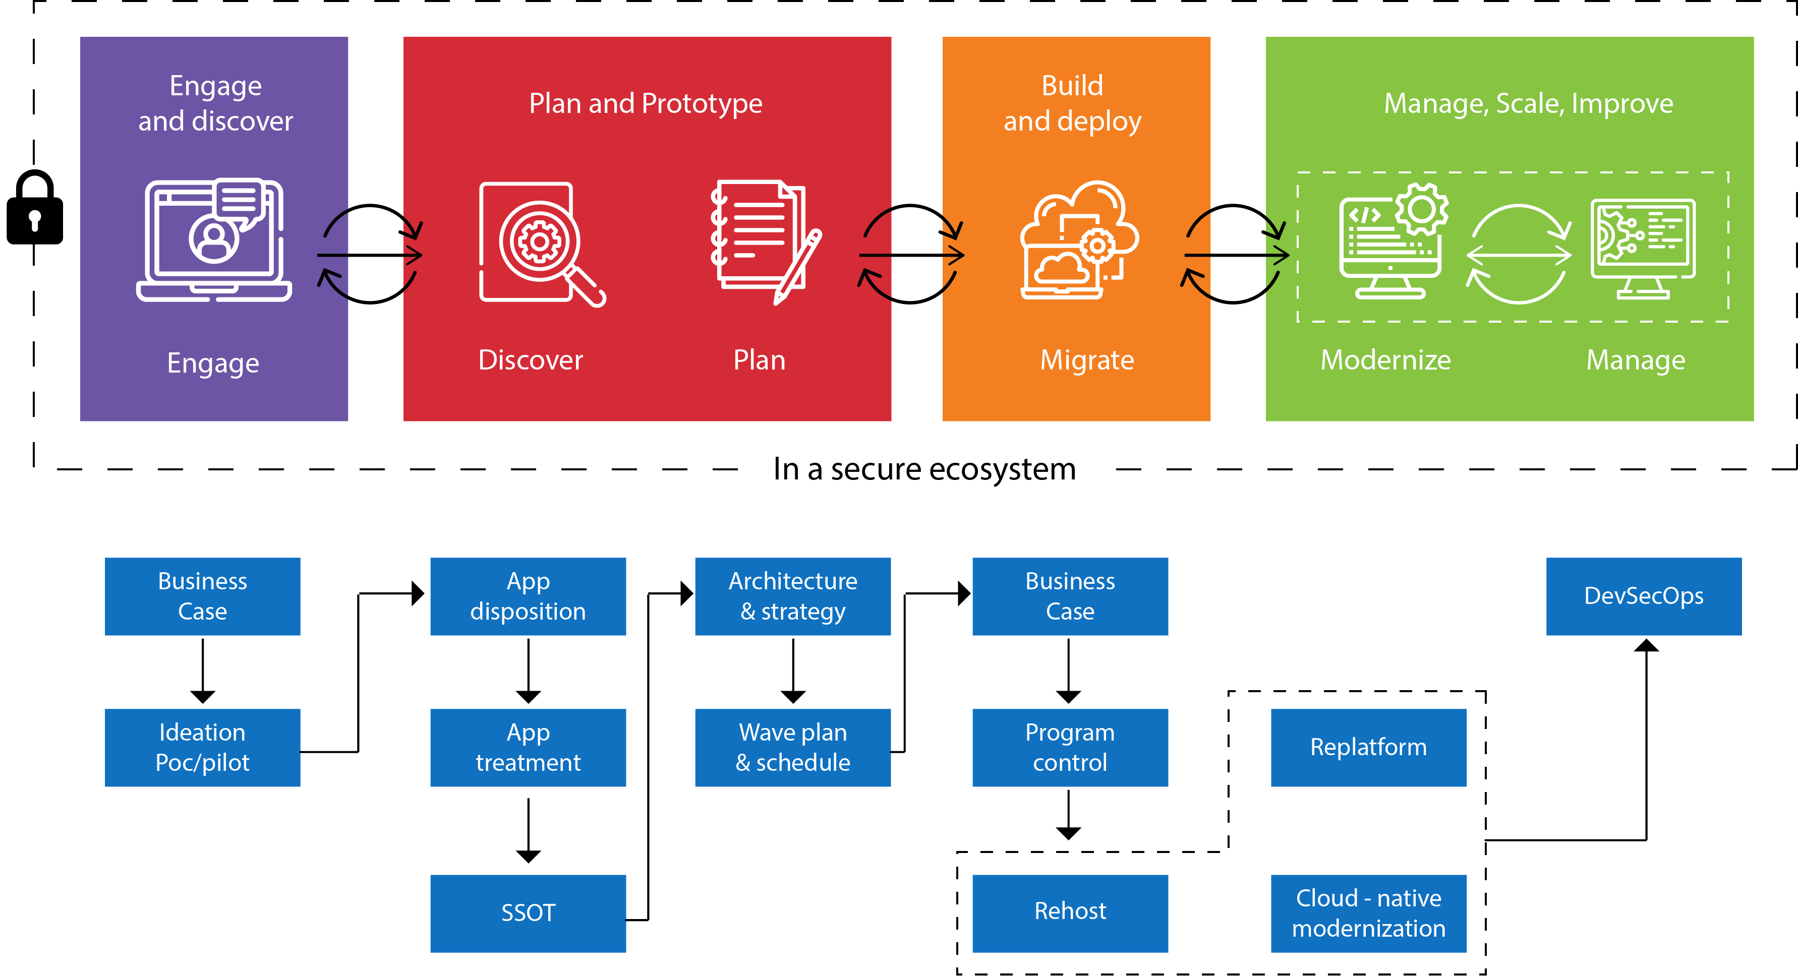
Engagement Model

Slide 6
Pricing Model
Outcome Based | Budget for estimated outcome volume. Payment based on result / SLAs.
Managed Services | Budget for monthly fixed cost and x% of variance cost. Payment based on delivered units.
Transaction based model | Budget for a specific transaction volume band per agreed duration. Payment based on transaction volume executed in agreed duration
Fixed Price (FP) | Specific / limited budget with predicted needs for few years. Payment based on Milestone/ project Completion.
Time & Material(T&M) | Floating budget. Payment based on Effort Put.
Hybrid (T&M for FP) | Phase wise budget, Phase1: Floating budget Phase2 : Specific / limited budget. Payment – Phase1 –Effort Based, Phase2 – Milestone / Project Completion.
Dedicated team | Fixed monthly budget. Payment based on resource.
While we are open to any flexible model, we strongly prefer, outcome based pricing model substantiated by our open product driven solutioning that protect customer investments.

Slide 7
Rate Card for Key Skill Sets
System
Architect
DevSecOps Engineer
Full Scale Developer
UX
Designer
Architecture
POC
Planning
Consulting
SME
Release
Coordination
Execution
ATP
Design
Development
Testing
End User Experience
$ 120 / Hour
$ 95 / Hour
$ 90 / Hour
$ 70 / Hour

