Slide 1

Delivering TAAS (Transformation As A Service)
Open Products Accelerating
Enterprise Transformation
Keep it simple…
© 2020 SYNECTIKS. All Rights Reserved. Proprietary and Confidential.

Slide 2
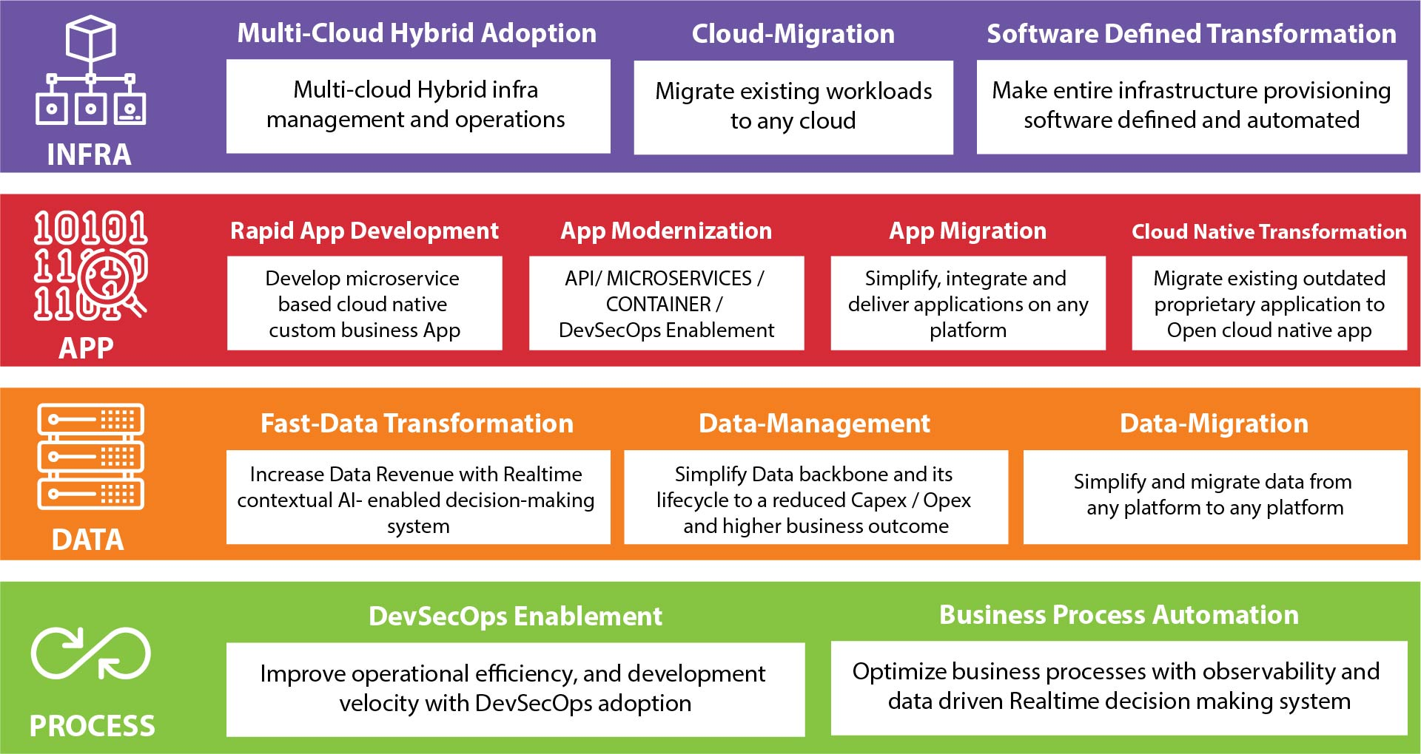
Capabilities

Slide 3
Key Capabilities / Accelerator / Gaps / Risks
Services | Accelerator- Tools | Accelerator- People Resources
TAAS / Migration And Modernization / RFP based projects/ Outsource team | Automation blocks for Cloud Infrastructure Provisioning Cross Cloud monitoring solution App Blocks for Microservices –RAD DevSecOps Audit Tools CI/CD templates Procurement & EMS example solution Our Process / Architecture Documentation | Ready resource pipeline Cloud Engineer / DevOps Engineer / Kuberenetes Engineer FSD – UI / API / Design specialists
Gaps | RCA | Risks | Resolution
No Marketing expertise Lack in continuous release in any products | Neither capable nor have any tie ups with appropriate body – Need huge upfront investments | Team Retention Sustainability | Fix Marketing Gap Focus on only product with pure investment model with an aim to sell out product.
Complete Procurement Solution (Web/Mobile) and Extend Fill few Gaps in Cross Cloud Monitoring Product – make complete release Improve on Data Management and Analytics Expand team – be ready for team outsource Bid more projects – run campaign in LinkedIn + Visit expos in Middle Easts

