Slide 1

Delivering TAAS
Open Products Accelerating
Enterprise Transformation
Keep it simple…
© 2020 SYNECTIKS. All Rights Reserved. Proprietary and Confidential.

Slide 2
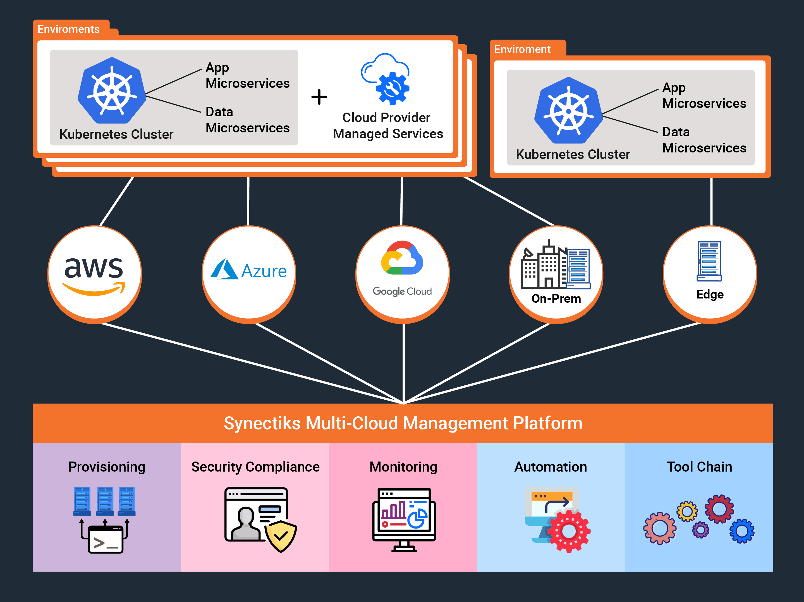
Appkube Platform

Slide 3
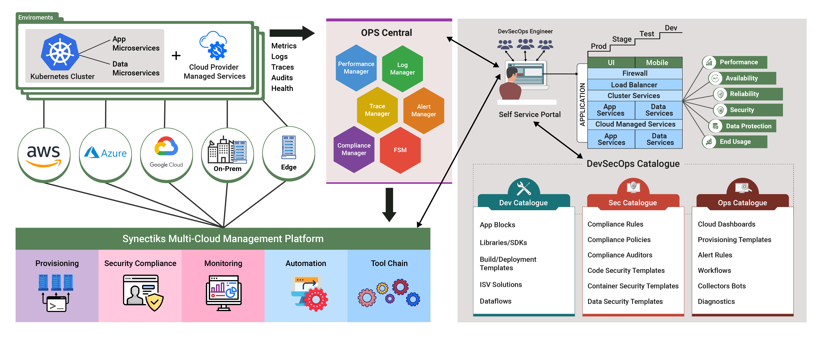
Appkube Overall Architecture
© 2021 Synectiks. All Rights Reserved. Proprietary and Confidential.

Slide 4
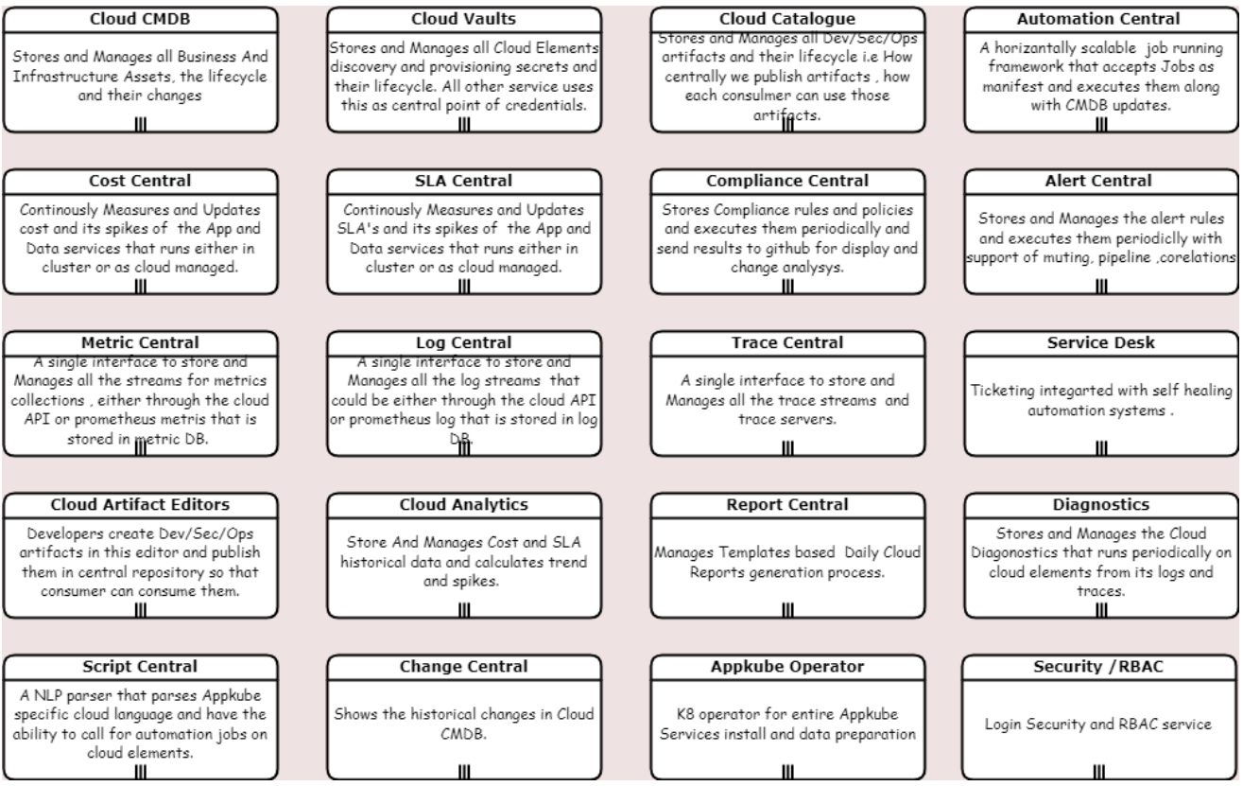
Appkube Key Modules
© 2021 Synectiks. All Rights Reserved. Proprietary and Confidential.

Slide 5
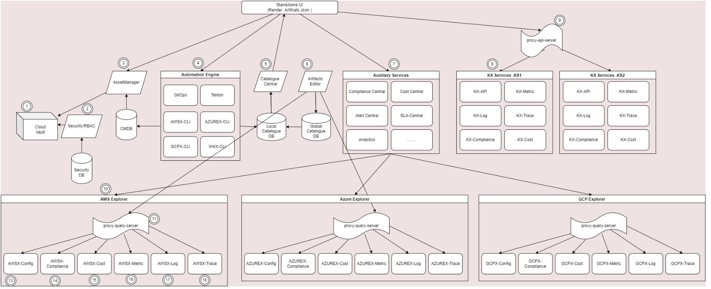
Appkube Interaction Diagram
13/14/15/16/17/18- Services that manages config/ compliance/cost/metric/log/trace of cloud elements.
11- Proxy Query server takes queries from auxiliary services and get data from 13/14/..
12- Developers create artifacts like dashboards/pages with queries and publish them to global catalogue, so that UI can consume.
Entire architecture has been done with the objective of 1. Extreme Granularity –only small Cli’s 2.No regression 3. Easier Troubleshooting
© 2021 Synectiks. All Rights Reserved. Proprietary and Confidential.

Slide 6
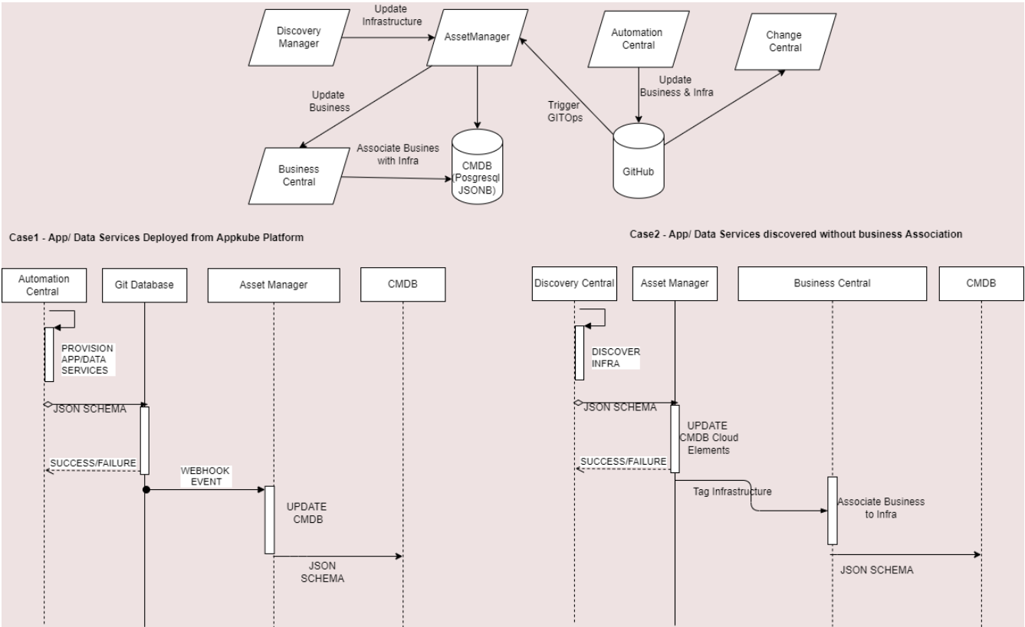
Asset Manager / CMDB
© 2021 Synectiks. All Rights Reserved. Proprietary and Confidential.

Slide 7
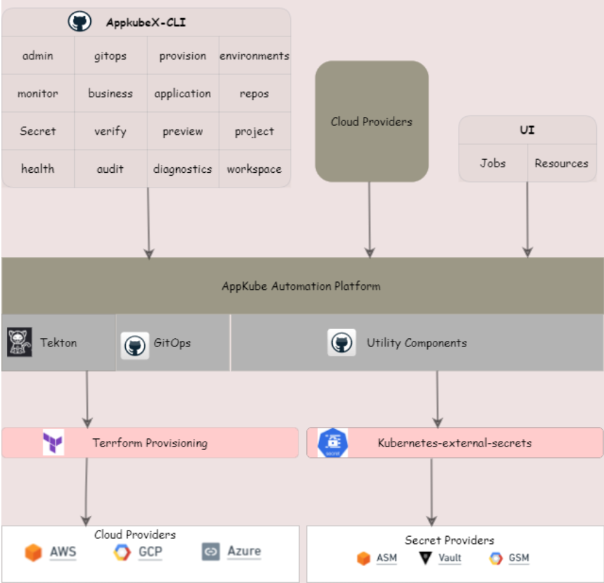
Automation Central
© 2021 Synectiks. All Rights Reserved. Proprietary and Confidential.

Slide 8
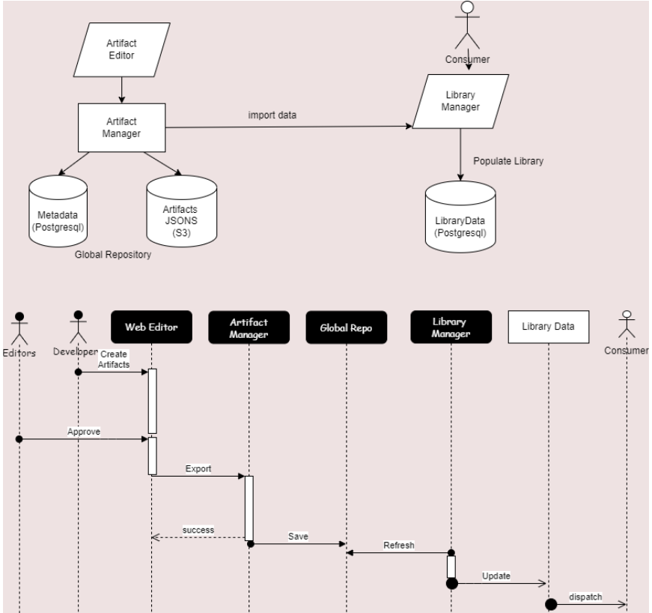
Cloud Catalogue
© 2021 Synectiks. All Rights Reserved. Proprietary and Confidential.

Slide 9
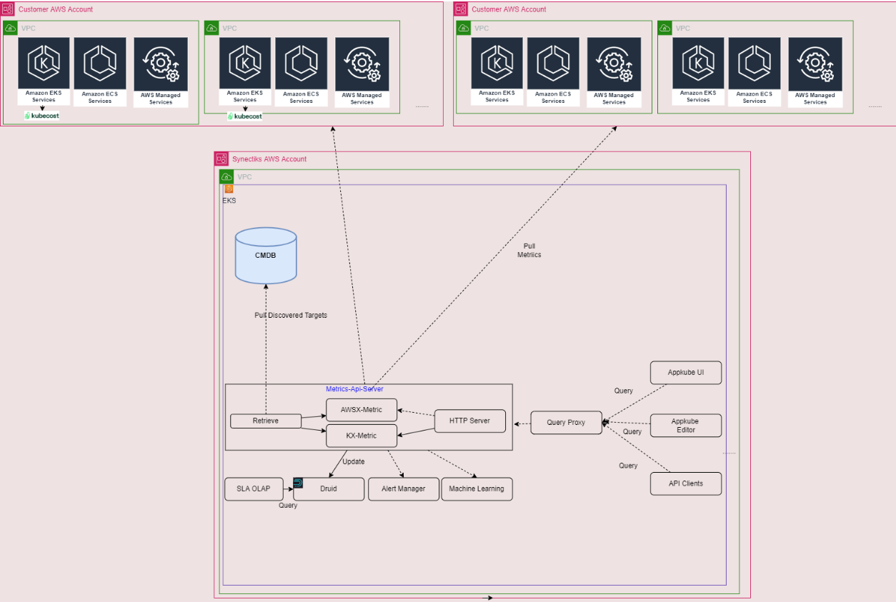
Metric Central
© 2021 Synectiks. All Rights Reserved. Proprietary and Confidential.

Slide 10
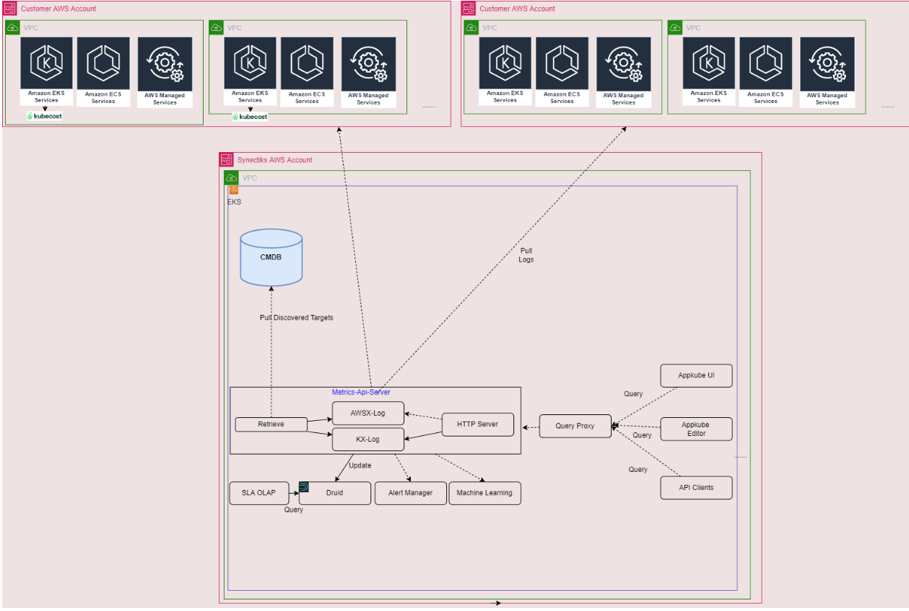
Log Central
© 2021 Synectiks. All Rights Reserved. Proprietary and Confidential.

Slide 11
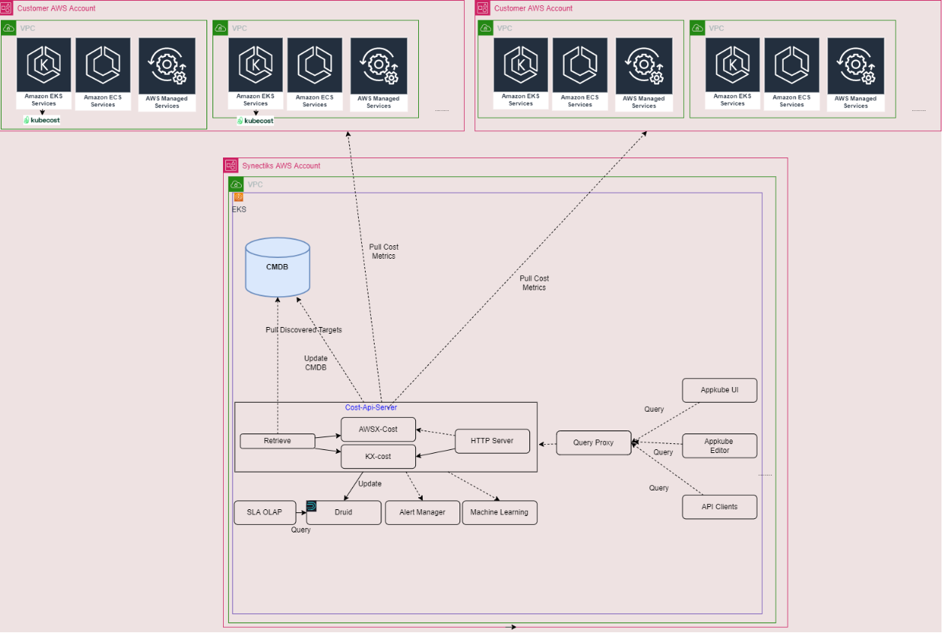
Cost Central
© 2021 Synectiks. All Rights Reserved. Proprietary and Confidential.

Slide 12
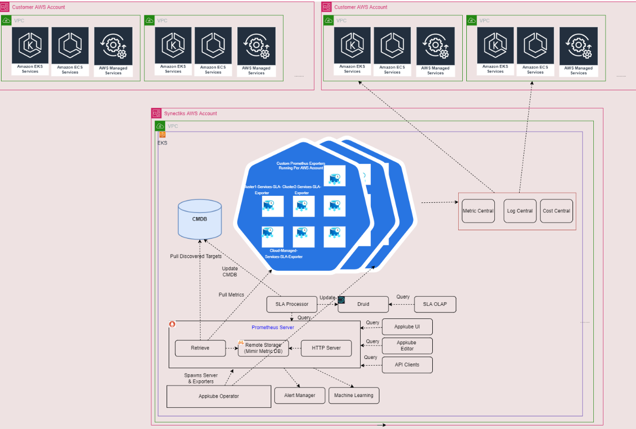
SLA Central
© 2021 Synectiks. All Rights Reserved. Proprietary and Confidential.

Slide 13
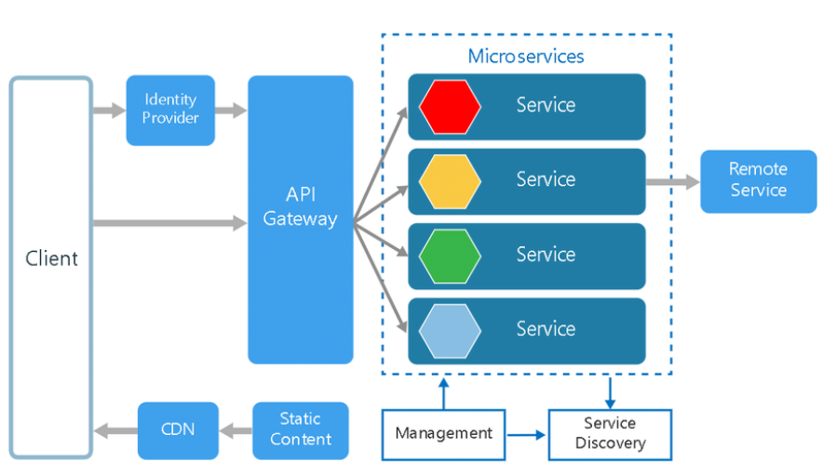
Application Architecture
Development Principle
We build custom solutions based on Cloud Native principles with micro-service-based architecture , driven by DevSecOps approach to add development velocity and site reliability. While we are willing to be flexible on our execution approach, we believe that adopting the most modern technology stacks and architecture principles are critical to the project success.
© 2021 Synectiks. All Rights Reserved. Proprietary and Confidential.

Slide 14
Tech Stack
Front End
Backend
Sprint backlog
Sprint closure
UX designs & prototyping
  Figma / Adobe
Core Web UI
  HTML5/CSS3/JAVASCRIPT
Web Framework
  Reacts / Redux / Flutter
Mobile Dev
  React Native / Flutter
API Development
  Golang/ Node-Js / Java / Lambda / Serverless
Tests
  Junit5/ Cucumber BDD / Gatling/Post Man
Data Bases
  Postgres , Mongo , Dynamo, Redis , OpenSearch, metric DB, LogDB, GraphDB
Release plan
Product backlog
Release burn up
Sprint backlog
Definition of “Done”
Test approach
Acceptance criteria for each story
Sprint Goal
Documentation approach
Impediment tracking list
Sprint backlog prioritization
Sprint burn-down chart
Kanban / Scrum board
Defect management
Development documentation
Working Software
Retrospective backlog / action list
Continuous improvement plan
Defect management
Release burn-down

