Slide 1

Delivering TAAS
Open Products Accelerating
Enterprise Transformation
Keep it simple…
© 2020 SYNECTIKS. All Rights Reserved. Proprietary and Confidential.

Slide 2
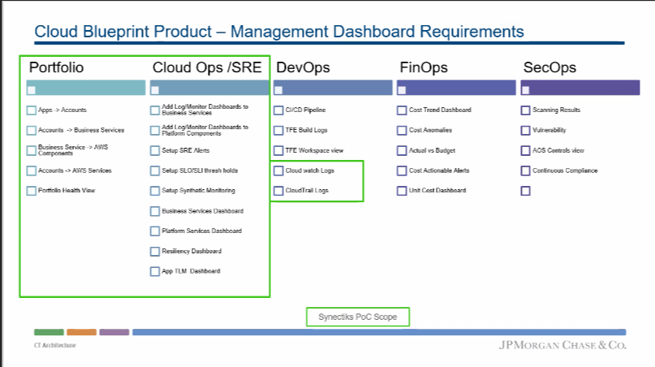
SLA Central
© 2021 Synectiks. All Rights Reserved. Proprietary and Confidential.

Slide 3

SLA Central
© 2021 Synectiks. All Rights Reserved. Proprietary and Confidential.

Slide 4
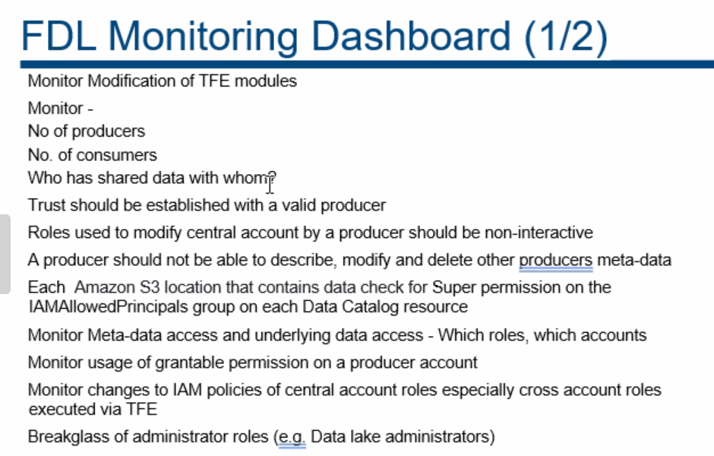
SLA Central
© 2021 Synectiks. All Rights Reserved. Proprietary and Confidential.

Slide 5
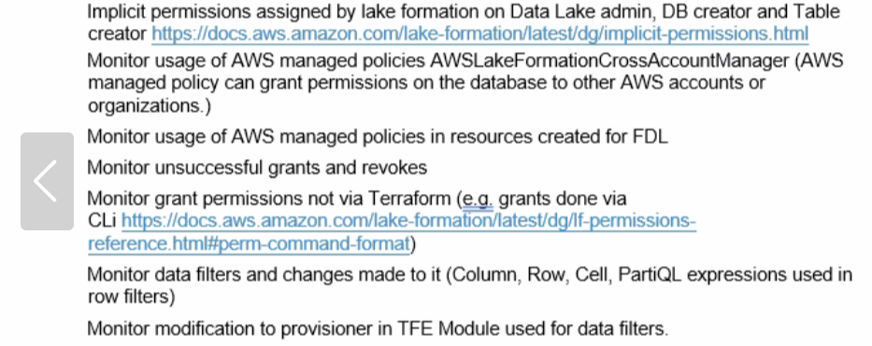
SLA Central
© 2021 Synectiks. All Rights Reserved. Proprietary and Confidential.

Slide 6
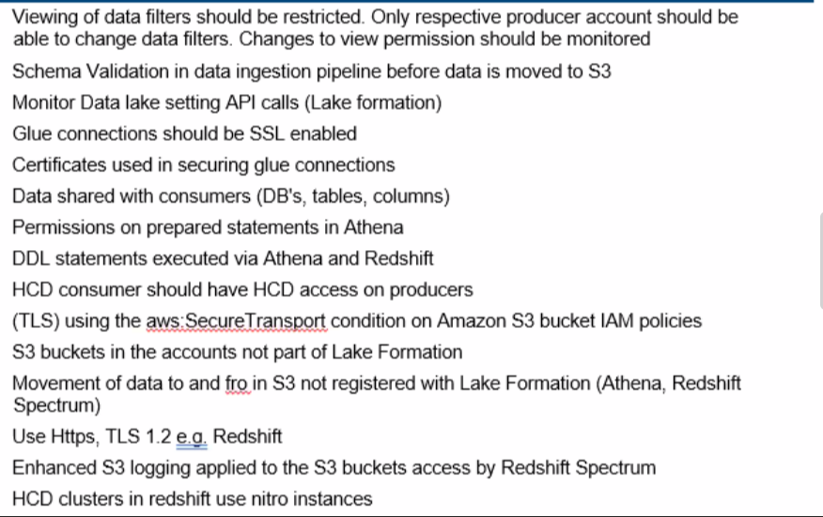
SLA Central
© 2021 Synectiks. All Rights Reserved. Proprietary and Confidential.

Slide 7
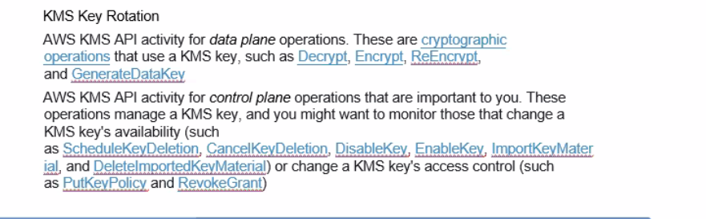
SLA Central
© 2021 Synectiks. All Rights Reserved. Proprietary and Confidential.

