Slide 1

Delivering TAAS
Open Products Accelerating
Enterprise Transformation
Keep it simple…
© 2020 SYNECTIKS. All Rights Reserved. Proprietary and Confidential.

Slide 2
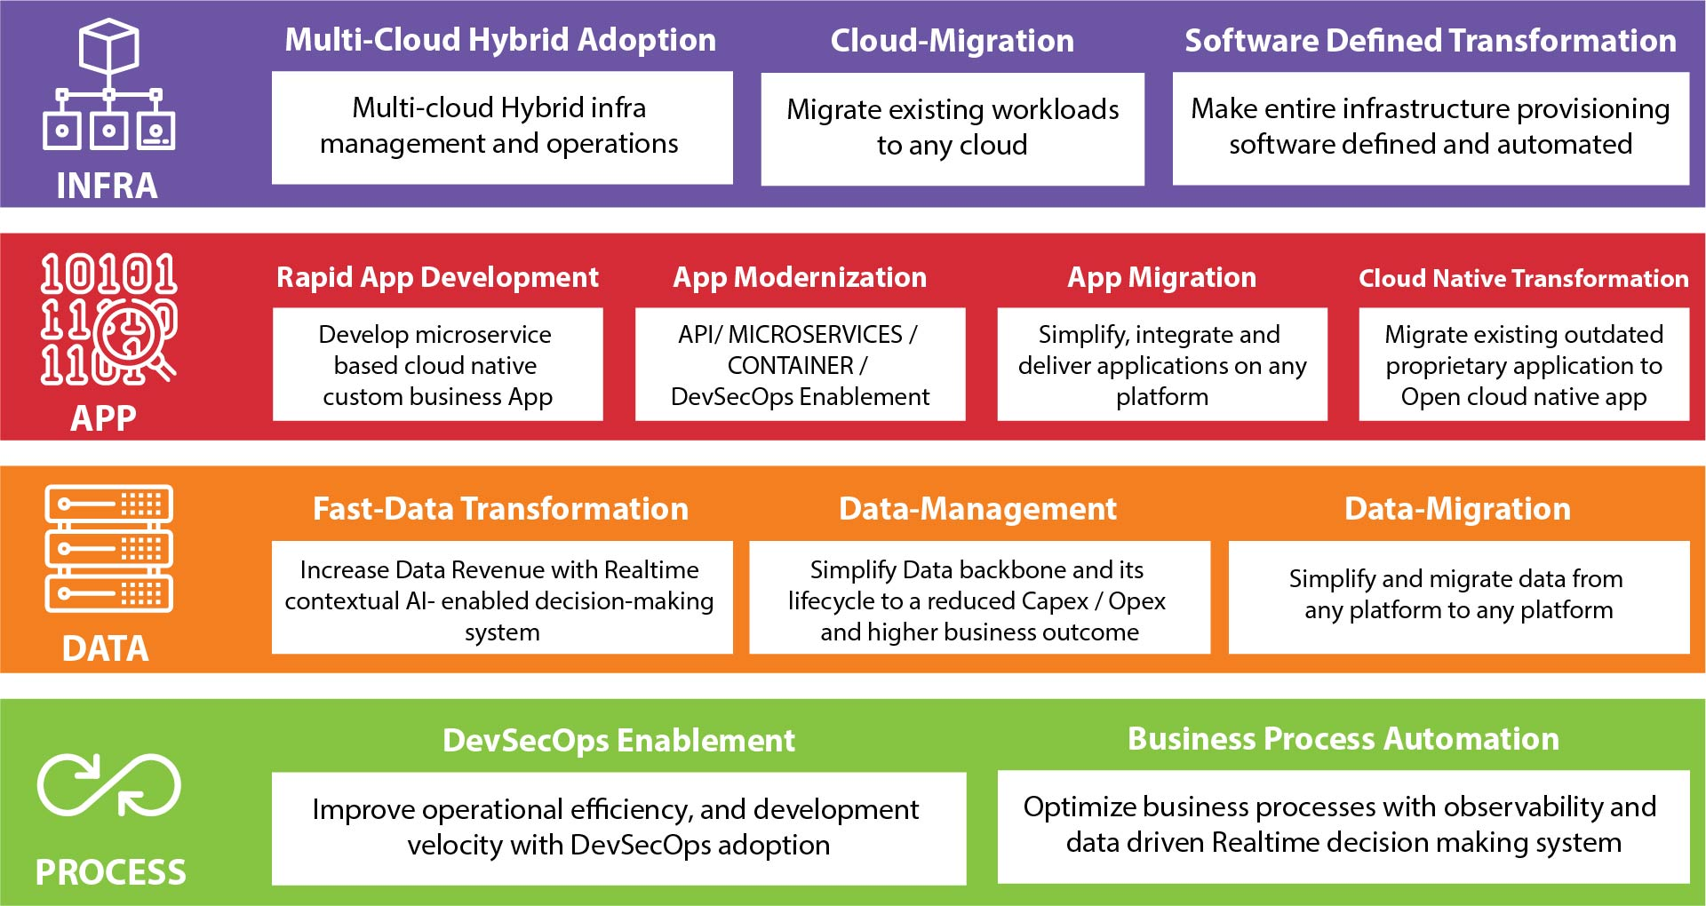
Our TAAS Capabilities

Slide 3

Agenda
Automated Cloud Test Framework to validate cloud readiness
      Rationale
      Process/Tooling
      Datafication
      Instrumentation
      Accelerator
© 2020 SYNECTIKS. All Rights Reserved. Proprietary and Confidential.

Slide 4
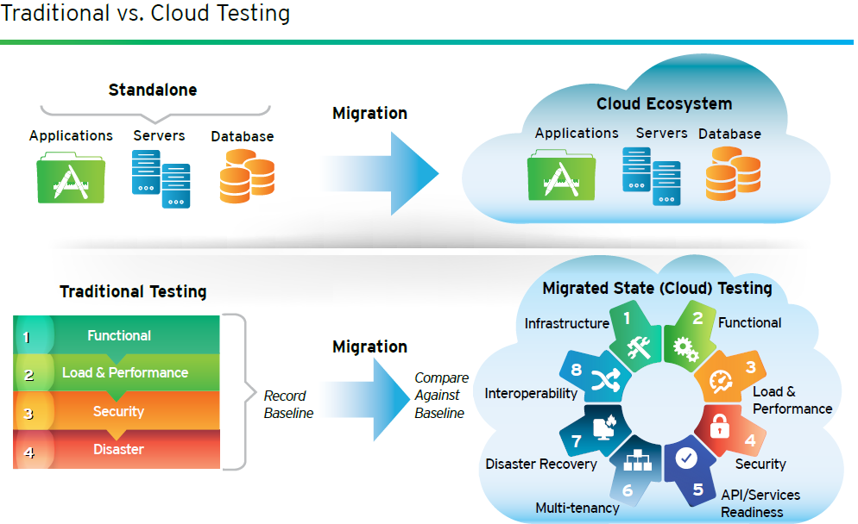
Rationale for Automated Cloud Assurance Framework
  Need
  Validation of cloud attributes- availability, scalability, multitenancy, interoperability and security
  Flexible test-ing approach that caters migration methods – namely re-host, re-platform, re-factor and re-ar-chitect
  framework that offers IT teams a structured approach to validate business readiness post cloud migration
  Our Answer?
  A quantitative, KPI-based test framework provides a consistent method toward workload profiling across multiple parameters and results in a cumulative score to determine the fitment for cloud.
  Availability of Specialized resource Pool executing the framework

Slide 5
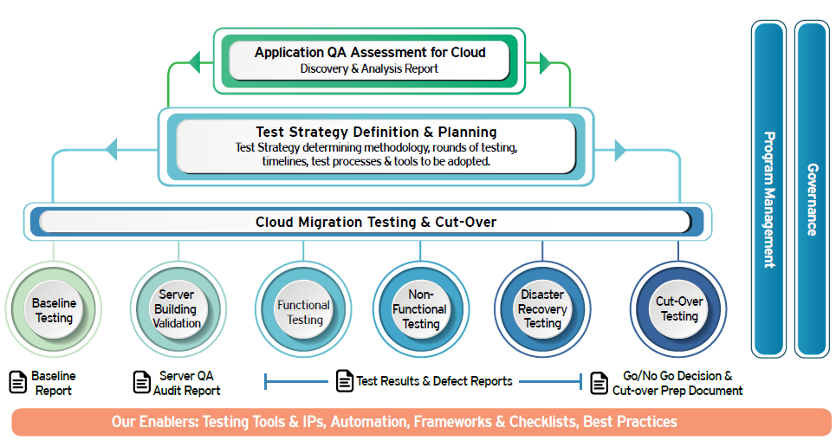
Our Cloud Assurance QA Framework

Slide 6
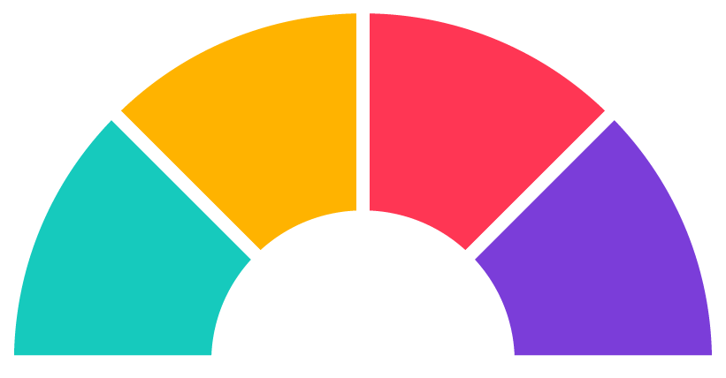
Our focus area Cloud Testing
Multi-tenancy
Microservices Testing
Application upgrades to few tenants
Validate app design for different customers/domains
Isolate data based on privileges and authentication
Validate tenants' use of resources as per requirements
Validate upgraded instances and old instances
Validate each service independently
Validate the different pieces of the application
Validate on multiple environments
Use canary testing (Al is used to automate)
Disaster Recovery
Provisioning Testing
Test, measure, and update BCP periodically
Run simulations and evaluate the team's readiness
Monitor test results to update BCP over time
Validate instances restore automatically during failures
2
3
Self provisioning
Dynamic provisioning
Provisioning of new services when new users sign up and vice versa
1
4
FOCUS AREAS
OF CLOUD TESTING

Slide 7
Our focus area Cloud Testing
FOCUS AREAS
OF CLOUD TESTING
Synchronization Testing
Portability Testing
Verify device to device
synchronization issues
Recovery situations when sync is, disrupted
Rollback scenarios in case of failures
5
8
Verify data schema as per new application
Verify checks like
  Data integrity and data flow
  Data consistency and data volume
6
7
Performance & Security
Portability Testing
Verify how system behaves under heavy load
Verify scaling up/down as per load
Verify security of the systems
Validate proper installation of product
Validate Ul of application in different browsers
Validate application in different environments

Slide 8

Our focus area Cloud Testing
Testing on cloud
Functional testing
Non-functional
Testing
Ability/cloud-
specific testing
Component testing
Microservices testing
Data migration testing
Usability testing
Integration testing
Licensing testing
Accessibility testing
il8N & L1ON
Performance testing
  Load/stress testing
  Latency testing
  Capacity testing
  Browser performance
Security testing
  Application testing
  Network testing
  Compliance testing
Interoperability testing
Compatibility testing
Multi-tenancy testing
Disaster recovery testing
  Failover testing
  Failback testing
Availability/continuity testing
Elasticity Synchronization
End-to-end testing

Slide 9
Functional Testing
Microservices
Integration
Data migration
Component
Unit testing
Integration testing
Component testing
Contract testing
End-to-end testing
Integration of modules
Integration of software and hardware
Integration between different components
Data consistency
File type and size checks Volume consistency
Driver testing
Effortless navigation of the site
Integration between services/components
Accessibility
Licensing
Data migration
il 8N &L1ON
QA will test the product and its compliance with the section 508 requirement standards
Verify all possible ways of navigation
Most pages will also be readable via assistive technology
Documentation should be available in electronic format
Tests pertaining to the licensing of the base product and its different features
Ensure only licensed functionality is available
Devices should meet certification requirements for the network, protocol compliance, device drivers, app store submissions, etc.
Effortless site navigation
Easy interface
Faster pickup
UI checksFont and font size
Application logo
Warning/error messages
UI responsiveness
Minimize and restore functionality
UI element and label alignment
Line wrapping
Word breaks or punctuation
Alphabetical sorting
Layout and text direction

Slide 10





NON -Functional Testing
Security Testing
Performance
Identification
  Password management
  Provisioning
  Registration
Access management
  Authorization
  Authentication
Plugins & Extensions
Web Interfaces (SQL Injections)
APIs
Unauthorized access to data
Data leakage
Multitenancy
Connectivity to cloud from on-prem or network
Open ports
Interfaces
  Network services
  Cloud interface
  Mobile interface
Load/Stress Testing
Measuring the optimal response time while the system is subjected to increasing load
Speed: Evaluates the system for good speed even under different loads
Scalability: Checks the variation in response time/scalability as the load on the system varies
Reliability: Validates whether the app is reliable under prolonged periods of high user traffic
Stability: Evaluates if the system is stable under heavy concurrent user load
Latency testing
Monitoring the time taken to move data messages between two points within the cloud network
Capacity Testing
Benchmarking the maximum amount of traffic that can be handled
Browser Performance
Validating the compatibility of different browsers with the overall system

Slide 11
Cloud Specific Testing
Elasticity
Disaster Recovery
Data migration
Synchronization
Automatic provisioning of computing power and memory
Dynamic scaling with no loss of data, and end-user connectivity
Failback plan
Failover plan
Availability
Business continuity
Self-healing ability
Upgrade testing
Rollback to stable version
Rigid failures
Data consistency
Access controls
Multi-tenant security Availability
Business continuity
Sync across services and devices
Recovery situations when a sync is disrupted
Restart of services
Compliance
Compatibility
Interrupt
End-to-end
Licensing of the base product and its different features
Only licensed functionality is available
Devices should meet certification requirements for the network, protocol compliance, device drivers, app store, etc.
Cross-platform compatibility is ensured
Compatibility is ensured across different generations of devices, versions, mobile devices, operating systems, etc.
Validation of application behavior against all types of interruptions
Network outage
Graceful shutdown
Abrupt shutdown
Graceful stop of services
Reboot hosts
Kill processes
Validation of end-to-end functionality
Validate SaaS/cloud services functions
Automated suite compatibility
Links and page layout are working as expected

Slide 12
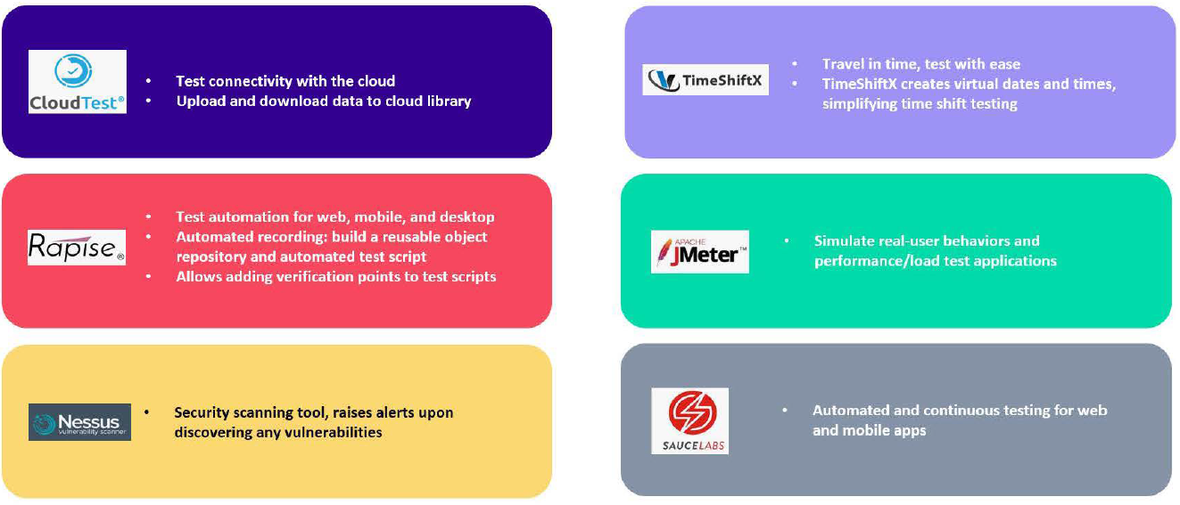
TestsTooling

Slide 13
Datafication
Goal –
A KPI driven (framework + Instrumentation) ensuring
  50% Reduction is migration time
  100% Test Coverage for Go-Live certification
  30% time reduction in deployment certification
  50% increase in resiliency and scalability
  80% Early defect detection

Slide 14
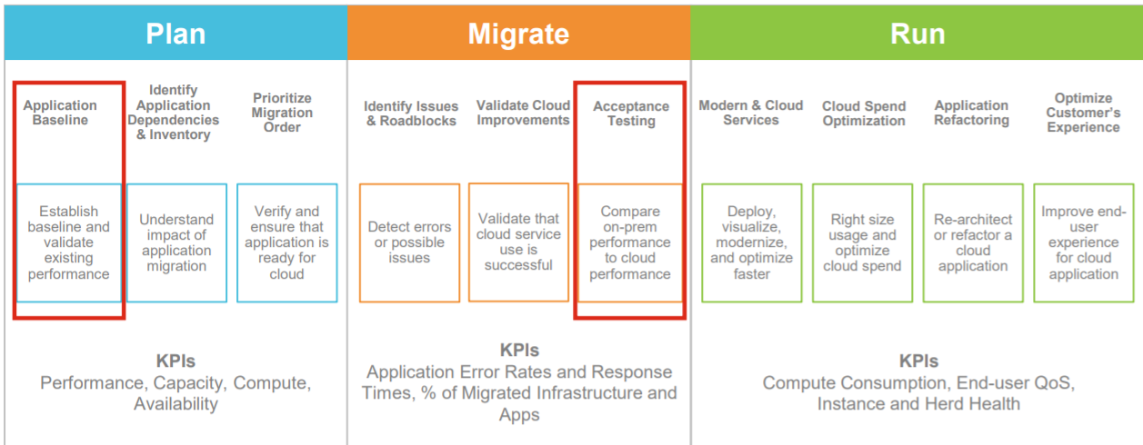
Datafication – KPI Framework

Slide 15
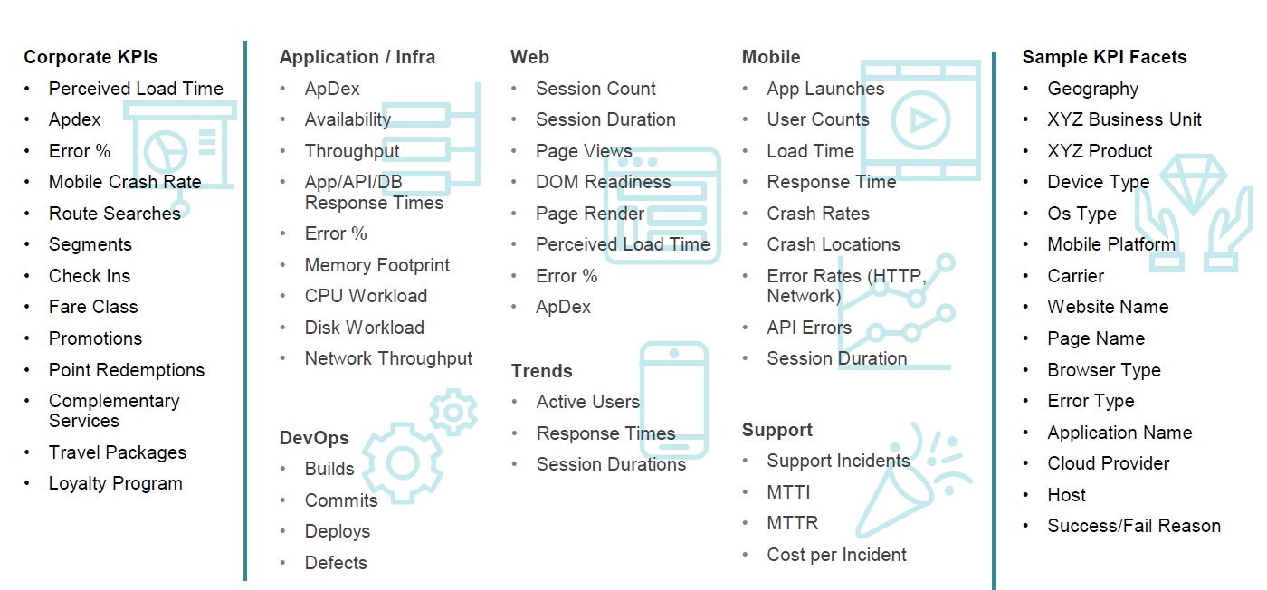
Datafication – KPI Framework

Slide 16
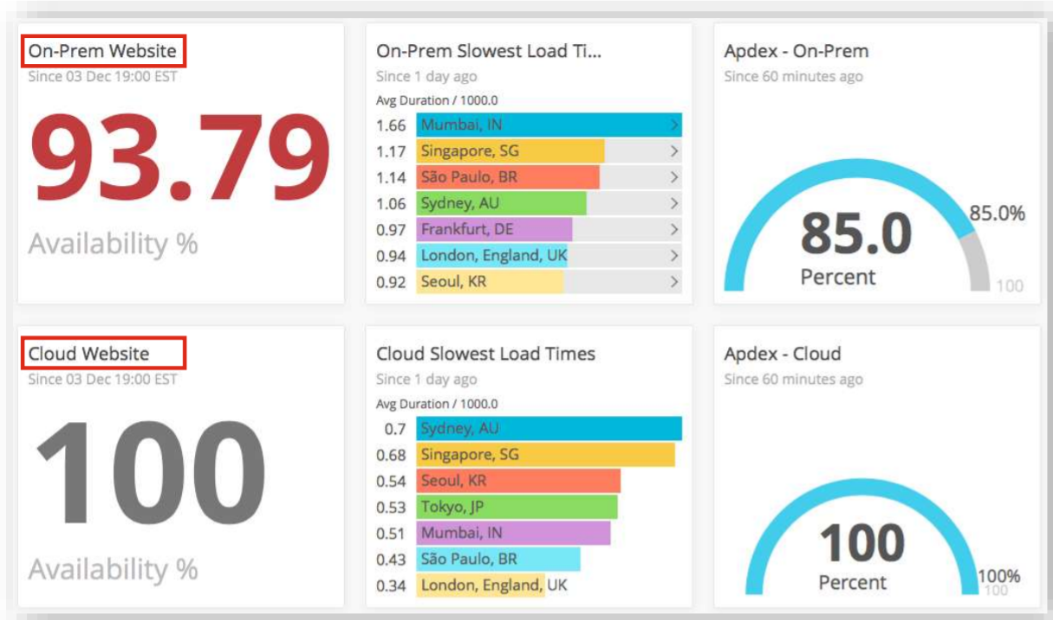
Instrumentation
© 2020 SYNECTIKS. All Rights Reserved. Proprietary and Confidential.

Slide 17






Differentiator
Time & Money
Experience
Expertise
Our open Product Driven Delivery
Model allows customers to
quickly build, deliver and
orchestrate cross cloud services
@50% time & cost
10+ Large Scale
Migration And Modernization
experience
Experience Team with a proven
track record of CloudOps delivery
enabled with DevSecOps
Capabilities
Long Term Retention
Single Control Panel
Compliance & Security
100% Customer Retention Rate
substantiated by excellent services
Xformation Product is a single
platform to manage all your
workloads distributed across
multiple clouds and boundaries
within a single control plane
Our compliance and security
assessment tools make sure
your hybrid cloud journey
meets your business compliance

Slide 18






Differentiator
E2E Solution
Public Cloud Partnership
Open-Source Contribution
Single point of contact for
Application Migration,
Transformation and Integration
to cloud-native Apps services
Our advanced partnership
with major public cloud
providers help you to get
support at every stage
Committed to codifying
our know-how, we write open
Products and Distribute
Optimization Service
Engagement Model
Extreme Automation
We do optimal resource pooling
from multiple clouds
Our every engagement
focused on empowerment
– not dependency
Use our existing automation
capabilities to automate
infrastructure, operations,
security in hybrid IT environment

