Slide 1

Delivering TAAS
Open Products Accelerating
Enterprise Transformation
Keep it simple…
© 2020 SYNECTIKS. All Rights Reserved. Proprietary and Confidential.

Slide 2
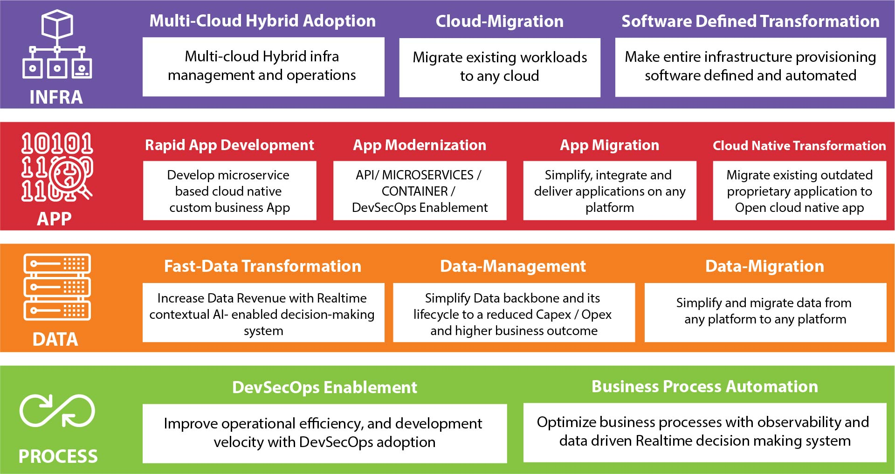
Our TAAS Capabilities

Slide 3

Agenda
Automated Service Mesh Assurance Framework for Mesh Adoption-
      Rationale
      Process / Tooling
      Datafication
      Accelerator
© 2020 SYNECTIKS. All Rights Reserved. Proprietary and Confidential.

Slide 4
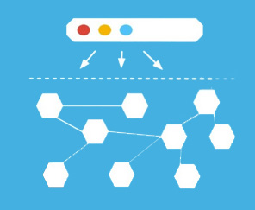






Rationale for Automated Service Mesh Assurance Framework
  Need
  Automated Service Mesh and Workloads Provisioning
  Available golden config based on best practice /patterns
  Standard Validation and Performance Verification Framework
  Multi-mesh operation automation
  Our Answer?
  An automated Mesh assurance framework for Mesh and Workload Provisioning, configuration, validation, verification and operation automation
  50% Reduced enterprise adoption time cycle
  Availability of Specialized resource Pool executing the framework
Service Mesh Offerings
Traffic Control
Content based
traffic steering
Resiliency
Control over chaos
Observability
Security
What gets people
Hooked on
service metrics
Identity & Policy
Adoption Challenges
It’s Multi Mesh World, Messy
Time to do standard compliance and performance validation
Significant time for integration and Operation Automation.
Complex configuration cycle

Slide 5

Our Cloud Assurance QA Framework
Service Mesh Assessment for Product
Discovery & Analysis Report
Design & Planning
Design specification determining deployment architecture, Golden configuration, Tooling & Operation Automation and Verification Strategy
Governance
Service Mesh Adoption
Program Management
Provisioning
Configuration Validation
Compliance & Performance Validation
Operation Tooling
Mesh Readied for test
Test Results & Defect Reports
Integration with
Management Stack
Our Enablers: Automated Provisioning, Config Pattern, Best Practices, Automated Verification, integration Tooling

Slide 6
Process for Automated Service Mesh Assurance Framework
Assessment & Plan
Execute
Test &Verification
Mesh Candidate Selection
Establish selection criterion and
validate key use-cases
Key Use-Cases Validation
Use sample application, well
known services mesh pattern and
filter to validate use cases
Service Design
Collaboratively Design Services
Network and dry run your
deployment in custom editor.
Tooling and Operation Planning
Use different toolset and their
integration with management
plane to support operation
readiness.
Service Mesh Provisioning
Automated Mesh provisioning of
different mesh (Istio ,linkerd,
AWS App Mesh, Consul, Traefik…)
with built-in industry pattern and
known best practices
Apply Custom Configuration
Apply custom config based on
built-in config pattern and web
assembly filter.
Setup Operation Tooling
Automated setup of Prometheus
and Grafana stack with our own
custom Grafana plugin and tooling
for topology and performance
benchmarking.
Validate Configuration
Validate Mesh configuration
against industry best practices
Standard Compliance
Run SMI conformance and Service
Mesh Interoperability Tests
Performance Verification
Run prebuilt performance tests for
Service Mesh and its Workloads
Operation Tooling Verification
Verify the management stack and
tooling (Mesh Manager, topology,
benchmarking, tracing)
integrations.

Slide 7
Our focus area –Service Mesh Adoption
Automation
Golden Configuration
Automatically Provision Multiple Service Mesh
Automatically deploy services from service catalogue
Automatic Side Car injection
Automated discovery and integration with management plane
Built In configuration Templates
Baselined and versioned infrastructure
Sample Application Catalogue for accelerated learning.
1
2
FOCUS AREAS
OF
SERVICE MESH
Tests & Verification
3
Integration
4
Integration with existing Operation Management Stack
Integration with CI/CD system
Extensible Management backplane (As standalone app or as Grafana plugin)
Consolidation of services running in different Service Mesh
Cost and SLA consolidation
Optimize services data revenue from service Mesh
Configuration Validation Tests
Standard Conformance Tests
Performance Tests

Slide 8

Datafication
Assessment & Plan
Execute
Test &Verification
Candidate
Selection
Use-Case
Validation
Service Mesh
Provisioning
Custom Configuration
Validate Configuration
Standard Compliance
Service Design
Tooling and Operation Planning
Operation Tooling
Performance Verification
Operation Tooling Verification
KPI’s
KPI’s
KPI’s
Mean Time to Prepare Service Mesh Design Specification Per Project
Mean Time for Deployment / Configuration / Management Plane Integration
Services Reliability Index
Mean Time to Prepare Service Mesh Design Specification Per Project
Accelerator
Accelerator
Accelerator
Application Catalogues / Patterns / WASM filters / Dry Run Simulation
Provisioning Automation / Golden Configs / Management Stack Extensions
Existing Verification And Validation Framework
Expected Result
Expected Result
Expected Result
30% Less Time for Design Specifications
50% Reduced time for Execution
20% increase in Service Reliability
50% Reduced time

Slide 9






Differentiator
Time & Money
Experience
Expertise
Our open Product Driven Delivery
Model allows customers to
quickly build, deliver and
orchestrate cross cloud mesh
services @50% time & cost
10+ Large Scale
Migration And Modernization
experience
Experience Team with a proven
track record of CloudOps delivery
enabled with DevSecOps
Capabilities
Long Term Retention
Simple Management Plane
Compliance & Verification
100% Customer Retention Rate
substantiated by excellent
services
Appkube platform manage all
your Service Mesh instances distributed across multiple clouds and boundaries within a single window or as Grafana App
Our compliance and
performance assessment tools
make sure your service mesh
journey meets your
business SLO

Slide 10
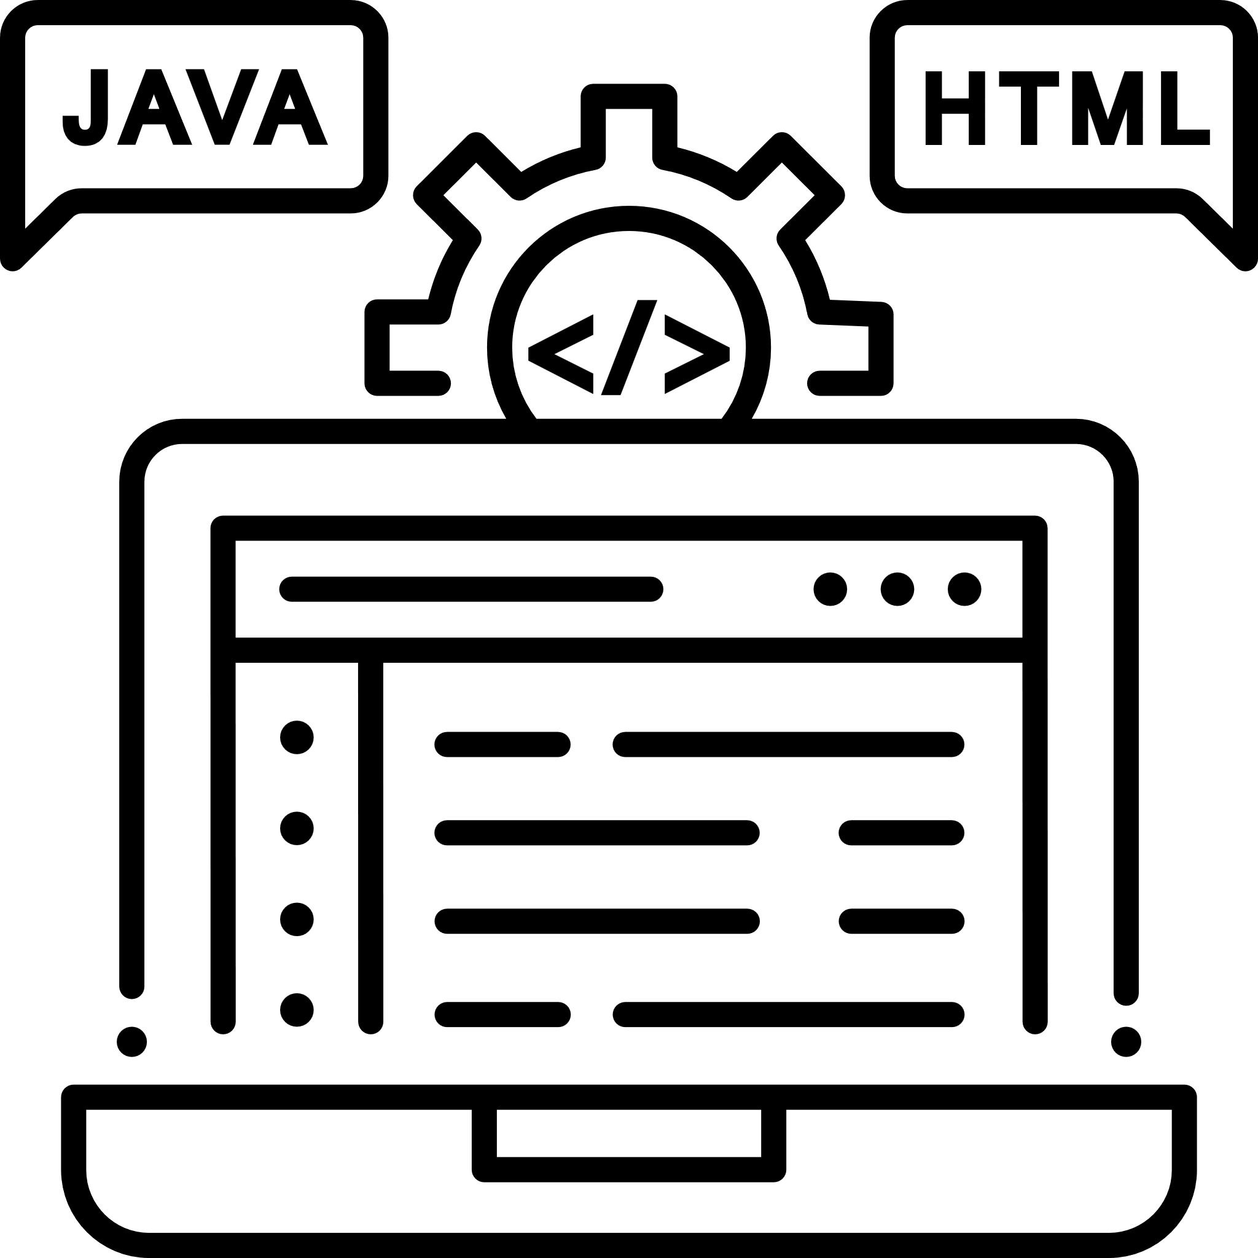





Differentiator
E2E Solution
Public Cloud Partnership
Open-Source Contribution
Single point of contact for
Assessment, Planning, Design,
Execution and Integration
of cloud-native mesh.
Our advanced partnership
with major public cloud
providers help you to get
support at every stage
Committed to codifying
our know-how, we write open
Products and Distribute
Flexibility
Engagement Model
Automation
Our tools and utilities are
Complete open, highly
extensible. They can modernize
your IT inventory without
rewriting your application.
Our every engagement
focused on empowerment
– not dependency
Use our existing automation
capabilities to automate
infrastructure, operations,
security in hybrid IT environment

