Slide 1

Delivering TAAS
Open Products Accelerating
Enterprise Transformation
Keep it simple…
© 2020 SYNECTIKS. All Rights Reserved. Proprietary and Confidential.

Slide 2

Agenda
Rationale / Data-Fication
TAAS Product
Value
© 2020 SYNECTIKS. All Rights Reserved. Proprietary and Confidential.

Slide 3
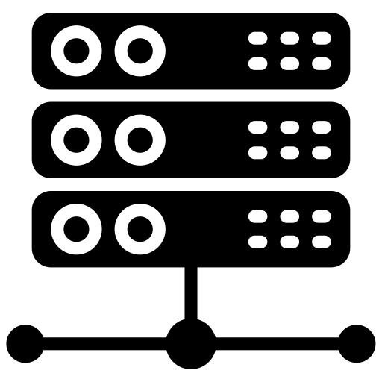

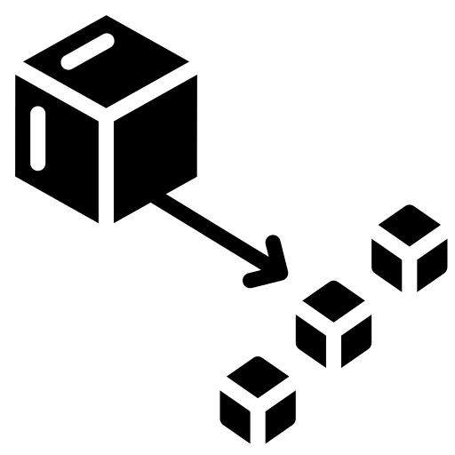
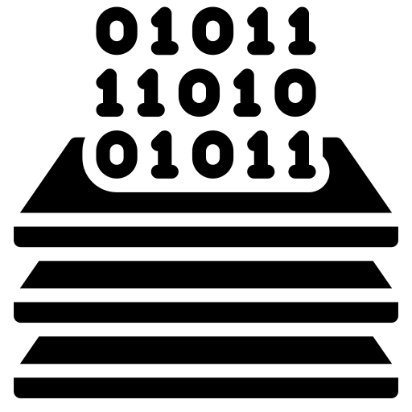

Rationale for Transformation
Discrete & Hardware-Defined
Less than 10% , Hardware Utilization Large provisioning window, Large Opex, Reduced Reliability SLA’s
Aggregated & Software-Defined
More than 80%, Hardware Utilization Up 80% reliability, Up 90% Provision/ Deprovision Time 60% Reduced OpEx
Infra
Monolith
Low Scalability Less Reliability Long Release Cycle
Microservice
Up 60% Business Agility 100% Uptime resilient system Horizontal Scalability across cloud / geographies
App
Big-Data
Data Originates Fast , Why to defer value? Large Opex in ELT, ETL
Fast-Data
Realtime Contextual 50% faster decision making Up 15% Data Revenue NO ETL, ELT, Reduced Capex, More simplicity
Data
Agile
Culture driven by more roles & lengthy feedback cycle
DevOps
Culture with more autonomy and responsibility
Process

Slide 4
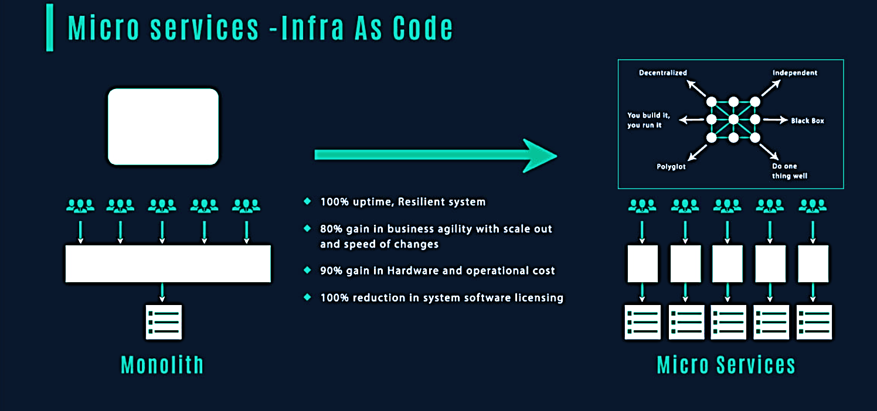
App Transformation
© 2020 SYNECTIKS. All Rights Reserved. Proprietary and Confidential.

Slide 5
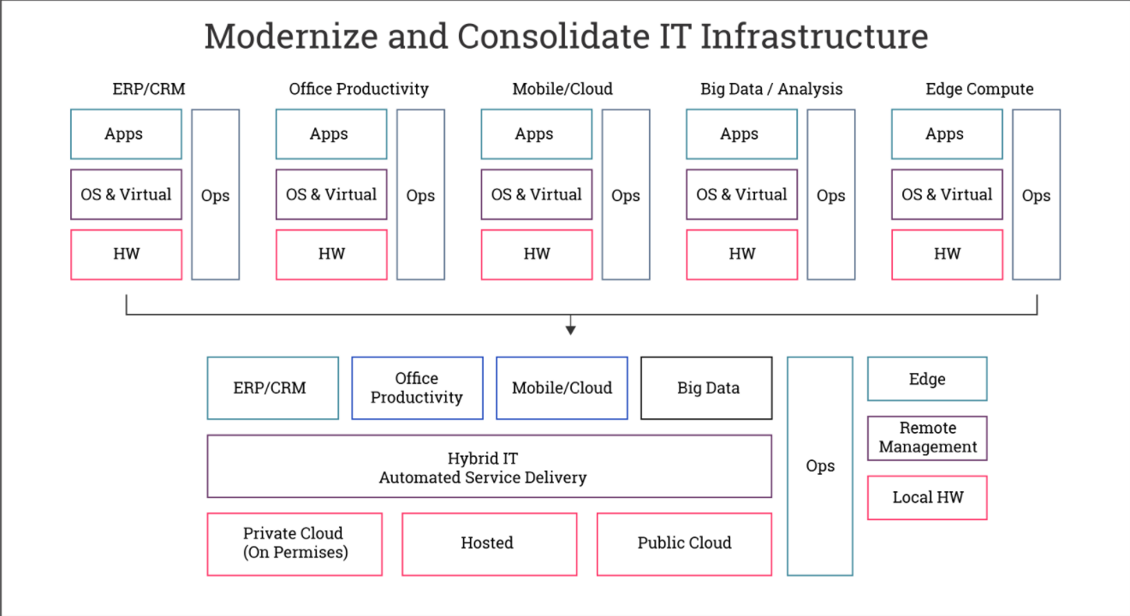
Infra Transformation
© 2020 SYNECTIKS. All Rights Reserved. Proprietary and Confidential.

Slide 6
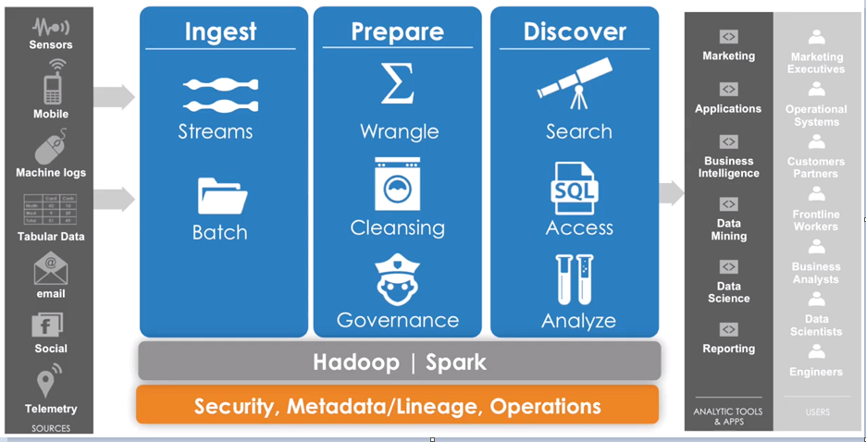
Data Transformation
Streaming
Analytics
+
Transactions
Batch/Iterative
Analytics
- Statistical Correlations
- Multi-Dimensional Analysis
- Predictive Analysis
© 2020 SYNECTIKS. All Rights Reserved. Proprietary and Confidential.

Slide 7
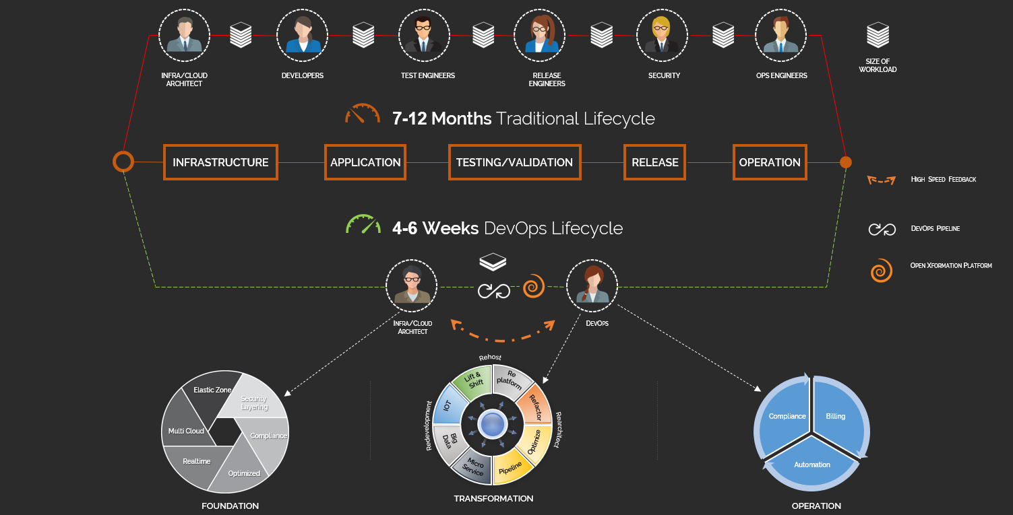
DevOps Transformation
© 2020 SYNECTIKS. All Rights Reserved. Proprietary and Confidential.

Slide 8
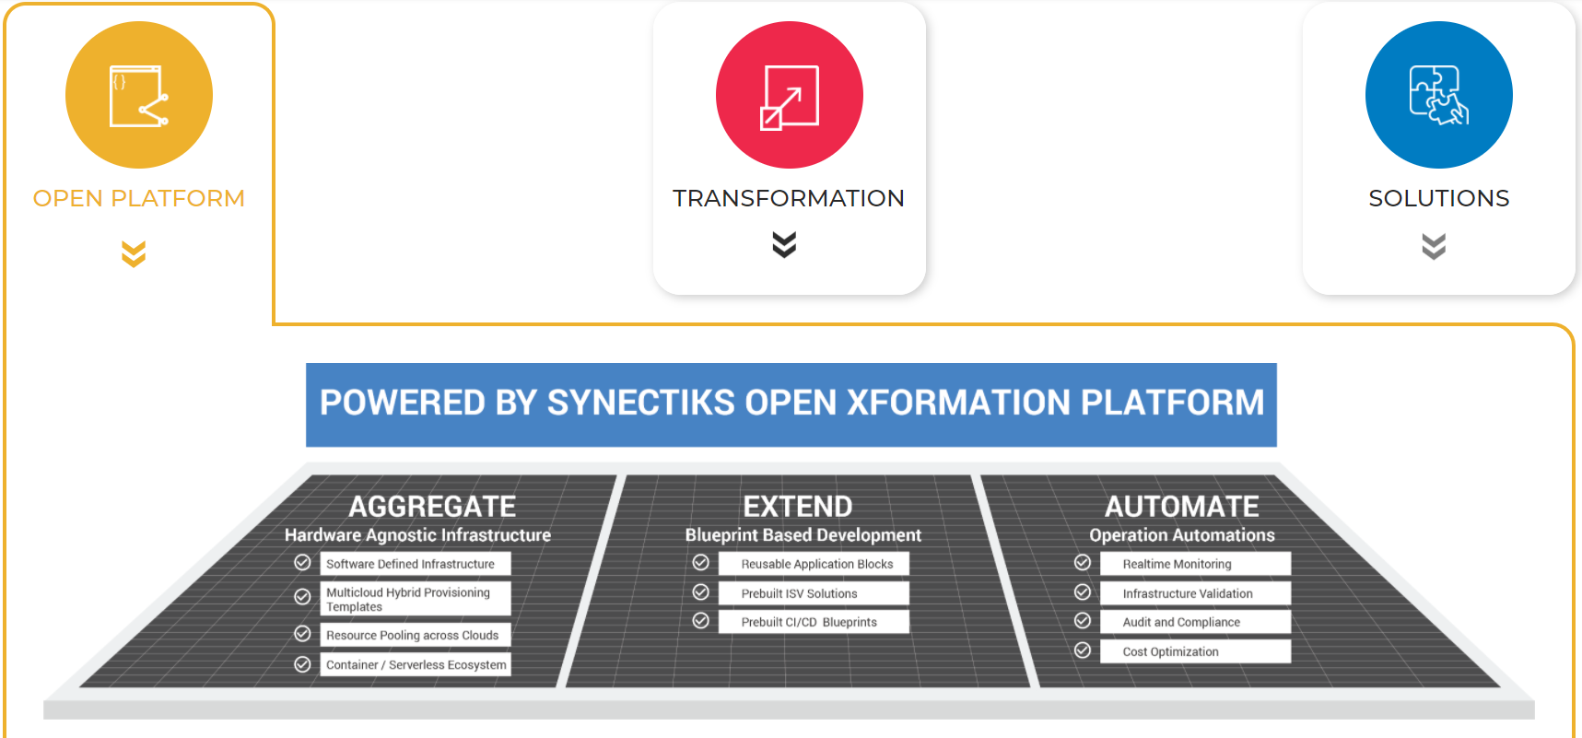
Open Product helping Xformation
© 2020 SYNECTIKS. All Rights Reserved. Proprietary and Confidential.

Slide 9
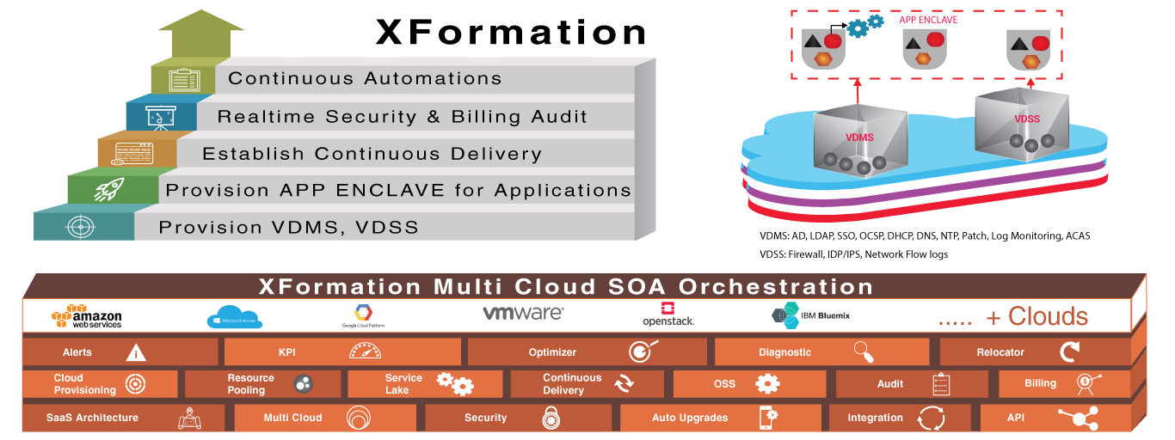
Xformation @50% Time & Cost
© 2020 SYNECTIKS. All Rights Reserved. Proprietary and Confidential.

Slide 10
Salient Features
Solid Foundation
Software Defined
01
Infrastructure /Cloud provisioning through standard compliant templates, liquid elastic layer.
Service Definitions
App/Service Lake
AppCentric Optimization
Rapidly develop microservices based app from existing base services templates.
06
02
Accelerated
Transformation
App-Centric View
Realtime Monitoring
Streamlined Delivery
Optimize Infrastructure and Operation based on production usage of application.
Proactive Control
05
03
Monitor billing, security, configuration in real time and combat any threats before it happen.
Operation Automation
04
Continuous Delivery
Available standard compliant delivery templates catering best practices and highest level of quality checks.
Continuous Automation Engine
Run jobs elastically and continuously audit on Infra and App security /compliance
© 2018 SYNECTIKS. All Rights Reserved. Proprietary and Confidential.
© 2020 SYNECTIKS. All Rights Reserved. Proprietary and Confidential.

Slide 11
Xformation Values
Fast Release
Scale Out
Publish changes rapidly through components with automation tests
Scale Out services across clouds in reliable and secure ecosystem
03
04
Catalogue Based Approach
Extend Built In Artifacts quickly with defined skillsets
Proactive & Resilient
02
Realtime audit, monitoring, configuration control
05
Any Cloud
Rapidly create deploy secure SOA apps across clouds
01
DevSecOps
06
DevSecOps with Ease
XFORMATION
© 2020 SYNECTIKS. All Rights Reserved. Proprietary and Confidential.

Slide 12
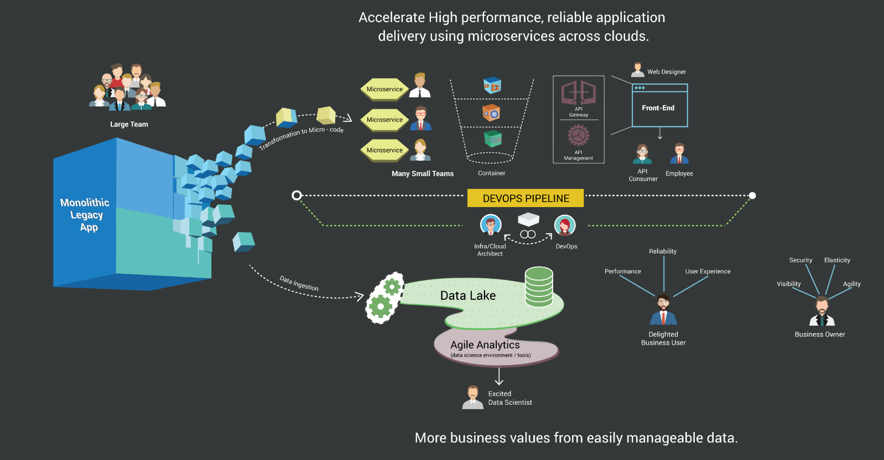
Use Case- Monolith -> Micro
App- Xformation
  Need
  Minimal Code Change Approach
  Accelerate associated changes in Infra/Process Layer
  Simple Upskilling
  Xformation?
  App blocks reduce 50% coding Effort
  Prebuilt Blueprints for associated Infra / Process
  Standardized Assets for E2E delivery (refactor, DevOps Workflow, Automation)
  Availability of Specialized resource Pool contributing in Open Product driven transformation.

Slide 13
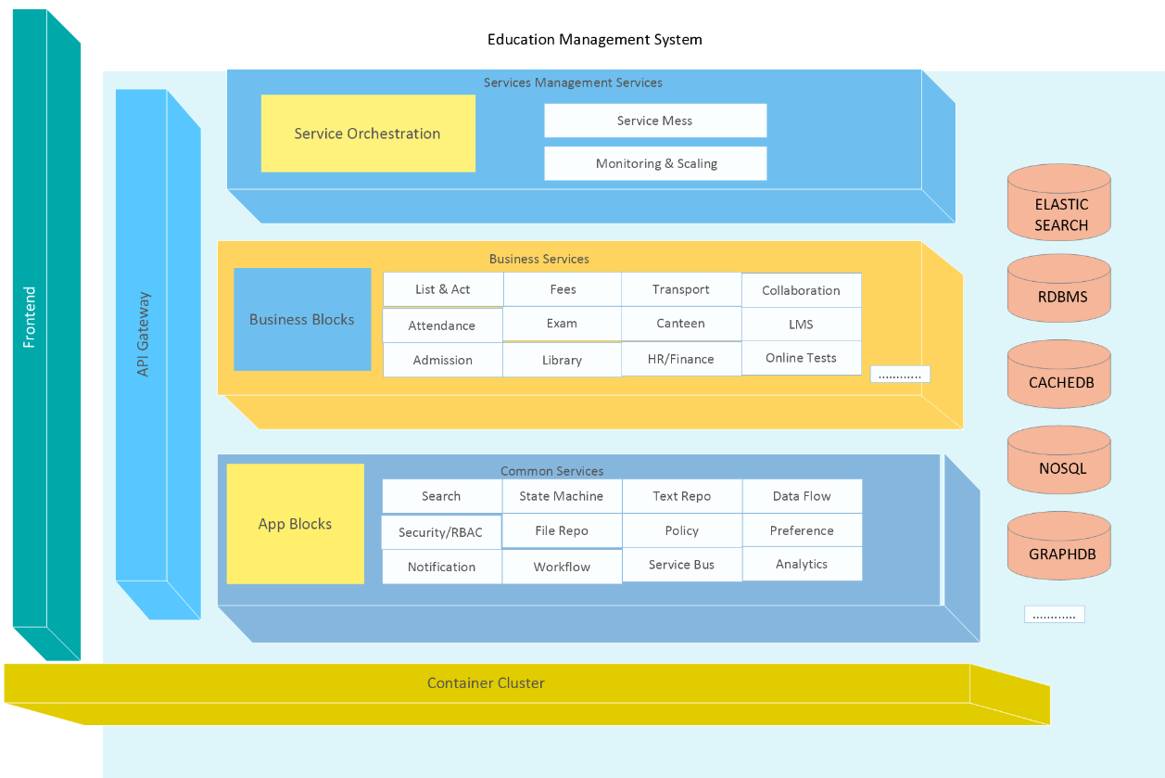
Example App with Blocks
App Blocks Explained
  Need
  All Apps have common services, why not build and maintain those fundamental blocks in Rock Solid way and develop different business Apps based on those services' API.
  Develop strong Business specific blocks in unified way.
  Increase developer productivity by having a unified dev process that is predictive & deterministic.
  Answer
  Reusable cloud agnostic App Blocks reducing refactoring effort @50%.
  A complete microservice driven standard example App to empower customer engineering team build microservices delivery practices rapidly.

Slide 14
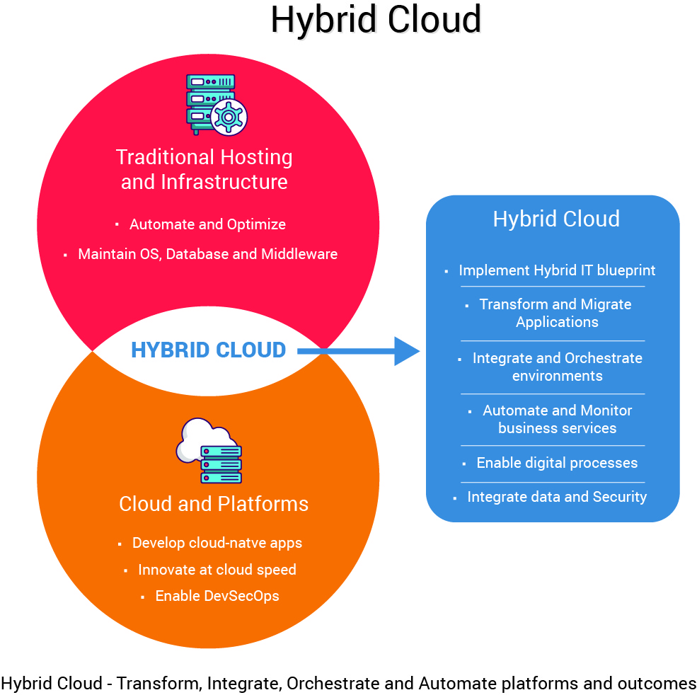
Use Case- Hybrid It
Infra- Xformation
  Need
  Right Technology / People / Process to implement Hybrid IT strategy that scale across clouds and offers maximum security ,innovation speed at optimal economies .
  Xformation?
  Prebuilt multi-cloud hybrid provisioning templates helps customers to quickly build, deliver and orchestrate cross cloud services @50% time & cost.
  Existing automation capabilities to automate infrastructure , operations, security in hybrid IT environment
© 2020 SYNECTIKS. All Rights Reserved. Proprietary and Confidential.

Slide 15
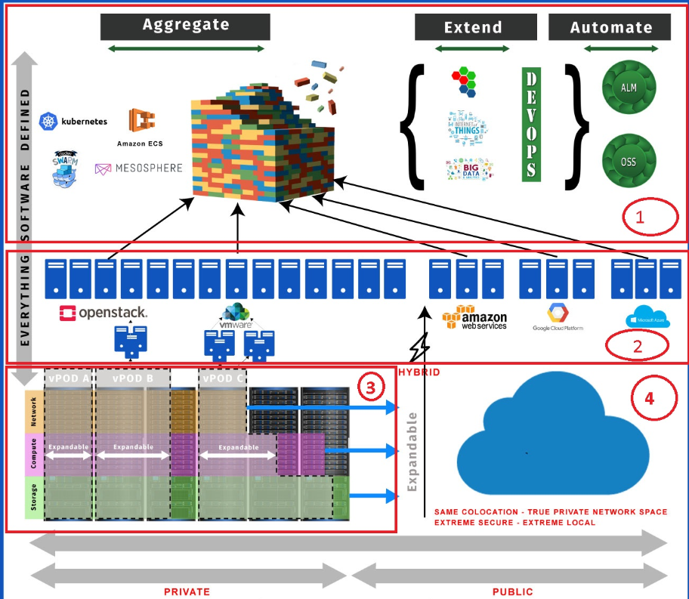
Use Case- Software Defined
Infra- Xformation
  Need
Aggregate computing, storage, network @software layer from any public/private cloud, develop apps rapidly and establish operation automation to run in autopilot mode.
  Xformation?
  Tools to provision container clusters across clouds and aggregate hardware pool.
  Tools to manage multiple products and associated service through single control plane.
  Standardized continuous delivery, continuous compliance, continuous automation artifacts.

Slide 16


Use Case- Fast Data
Data- Xformation
BI-REPORTING
  Need
Cloud native Fast-Data platform that serves as single source of truth for real -time , olap , relational data catering any data source (unstructured , semi- structured un-structured
Xformation?
  Tools to provision Fast Data backbone in container cluster.
  Open framework to
  1) Automate Data Management & Query optimization
  2)Integrated Policy based alert & remediation
FAST DATA
DATA LAKE
FAST SERVICE ANALYTICS
TREND ANALYTICS
Predictive Analysis
REAL-TIME
ANALYTICS
Multi-Dimensional Analysis
INGEST/
INTERACTIVE
DECISIONING
EXPORT
BIG STORAGE
S3, HADOOP….
Statistical Correlations

