Slide 1

Open Platform Accelerating
Enterprise Transformation
Keep it simple…
© 2020 SYNECTIKS. All Rights Reserved. Proprietary and Confidential.

Slide 2
What you focus at!
Capabilities:
Manage Microservices at scale - Build, Deploy, Operate,.. using reusable building blocks, blueprint IaC
SRE - CloudOps Dashboard, Proactive monitoring, Alerts, SLO/SLIs..
- DevSecOps - How security first approach helps accelerating cloud modernization at scale. Especially in the areas of security controls, IAM roles, fine grained entitlements, regulatory controls
Any customer success stories and any solutions you can demo.
Sec – Infra /App /Data
© 2020 SYNECTIKS. All Rights Reserved. Proprietary and Confidential.

Slide 3
Answering Following Query!
Select a Simple solution To Manage:
N – Products spread across M Clouds
Each Cloud Has P - no of Landing Zones
Each Landing Zones Q no of Product Enclaves
Each Landing hosts R no total services (App+ Data+ NW)
  Some are hosted in S no of k8.. Cluster
  (R-S) are hosted from Cloud Managed
  R services partitioned across T environments
  Implement U Business Services with (App/Data/NW)
M x N x P x Q x R x S x T x U complexity across following dimension:
Dev – Volume/Velocity /Reliability
+
Sec – Infra /App /Data
Ops - Volume/Velocity /Reliability
Where Solution provide :
Simple Catalogue of Dev/Sec/Ops templates and Utilities to :
Provision Landing Zone/Product Enclaves/Cluster/ Services ( In Cluster + Cloud-Managed)
Establish Operation Management System (Cost & Quality)
Accelerated building block to do rapid SOA transformation
© 2020 SYNECTIKS. All Rights Reserved. Proprietary and Confidential.

Slide 4
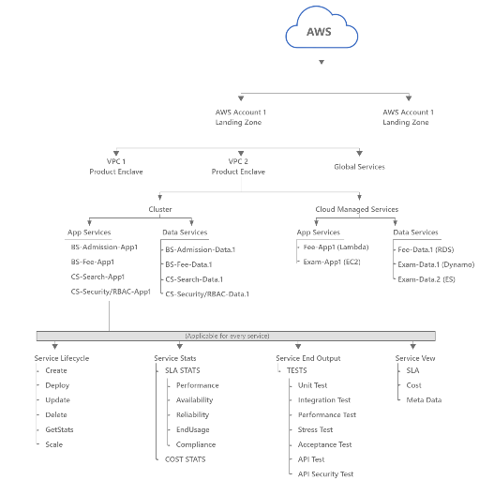

Slide 5
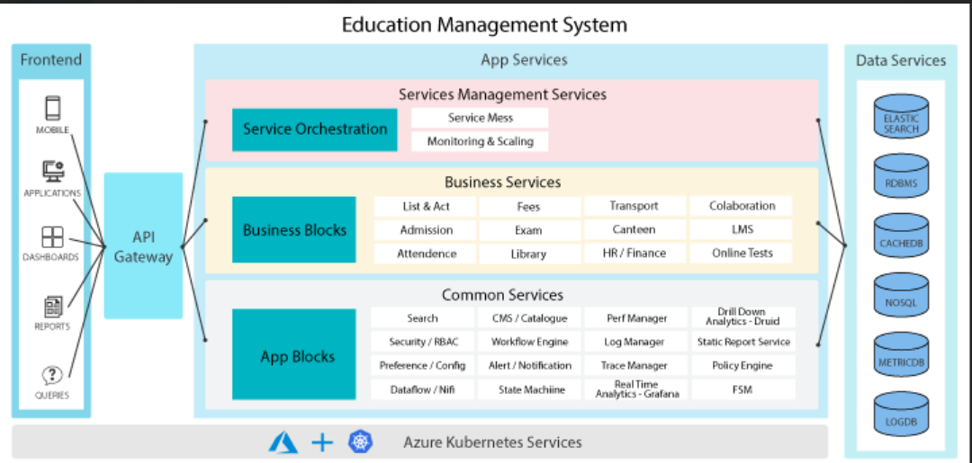
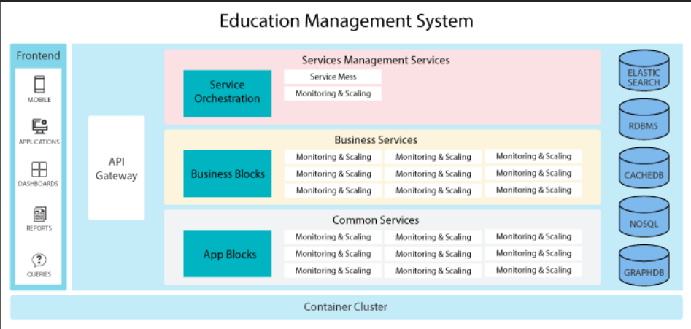

Slide 6
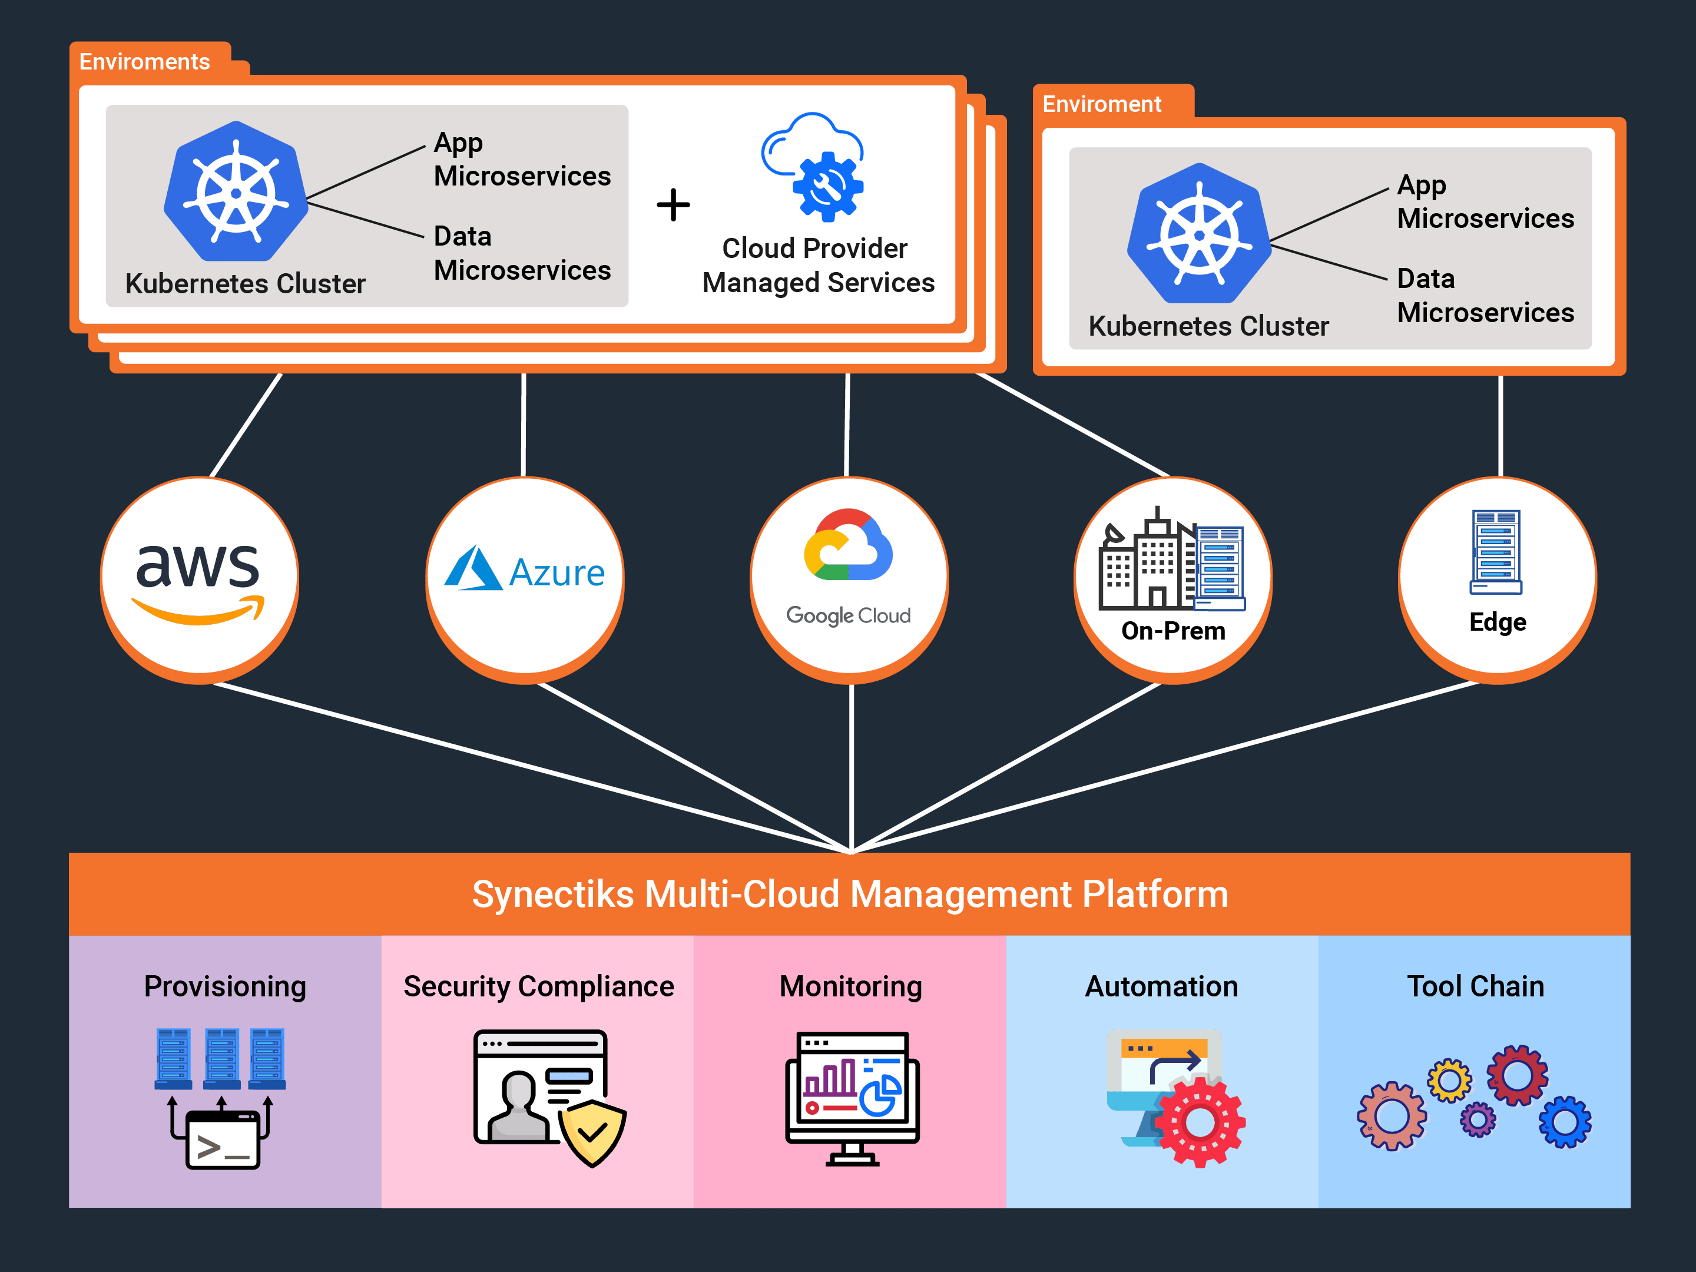

Slide 7
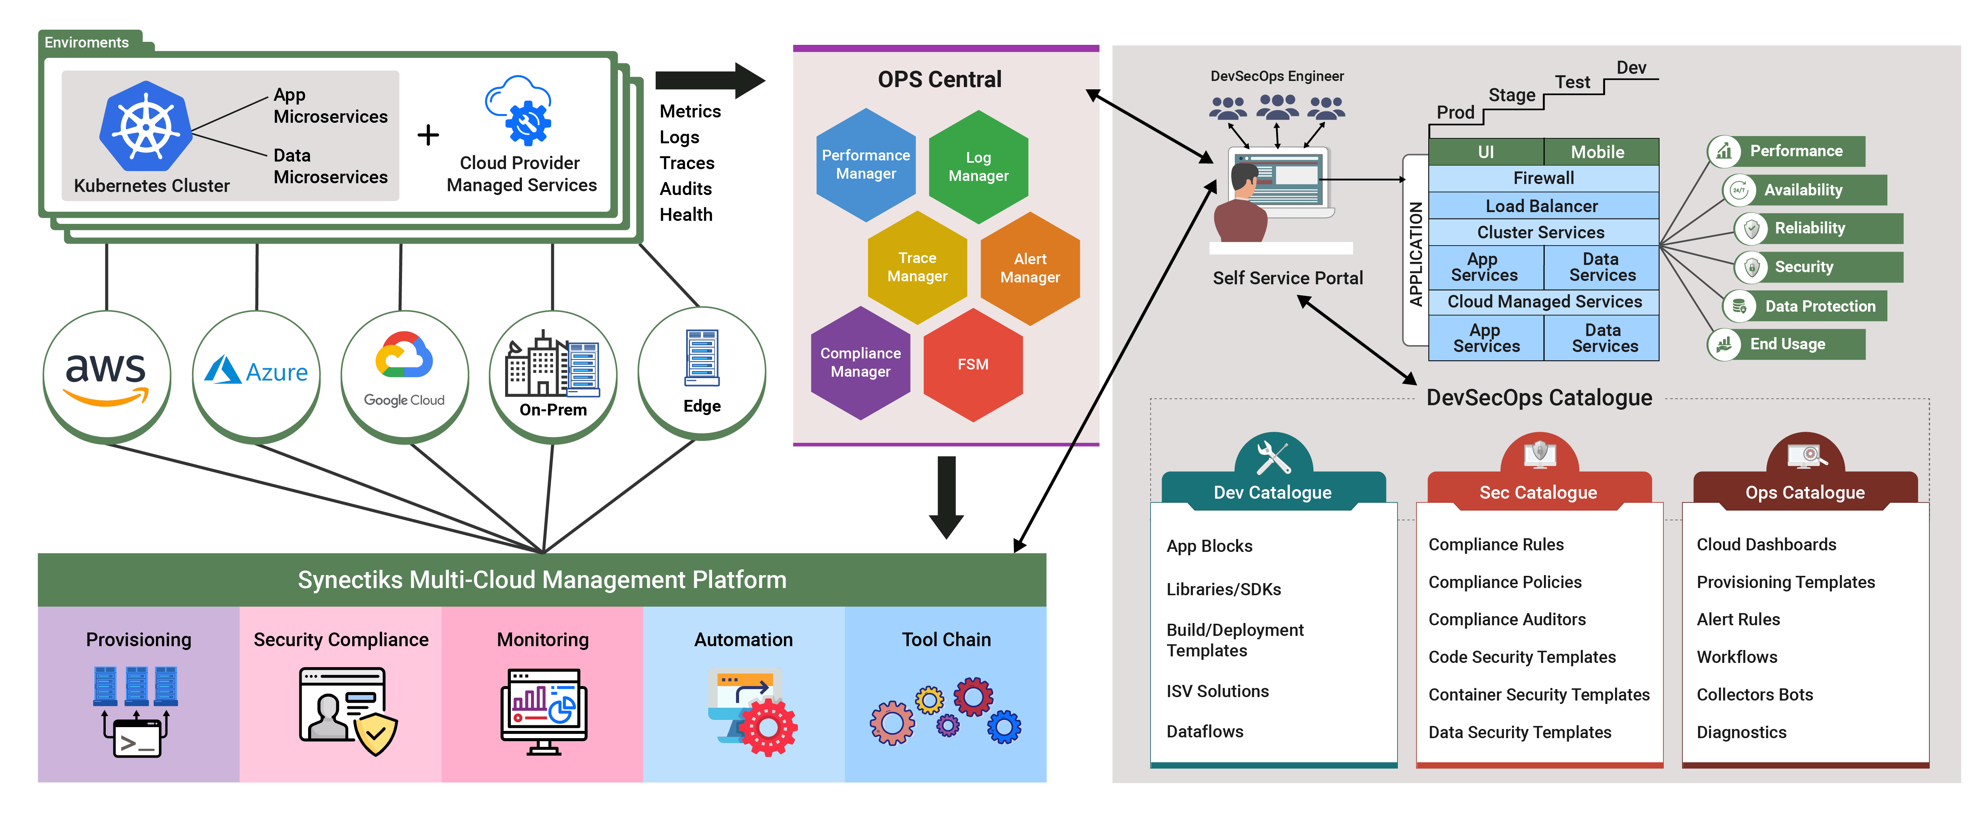

Slide 8
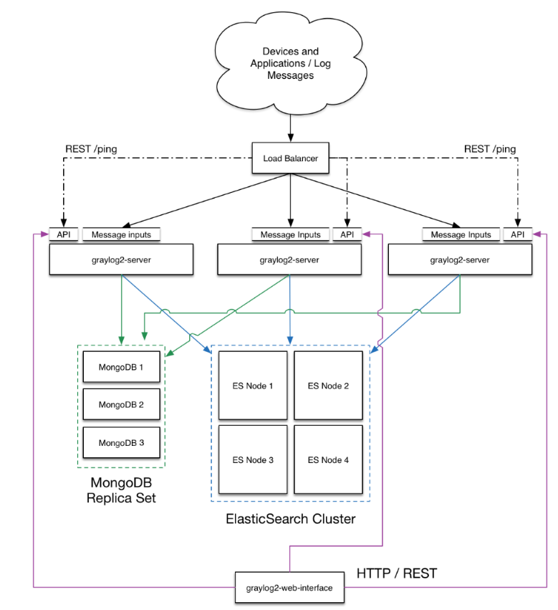
C-Log/Perf Manager
© 2020 SYNECTIKS. All Rights Reserved. Proprietary and Confidential.

Slide 9
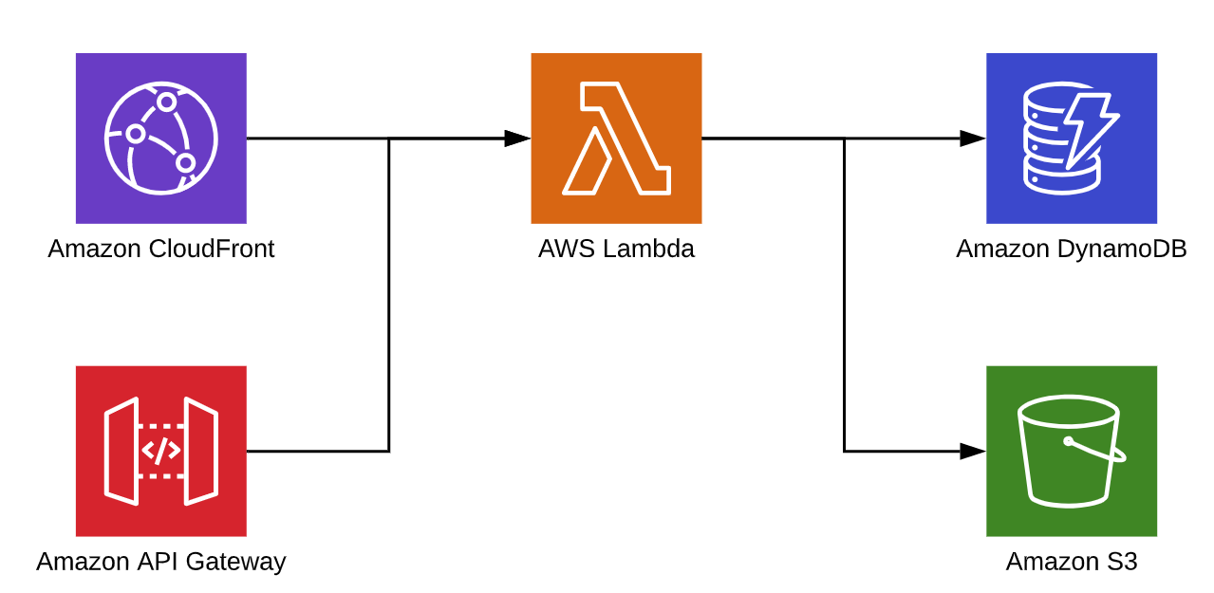
C-File repo
© 2020 SYNECTIKS. All Rights Reserved. Proprietary and Confidential.

Slide 10
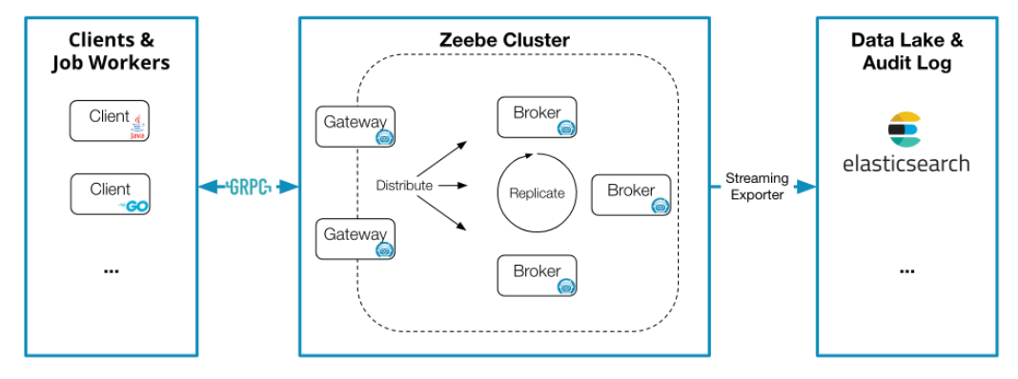
C-Workflows
© 2020 SYNECTIKS. All Rights Reserved. Proprietary and Confidential.

Slide 11
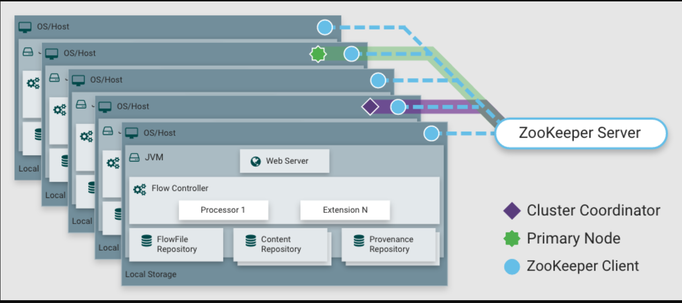
C-Dataflows
© 2020 SYNECTIKS. All Rights Reserved. Proprietary and Confidential.

Slide 12
Few Strength
Simplicity -- Landing Zone / Product Enclave / App Cluster / Services (App /Data / Network) - we take care of learning effort
Framework --A very flexible / extensible framework for Analytics + Simple Automation framework based on gitops (GitHub + A sync jobs) + Catalogue based approach + K8 at best
Solution / Framework - Neither a licensed product / Nor pure human supply
Infinite Flexibility- source / docs / trainings / empowerment / learning
We always prefer to do stuff with available cloud native stuff - but we also know how to do anything inside k8 cluster
We are Trick driven - Outcome based financial model - zero loss
Nodejs + Go Stack /java
Framework is more cloud native - applied many other open framework to its best to achieve business outcome.
Business Model is plugin-based solutions. DevSecOps Tooling approach
© 2020 SYNECTIKS. All Rights Reserved. Proprietary and Confidential.

Slide 13
Few Weakness
We are yet to get a complete - released product - still operating on SOW based solutioning model
We need to improve a lot of stuffs - documentation / processes
We often say you directly on ROI - we don't waste your time, neither our time
Dev Mindset - we need courageous management support
Document & POC driven - Follow a strict discovery process
We are having less people - we are very choosy - only recruit dedicated / passionate guys
Retention 100% - acquisition very less
Follow no shortcuts
We are not human supplier
© 2020 SYNECTIKS. All Rights Reserved. Proprietary and Confidential.

