Slide 1

Open Platform Accelerating
Enterprise Transformation
Keep it simple…
© 2020 SYNECTIKS. All Rights Reserved. Proprietary and Confidential.

Slide 2


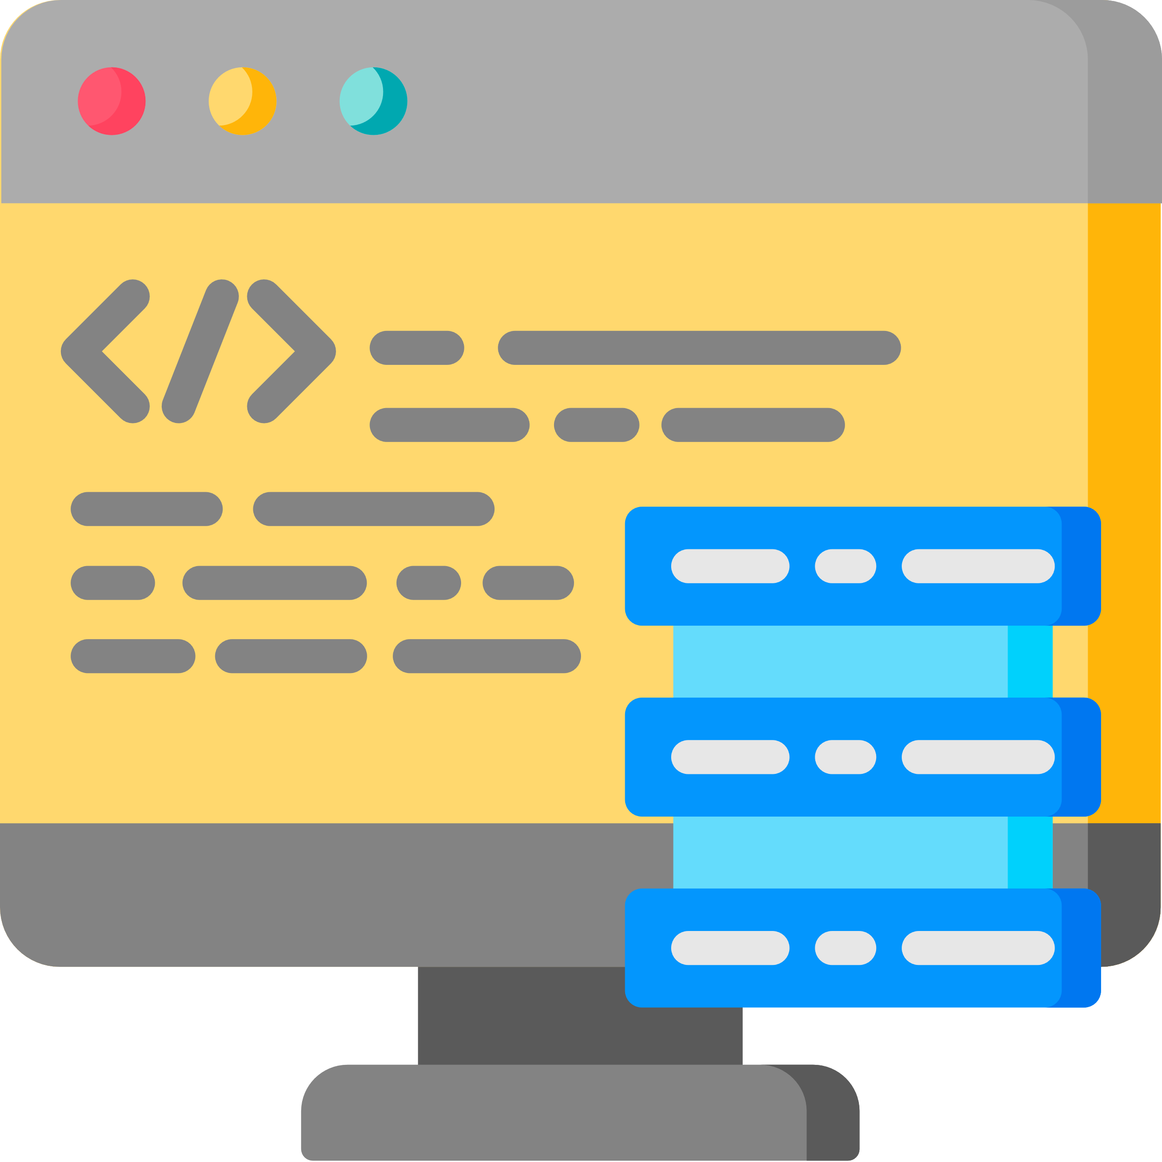



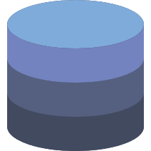
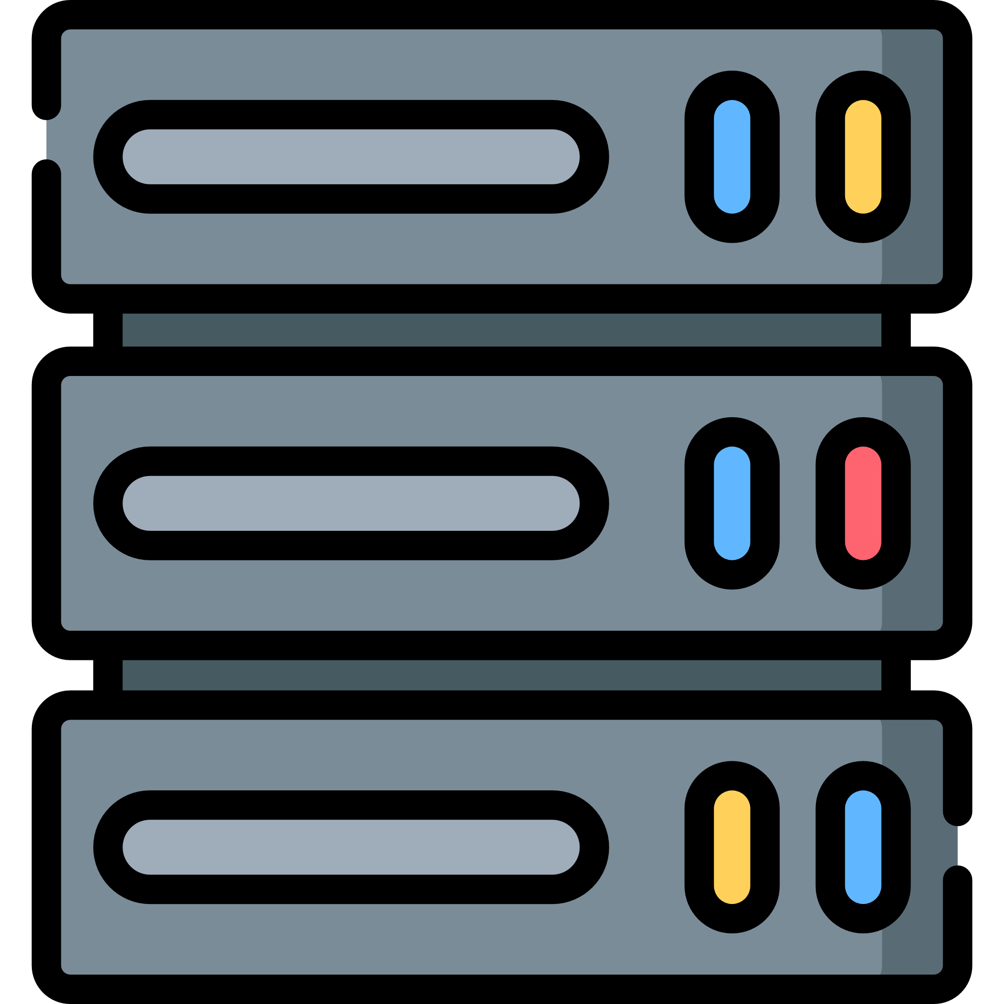

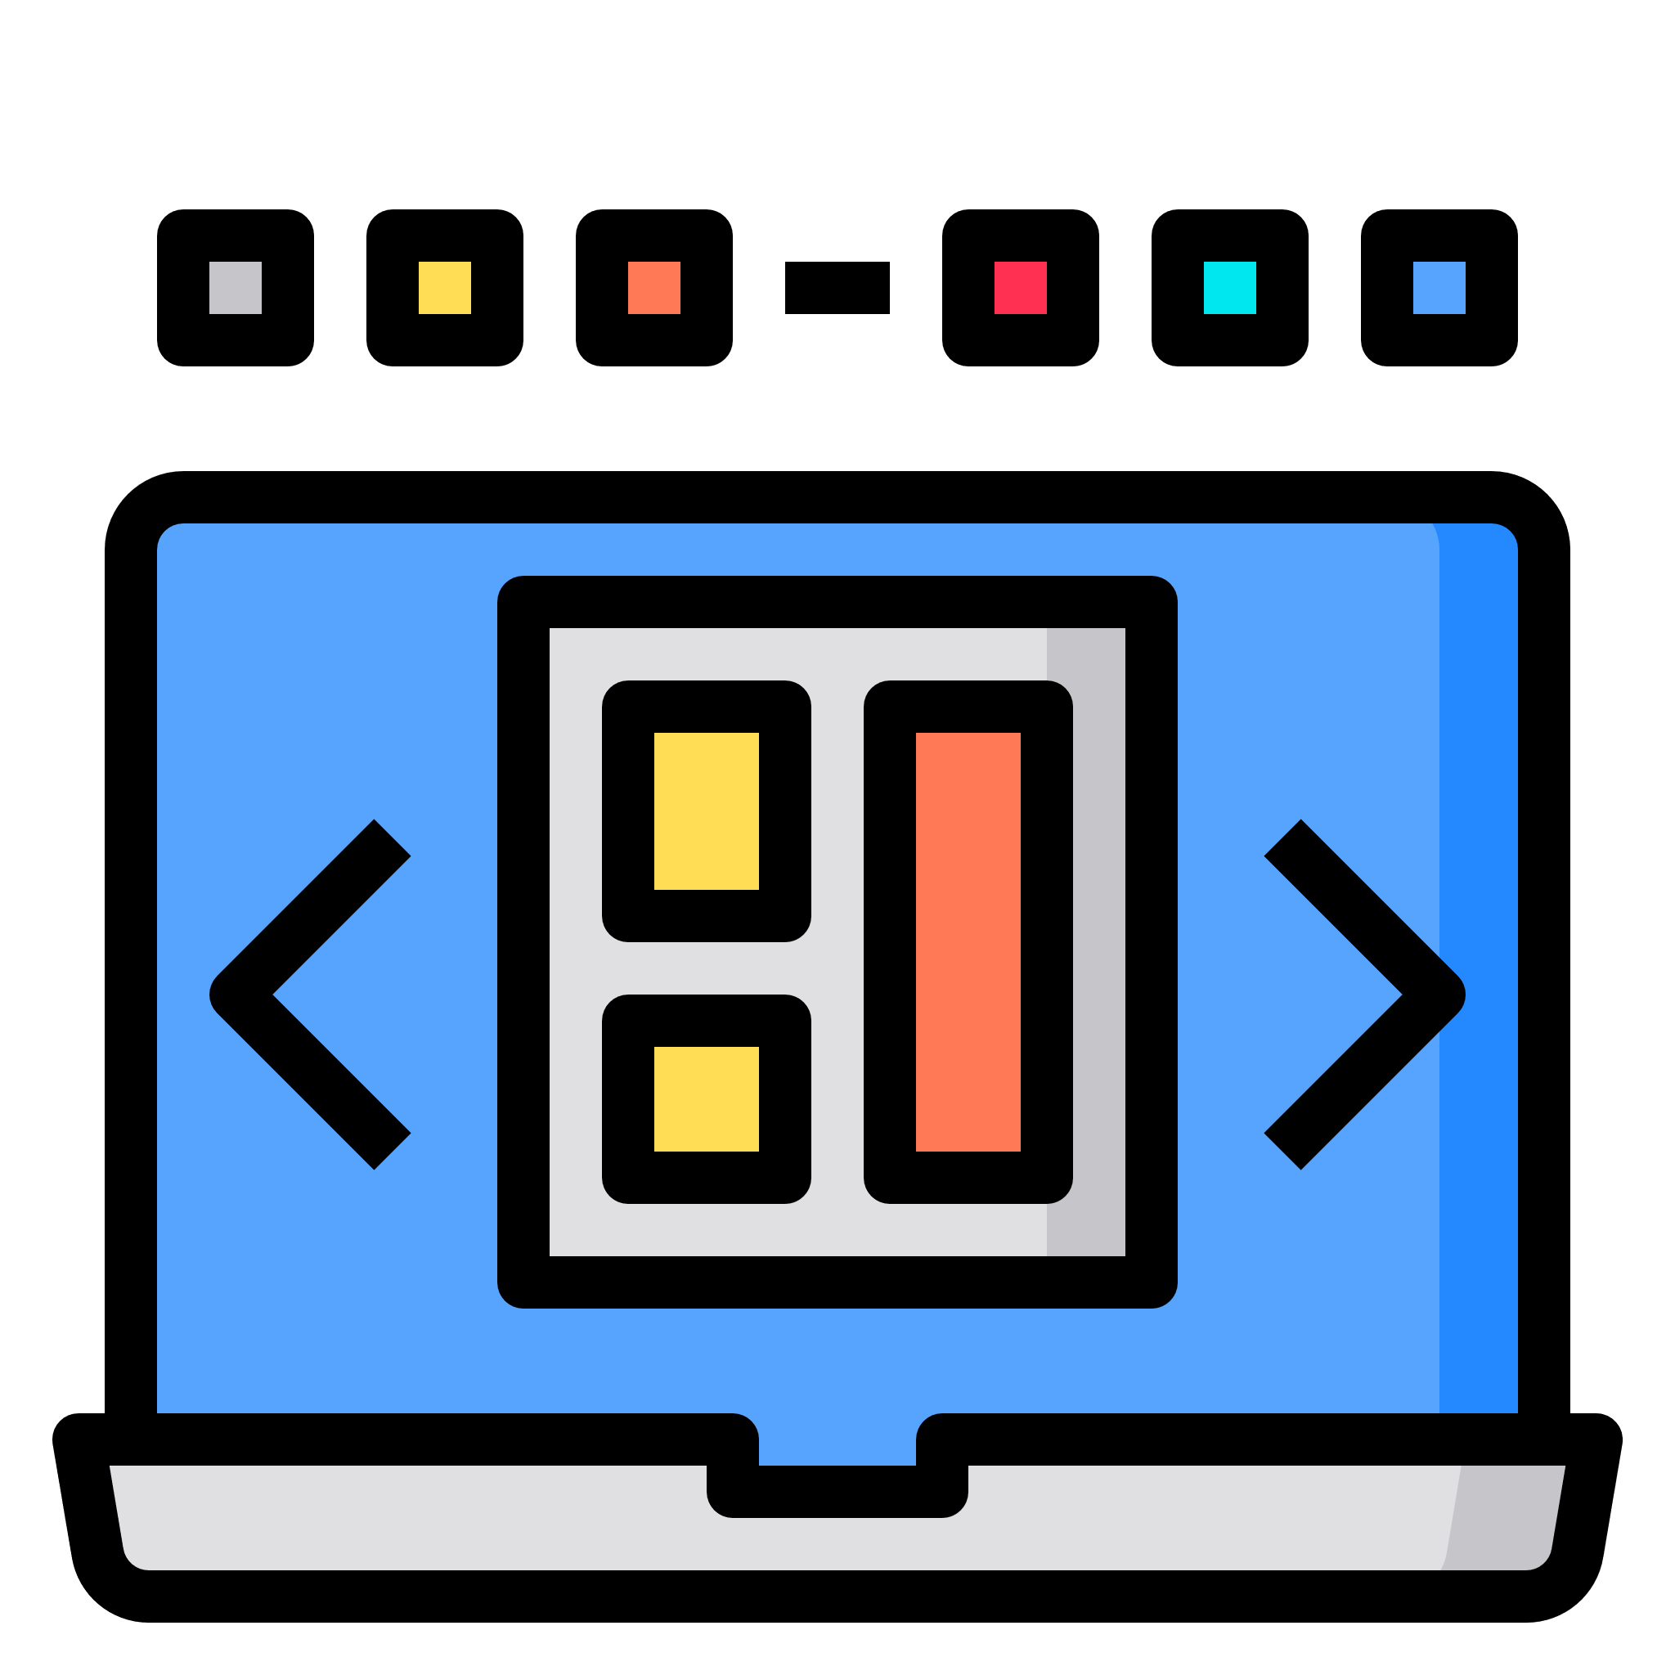
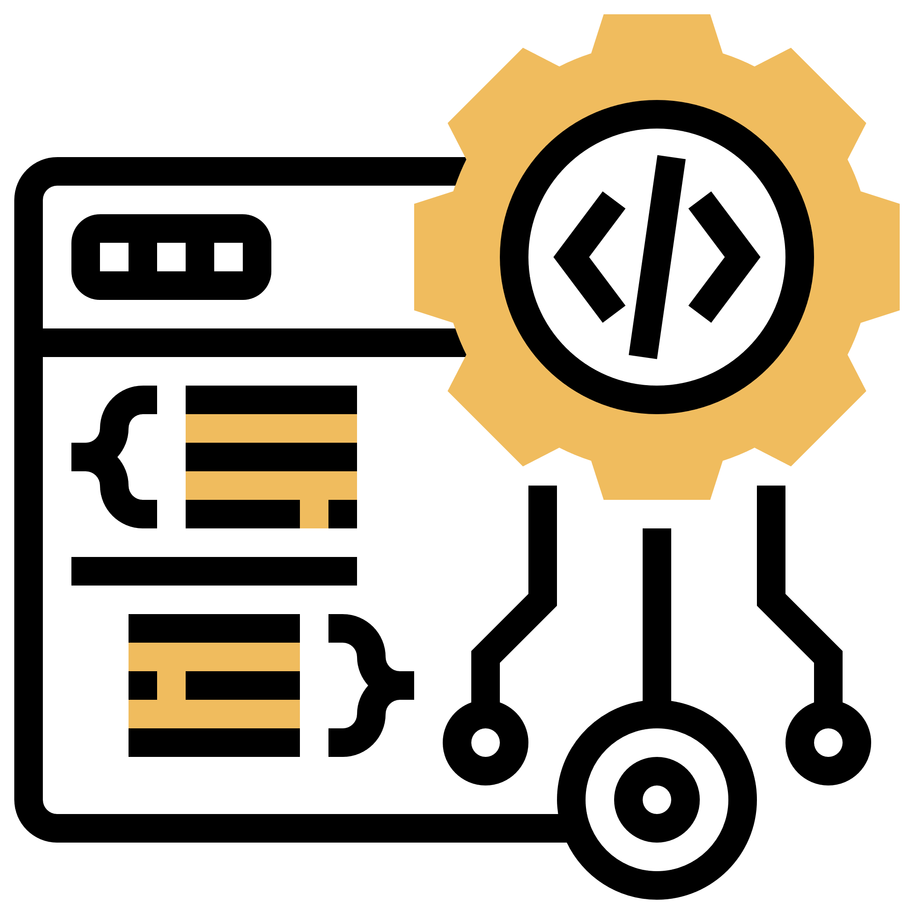

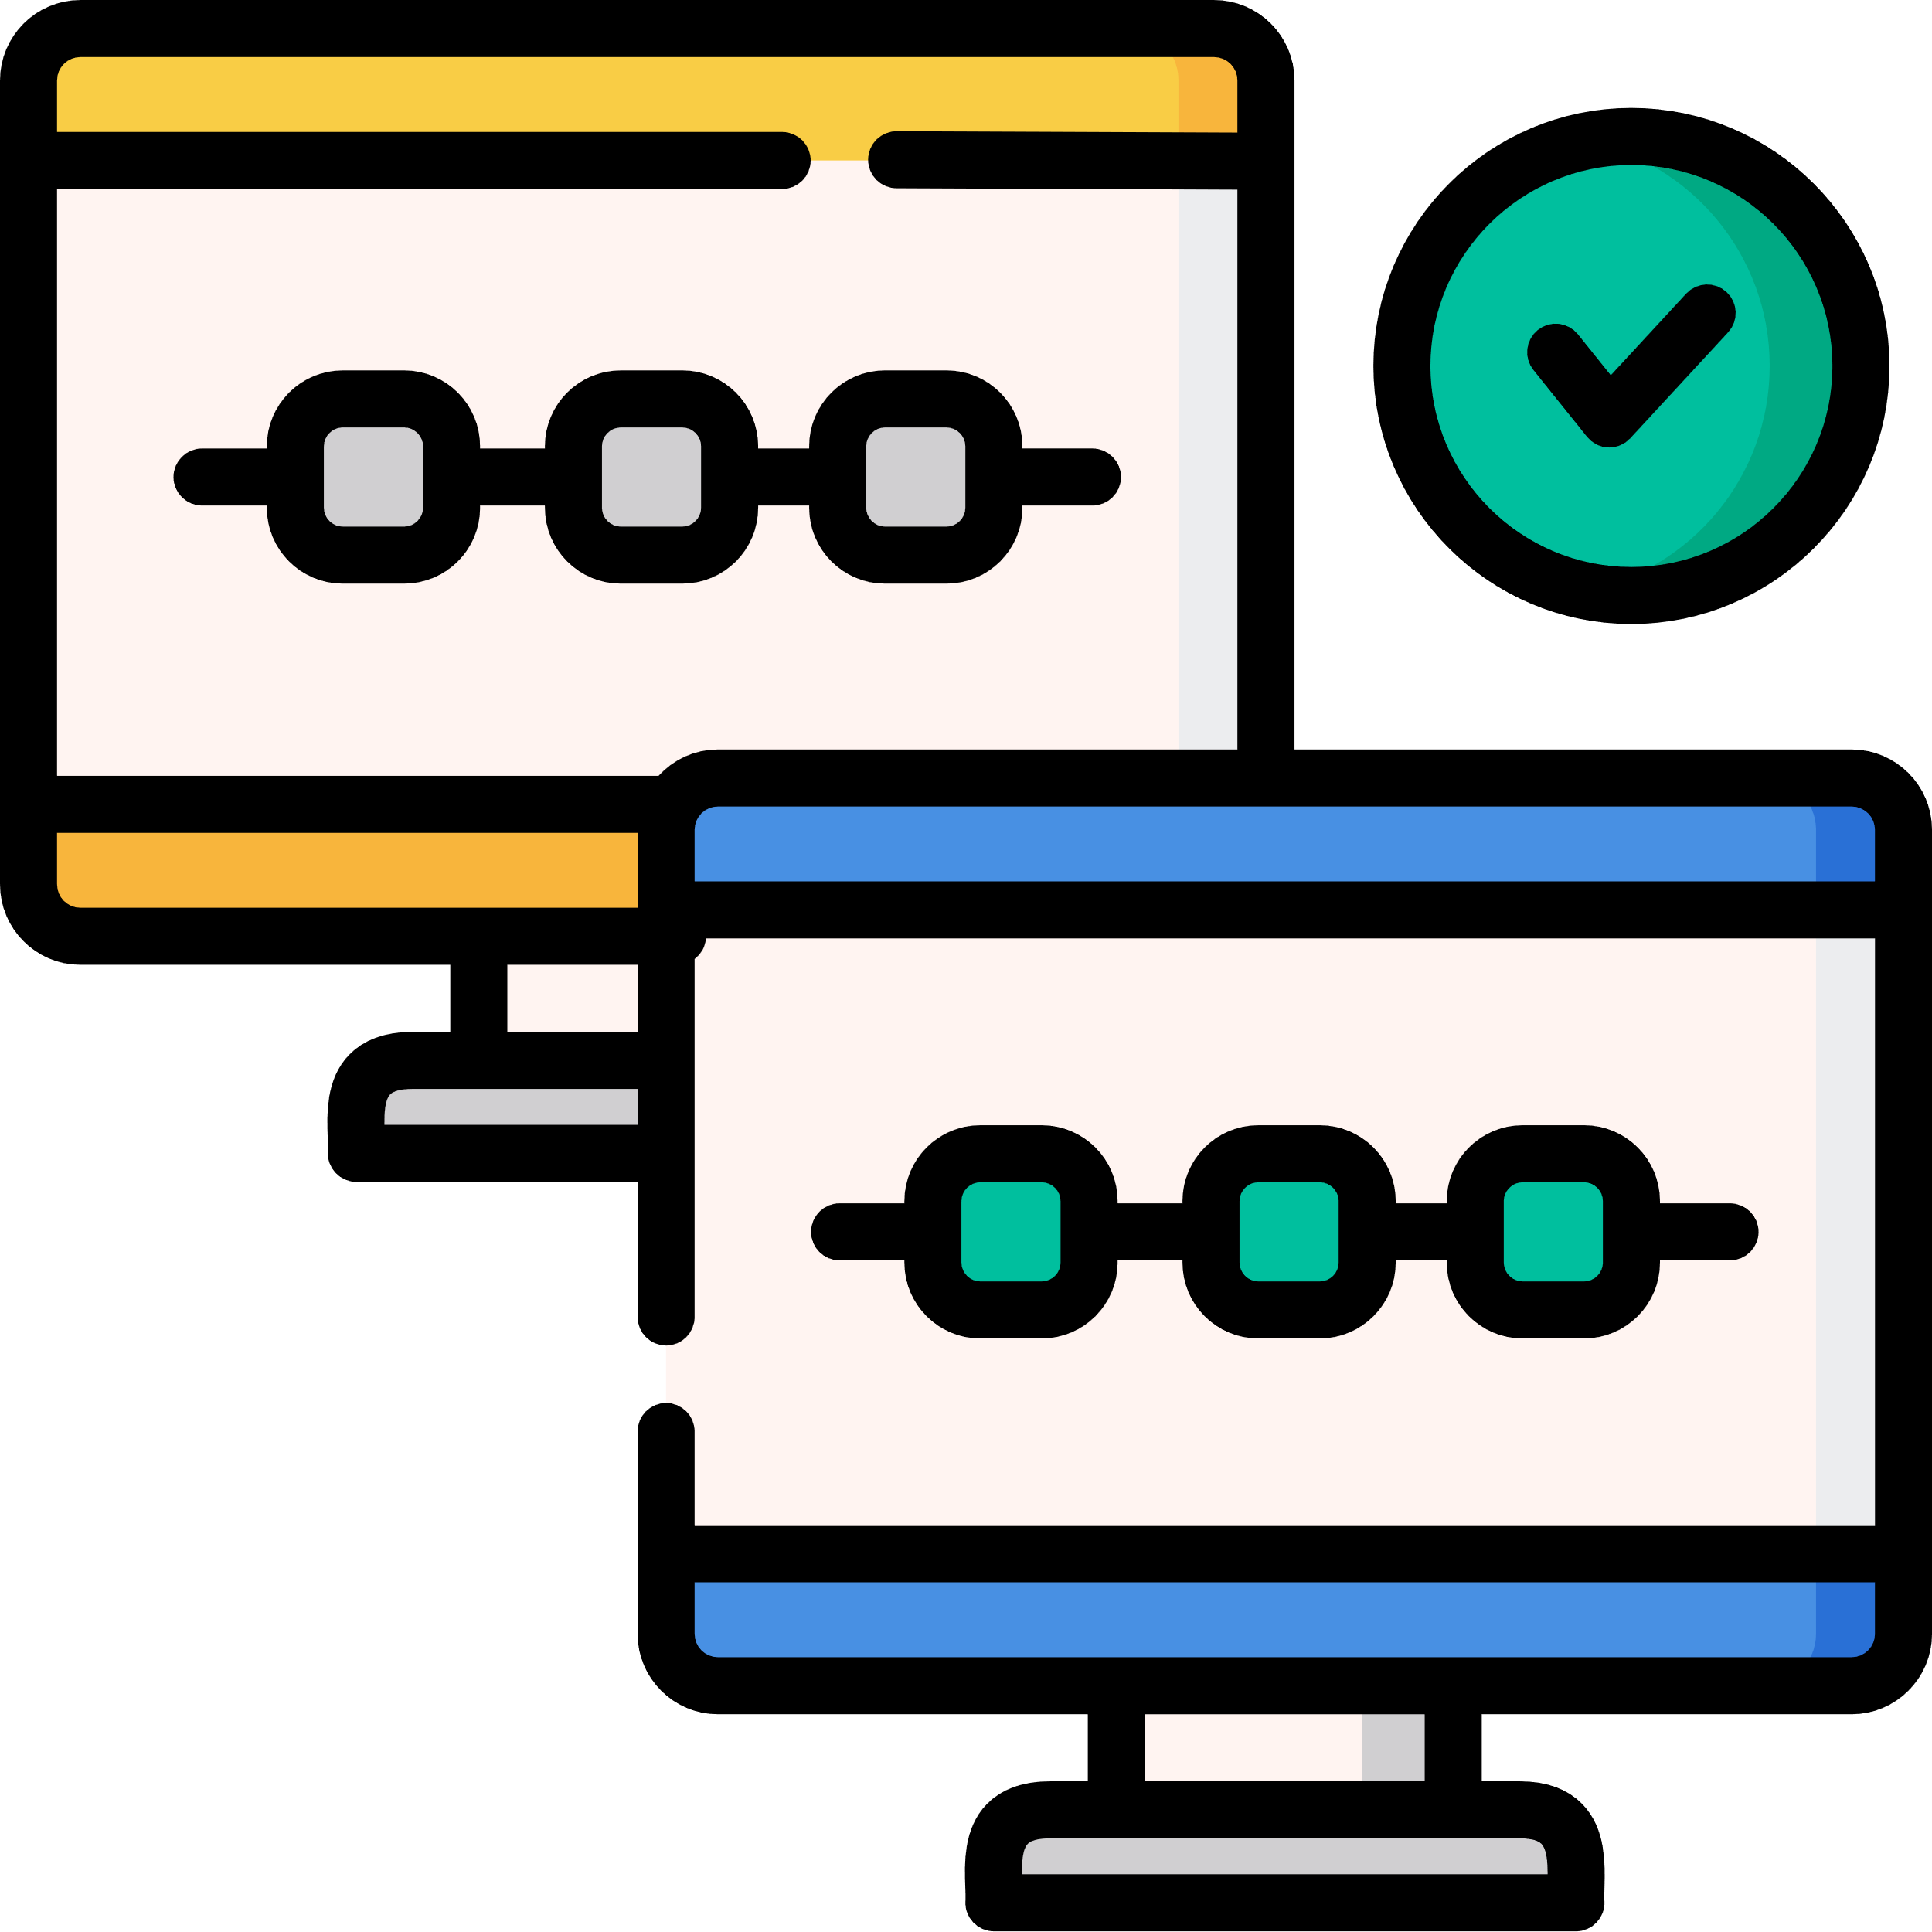
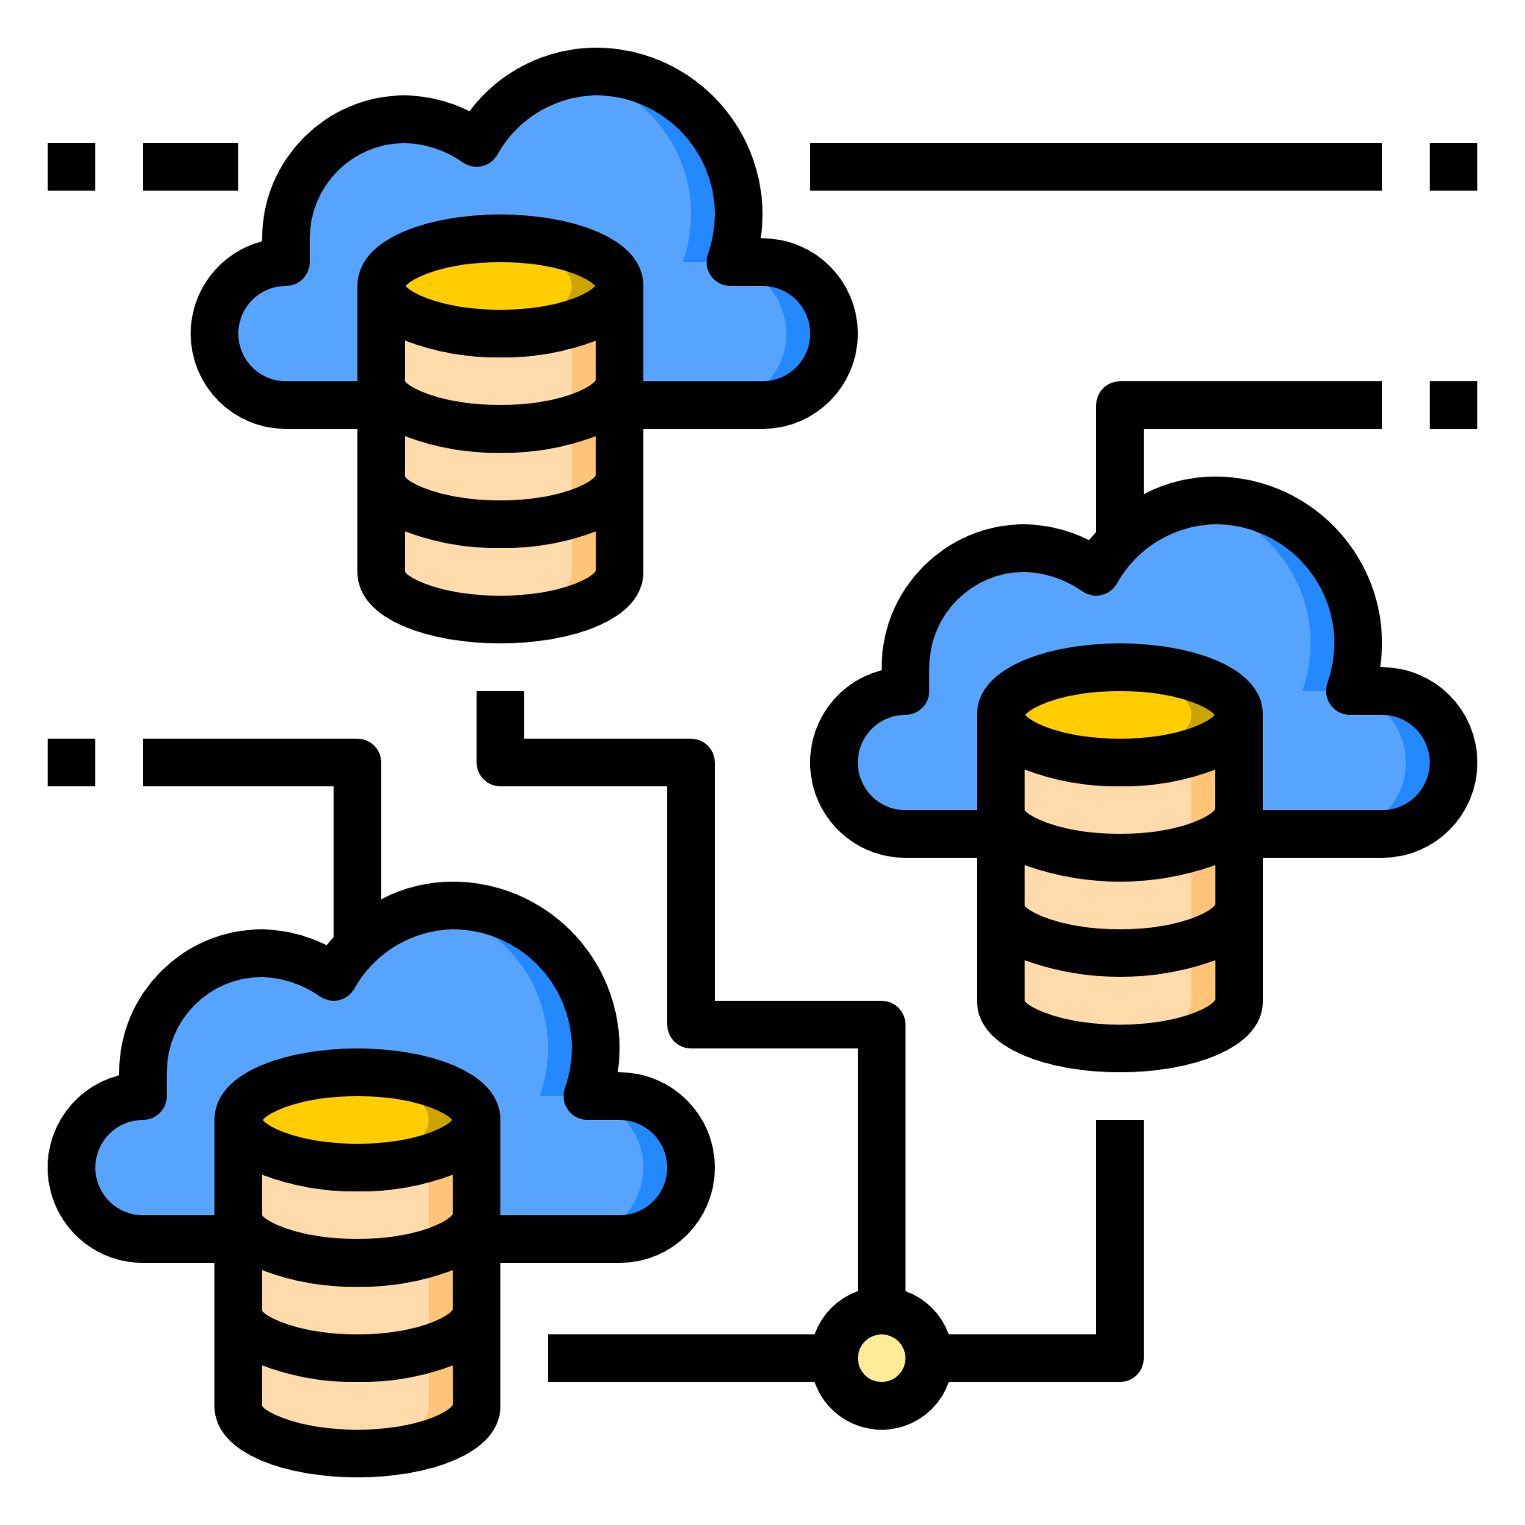

Make sense To Read Further, if you have following strategies:
VS
O
License Agnostic
Complete Open
Cloud Native First
Everything
Software Defined
Complete SOA
Across Products
Build Vs Buy
Prefer
Bottom Up Approach
In App Modernization
Dev Only Focus
Single Control
Plane to Manage
all Products
Shared Service Model
for DevOps
Multi-Cloud Hybrid
is way to go
© 2020 SYNECTIKS. All Rights Reserved. Proprietary and Confidential.

Slide 3
Answering Following Query!
Select 1 Control Plane To Manage:
N – Products spread across M Clouds
Each Cloud Has P - no of App Enclaves
Each App Enclave has Q - no of App Clusters
Each App-Cluster has R – no of Apps
Each App has S - no of Environments
Each Env has T – no of Native Business Services
Each Business Services depends on U – no of Data Services
M x N x P x Q x R x S x T x U complexity across following dimension:
Dev – Continuous (Integration/build/deployment/
tests/code quality/gitOps..)
+
Ops - Continuous (Provisioning/Monitoring/
Compliance/Automation/…………)
Where Control Plane has:
Self Service portal for Provisioning / Deprovisioning across clouds
Shared Services for Dev & Ops are Flexible/Extensible/Templatized/Manifest driven
One single Asset repo for all shared services
Claim/ Reclaim resources(unused/copied) across organization
Delivers real-time insights on Billing/Chargebacks
Accelerated building block to do SOA transformation to plug products into this control plane.
© 2020 SYNECTIKS. All Rights Reserved. Proprietary and Confidential.

Slide 4
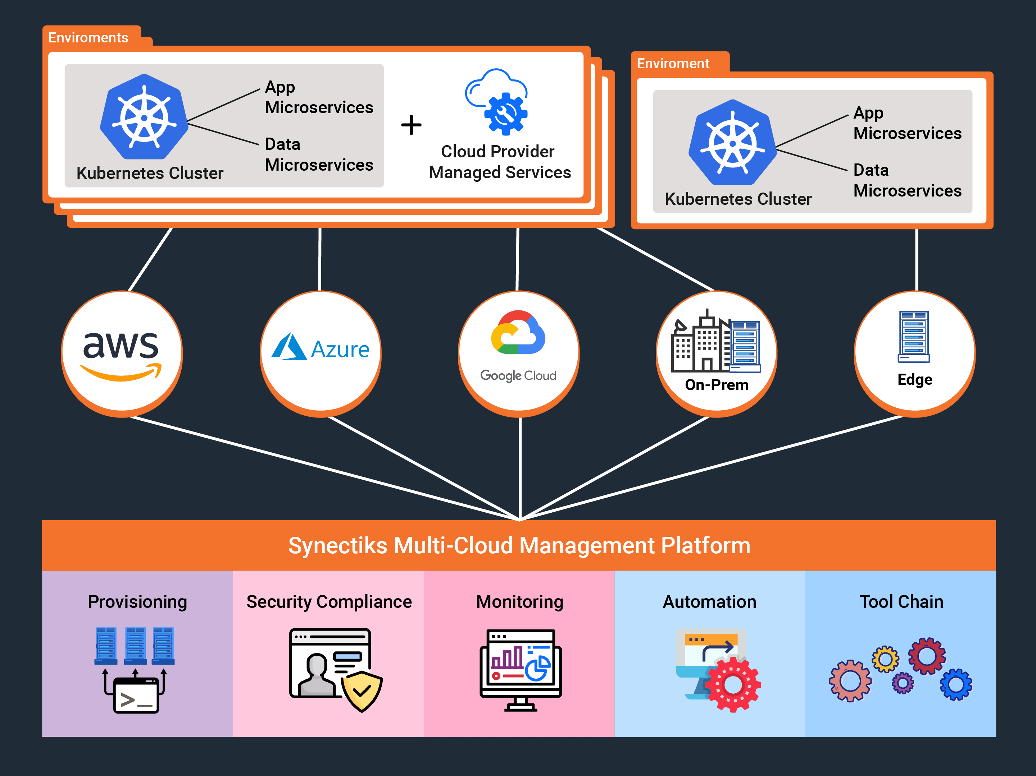

Slide 5
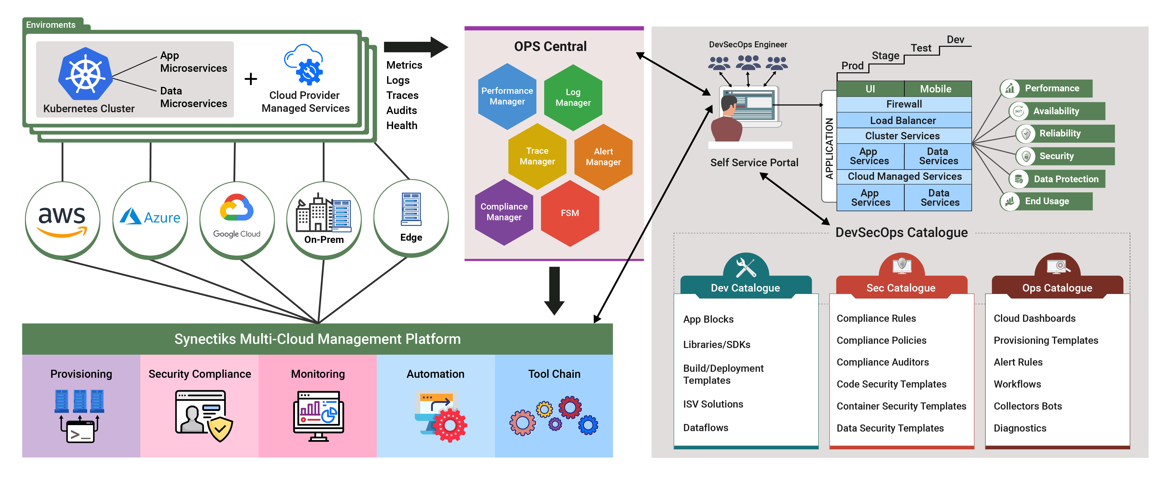

Slide 6
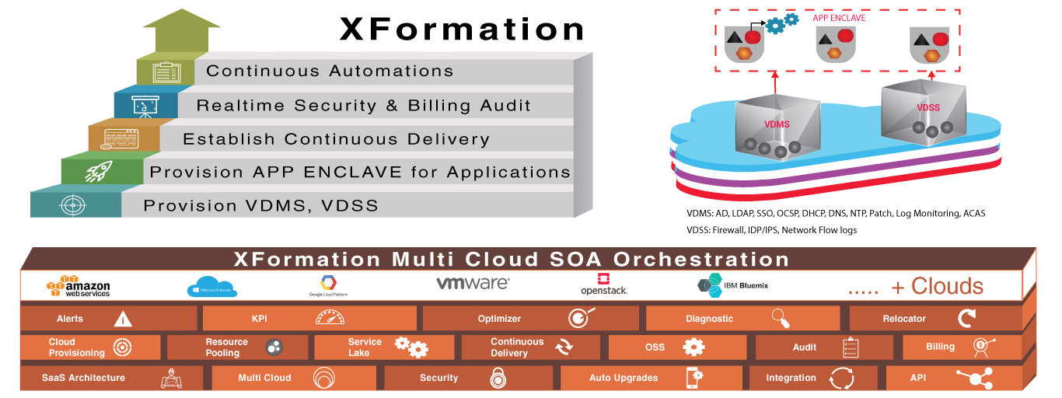
Xformation @50% Time & Cost
© 2020 SYNECTIKS. All Rights Reserved. Proprietary and Confidential.

Slide 7
Salient Features
Solid Foundation
Software Defined
01
Infrastructure /Cloud provisioning through standard compliant templates, liquid elastic layer.
Service Definitions
App/Service Lake
AppCentric Optimization
Rapidly develop microservices based app from existing base services templates.
06
02
Accelerated
Transformation
App-Centric View
Realtime Monitoring
Streamlined Delivery
Optimize Infrastructure and Operation based on production usage of application.
Proactive Control
05
03
Monitor billing, security, configuration in real time and combat any threats before it happen.
Operation Automation
04
Continuous Delivery
Available standard compliant delivery templates catering best practices and highest level of quality checks.
Continuous Automation Engine
Run jobs elastically and continuously audit on Infra and App security /compliance
© 2018 SYNECTIKS. All Rights Reserved. Proprietary and Confidential.
© 2020 SYNECTIKS. All Rights Reserved. Proprietary and Confidential.

Slide 8
Key Benefits
Standardization & Simplification
Product Quality
Culture
Everything Software Defined
All SOA
Multi-Cloud–Hybrid
Everything Aggregated / Elastics
All self-service portal based
Manifest Driven Automation
DevOps Services Decoupled
1 Control Plane + 1 Assets Repo
All SOA Benefits
  Scalability
  Reliability
  Flexibility
  Agility
All Fast Data Benefits
  High Data Revenue
  Realtime
Only 1 role – Developer
Reduce Dev Cycle – App block driven
Auto Pilot Operation
Optimized Infra – Aggregation Benefits / Continuous Reclaim
Fast Data Driven Realtime Decision Support System
© 2020 SYNECTIKS. All Rights Reserved. Proprietary and Confidential.

Slide 9
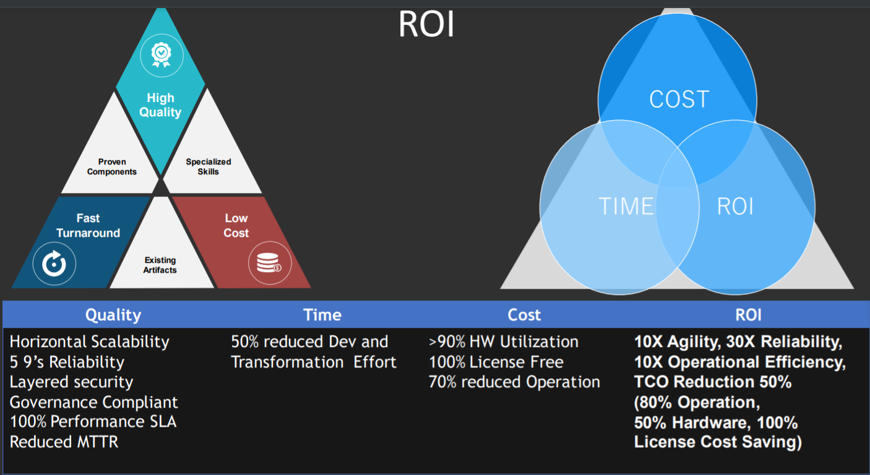
Common Modules
© 2020 SYNECTIKS. All Rights Reserved. Proprietary and Confidential.

Slide 10
Cloud Asset Management
Discovery | Add AWS/AZURE/GCP/Kubernetes accounts (role arn or access key based) | AWS /AZURE/ GCP/ Kubernetes asset lists
Provisioning | Account Provisioning | Cluster Provisioning | Service Provisioning | Self Service Provisioning
Analytics | Overall Cloud Consumption | Compliance Analytics | Billing Analytics
RBAC/ Multitenancy | Org wide Teams And Role
© 2020 SYNECTIKS. All Rights Reserved. Proprietary and Confidential.

Slide 11
Cross Cloud Monitoring
Dashboard Catalogue | AWS /AZURE/GCP Dashboards Lists with filters
Monitoring | Enable Performance / Logs / Trace Based Data Collection sources on ENV | Enable Monitoring on Discovered Assets from Dashboard Catalogue | AWS/AZURE/GCP/KUBE Explorer | App Centric Monitoring
Alerting | Alert Catalogue | Enable Alerting Rules | Alert Dashboards | Alerts Filter
Service Desk | Ticket Central | Alert Ticket Integration
Workflows | Service Desk & workflows integration
© 2020 SYNECTIKS. All Rights Reserved. Proprietary and Confidential.

Slide 12
Cloud Security & Compliance
Compliance Engine | Rule / Policy /Compliances | Compliance Collector | Compliance Reports / Dashboards | Alert Central | History
Rule Editor
© 2020 SYNECTIKS. All Rights Reserved. Proprietary and Confidential.

Slide 13
Tool Chain & Automation Central
Tool Chain Framework | Runbook/ Tools Catalogue | Operator Catalogue | Cloud Templates
© 2020 SYNECTIKS. All Rights Reserved. Proprietary and Confidential.

Slide 14
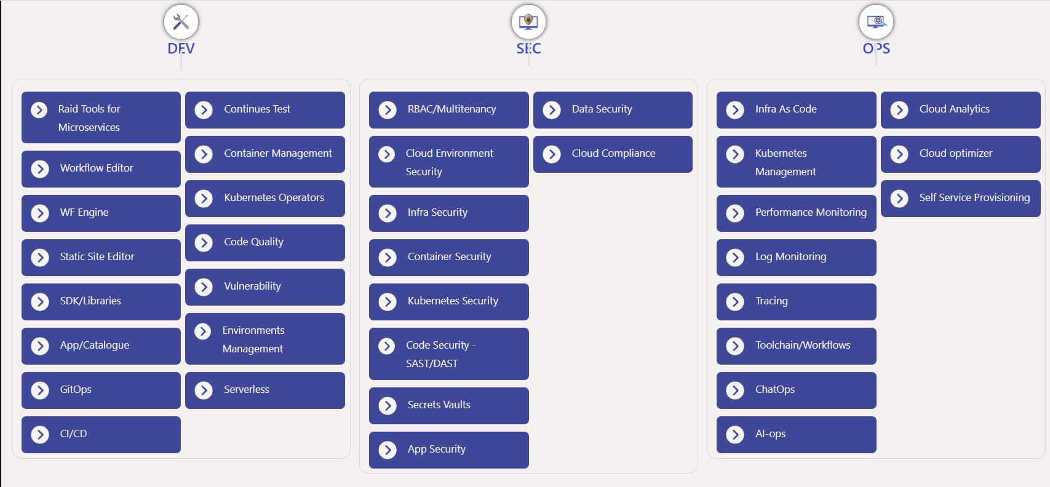
DevSecOps Tooling
© 2020 SYNECTIKS. All Rights Reserved. Proprietary and Confidential.

Slide 15
Common Modules
Performance Manager | Log Manager | Trace Manager | View Manager
App Catalogue | FSM
© 2020 SYNECTIKS. All Rights Reserved. Proprietary and Confidential.

