Slide 1
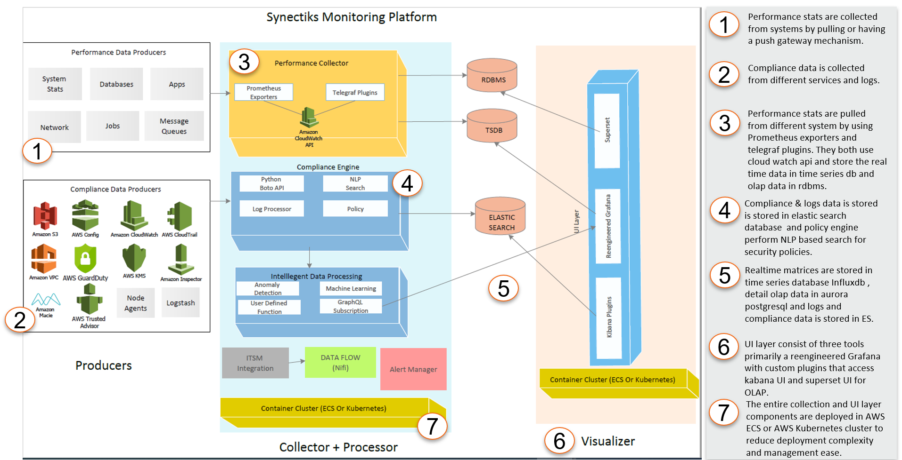
Platform Architecture
  Need
  Every business monitoring requirement is unique, customers need a highly flexible platform so that they can build highly customizable purpose-built solutions at speed and lower economies.
  Why Us?
  Delivered purpose-built monitoring for large business.
  Build any custom solutions using proven framework.
  Buy capabilities , not any propitiatory closed product.
  A team able to collect and deliver business monitoring requirement at speed.

Slide 2




Tooling Discovery /Assessment
4 Phased – 6 Days
1
2
3
4
1/2 Day
Project Kick-off
4.5 Days
Requirement Gathering
1 /2 Day
Plan/Report Preparation
1/2 Day
Presentation
 Initial Meetings
Meeting with decision-makers to get an insight on client current pain-points and desired-future-state
Kick-off meeting with assessment stakeholders, clarification on assessment process and tooling.
 Requirement Spec Generation
Performance, Reliability, Logs , Security ,Compliance Monitoring,
Any data Model Capturing
Integration requirement of Automation and Service Desk Management.
Architecture review and Approval
  Services , Integration , Deployment
 Planning & Roadmap
Roadmap
Milestones & Deliverables
Risk Plans
ROI Analysis
 Presentation
Presentation of the report and plans to stakeholders.
© 2020 Synectiks. All Rights Reserved. Proprietary and Confidential.

Slide 3
Key Consideration
Monitoring Need ? Performance, Site Reliability, Jobs , Logs , Security ,Compliance Monitoring – Phase – wise - requirement Automation Need ? Existing Backup / Recovery / Snapshot / Patch Management / Audit ? Log Cleaning / Space provisioning / Diagnostics Automation Tooling Need ? Containerized Jenkins Jobs / Serverless on Kubernetes Platform Using Tekton / Aws Lambda Driven / AWS Step Jobs / Apache NIFI Dataflow Engine Job Automation Framework ? Microservices framework that gives better visibility , resilience and change management ability ? Integration with ITSM Access / Authentication & RBAC Framework? Authentication ? AD/ MFA Remote worker access via access gateway / VPN Access Control – Read Only / Admin Integration Framework ? Alerting Framework Monitoring Tools Integration with ITSM and Automation Framework – Ticket Generation , Remediation ITSM integration with Automation Framework Deployment Framework ? Dev / Test / Stage / Prod platform How to deploy in Dev / Prod? Dev in single kube microk8s , prod in cluster?
© 2018 Synectiks. All Rights Reserved. Proprietary and Confidential.

Slide 4
Q’s Operations
 | F/P/N
What best describes your operation monitoring capability? Monitoring Tool in place which can monitor the following from single window Service cluster performance Application services performance Application availability Database performance Load balancer statistics Network traffic Physical server performance Virtual Server performance Storage performance Monitoring practices scale to manage more modern distributed and microservices-style architectures with many new languages and data stores and potentially thousands of services to support? Teams can visually depict changes in application environments to quickly identify when and where changes occurred, together with the resulting impact on performance? Is your monitoring able to distinguish the most critical and recurrent problems and how they impact business services, without lengthy configuration and baselining? Has your organization been effective in moving monitoring into development and test - making it an established element of the process in those areas to prevent defects from getting into production? Do you have complete end-to-end visibility into all business services and transactions - from customer engagement via mobile devices and apps, through middleware and databases to back-end systems-of-record. How effective are your teams in monitoring information and analytics on mobile app behavior and usage to not only resolve problems, but also drive development improvements? Can your teams monitor complete business services that link end-user experience, end-to-end transactions and applications to infrastructure and pinpoint root cause and potential impact? Are your teams able to quickly correlate and analyze multiple application performance metrics to solve complex emerging problems before they impact end-user experience? Do teams have visibility into system capacity in order to understand the impact of increased system workloads? Are your teams aware of third-party dependencies to ensure reliable service delivery? Do teams have a unified view that enables them to quickly pinpoint and triage problems? What best describes your operation log analysis capability? Central Log collection and search tool is present and team is trained on that. You have intelligent log analysis tools present that continuously gives insights to application services reliability & performance. Your log analysis tools are integrated with ITSM tool to raise alerts depending on log analysis results.
© 2018 Synectiks. All Rights Reserved. Proprietary and Confidential.

Slide 5
Q’s Operations
 | F/P/N
What best describes your ITSM process capability? You have a central ITSM tool and Operation SLA’s defined and different teams in operation address different tickets You do resource provisioning manually through ITSM tickets You have intelligent tools that does automated ticket remediation Your resource provisioning is entirely automatics , the architecture guarantee automated elastic provisioning of cluster , services , and associated resources. What best describes your operation log analysis capability? Central Log collection and search tool is present, and team is trained on that. You have intelligent log analysis tools present that continuously gives insights to application services reliability & performance. Your log analysis tools are integrated with ITSM tool to raise alerts depending on log analysis results. What best describes your audit capability? You have tools and scripts in place to do regular application and infrastructure security audits You have audit trails tools present to perform audit trailing You have continuous security and continuous compliance system in place that gives you real time visibility on security and compliance You have centralized tools for auditing different environments (dev/stage/qa/tests) , products deployed across clouds in real time What best describe your resilience capability? You mostly troubleshot from you log analysis or monitoring tool and restore the services manually You have diagnostics scripts available that you run to troubleshoot failure and restore services manually Application support resiliency through resilience architecture (circuit breaker sort of) Automation scripts are present which does regular and preventive maintenance in response to system nature What best describe your operation maturity in adopting advanced technologies? You have automated ticker remediation and workflows that caters your 60% tickets You provision your infrastructure with automated tools that seamlessly does hyper scaling cluster and cloud provisioning You have centralized tool to monitor different product , environments , services and clouds You have continuous security , billing , compliance mechanism in place
© 2018 Synectiks. All Rights Reserved. Proprietary and Confidential.

Slide 6
Centralized Job Runner Framework
Manage all types of jobs from 1 console in 1 pool VS N+ jobs in M different edge nodes, U+ upgrade process

Batch3 Project featured
Batch4g
Elastic
DMaster
gn
concept
Elastic Scheduling
Batch2ather information
Realtime visibility + Diagnostics
Batch14 Web development
Batch5rking site
Batch6sting product

Time Series DB
Real Time
Resilience
Agility
⬅
MGMT(Visibility)
Resilient
Reliability / Manageability / Extension

