Slide 1
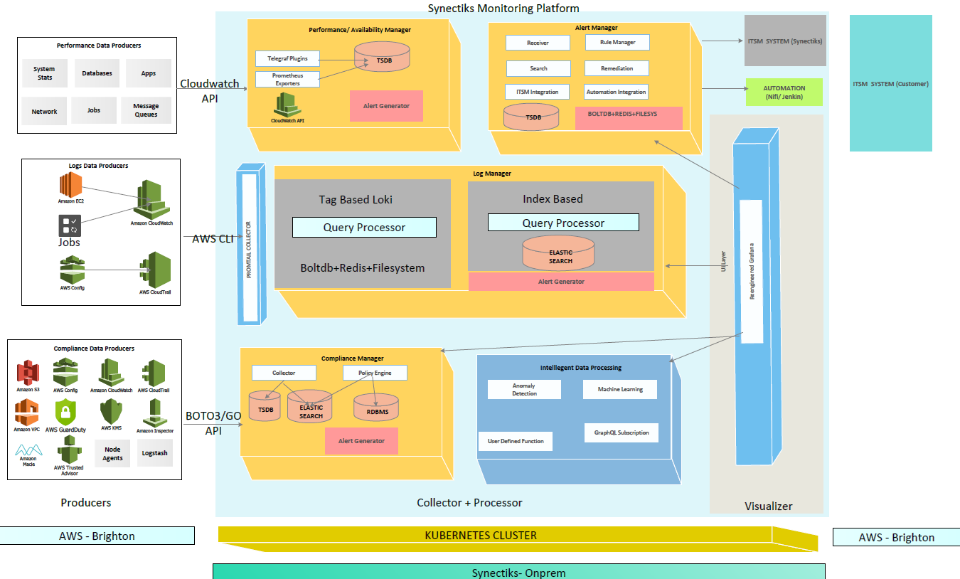
Platform Architecture
  Need
  Every business monitoring requirement is unique, customers need a highly flexible platform so that they can build highly customizable purpose-built solutions at speed and lower economies.
  Why Us?
  Delivered purpose-built monitoring for large business.
  Build any custom solutions using proven framework.
  Buy capabilities , not any propitiatory closed product.
  A team able to collect and deliver business monitoring requirement at speed.

Slide 2
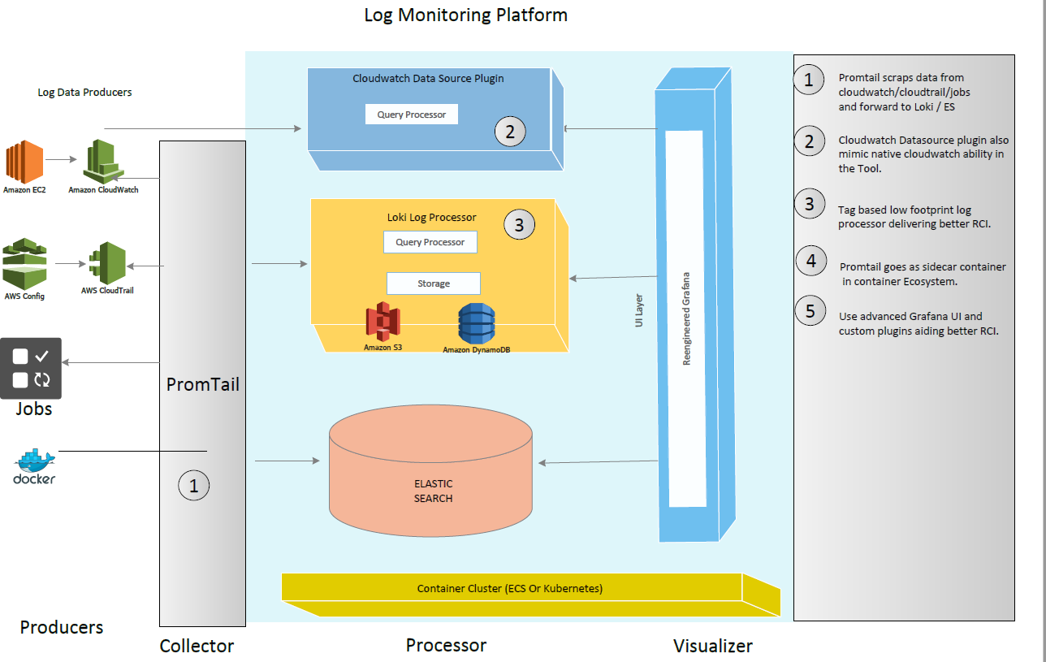
Log Manager
  Need
  Every business monitoring requirement is unique, customers need a highly flexible platform so that they can build highly customizable purpose-built solutions at speed and lower economies.
  Why Us?
  Delivered purpose-built monitoring for large business.
  Build any custom solutions using proven framework.
  Buy capabilities , not any propitiatory closed product.
  A team able to collect and deliver business monitoring requirement at speed.

Slide 3
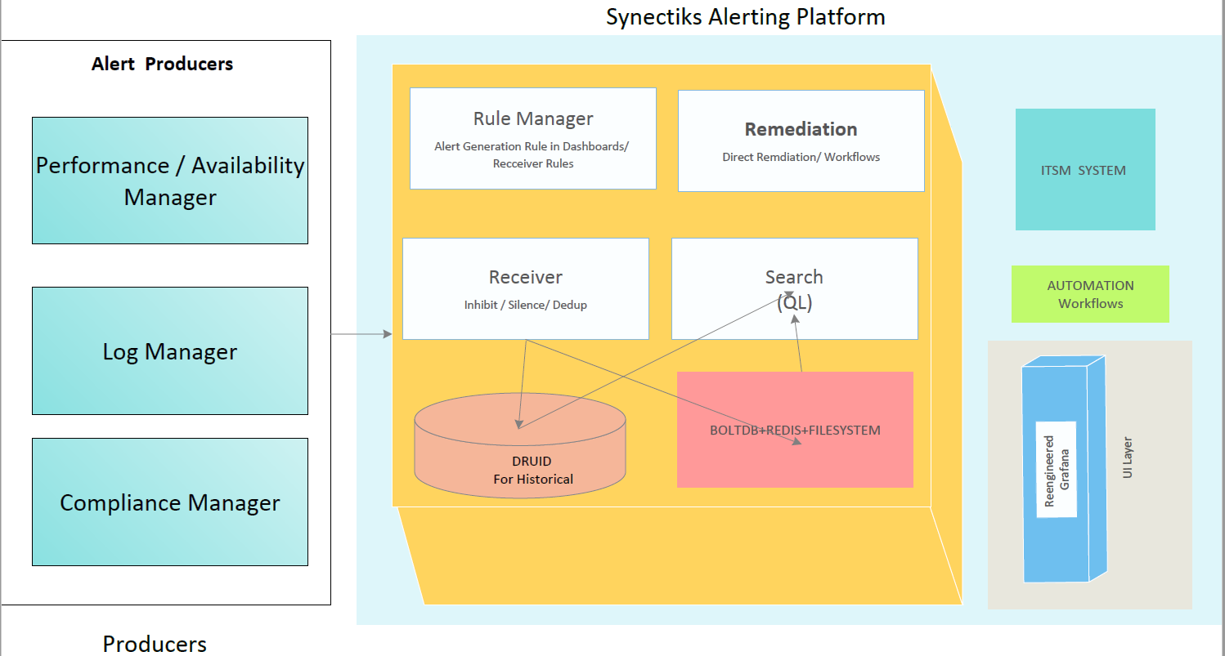
Alert Manager
  Need
  Every business monitoring requirement is unique, customers need a highly flexible platform so that they can build highly customizable purpose-built solutions at speed and lower economies.
  Why Us?
  Delivered purpose-built monitoring for large business.
  Build any custom solutions using proven framework.
  Buy capabilities , not any propitiatory closed product.
  A team able to collect and deliver business monitoring requirement at speed.

Slide 4
UC Collection Template Ex
Use Case Name | Find out the root cause of latency and slow loading of Top 5 worst hit features of <siteXX>
Mechanism ( Logs based / KPI based) | Log Based - Deliver logs pertaining to the response time Monitoring of Public facing Website <XXXXXXXX>
Sources of Logs / Source of KPI | LB Logs ,Api Gateway Logs, Webserver Logs, DB instances Logs ( All the above logs will be available in cloudwatch)
Logs Format | <resource><user>,<ip/id>, <time><operation><message><status code> <severity> <Type> <ResponseTime> Type – Ex. Application , Service Health, System , Activity Log, Config Change Operation – Ex. Get a page / add item to cart
Logs Dashboards | Dashboard1 , Dashboard2, Dashboard3 , Dashboard4
Perf Dashboards | Dashboard1 (RCA Dashboard) , Dashboard2 (Error Code), Dashboard3 (Tracing) , Dashboard4
Alert Correlation / Format | Anything return code 500, Response Time > 2 Sec. <Source-Type><ip/id><message><status code> <severity> <Type> <ResponseTime> Source-Type – Ex. Node / Application / Database / Jobs / IAM / Type – Performance / Reliability / Security / Vulnerability / Data Protection
Steps for RCA | Go to RCA Dashboard for any latency / Error code Identify RC of any latency from trace (app / database ) Identify logs corresponding to error codes Do some rea-ltime diagnose if require
Remediation | Generate Tickets / Associate Workflows / Trigger Automation / Ignore Manually / Batch Ignore

Slide 5
UC Collection Template Ex
Use Case Name | Find out the root cause of failure or slow processing jobs XXX.
Mechanism ( Logs based / KPI based) | Log Based – deliver logs pertaining to job execution time.
Sources of Logs / Source of KPI | Job details logs that is forwarded to cloud watch | Jobs logs are available in individual instances that is running the jobs and populating the logs in /var/log/job/job.log ( rotating ) , u need to tail them and forward them to cloudwatch.
Logs Format | <time> <JobId>, <Step Name> < Task Name> <message><status code> <severity> <Type> <ReasonCode> <CompletionTime> Type – Job , Status_Code =0 success , …
Logs Dashboards | Dashboard1 ( Failed Jobs Today) , Dashboard2 ( Top 10 Time consuming jobs) , Dashboard3 ( Mostly failed jobs by category ) , Dashboard4 ( Job Status Today)
Perf Dashboards | Dashboard1 (Weekly Performance Trend by job)
Alert Correlation | Any Job Failure ,Completion Time > 30 mins <Source-Type><ip/id><message><status code> <severity> <Type> <ResponseTime> Source-Type – Ex. Node / Application / Database / Jobs / IAM / Type – Performance / Reliability / Security / Vulnerability / Data Protection
Steps for RCA | Go to logs dashboard of Failed Jobs Today Identify RC of failure by looking at the logs of that job_id and that days logs Do some realtime diagnose if require
Remediation | Generate Tickets / Associate Workflows / Trigger Automation / Ignore Manually / Batch Ignore

Slide 6
UC Collection Template Ex
Use Case Name | Find out if any disk in any node is filled up more than 80% of its capacity.
Mechanism ( Logs based / KPI based) | KPI Based – Have dashboards to monitor the filesystem and disk usage of critical nodes and make sure that we alert rules placed against those KPI dashboards.
Sources of Logs / Source of KPI | Nodes – Disk & filesystem monitoring dashboards
Logs Format | NA
Logs Dashboards | NA
Perf Dashboards | Dashboard1 (Filesystem monitoring of Nodes)
Alert Correlation | Disk / Filesystem usage > 80% <Source-Type><ip/id><message><status code> <severity> <Type> <ResponseTime> Source-Type – Ex. Node / Application / Database / Jobs / IAM / Type – Performance / Reliability / Security / Vulnerability / Data Protection
Steps for RCA | Go to kpi dashboard of alerts Identify which filesystem getting filled up
Remediation | Generate Tickets / Associate Workflows / Trigger Automation / Ignore Manually / Batch Ignore

Slide 7
Example Use Cases
Key Categories:
Nodes—
Resource Usage – CPU / Memory / Disks ,File integrity monitoring, Anomaly and malware detection , Security policy monitoring,
System inventory,Vulnerability detection, Auditing who-data
Nodes Provisioning ---
Run/ Start / Stop / Update SG / Allocate & Associate EIP
IAM
User account provisioning / Login Failures / Possible break in attempt / many login success
Network / VPC
Create attempt without permission / Spike in Traffic from specific IP
Applications & Jobs –
Errors & Latencies, Site Reliability , Unauthorized Access / Possible break in Attempts
Data Protection & DR –
Snapshots failures / Backup Jobs Failure / DR Jobs failure
Databases –
Latencies / Performance

