Slide 1
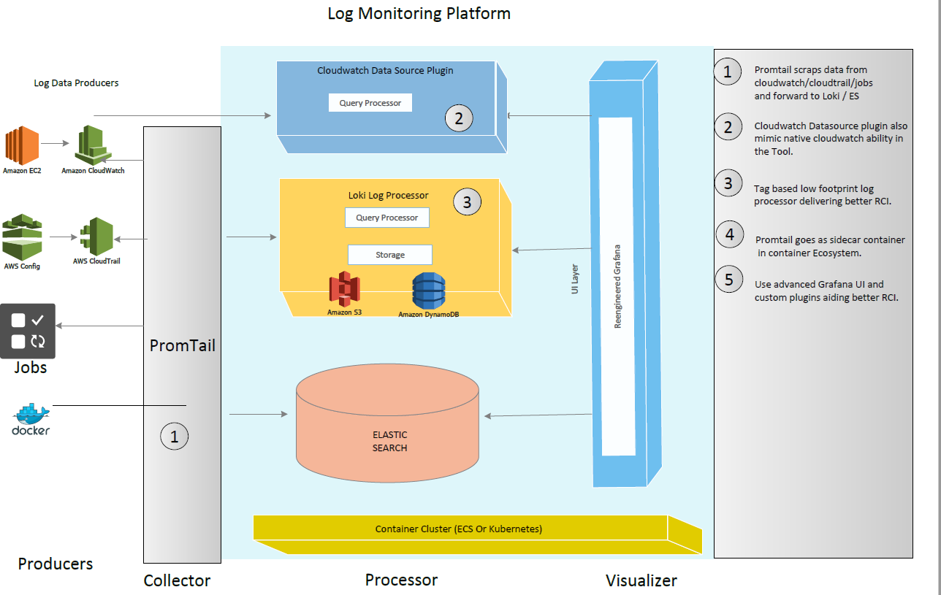
Platform Architecture
  Need
  Every business monitoring requirement is unique, customers need a highly flexible platform so that they can build highly customizable purpose-built solutions at speed and lower economies.
  Why Us?
  Delivered purpose-built monitoring for large business.
  Build any custom solutions using proven framework.
  Buy capabilities , not any propitiatory closed product.
  A team able to collect and deliver business monitoring requirement at speed.

Slide 2
Intent
  Need
  Cloud native Fast-Data & Big-Data platform that serves as single source of truth for real -time , olap , relational data catering any data source (unstructured , semi- structured un-structured) .
  Why Us?
  Delivered purpose-built analytics for large business.
  Open framework to
  1) Automate Data Management & Query optimization
  2)Integrated Policy based alert & remediation
  3)NLP & Deep Learning Enabled
  -- Resource pool trained to
  Data Management
  Data Governance
  Smart Analytics
Agent Less
Scrap existing Cloud Native Services
Easy to scale out – avoid full text indexing
Do more ad-hoc analysis in browser
Integrate tools like Jaeger for Better RCA
Kubernetes & Container Ecosystem Friendly
Good for both microservices & monolith

Slide 3
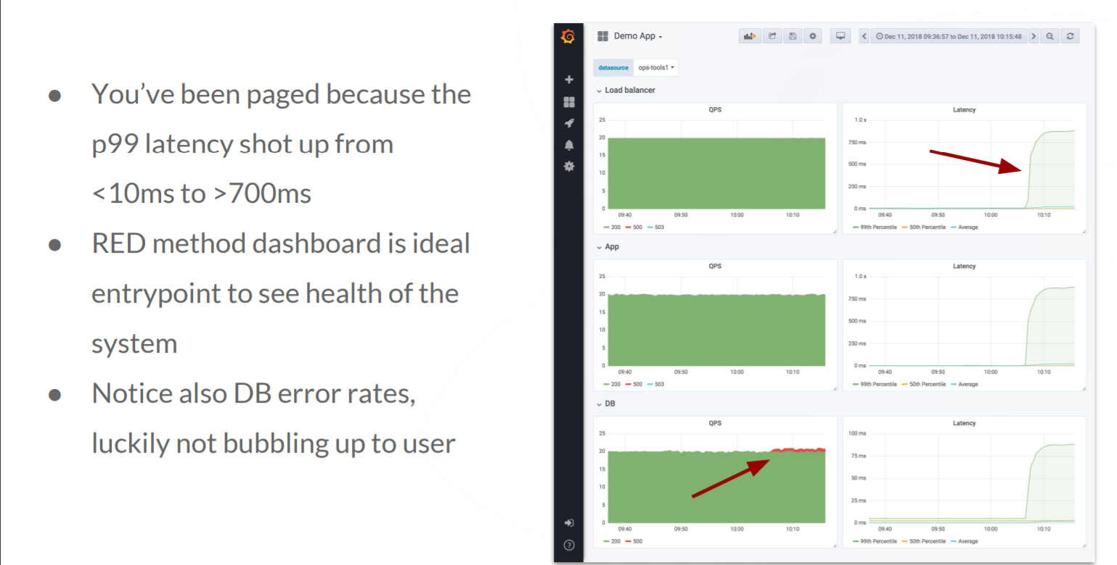
RCA Dashboard for App
  Need
  Cloud native Fast-Data & Big-Data platform that serves as single source of truth for real -time , olap , relational data catering any data source (unstructured , semi- structured un-structured) .
  Why Us?
  Delivered purpose-built analytics for large business.
  Open framework to
  1) Automate Data Management & Query optimization
  2)Integrated Policy based alert & remediation
  3)NLP & Deep Learning Enabled
  -- Resource pool trained to
  Data Management
  Data Governance
  Smart Analytics

Slide 4
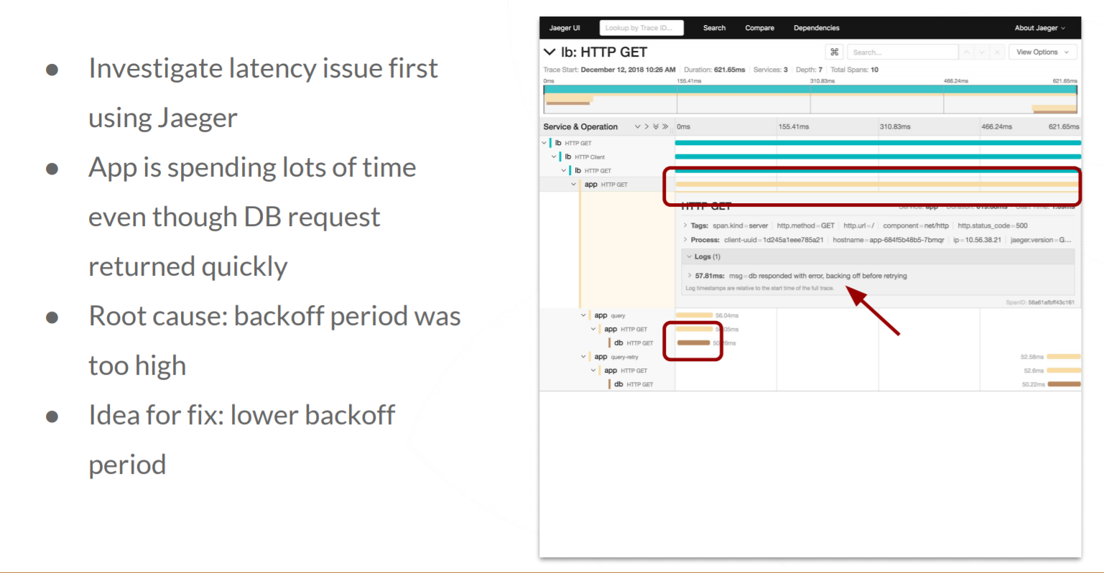
Debug
  Need
  Cloud native Fast-Data & Big-Data platform that serves as single source of truth for real -time , olap , relational data catering any data source (unstructured , semi- structured un-structured) .
  Why Us?
  Delivered purpose-built analytics for large business.
  Open framework to
  1) Automate Data Management & Query optimization
  2)Integrated Policy based alert & remediation
  3)NLP & Deep Learning Enabled
  -- Resource pool trained to
  Data Management
  Data Governance
  Smart Analytics

Slide 5
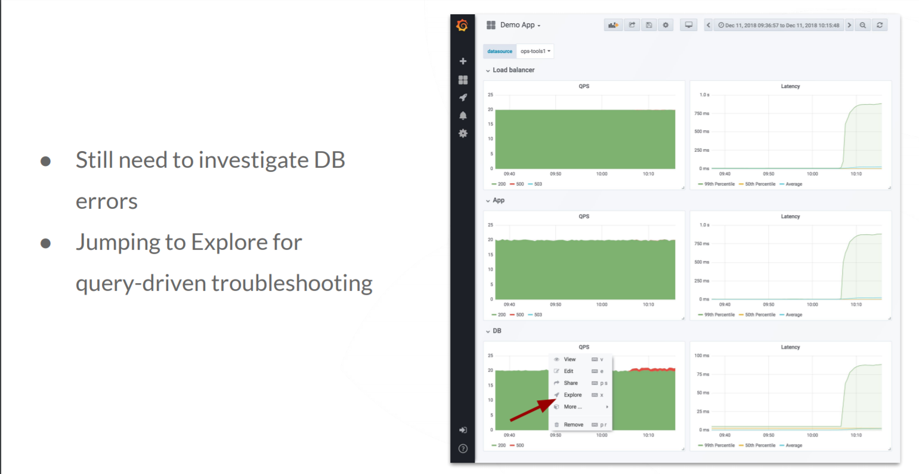
Explore more on DB
  Need
  Cloud native Fast-Data & Big-Data platform that serves as single source of truth for real -time , olap , relational data catering any data source (unstructured , semi- structured un-structured) .
  Why Us?
  Delivered purpose-built analytics for large business.
  Open framework to
  1) Automate Data Management & Query optimization
  2)Integrated Policy based alert & remediation
  3)NLP & Deep Learning Enabled
  -- Resource pool trained to
  Data Management
  Data Governance
  Smart Analytics

Slide 6
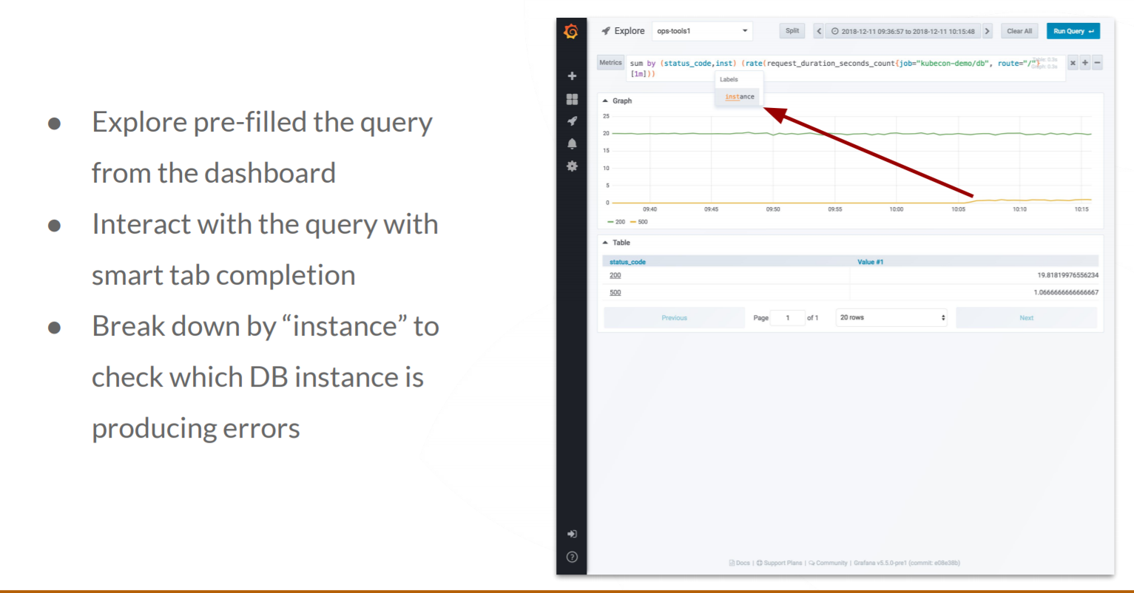
Explore for Query/Instance
  Need
  Cloud native Fast-Data & Big-Data platform that serves as single source of truth for real -time , olap , relational data catering any data source (unstructured , semi- structured un-structured) .
  Why Us?
  Delivered purpose-built analytics for large business.
  Open framework to
  1) Automate Data Management & Query optimization
  2)Integrated Policy based alert & remediation
  3)NLP & Deep Learning Enabled
  -- Resource pool trained to
  Data Management
  Data Governance
  Smart Analytics

Slide 7
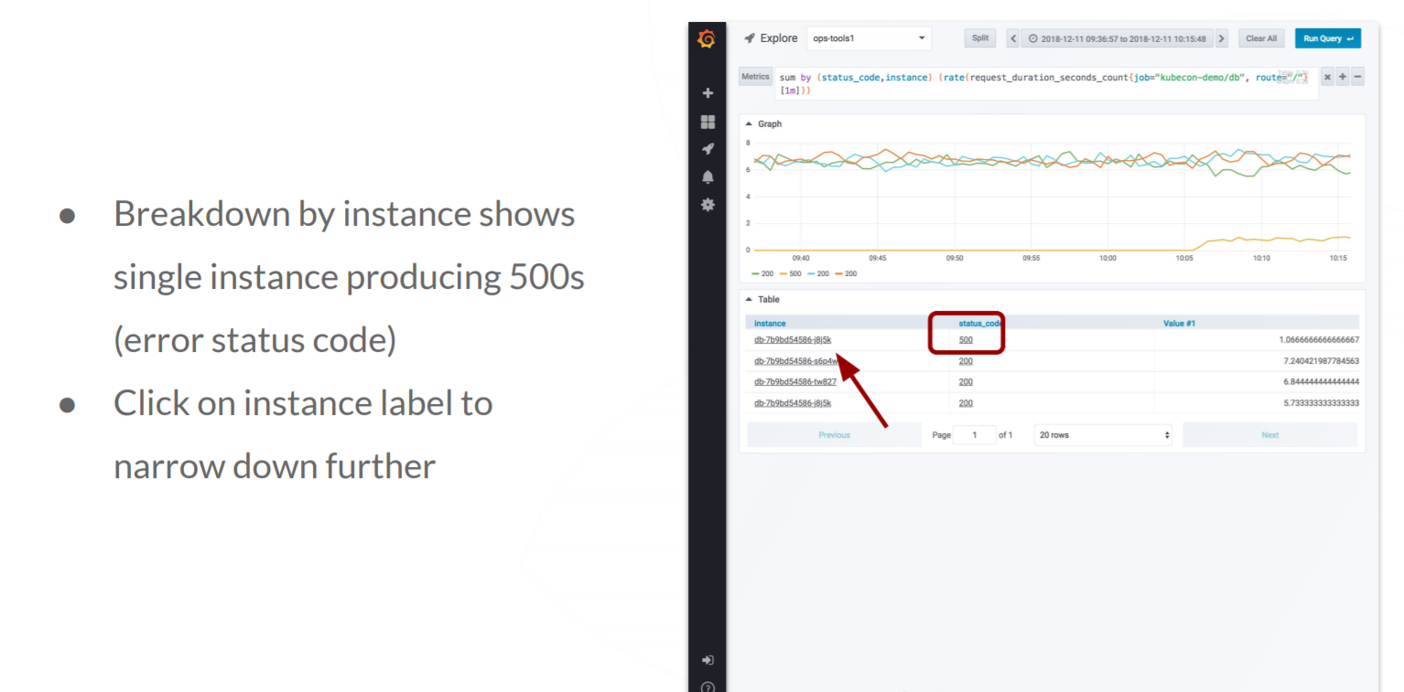
Further Breakdown
  Need
  Cloud native Fast-Data & Big-Data platform that serves as single source of truth for real -time , olap , relational data catering any data source (unstructured , semi- structured un-structured) .
  Why Us?
  Delivered purpose-built analytics for large business.
  Open framework to
  1) Automate Data Management & Query optimization
  2)Integrated Policy based alert & remediation
  3)NLP & Deep Learning Enabled
  -- Resource pool trained to
  Data Management
  Data Governance
  Smart Analytics

Slide 8
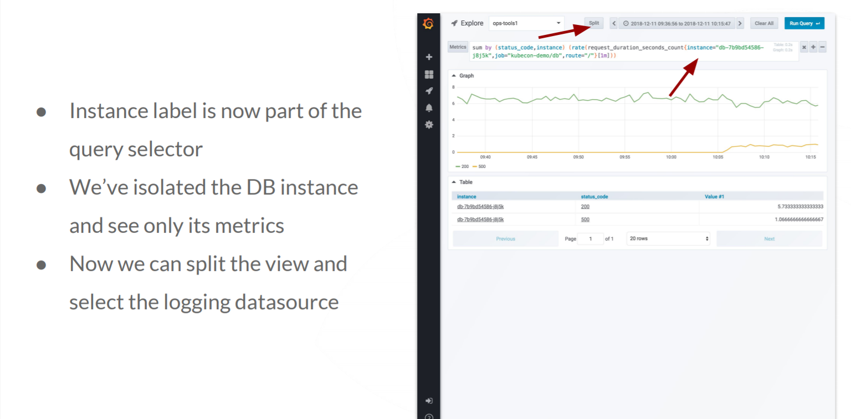
Further Breakdown
  Need
  Cloud native Fast-Data & Big-Data platform that serves as single source of truth for real -time , olap , relational data catering any data source (unstructured , semi- structured un-structured) .
  Why Us?
  Delivered purpose-built analytics for large business.
  Open framework to
  1) Automate Data Management & Query optimization
  2)Integrated Policy based alert & remediation
  3)NLP & Deep Learning Enabled
  -- Resource pool trained to
  Data Management
  Data Governance
  Smart Analytics

Slide 9
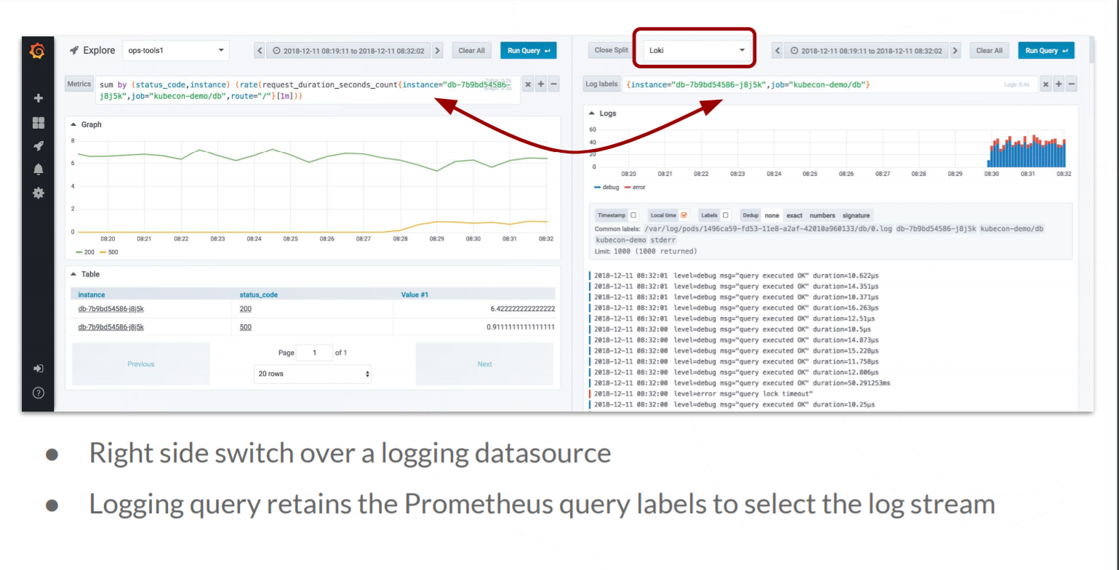
Split View
  Need
  Cloud native Fast-Data & Big-Data platform that serves as single source of truth for real -time , olap , relational data catering any data source (unstructured , semi- structured un-structured) .
  Why Us?
  Delivered purpose-built analytics for large business.
  Open framework to
  1) Automate Data Management & Query optimization
  2)Integrated Policy based alert & remediation
  3)NLP & Deep Learning Enabled
  -- Resource pool trained to
  Data Management
  Data Governance
  Smart Analytics

Slide 10
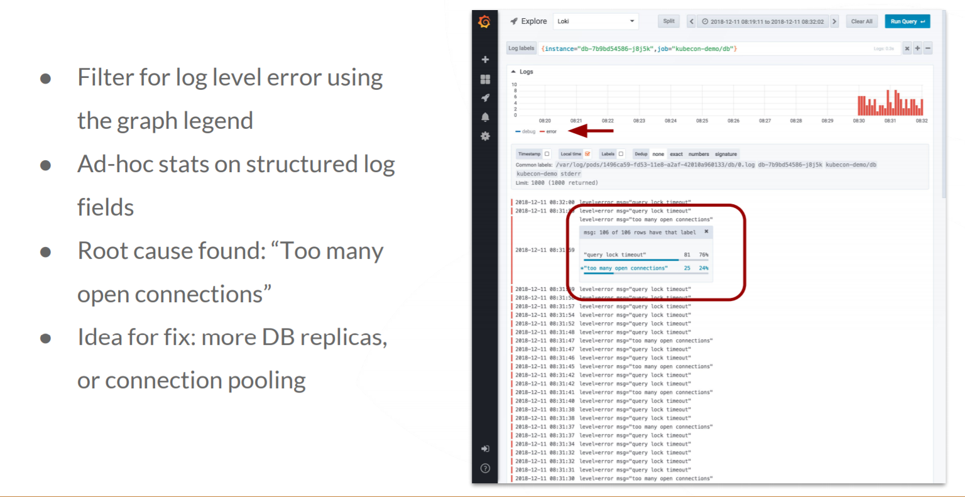
Drill Down
  Need
  Cloud native Fast-Data & Big-Data platform that serves as single source of truth for real -time , olap , relational data catering any data source (unstructured , semi- structured un-structured) .
  Why Us?
  Delivered purpose-built analytics for large business.
  Open framework to
  1) Automate Data Management & Query optimization
  2)Integrated Policy based alert & remediation
  3)NLP & Deep Learning Enabled
  -- Resource pool trained to
  Data Management
  Data Governance
  Smart Analytics

Slide 11
Use Case Template
Use Case Name | Response Time Monitoring of Public facing Website <XXXXXXXX>
Objective | Find out the root cause of latency and slow loading of Top 5 worst hit features of <siteXX>
Sources of Logs | LB Logs ,Api Gateway Logs, Webserver Logs, DB instances Logs ( All the above logs will be available in cloudwatch)
Logs Format | <resource><user>,<ip/id>, <time><operation><message><status code> <severity> <Type> <ResponseTime> Type – Ex. Application , Service Health, System , Activity Log, Config Change Operation – Ex. Get a page / add item to cart
Logs Dashboards | Dashboard1 , Dashboard2, Dashboard3 , Dashboard4
Perf Dashboards | Dashboard1 (RCA Dashboard) , Dashboard2 (Error Code), Dashboard3 (Tracing) , Dashboard4
Alert Correlation | Anything return code 500, Response Time > 2 Sec,
Steps for RCA | Go to RCA Dashboard for any latency / Error code Identify RC of any latency from trace (app / database ) Identify logs corresponding to error codes Do some rea-ltime diagnose if require
Remediation | Generate Tickets / Associate Workflows / Trigger Automation / Ignore Manually / Batch Ignore

Slide 12
Jobs Template
Use Case Name | Batch Jobs reliability Monitoring (Mostly ETL dataflow jobs)
Objective | Find out the root cause of failure or slow processing jobs.
Sources of Logs | Job details logs that is forwarded to cloud watch | Jobs logs are available in individual instances that is running the jobs and populating the logs in /var/log/job/job.log ( rotating ) , u need to tail them and forward them.
Logs Format | <time> <JobId>, <Step Name> < Task Name> <message><status code> <severity> <Type> <ReasonCode> <CompletionTime> Type – Job , Status_Code =0 success , …
Logs Dashboards | Dashboard1 ( Failed Jobs Today) , Dashboard2 ( Top 10 Time consuming jobs) , Dashboard3 ( Mostly failed jobs by category ) , Dashboard4 ( Job Status Today)
Perf Dashboards | Dashboard1 (Weekly Performance Trend by job)
Alert Correlation | Any Job Failure Completion Time > 30 mins,
Steps for RCA | Go to logs dashboard of Failed Jobs Today Identify RC of failure by looking at the logs of that job_id and that days logs Do some realtime diagnose if require
Remediation | Generate Tickets / Associate Workflows / Trigger Automation / Ignore Manually / Batch Ignore

Slide 13
Example Use Cases
Key Categories:
EC2 - File integrity monitoring, Anomaly and malware detection , Security policy monitoring, System inventory,Vulnerability detection, Auditing who-data
EC2 Provisioning – (Run/ Start / Stop / Update SG / Allocate & Associate EIP)
IAM ( User account provisioning / Login Failures / Possible break in attempt / many login success)
VPC ( Provisioning / Create attempt without permission / Spike in Traffic from specific IP)
Applications & Jobs – Errors & Latencies
Sample Dashboard
Get a list of the number of exceptions per hour.
Find the 25 most recently added log events.
Determine the amount of overprovisioned memory.
Create a latency report of web facing application
Find the top 15 packet transfers across hosts
Find the top 15 byte transfers for hosts on a given subnet
Find the 10 DNS resolvers with the highest number of requests.
Find the number of records by domain and subdomain where the server failed to complete the DNS request.
Find the Amazon EC2 hosts that were started or stopped in a given Region.
Find average latency for each unique combination of @method and @user
Find the log events that contain ERROR strings for an application.
Find the latest 7 days changes in security groups ordered by users.

