Slide 1
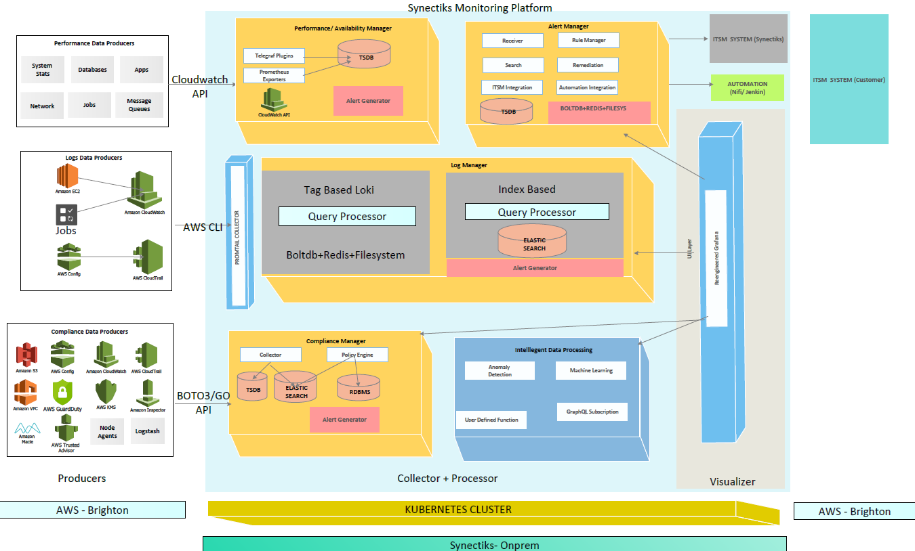
Platform Architecture
  Need
  Every business monitoring requirement is unique, customers need a highly flexible platform so that they can build highly customizable purpose-built solutions at speed and lower economies.
  Why Us?
  Delivered purpose-built monitoring for large business.
  Build any custom solutions using proven framework.
  Buy capabilities , not any propitiatory closed product.
  A team able to collect and deliver business monitoring requirement at speed.

Slide 2
Access & OpEx
  Need
  Cloud native Fast-Data & Big-Data platform that serves as single source of truth for real -time , olap , relational data catering any data source (unstructured , semi- structured un-structured) .
  Why Us?
  Delivered purpose-built analytics for large business.
  Open framework to
  1) Automate Data Management & Query optimization
  2)Integrated Policy based alert & remediation
  3)NLP & Deep Learning Enabled
  -- Resource pool trained to
  Data Management
  Data Governance
  Smart Analytics
IAM user with CloudWatch API + … Read Access / Api access though access key
Public URL+ (password + Mfa) or (VPN + URL+ Password) or (VPN + Jumpbox + password)
Cost – API + Data Transfer ( 20 GB/ Day + 1 Million Requests / Day ) ~ 200$/Month

Slide 3
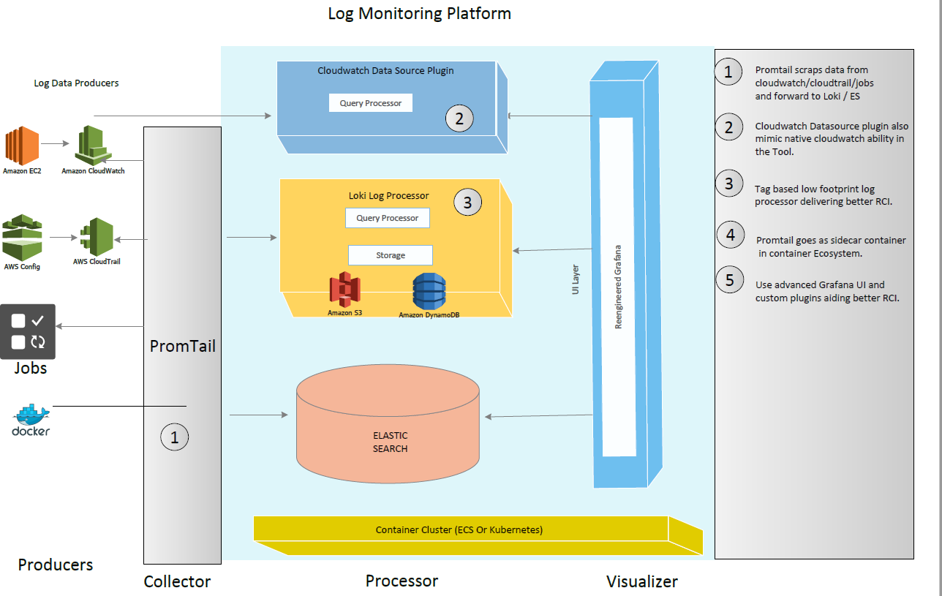
Log Manager
  Need
  Every business monitoring requirement is unique, customers need a highly flexible platform so that they can build highly customizable purpose-built solutions at speed and lower economies.
  Why Us?
  Delivered purpose-built monitoring for large business.
  Build any custom solutions using proven framework.
  Buy capabilities , not any propitiatory closed product.
  A team able to collect and deliver business monitoring requirement at speed.

Slide 4
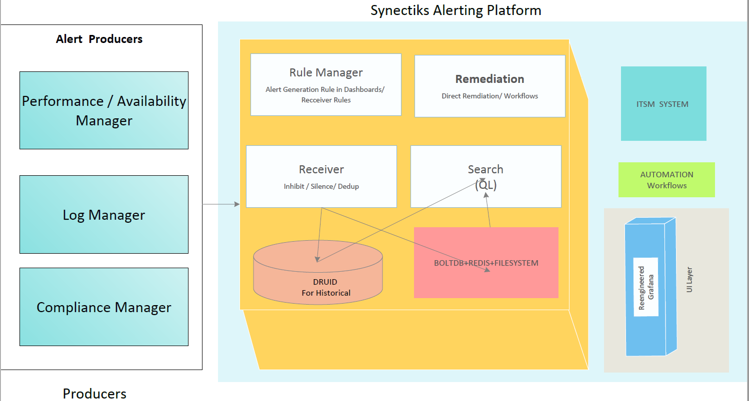
Alert Manager
  Need
  Every business monitoring requirement is unique, customers need a highly flexible platform so that they can build highly customizable purpose-built solutions at speed and lower economies.
  Why Us?
  Delivered purpose-built monitoring for large business.
  Build any custom solutions using proven framework.
  Buy capabilities , not any propitiatory closed product.
  A team able to collect and deliver business monitoring requirement at speed.

