Slide 1
AWS-RDS-POSTGRESQL
Use Case Name | Monitor the Storage space usage of AWS RDS postgresql database and generate alert depending on usage rule.
Mechanism ( Logs based / KPI based) | KPI Based – Have dashboards to monitor the filesystem and disk usage of AWS RDS instance and make sure that we alert rules placed against those KPI dashboards.
Sources of Logs / Source of KPI | AWS RDS – Storage Consumption monitoring dashboards
Logs Format | NA
Logs Dashboards | NA
Perf Dashboards | AWS RDS Dashboard (monitoring of Stoarge Consumption)
Alert Correlation | Storage usage > 90% <Resource Group><Resource><Source-Type><ip/id><message><status code> <severity> <Type> Source-Type – Ex. Node / Application / Database / Jobs / IAM / Type – Performance / Reliability / Security / Vulnerability / Data Protection
Steps for RCA | Go to kpi dashboard of alert Identify which database filesystem getting filled up
Remediation | Generate Tickets and Perform storage expansion Workflows based on ticket approval

Slide 2
AWS-RDS-POSTGRESQL
Use Case Name | Monitor the CPU usage of AWS RDS postgresql database and generate alert depending on usage rule.
Mechanism ( Logs based / KPI based) | KPI Based – Have dashboards to monitor the CPU usage of AWS RDS instance and make sure that we alert rules placed against those KPI dashboards.
Sources of Logs / Source of KPI | AWS RDS – Storage Consumption monitoring dashboards
Logs Format | NA
Logs Dashboards | NA
Perf Dashboards | AWS RDS Dashboard (monitoring of CPU utilization)
Alert Correlation | Max CPU usage > 75% <Resource Group><Resource><Source-Type><ip/id><message><status code> <severity> <Type> Source-Type – Ex. Node / Application / Database / Jobs / IAM / Type – Performance / Reliability / Security / Vulnerability / Data Protection
Steps for RCA | Go to kpi dashboard of alert Identify which database CPU utilization is high Look at other KPI ‘s like concurrent connections to see that time no of active connections.
Remediation | Generate Tickets

Slide 3
AWS-RDS-POSTGRESQL
Use Case Name | Monitor the average read/ write latency of postgresql database and generate alert depending on usage rule.
Mechanism ( Logs based / KPI based) | KPI Based – Have dashboards to monitor the Read/Write latency of AWS RDS instance and make sure that we alert rules placed against those KPI dashboards.
Sources of Logs / Source of KPI | AWS RDS – Read/ write latency dashboards
Logs Format | NA
Logs Dashboards | NA
Perf Dashboards | AWS RDS Dashboard (monitoring of Read Write Latency)
Alert Correlation | Max latency > 10 ms <Resource Group><Resource><Source-Type><ip/id><message><status code> <severity> <Type> Source-Type – Ex. Node / Application / Database / Jobs / IAM / Type – Performance / Reliability / Security / Vulnerability / Data Protection
Steps for RCA | Go to kpi dashboard of alert Identify which database read / write latecy is high Look at the disk speed and network speed to do a deep dive.
Remediation | Generate Tickets

Slide 4
AWS-RDS-POSTGRESQL
Use Case Name | Monitor the concurrent connections AWS RDS postgresql database and generate alert depending on usage rule.
Mechanism ( Logs based / KPI based) | KPI Based – Have dashboards to monitor the concurrent connection AWS RDS instance and make sure that we alert rules placed against those KPI dashboards.
Sources of Logs / Source of KPI | AWS RDS – Concurrent connections monitoring dashboards
Logs Format | NA
Logs Dashboards | NA
Perf Dashboards | AWS RDS Dashboard (monitoring of concurrent connections)
Alert Correlation | Max connections > 30 <Resource Group><Resource><Source-Type><ip/id><message><status code> <severity> <Type> Source-Type – Ex. Node / Application / Database / Jobs / IAM / Type – Performance / Reliability / Security / Vulnerability / Data Protection
Steps for RCA | Go to kpi dashboard of alert Identify which database concurrent connection is high Look at the database which apps are holding the connections, any app that is constantly holding it.
Remediation | Generate Tickets

Slide 5
AWS-RDS-POSTGRESQL
Use Case Name | Monitor the Health Check / Availability AWS RDS postgresql database and generate alert depending on usage rule.
Mechanism ( Logs based / KPI based) | KPI Based – Have dashboards to monitor the concurrent connection AWS RDS instance and make sure that we alert rules placed against those KPI dashboards.
Sources of Logs / Source of KPI | AWS RDS – Health Check / Availability monitoring dashboards
Logs Format | NA
Logs Dashboards | NA
Perf Dashboards | AWS RDS Dashboard (monitoring of Health Check / Availability)
Alert Correlation | Availability != 1 <Resource Group><Resource><Source-Type><ip/id><message><status code> <severity> <Type> Source-Type – Ex. Node / Application / Database / Jobs / IAM / Type – Performance / Reliability / Security / Vulnerability / Data Protection
Steps for RCA | Go to kpi dashboard of alert Identify which database Health Check / Availability has issue
Remediation | Generate Tickets

Slide 6
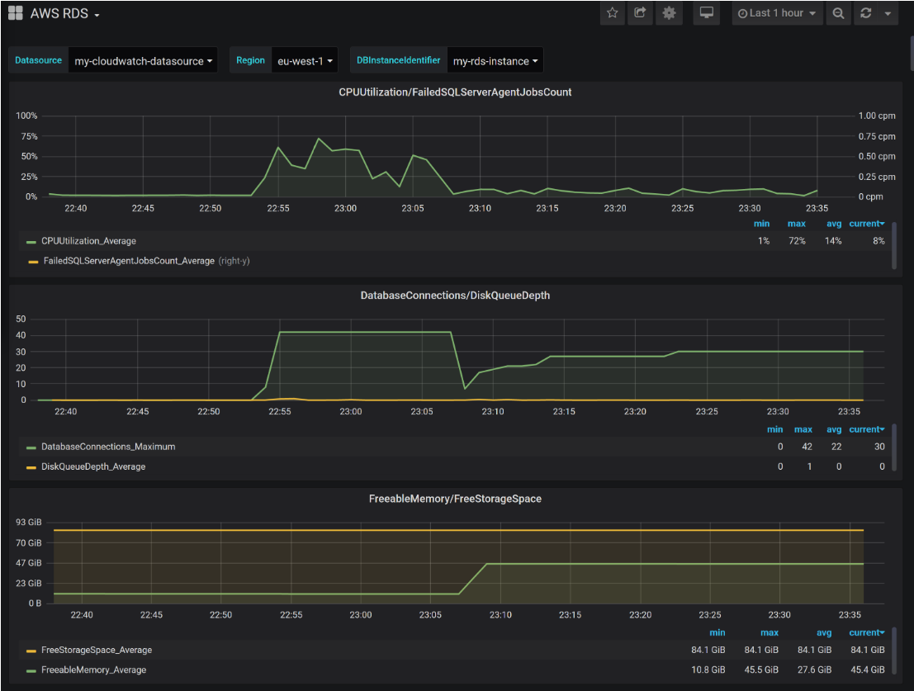
AWS –RDS-POSTGRESQL

Slide 7
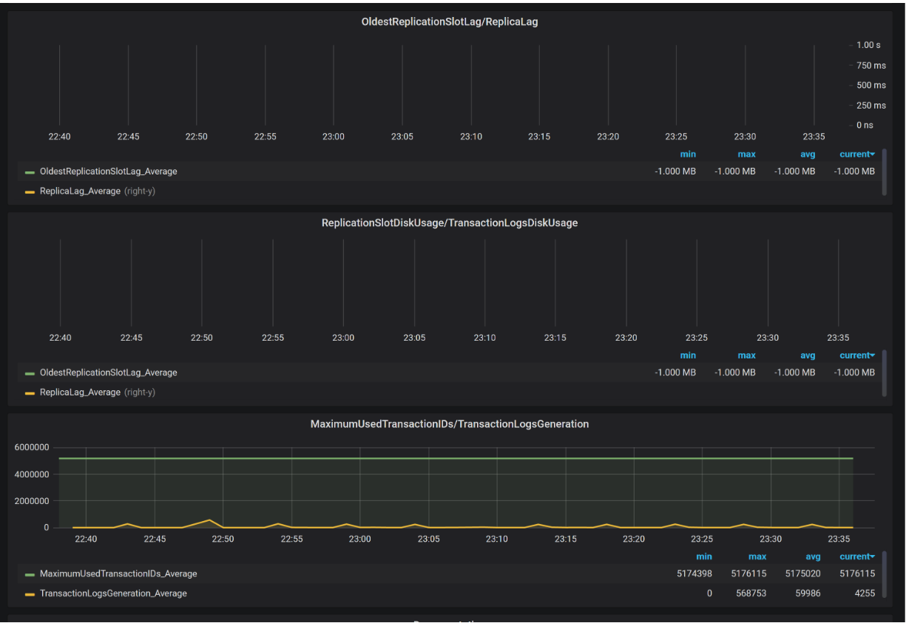
AWS –RDS-POSTGRESQL

Slide 8
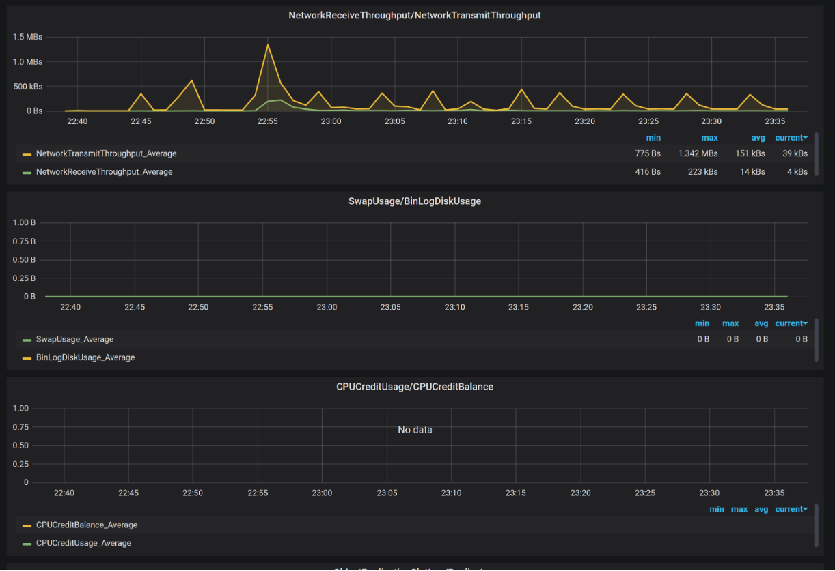
AWS –RDS-POSTGRESQL

Slide 9
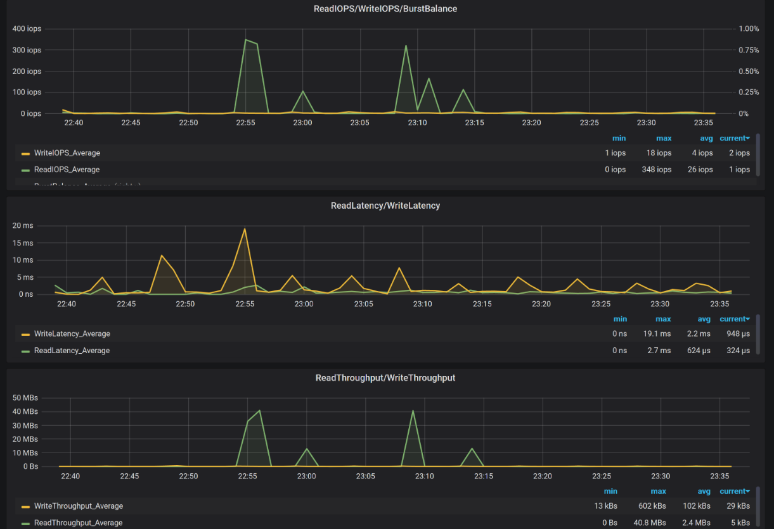
AWS –RDS-POSTGRESQL

Slide 10
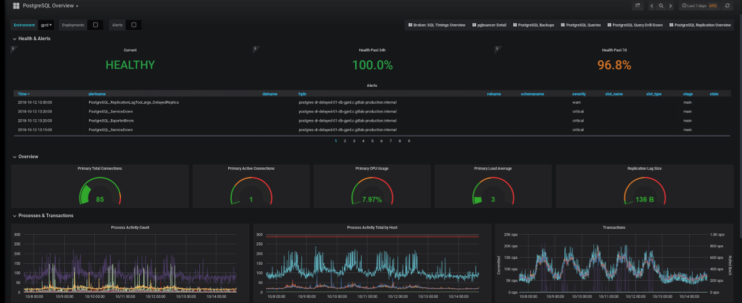
AWS –RDS-POSTGRESQL

Slide 11
AWS - VPN Monitoring
Use Case Name | Availability Tunnel State, Tunnel Data In, Tunnel Data Out
Mechanism ( Logs based / KPI based) | KPI Based – Have dashboards to monitor the VPN Availability, Tunnel Data In, Tunnel Data Out and make sure that we alert rules placed against those Logs dashboards.
Sources of Logs / Source of KPI | AWS VPN – VPN monitoring dashboards
Logs Format | NA
Logs Dashboards | NA
Perf Dashboards | AWS VPN Dashboard (monitoring of VPN Availability Tunnel Data In/Out)
Alert Correlation | Availability != 1 <Resource Group><Resource><Source-Type><ip/id><message><status code> <severity> <Type> Source-Type – Ex. Node / Application / Database / Jobs / IAM / Type – Performance / Reliability / Security / Vulnerability / Data Protection
Steps for RCA | Go to VPC Flow Logs dashboard of alerts Identify which VPN Health Check / Availability
Remediation | Generate Tickets

Slide 12
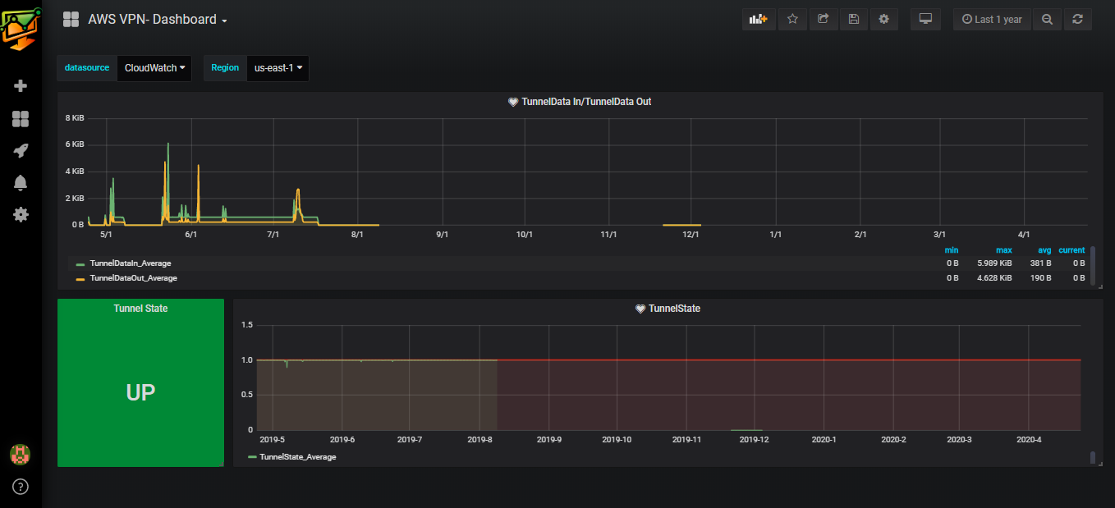
AWS – VPN Monitoring

Slide 13
AWS – VPC Flow Logs
Use Case Name | VPC Flow Logs – Discover network traffic
Mechanism ( Logs based / KPI based) | Logs Based – Have dashboards to monitor the network traffic, gives the list of top resource and destination addresses and make sure that we alert rules placed against those Logs dashboards.
Sources of Logs / Source of KPI | CloudWatch – VPC Flow Logs monitoring dashboards ( focus on ip based tabular dashboards).
Logs Format | NA
Logs Dashboards | NA
Perf Dashboards | AWS VPC Dashboard (monitoring of VPC Flow Logs)
Alert Correlation | Number of reject request > 200 <Source-Type><id><message><status code> <severity> <Type> <ResponseTime> Source-Type – <Acc ID><ENI IP><Src IP><dest IP>…… REJECT/ACCEPT OK Type – Security / Data Protection
Steps for RCA | Go to VPC Flow Logs dashboard of alerts Identify which are the top reject request per minute
Remediation | Generate Tickets

Slide 14
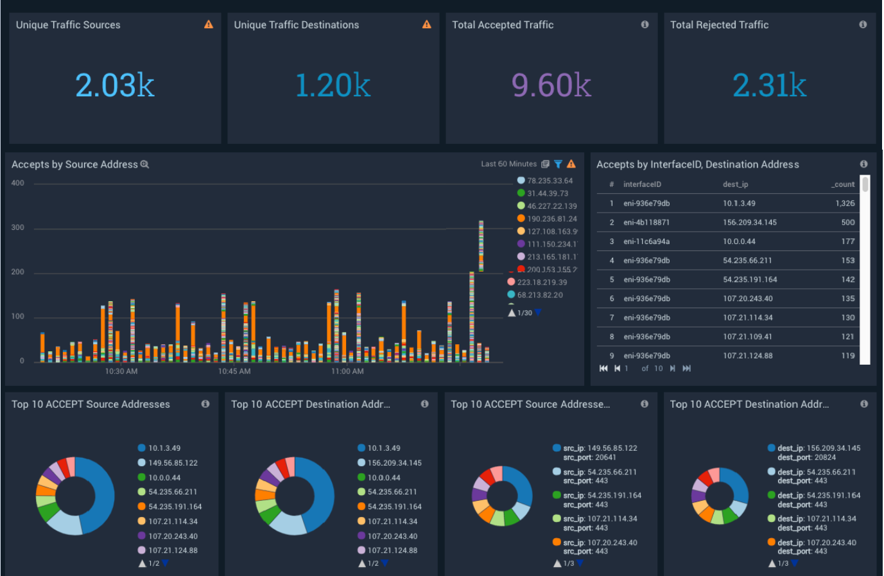
AWS – VPC Flow Logs

Slide 15
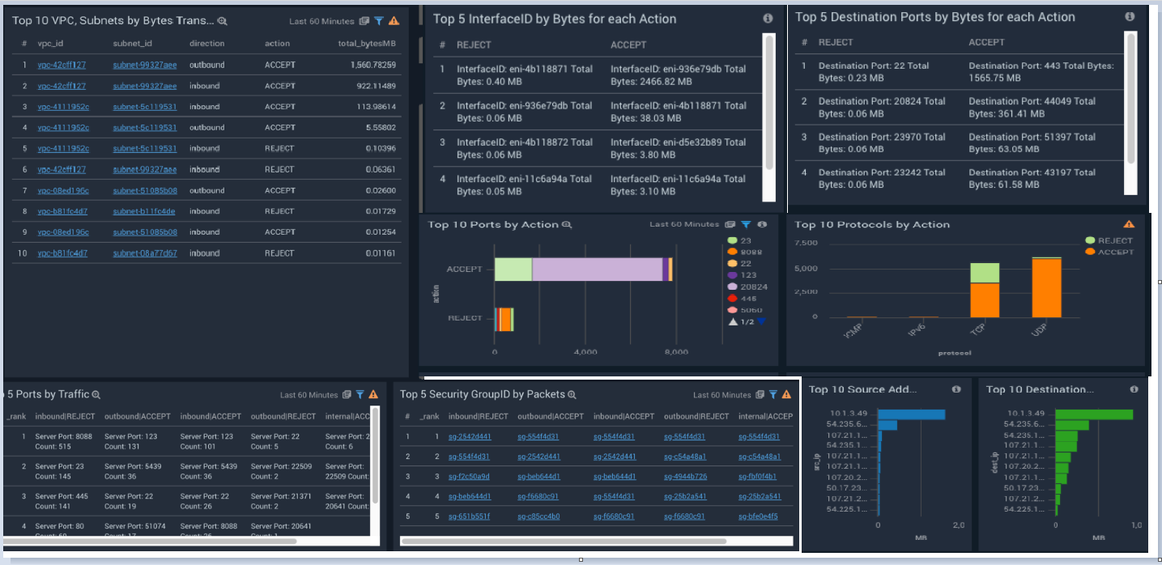
AWS – VPC Flow Logs

Slide 16
NGINX Monitoring
Use Case Name | NGINX – Discover non 200 response / latency / server error over time
Mechanism ( Logs based / KPI based) | Logs Based – Have dashboards to monitor request / response , error codes and compute average / percentile latency time of responses.
Sources of Logs / Source of KPI | CloudWatch – NGINX log monitoring Dashboard
Logs Format | NA
Logs Dashboards | NA
Perf Dashboards | NGINX Dashboard (monitoring of NGIX Logs)
Alert Correlation | Number of non 200 res > 0 <Source-Type><id><message><status code> <severity> <Type> <ResponseTime> Source-Type – <Acc ID><ENI IP><Src IP><dest IP>…… REJECT/ACCEPT OK Type – Application
Steps for RCA | Go to NGINX Logs dashboard of alerts Identify server error and latency for urls Find out the logs for the corresponding time and nail down the RCA.
Remediation | Generate Tickets

Slide 17
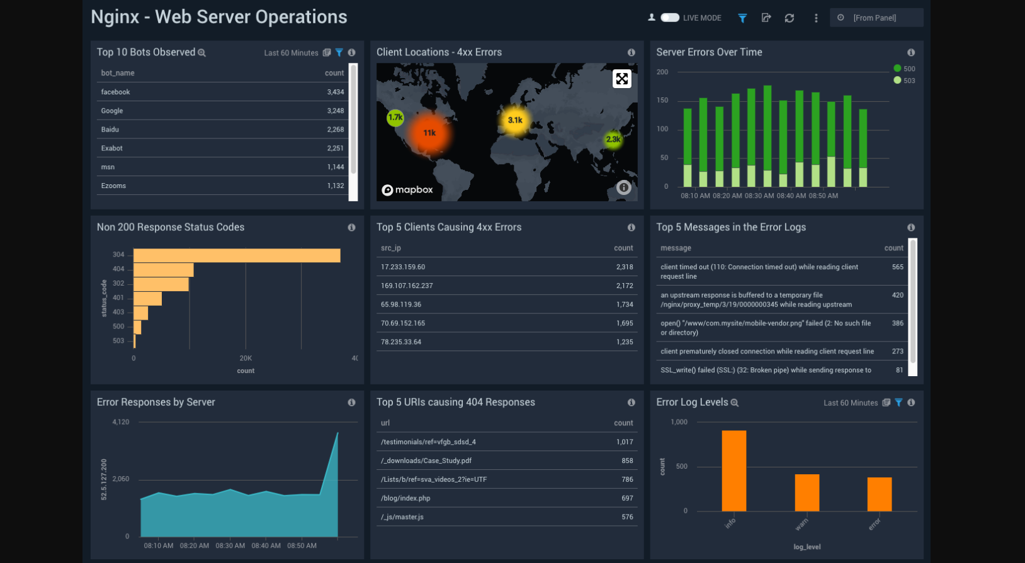
AWS – nginx

Slide 18
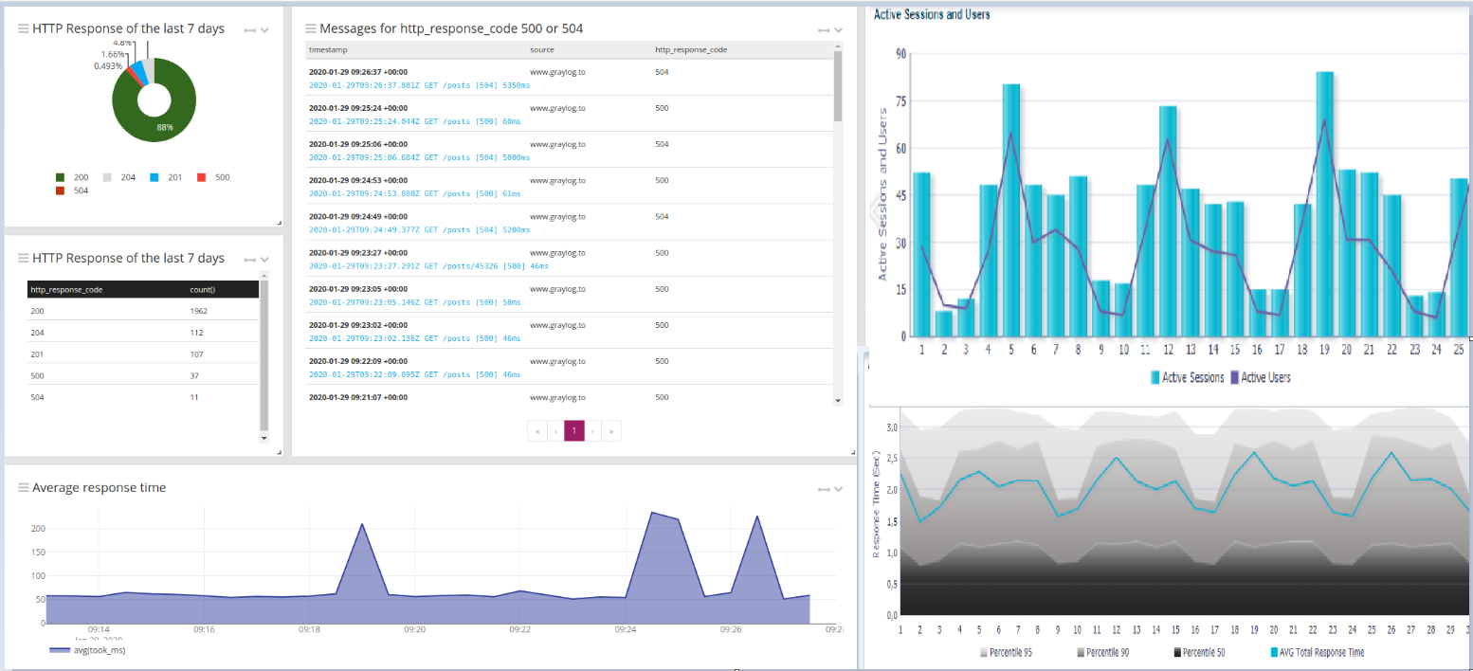
AWS – nginx

Slide 19
AWS – nginx-format
http {
log_format upstream_time '$remote_addr - $remote_user [$time_local] '
'"$request" $status $body_bytes_sent '
'"$http_referer" "$http_user_agent"'
'rt=$request_time uct="$upstream_connect_time" uht="$upstream_header_time" urt="$upstream_response_time"';
server {
access_log /spool/logs/nginx-access.log upstream_time;
...
}
}

Slide 20
Jobs Template
Use Case Name | Batch Jobs reliability Monitoring (Mostly ETL dataflow jobs)
Objective | Find out the root cause of failure or slow processing jobs.
Sources of Logs | Job details logs that is forwarded to cloud watch | Jobs logs are available in individual instances that is running the jobs and populating the logs in /var/log/job/job.log ( rotating ) , u need to tail them and forward them.
Logs Format | <time> <JobId>, <Step Name> < Task Name> <message><status code> <severity> <Type> <ReasonCode> <CompletionTime> Type – Job , Status_Code =0 success , …
Logs Dashboards | Dashboard1 ( Failed Jobs Today) , Dashboard2 ( Top 10 Time consuming jobs) , Dashboard3 ( Mostly failed jobs by category ) , Dashboard4 ( Job Status Today)
Perf Dashboards | Dashboard1 (Weekly Performance Trend by job)
Alert Correlation | Any Job Failure Completion Time > 30 mins,
Steps for RCA | Go to logs dashboard of Failed Jobs Today Identify RC of failure by looking at the logs of that job_id and that days logs Do some realtime diagnose if require
Remediation | Generate Tickets / Associate Workflows / Trigger Automation / Ignore Manually / Batch Ignore

