Slide 1
AWS-RDS-POSTGRESQL
Use Case Name | Monitor the Storage space usage of AWS RDS postgresql database and generate alert depending on usage rule.
Mechanism ( Logs based / KPI based) | KPI Based – Have dashboards to monitor the filesystem and disk usage of AWS RDS instance and make sure that we alert rules placed against those KPI dashboards.
Sources of Logs / Source of KPI | AWS RDS – Storage Consumption monitoring dashboards
Logs Format | NA
Logs Dashboards | NA
Perf Dashboards | AWS RDS Dashboard (monitoring of Stoarge Consumption)
Alert Correlation | Storage usage > 90% <Resource Group><Resource><Source-Type><ip/id><message><status code> <severity> <Type> Source-Type – Ex. Node / Application / Database / Jobs / IAM / Type – Performance / Reliability / Security / Vulnerability / Data Protection
Steps for RCA | Go to kpi dashboard of alert Identify which database filesystem getting filled up
Remediation | Generate Tickets and Perform storage expansion Workflows based on ticket approval

Slide 2
AWS-RDS-POSTGRESQL
Use Case Name | Monitor the CPU usage of AWS RDS postgresql database and generate alert depending on usage rule.
Mechanism ( Logs based / KPI based) | KPI Based – Have dashboards to monitor the CPU usage of AWS RDS instance and make sure that we alert rules placed against those KPI dashboards.
Sources of Logs / Source of KPI | AWS RDS – Storage Consumption monitoring dashboards
Logs Format | NA
Logs Dashboards | NA
Perf Dashboards | AWS RDS Dashboard (monitoring of CPU utilization)
Alert Correlation | Max CPU usage > 40% <Resource Group><Resource><Source-Type><ip/id><message><status code> <severity> <Type> Source-Type – Ex. Node / Application / Database / Jobs / IAM / Type – Performance / Reliability / Security / Vulnerability / Data Protection
Steps for RCA | Go to kpi dashboard of alert Identify which database CPU utilization is high Look at other KPI ‘s like concurrent connections to see that time no of active connections.
Remediation | Generate Tickets

Slide 3
AWS-RDS-POSTGRESQL
Use Case Name | Monitor the average read/ write latency of postgresql database and generate alert depending on usage rule.
Mechanism ( Logs based / KPI based) | KPI Based – Have dashboards to monitor the Read/Write latency of AWS RDS instance and make sure that we alert rules placed against those KPI dashboards.
Sources of Logs / Source of KPI | AWS RDS – Read/ write latency dashboards
Logs Format | NA
Logs Dashboards | NA
Perf Dashboards | AWS RDS Dashboard (monitoring of Read Write Latency)
Alert Correlation | Max latency > 10 ms <Resource Group><Resource><Source-Type><ip/id><message><status code> <severity> <Type> Source-Type – Ex. Node / Application / Database / Jobs / IAM / Type – Performance / Reliability / Security / Vulnerability / Data Protection
Steps for RCA | Go to kpi dashboard of alert Identify which database read / write latecy is high Look at the disk speed and network speed to do a deep dive.
Remediation | Generate Tickets

Slide 4
AWS-RDS-POSTGRESQL
Use Case Name | Monitor the concurrent connections AWS RDS postgresql database and generate alert depending on usage rule.
Mechanism ( Logs based / KPI based) | KPI Based – Have dashboards to monitor the concurrent connection AWS RDS instance and make sure that we alert rules placed against those KPI dashboards.
Sources of Logs / Source of KPI | AWS RDS – Concurrent connections monitoring dashboards
Logs Format | NA
Logs Dashboards | NA
Perf Dashboards | AWS RDS Dashboard (monitoring of concurrent connections)
Alert Correlation | Max connections > 30 <Resource Group><Resource><Source-Type><ip/id><message><status code> <severity> <Type> Source-Type – Ex. Node / Application / Database / Jobs / IAM / Type – Performance / Reliability / Security / Vulnerability / Data Protection
Steps for RCA | Go to kpi dashboard of alert Identify which database concurrent connection is high Look at the database which apps are holding the connections, any app that is constantly holding it.
Remediation | Generate Tickets

Slide 5
AWS-RDS-POSTGRESQL
Use Case Name | Monitor the concurrent connections AWS RDS postgresql database and generate alert depending on usage rule.
Mechanism ( Logs based / KPI based) | KPI Based – Have dashboards to monitor the concurrent connection AWS RDS instance and make sure that we alert rules placed against those KPI dashboards.
Sources of Logs / Source of KPI | AWS RDS – Concurrent connections monitoring dashboards
Logs Format | NA
Logs Dashboards | NA
Perf Dashboards | AWS RDS Dashboard (monitoring of concurrent connections)
Alert Correlation | Max connections > 30 <Resource Group><Resource><Source-Type><ip/id><message><status code> <severity> <Type> Source-Type – Ex. Node / Application / Database / Jobs / IAM / Type – Performance / Reliability / Security / Vulnerability / Data Protection
Steps for RCA | Go to kpi dashboard of alert Identify which database concurrent connection is high Look at the database which apps are holding the connections, any app that is constantly holding it.
Remediation | Generate Tickets

Slide 6
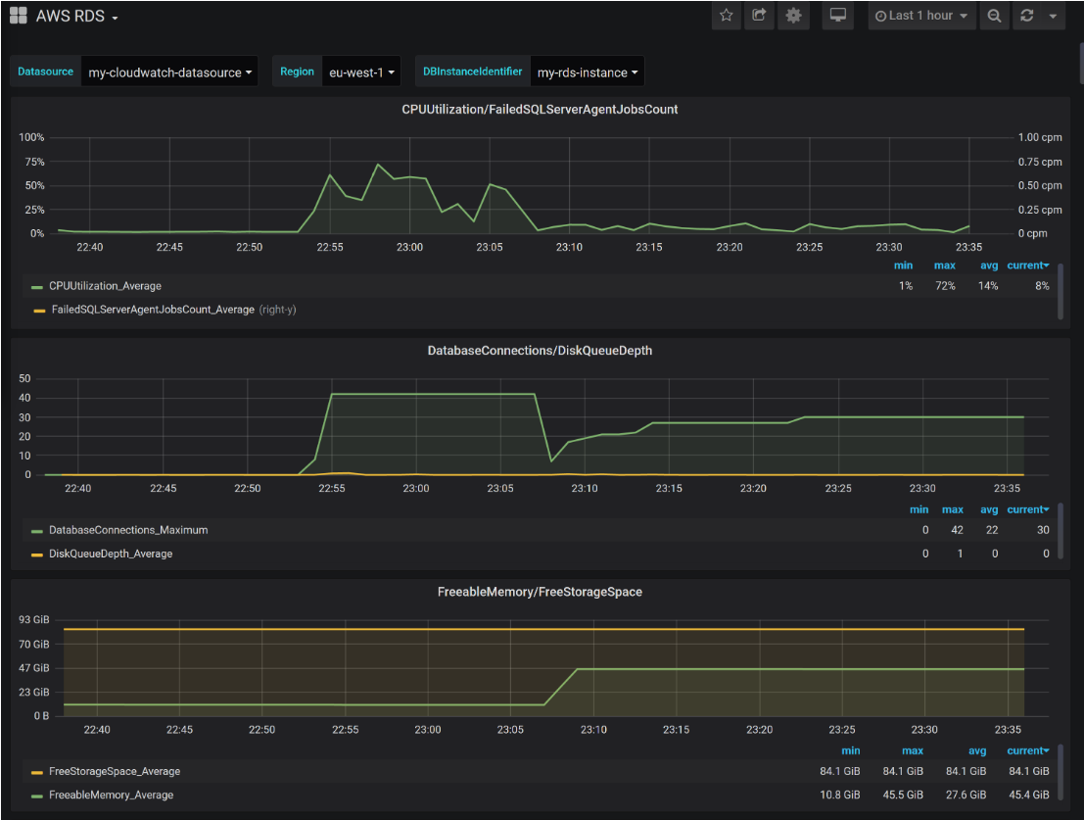
AWS –RDS-POSTGRESQL

Slide 7
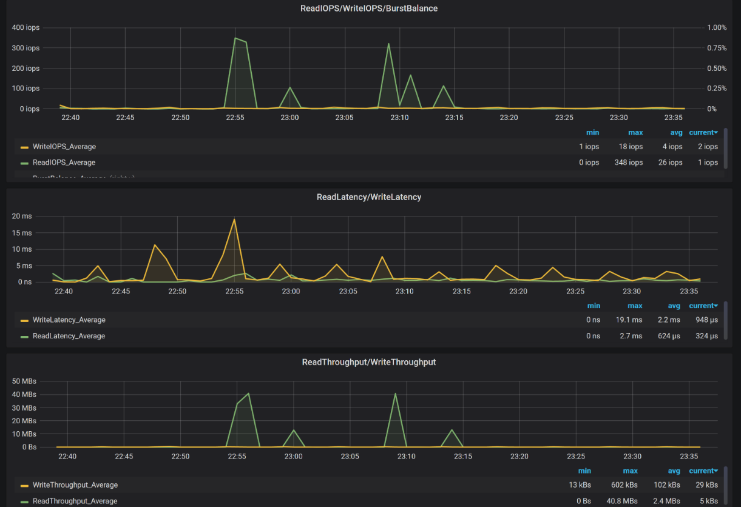
AWS –RDS-POSTGRESQL

Slide 8
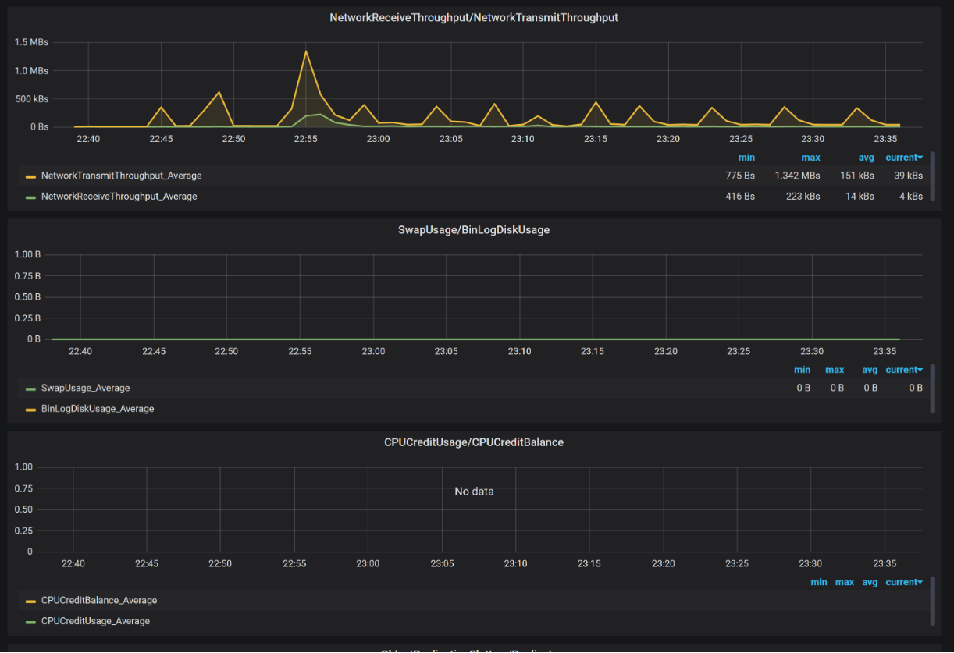
AWS –RDS-POSTGRESQL

Slide 9
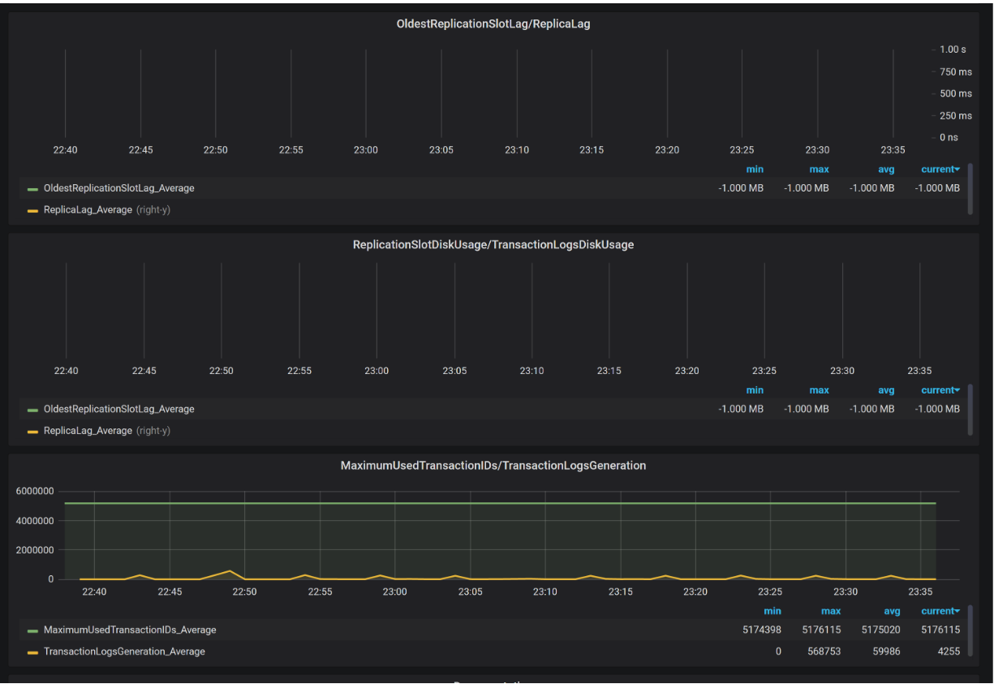
AWS –RDS-POSTGRESQL

