Slide 1
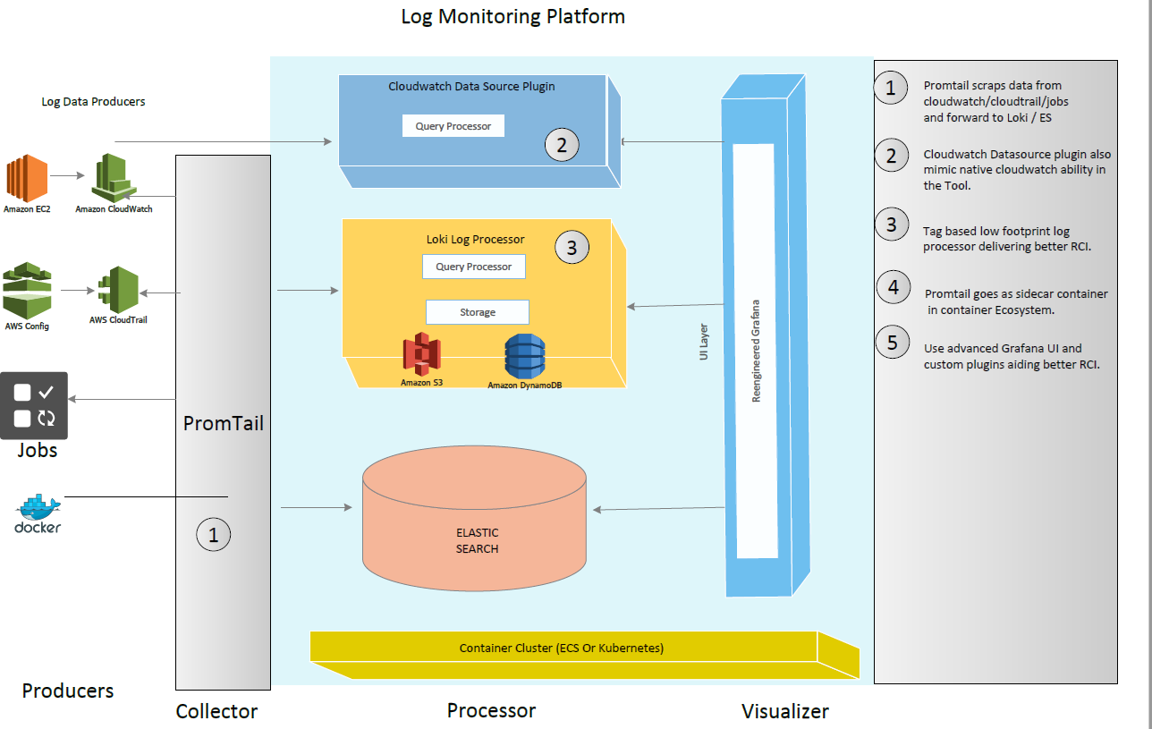
Platform Architecture
  Need
  Every business monitoring requirement is unique, customers need a highly flexible platform so that they can build highly customizable purpose-built solutions at speed and lower economies.
  Why Us?
  Delivered purpose-built monitoring for large business.
  Build any custom solutions using proven framework.
  Buy capabilities , not any propitiatory closed product.
  A team able to collect and deliver business monitoring requirement at speed.

Slide 2
Intent
  Need
  Cloud native Fast-Data & Big-Data platform that serves as single source of truth for real -time , olap , relational data catering any data source (unstructured , semi- structured un-structured) .
  Why Us?
  Delivered purpose-built analytics for large business.
  Open framework to
  1) Automate Data Management & Query optimization
  2)Integrated Policy based alert & remediation
  3)NLP & Deep Learning Enabled
  -- Resource pool trained to
  Data Management
  Data Governance
  Smart Analytics
Agent Less
Scrap existing Cloud Native Services
Easy to scale out – avoid full text indexing
Do more ad-hoc analysis in browser
Integrate tools like Jaeger for Better RCA
Kubernetes & Container Ecosystem Friendly
Good for both microservices & monolith

Slide 3
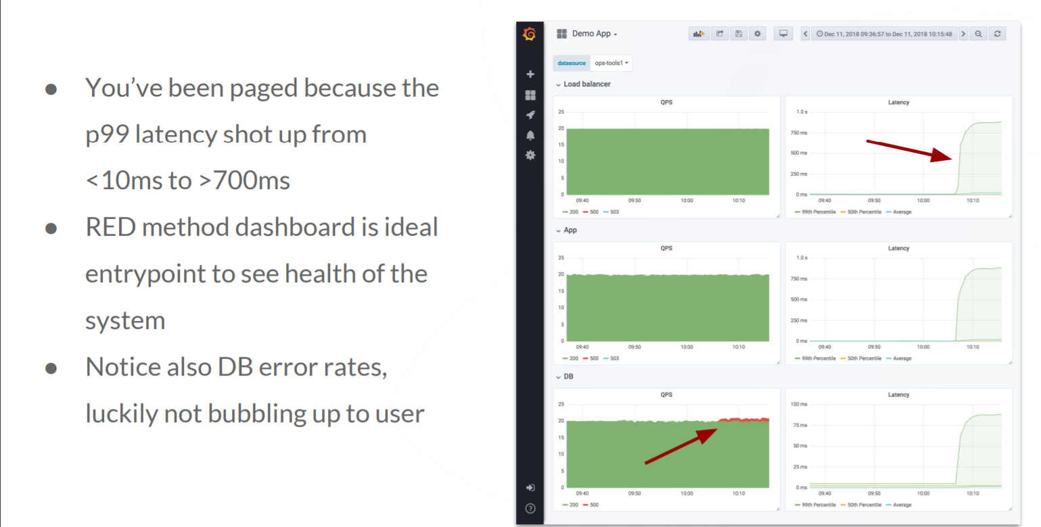
RCA Dashboard for App
  Need
  Cloud native Fast-Data & Big-Data platform that serves as single source of truth for real -time , olap , relational data catering any data source (unstructured , semi- structured un-structured) .
  Why Us?
  Delivered purpose-built analytics for large business.
  Open framework to
  1) Automate Data Management & Query optimization
  2)Integrated Policy based alert & remediation
  3)NLP & Deep Learning Enabled
  -- Resource pool trained to
  Data Management
  Data Governance
  Smart Analytics

Slide 4
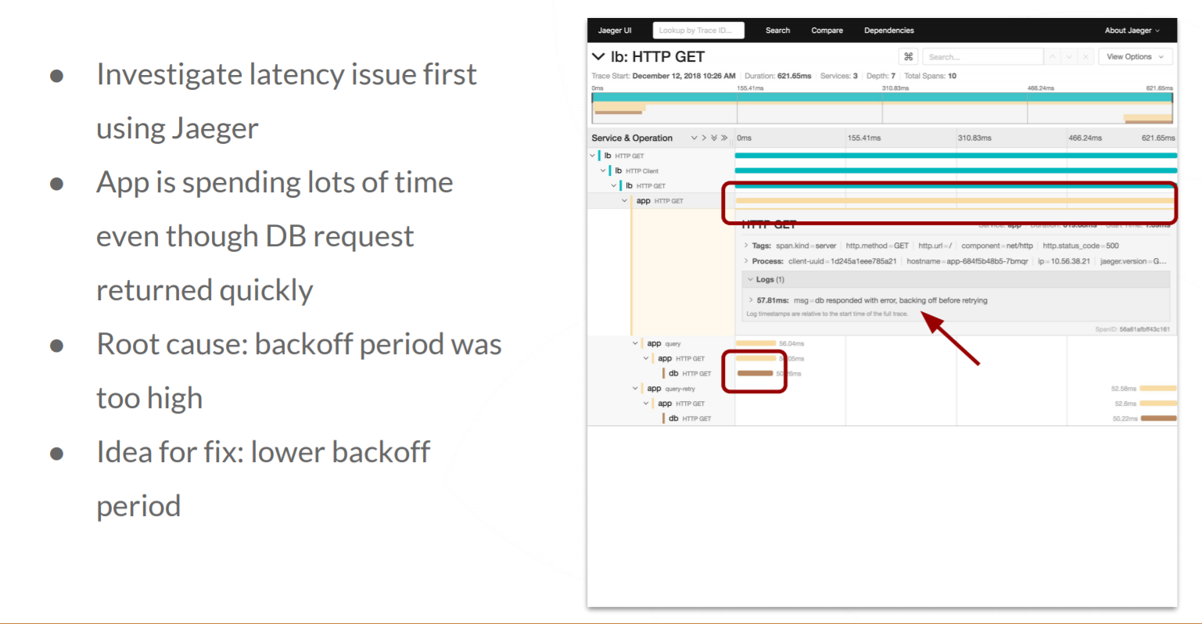
Debug
  Need
  Cloud native Fast-Data & Big-Data platform that serves as single source of truth for real -time , olap , relational data catering any data source (unstructured , semi- structured un-structured) .
  Why Us?
  Delivered purpose-built analytics for large business.
  Open framework to
  1) Automate Data Management & Query optimization
  2)Integrated Policy based alert & remediation
  3)NLP & Deep Learning Enabled
  -- Resource pool trained to
  Data Management
  Data Governance
  Smart Analytics

Slide 5
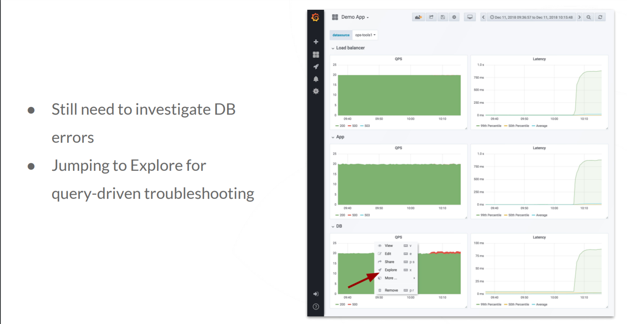
Explore more on DB
  Need
  Cloud native Fast-Data & Big-Data platform that serves as single source of truth for real -time , olap , relational data catering any data source (unstructured , semi- structured un-structured) .
  Why Us?
  Delivered purpose-built analytics for large business.
  Open framework to
  1) Automate Data Management & Query optimization
  2)Integrated Policy based alert & remediation
  3)NLP & Deep Learning Enabled
  -- Resource pool trained to
  Data Management
  Data Governance
  Smart Analytics

Slide 6
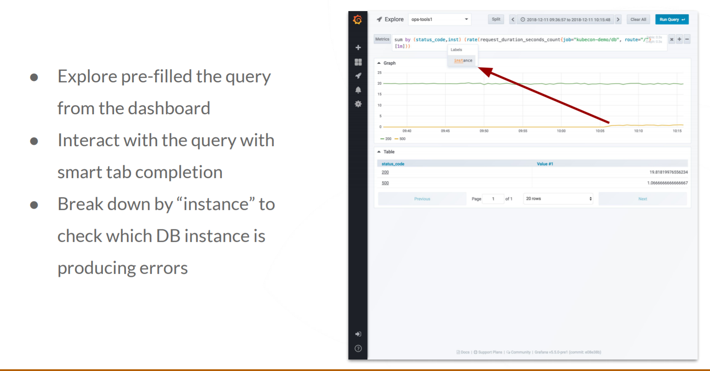
Explore for Query/Instance
  Need
  Cloud native Fast-Data & Big-Data platform that serves as single source of truth for real -time , olap , relational data catering any data source (unstructured , semi- structured un-structured) .
  Why Us?
  Delivered purpose-built analytics for large business.
  Open framework to
  1) Automate Data Management & Query optimization
  2)Integrated Policy based alert & remediation
  3)NLP & Deep Learning Enabled
  -- Resource pool trained to
  Data Management
  Data Governance
  Smart Analytics

Slide 7
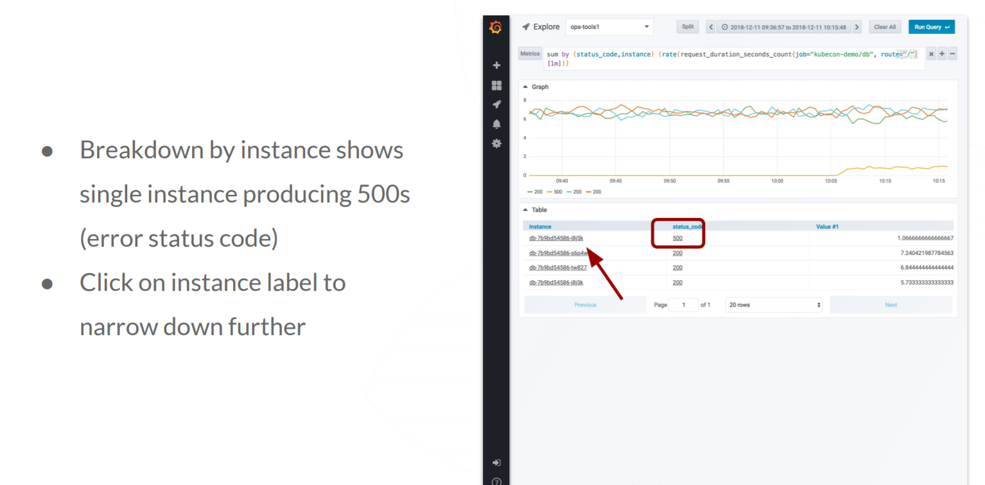
Further Breakdown
  Need
  Cloud native Fast-Data & Big-Data platform that serves as single source of truth for real -time , olap , relational data catering any data source (unstructured , semi- structured un-structured) .
  Why Us?
  Delivered purpose-built analytics for large business.
  Open framework to
  1) Automate Data Management & Query optimization
  2)Integrated Policy based alert & remediation
  3)NLP & Deep Learning Enabled
  -- Resource pool trained to
  Data Management
  Data Governance
  Smart Analytics

Slide 8
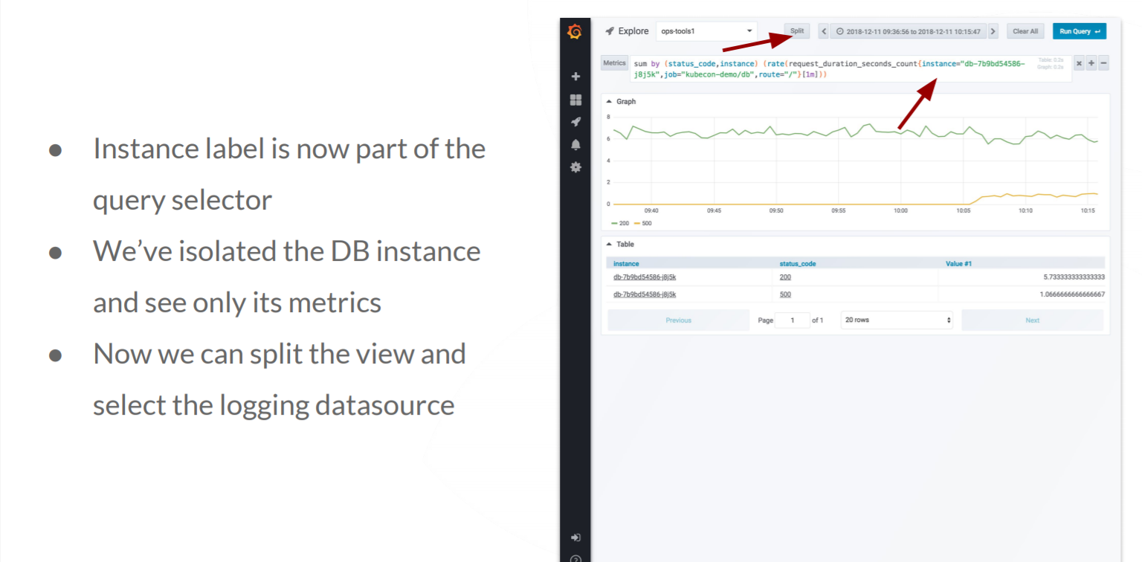
Further Breakdown
  Need
  Cloud native Fast-Data & Big-Data platform that serves as single source of truth for real -time , olap , relational data catering any data source (unstructured , semi- structured un-structured) .
  Why Us?
  Delivered purpose-built analytics for large business.
  Open framework to
  1) Automate Data Management & Query optimization
  2)Integrated Policy based alert & remediation
  3)NLP & Deep Learning Enabled
  -- Resource pool trained to
  Data Management
  Data Governance
  Smart Analytics

Slide 9
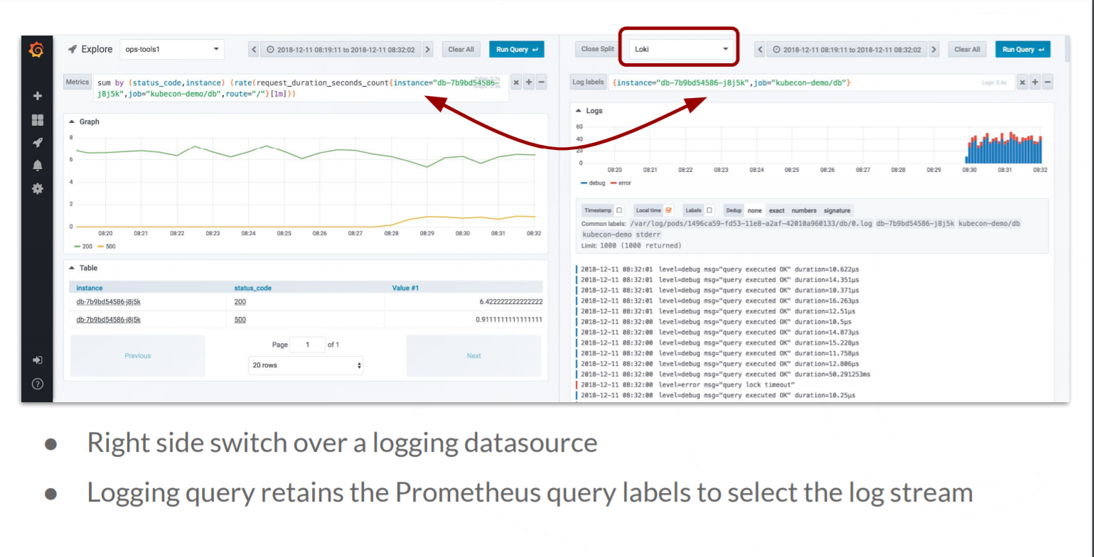
Split View
  Need
  Cloud native Fast-Data & Big-Data platform that serves as single source of truth for real -time , olap , relational data catering any data source (unstructured , semi- structured un-structured) .
  Why Us?
  Delivered purpose-built analytics for large business.
  Open framework to
  1) Automate Data Management & Query optimization
  2)Integrated Policy based alert & remediation
  3)NLP & Deep Learning Enabled
  -- Resource pool trained to
  Data Management
  Data Governance
  Smart Analytics

Slide 10
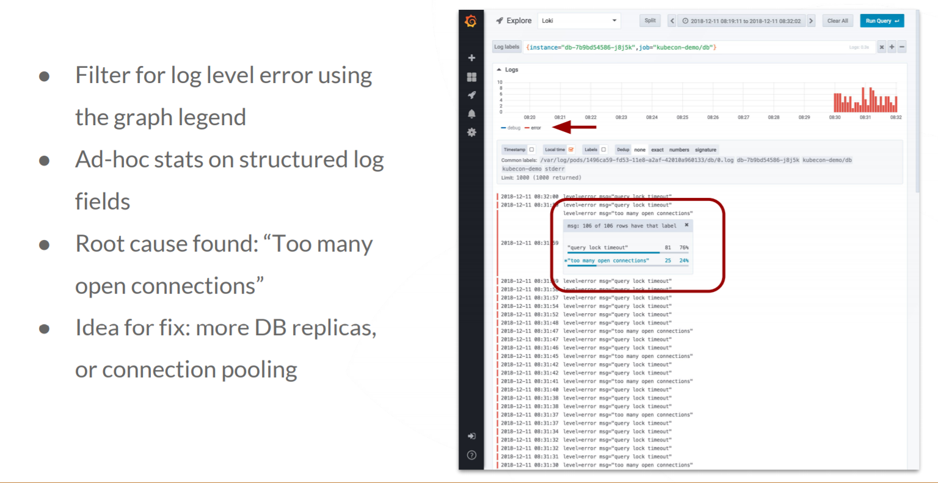
Drill Down
  Need
  Cloud native Fast-Data & Big-Data platform that serves as single source of truth for real -time , olap , relational data catering any data source (unstructured , semi- structured un-structured) .
  Why Us?
  Delivered purpose-built analytics for large business.
  Open framework to
  1) Automate Data Management & Query optimization
  2)Integrated Policy based alert & remediation
  3)NLP & Deep Learning Enabled
  -- Resource pool trained to
  Data Management
  Data Governance
  Smart Analytics

Slide 11
Use Case Template
Use Case Name | Response Time Monitoring of Public facing Website <XXXXXXXX>
Objective | Find out the root cause of latency and slow loading of Top 5 worst hit features of <siteXX>
Sources of Logs | LB Logs ,Api Gateway Logs, Webserver Logs, DB instances Logs ( All the above logs will be available in cloudwatch)
Logs Format | <resource><user>,<ip/id>, <time><operation><message><status code> <severity> <Type> <ResponseTime> Type – Ex. Application , Service Health, System , Activity Log, Config Change Operation – Ex. Get a page / add item to cart
Logs Dashboards | Dashboard1 , Dashboard2, Dashboard3 , Dashboard4
Perf Dashboards | Dashboard1 (RCA Dashboard) , Dashboard2 (Error Code), Dashboard3 (Tracing) , Dashboard4
Alert Correlation | Anything return code 500, Response Time > 2 Sec,
Steps for RCA | Go to RCA Dashboard for any latency / Error code Identify RC of any latency from trace (app / database ) Identify logs corresponding to error codes Do some rea-ltime diagnose if require
Remediation | Generate Tickets / Associate Workflows / Trigger Automation / Ignore Manually / Batch Ignore

