Slide 1
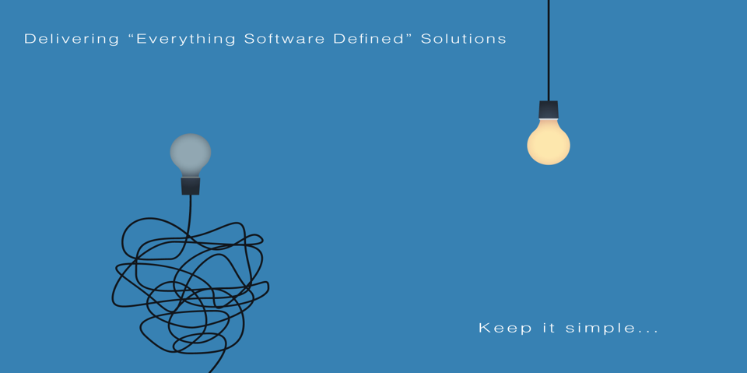
All information contained in this document and communicated to you by synectiks is confidential and proprietary to synectiks (“confidential information”). The information and any pricing data submitted here is non-binding and for evaluation purposes only and is subject to adjustment or modification by synectiks after its review, consideration, and negotiation of the terms and conditions of a definitive final contract. The data and information contained herein may not be reproduced, published or distributed to, or for, any third parties without the express prior written consent of synectiks.

Slide 2
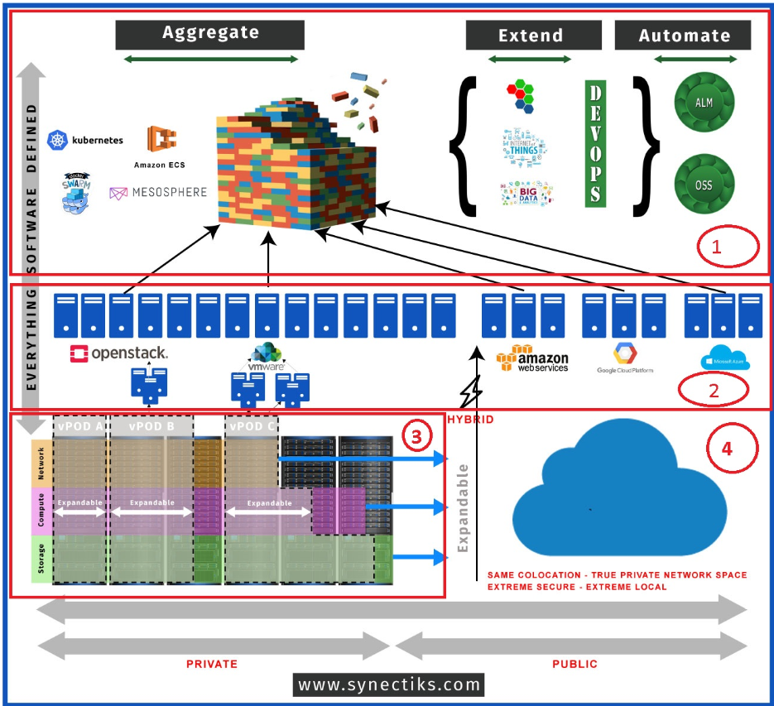
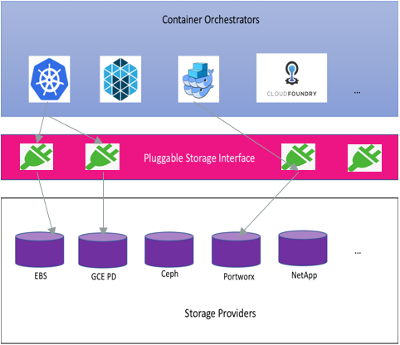
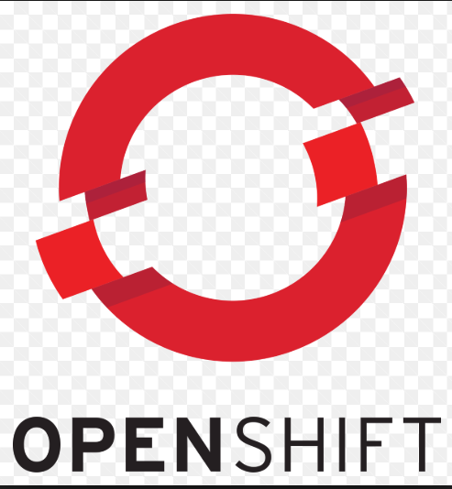
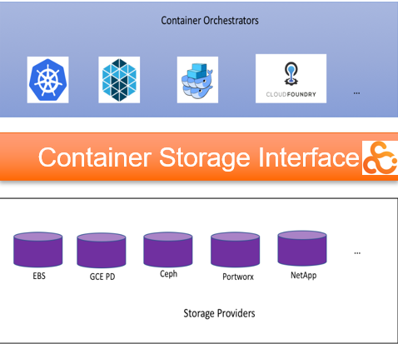
/Total Architecture
Use Cases
SDI-> NFV/SDN -> Storage Plugin -> Storage
SDI -> NFV/SDN -> COS -> COS Plugin (Volume Plugins) -> Storage
SDI-> SDN/BM -> COS -> COS Plugin (Volume Plugins) -> Storage
SDI-> SDN/BM -> COS -> SAAS Orchestrator(CSI) -> Storage
STORAGE
Current State
Futuristic

Slide 3
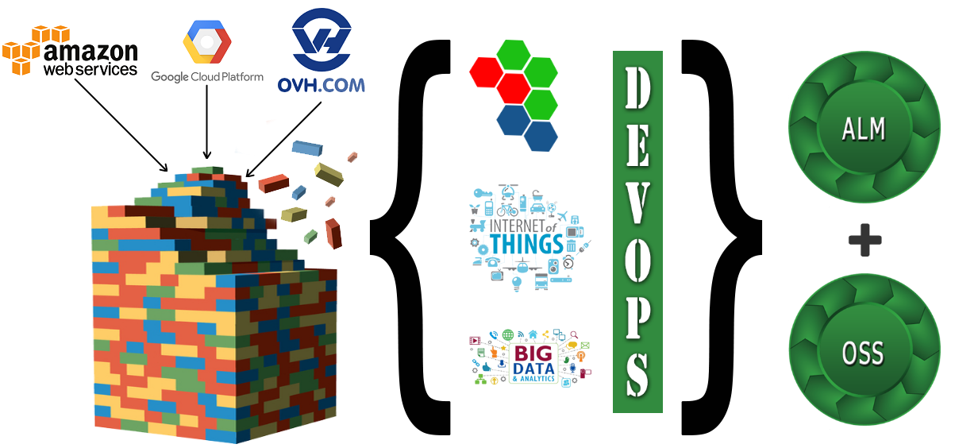
/Rapid App Development
Establish ALM
Develop Microservices / Bigdata / IOT apps with App blocks rapidly
Aggregate resources across any cloud and deploy Apps
Provision OSS/ Compliance

Slide 4
Synectiks Highlights
Strategic Driver –
Build Vs Buy + Open Ecosystem + Flexibility (Multi cloud + Hybrid)
Orchestrating Everywhere
E2E Solutioning ( App/Compute/Network/ Storage)
Container & FAAS Ecosystem
Contributing Open Ecosystem
Help Embracing DevOps with skilled resource and Open Solutions

Slide 5




Specialties
BEST RESULT IS OUR PURPOSE
01/ INFRA AS CODE
Everything Software Defined, Create/Change/Manage infrastructure through pure code across clouds.
02/ CONTAINERIZATION/SERVERLESS
We firmly believe that customers will adopt the flexibility of developing containerized and serverless microservices across cloud and geographies.
04/ CONTINOUS DELIVERY & AUTOMATION
We help customers to establish the delivery pipelines of container/bigdata/ IOT application and provide them with Realtime insights on their application delivery.
01
04
02
03
03/ RAPID DEVELOPMENT
We develop Microservices, Bigdata, IOT applications based on proven frameworks.
© 2018 SYNECTIKS. All Rights Reserved. Proprietary and Confidential.

Slide 6
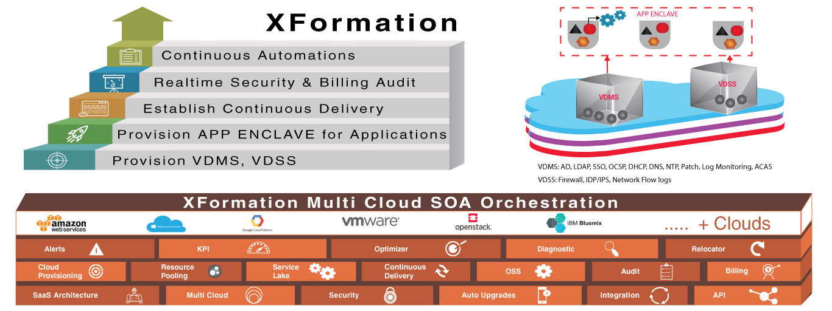
/Foundation
© 2018 SYNECTIKS. All Rights Reserved. Proprietary and Confidential.

Slide 7
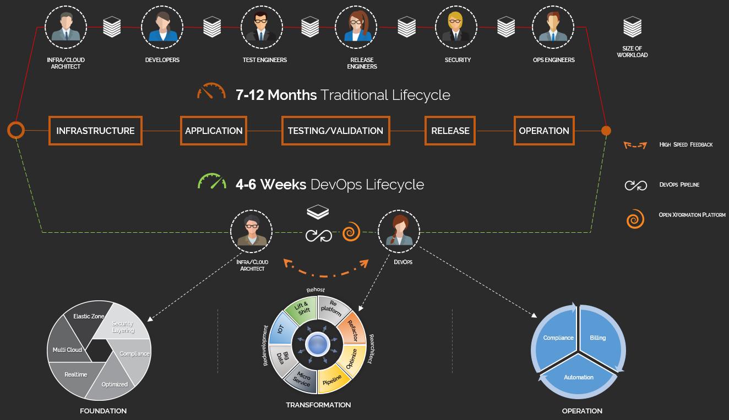

/Cultural Impact
DevOps Pipeline
Open Xformation Platform
© 2018 SYNECTIKS. All Rights Reserved. Proprietary and Confidential.

Slide 8
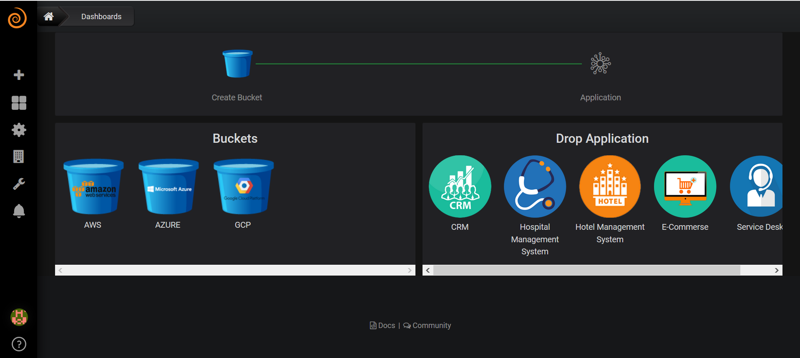
/Simplify

Slide 9
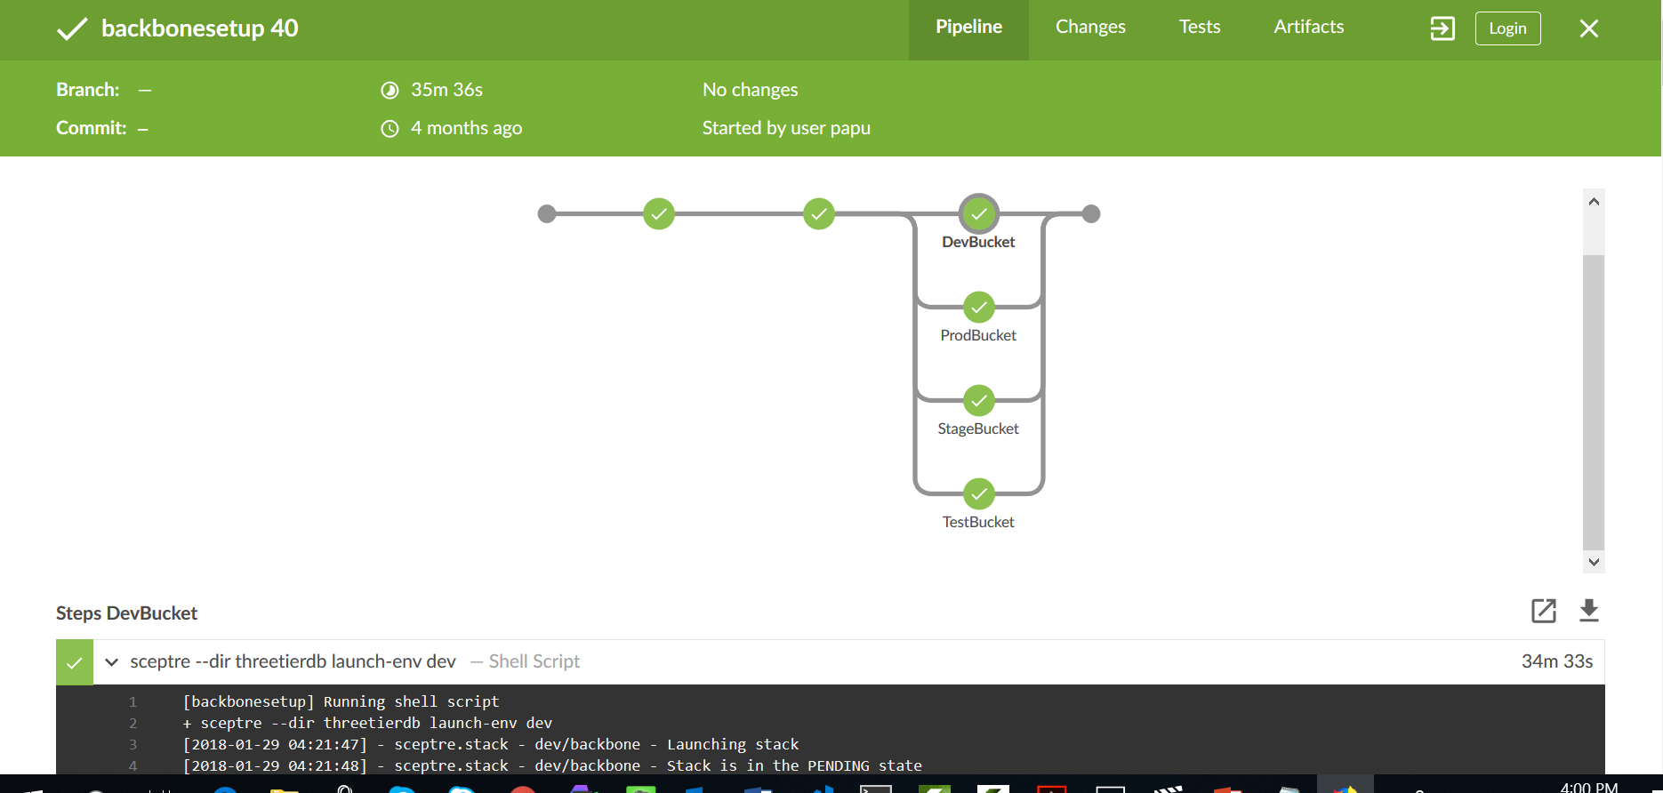
/Software Defined

Slide 10
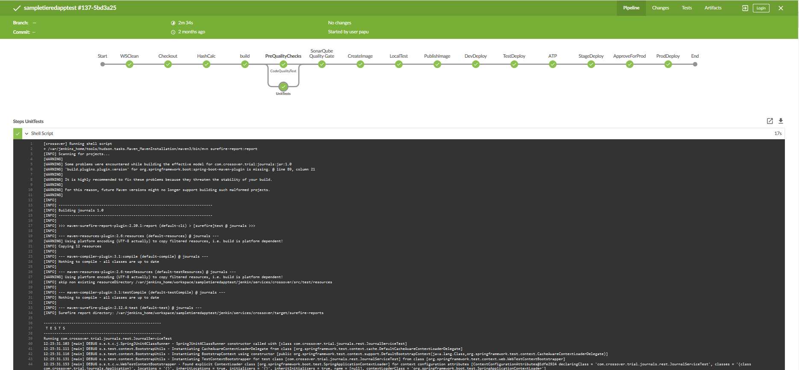
Continuous Delivery

Slide 11
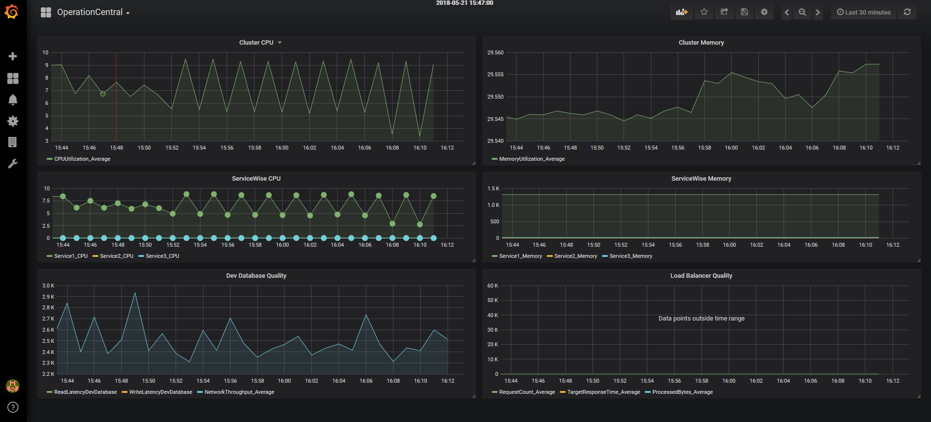
Operation Central

Slide 12
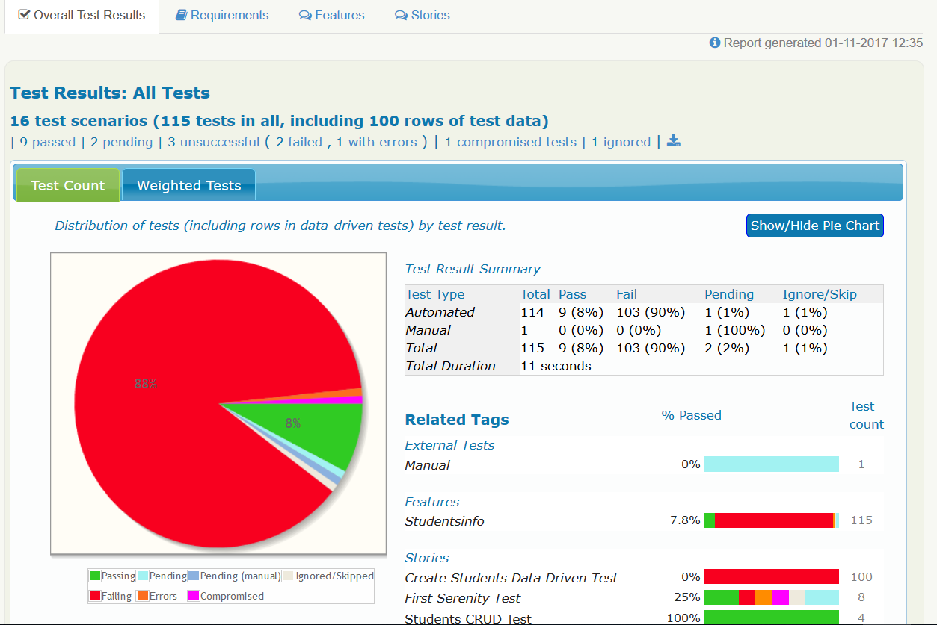
Service Quality Central

Slide 13
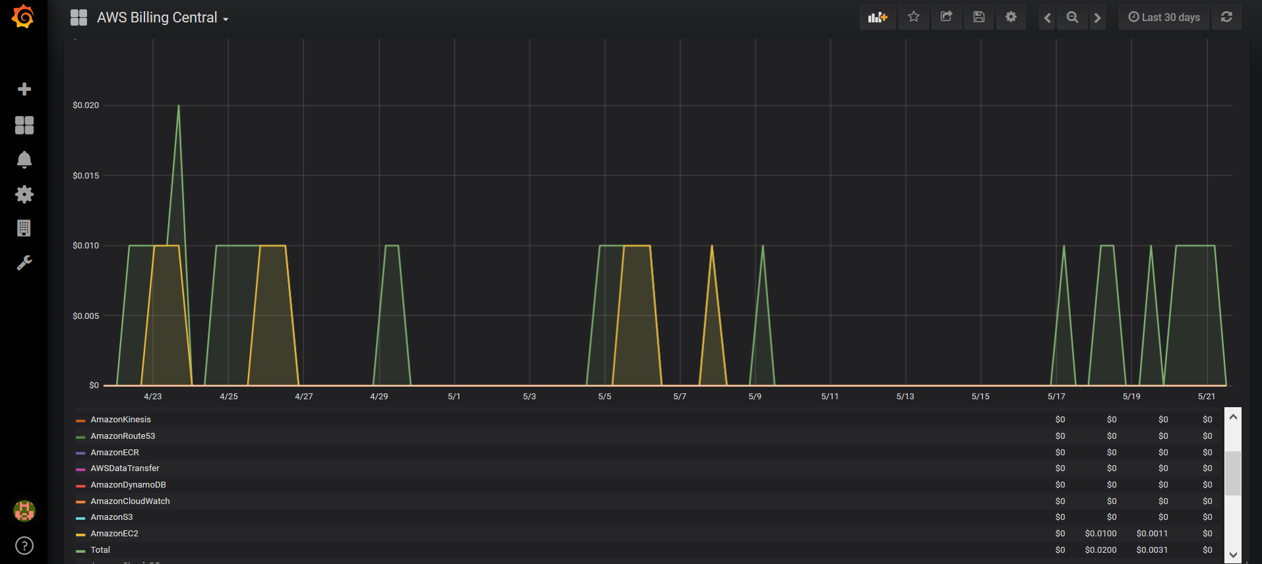
Billing Central

Slide 14
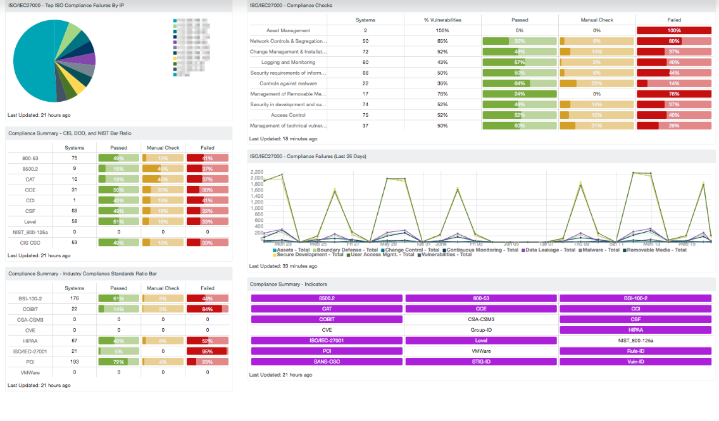
/Compliance Central

Slide 15


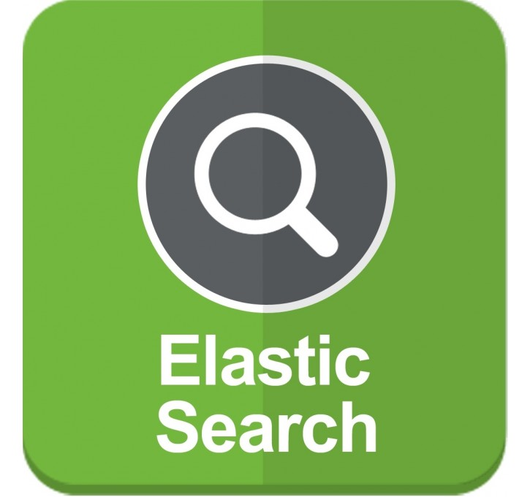

/Automation Engine
Master
Runs automations / audits / patches / application delivery / tests jobs into 1 single elastic cluster
Every job is written in python, in 1 single unified way, easily plugged to automation platform
Real-time visibility + diagnostics
Resilience
Agility
Reliability / Manageability / Extension
Elastic
Automation Bots
Continuous Audits
Continuous Delivery
Real-Time
Workforce
Workforce
Workforce
Time Series DB
Search DB
Resilient
MGMT(Visibility)

Slide 16


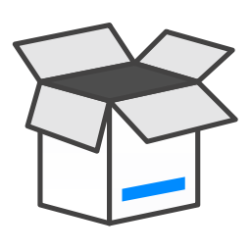
SOME KEY DIFFERENTIATOR
Expertise
As IT changes so the resource requirement. We understand the minimal requirement and designed only 2 Types of resources 1) Cloud Architect 2) DevOps
Experience
We have done large transformation projects with Toyota, Reliance and addressed the technology and cultural challenges effectively and brought the changes, resulting significant improvement and savings
Contribution
We are continuously contributing open XFormation platform that is accelerating the transformation @50% Time & Cost.
Experience
Specialized
Resource
Large
Transformations
Open Source
Contribution
© 2018 SYNECTIKS. All Rights Reserved. Proprietary and Confidential.

