Slide 1
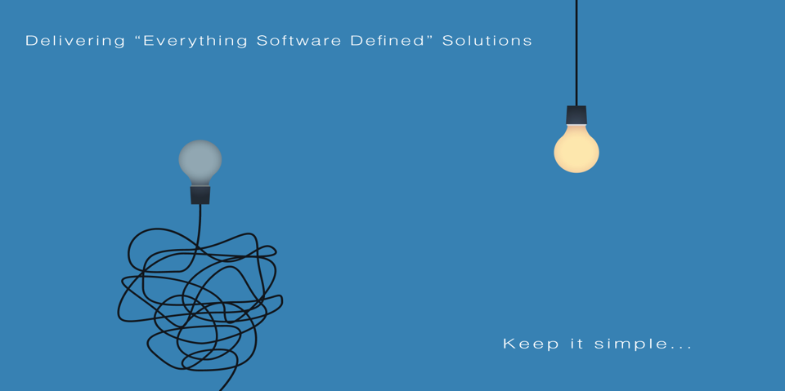
All information contained in this document and communicated to you by synectiks is confidential and proprietary to synectiks (“confidential information”). The information and any pricing data submitted here is non-binding and for evaluation purposes only and is subject to adjustment or modification by synectiks after its review, consideration, and negotiation of the terms and conditions of a definitive final contract. The data and information contained herein may not be reproduced, published or distributed to, or for, any third parties without the express prior written consent of synectiks.

Slide 2
/Automation Platform
NIFI
Dataflow Processing and Reporting Metrics Ingestion
Realtime Analytics
Synectiks Realtime Graphs & Charts
Navigate
OLAP Analytics
Superset -Detail Pivot Views
Excel Files
Query
Results
Query
Validation
Results
Results
Influxdb
Time Series Database
Ingestion
Postgres
RDBMS OLAP Database
Transformation
Scada Client
Notification
Action
Alerting Framework
Machine Learning
User Defined Functions

