Slide 1
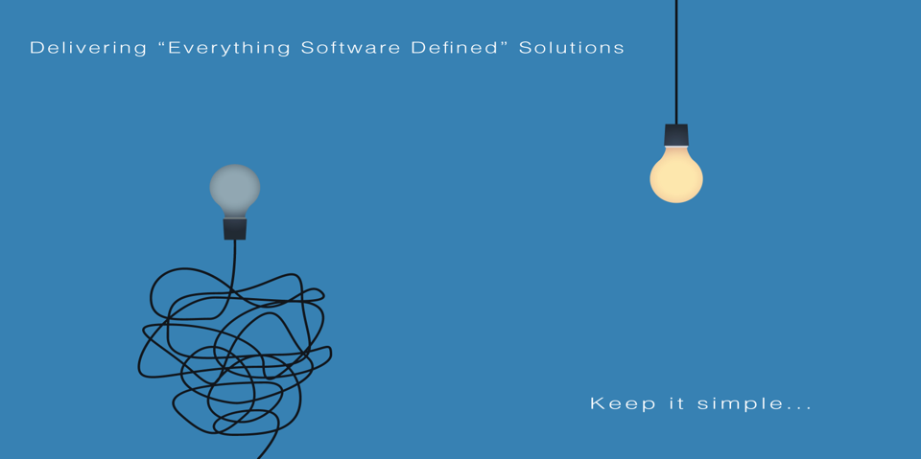
All information contained in this document and communicated to you by synectiks is confidential and proprietary to synectiks (“confidential information”). The information and any pricing data submitted here is non-binding and for evaluation purposes only and is subject to adjustment or modification by synectiks after its review, consideration, and negotiation of the terms and conditions of a definitive final contract. The data and information contained herein may not be reproduced, published or distributed to, or for, any third parties without the express prior written consent of synectiks.

Slide 2
  Realtime Monitoring Solution
  For
  Hospital Management System

Slide 3
Synectiks Solution Highlights
Provide actionable insights of IT resources and business processes by providing real time analytics that helps increase performance, manage variations and improve patient outcome
Open platform for beautiful Analytic & Monitoring
Single source of truth for Real time , OLAP , Relational Data.
Any source , any data , scripted data collections
Integrated policy based Alert processing

Slide 4
Fernandes Hospital Use Cases
Key Use Cases
  Site wise network in/out traffic monitoring
  Server & Database monitoring
  System availability & Performance Monitoring
  Patient Volume/ Demographics / Contribution Margin
  Revenue Pipeline Monitoring
  Power / Inventory Usage Analytics
  Operations / Clinical / Financial Variations
  Service Desk / Branding efficiencies

Slide 5

Synectiks Solution

Slide 6
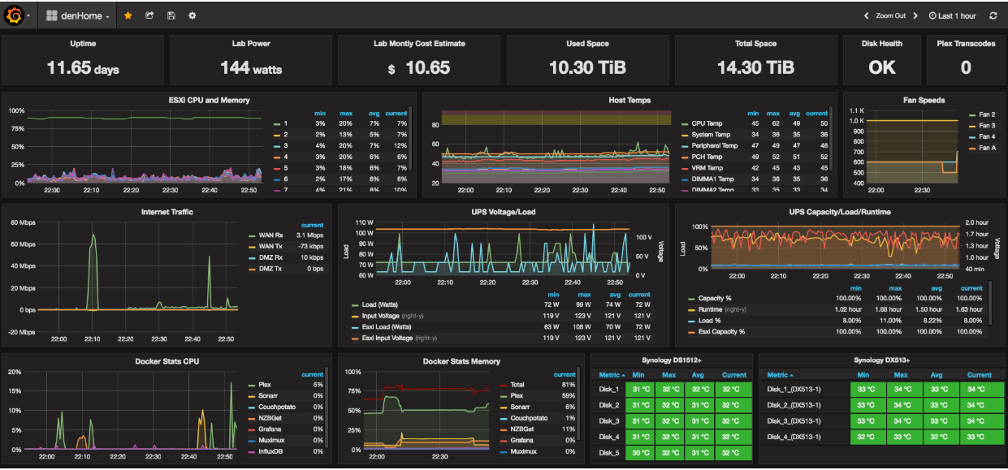
Visibility

Slide 7
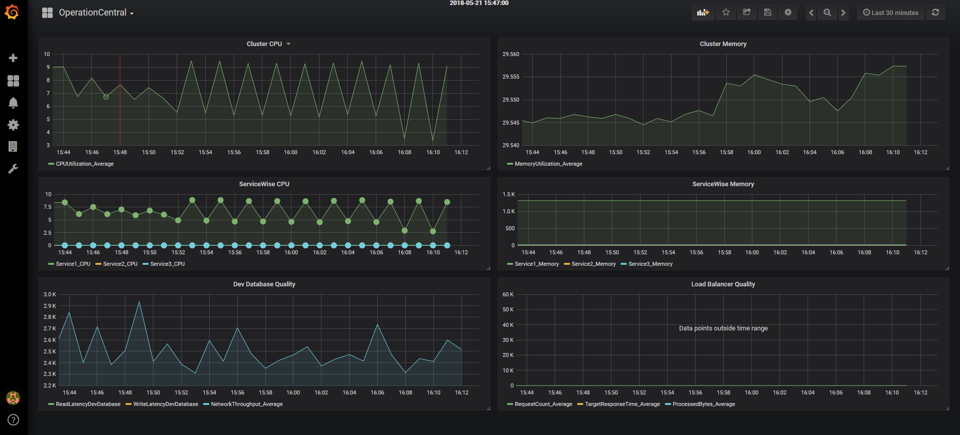
Operation Control

Slide 8
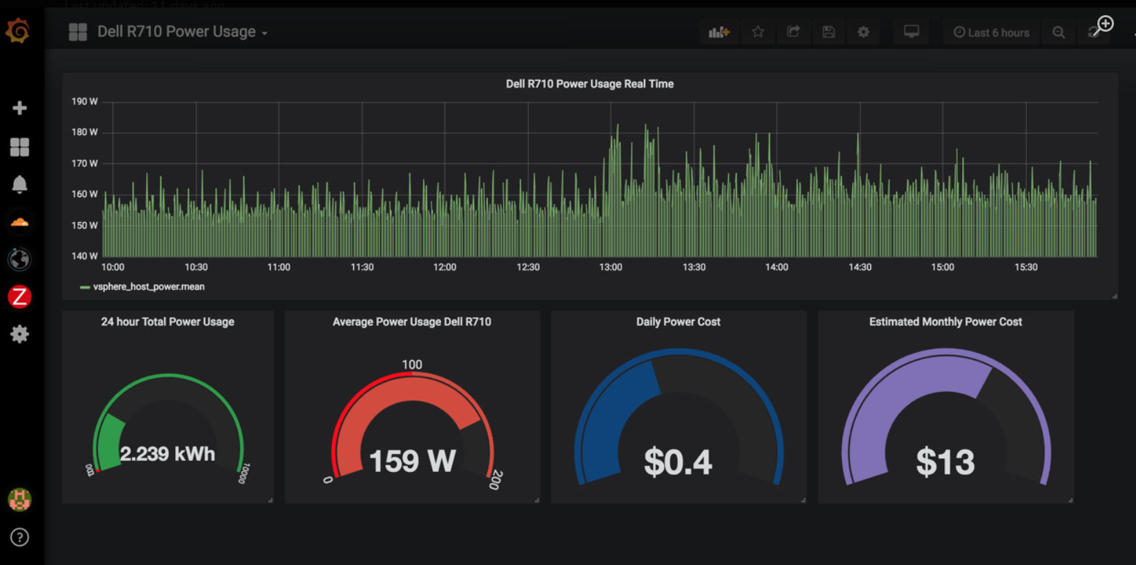

Slide 9
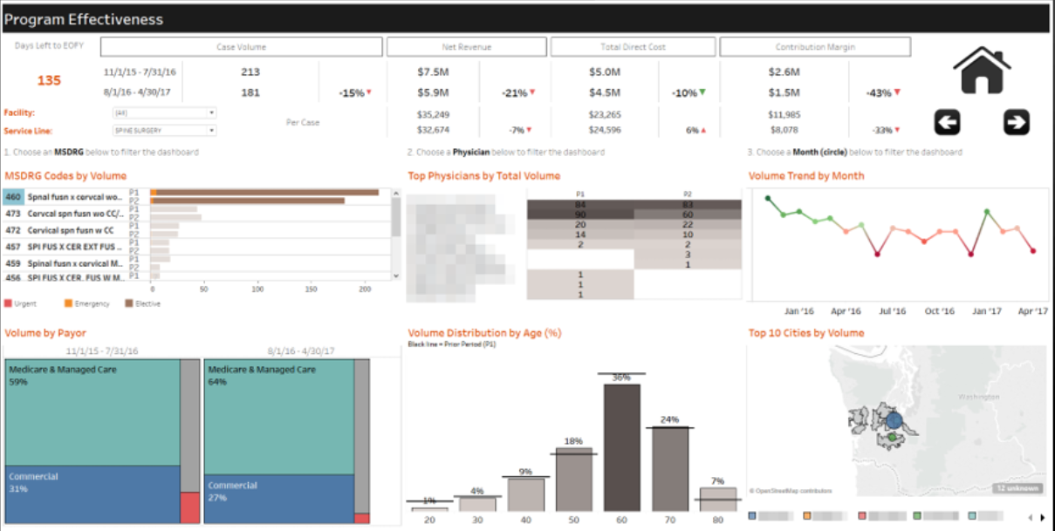

Slide 10
