Slide 1

Delivering TAAS
Open Products Accelerating
Enterprise Transformation
Keep it simple…
© 2020 SYNECTIKS. All Rights Reserved. Proprietary and Confidential.

Slide 2
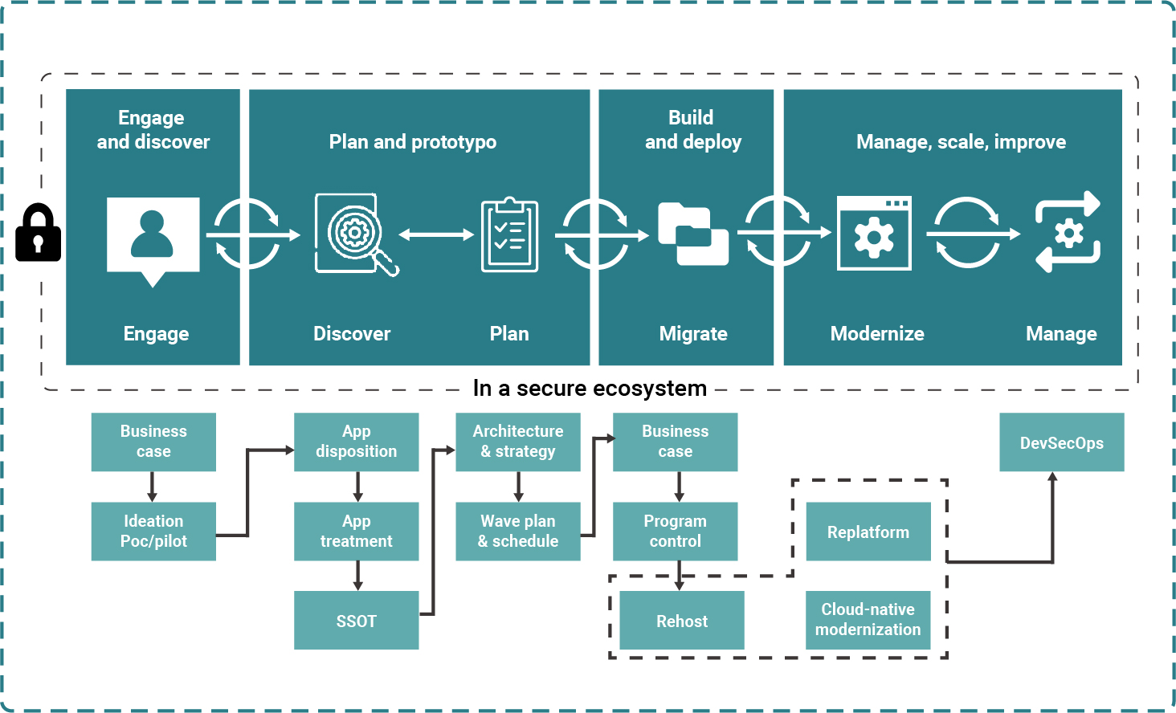

Slide 3
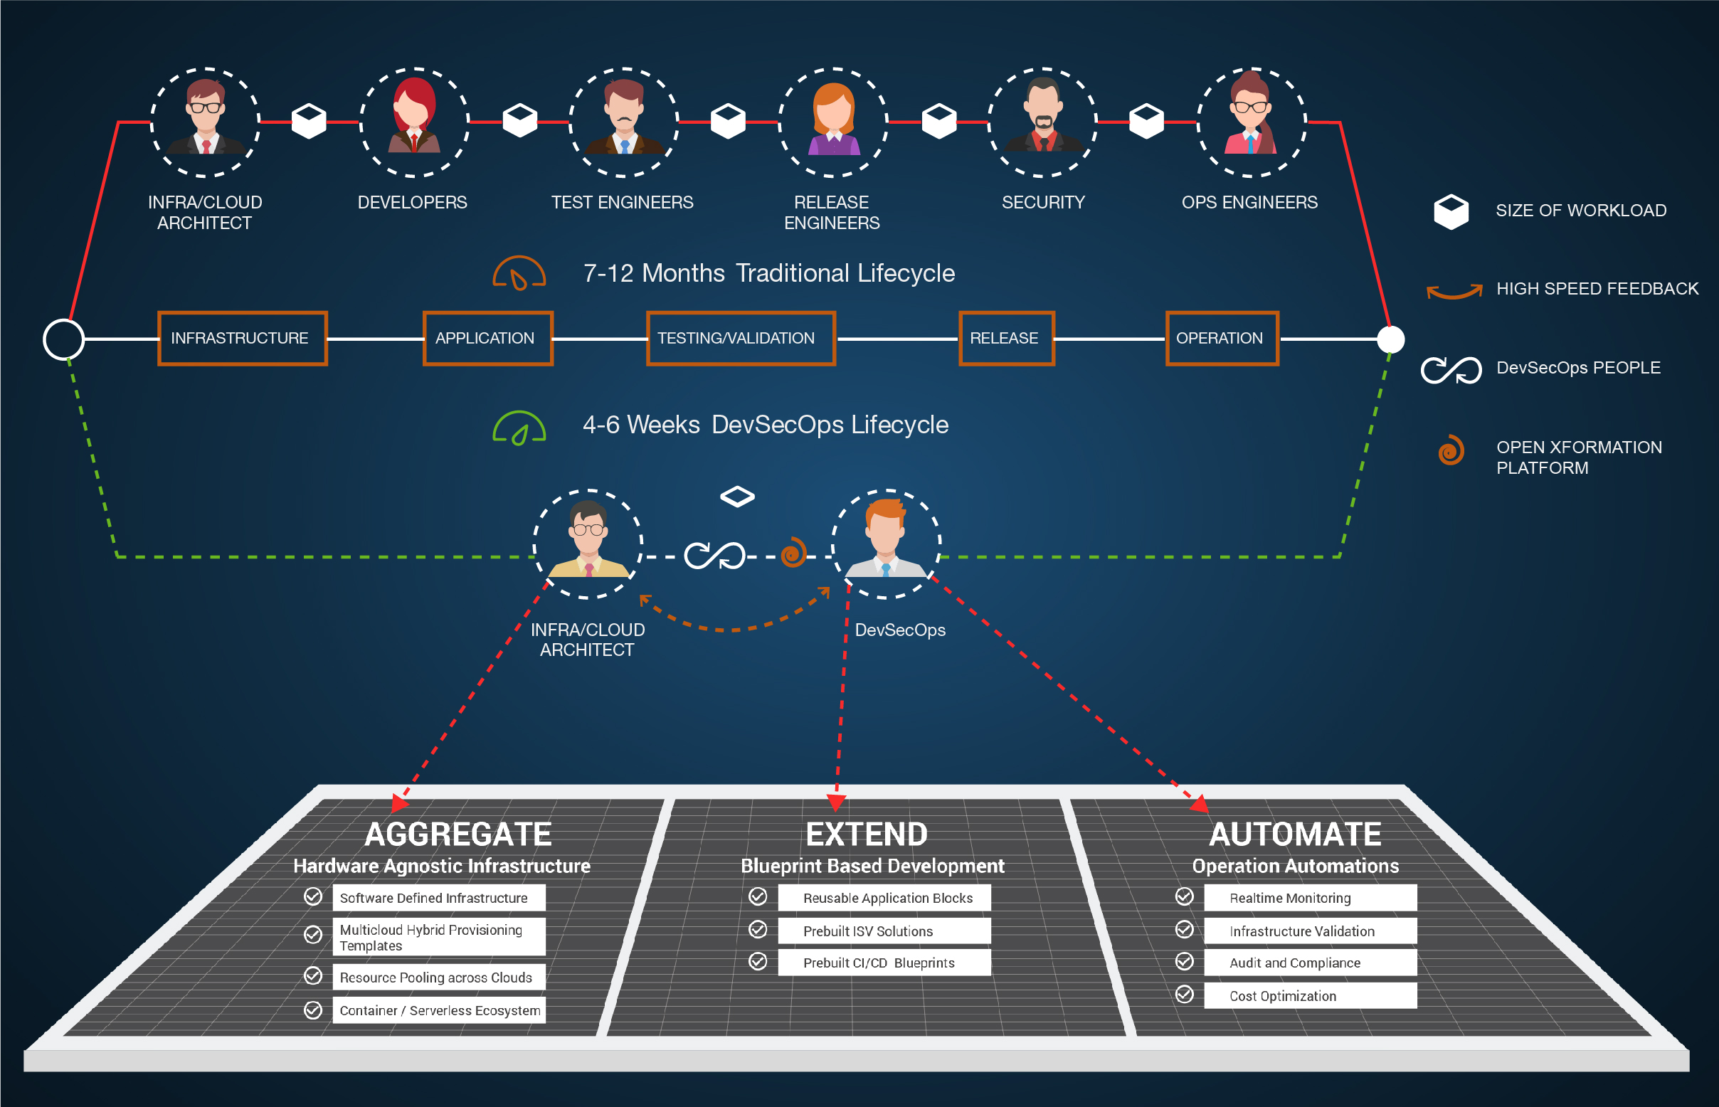

Slide 4
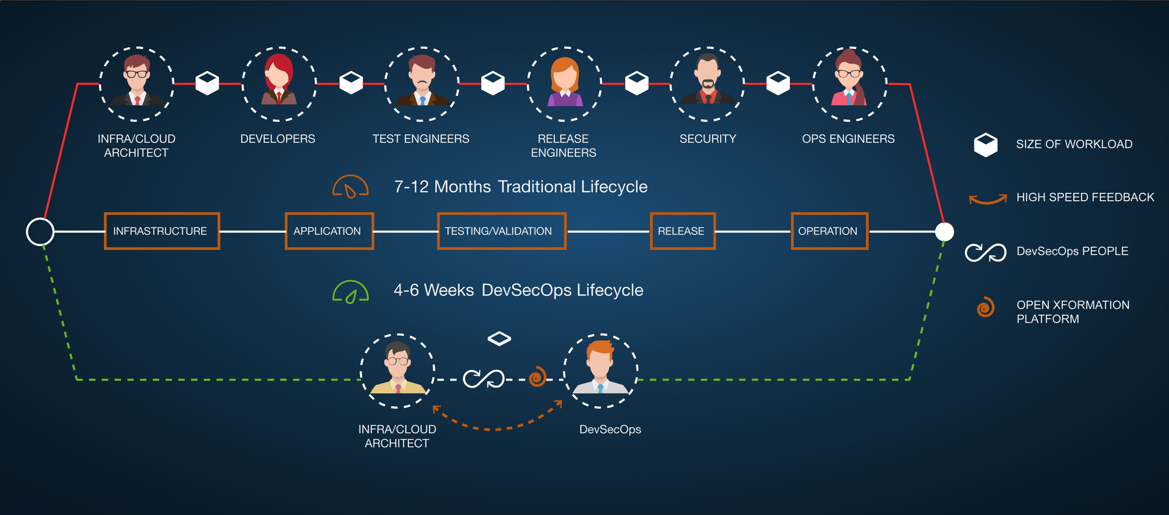

Slide 5
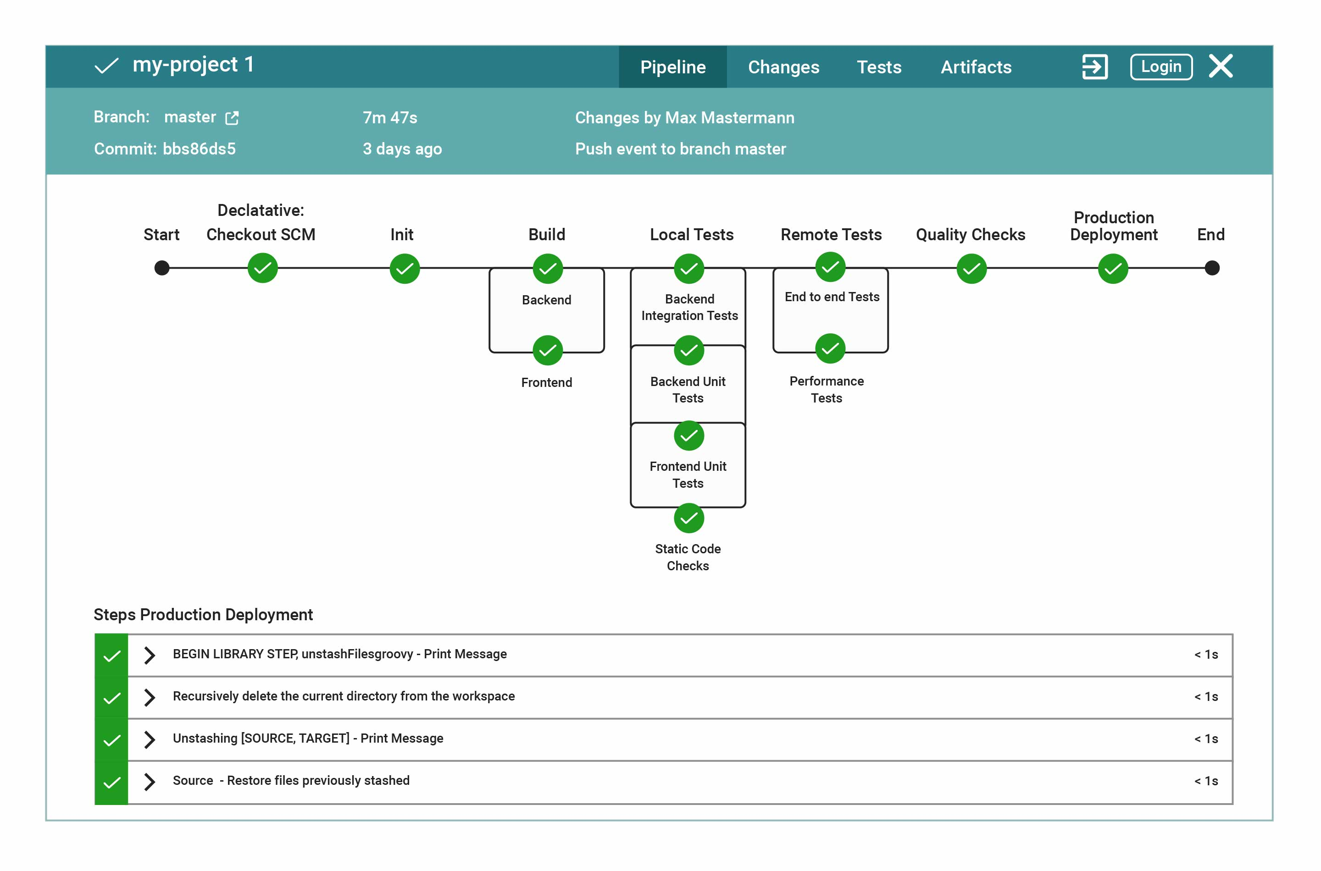

Slide 6
Process & Approaches
Methodology
Release plan / product backlog
Sprint backlog
Sprint goal
Sprint closure
Vision, ROI and project cadence
Creation of themes, epics
and user stories
Prioritization of backlog items and grooming
Develop definition of “Done”
Sprint backlog refinement
Develop acceptance criteria
Assign story points
Develop testing approach
Create, develop and assign tasks
Daily Scrum meetings
Development
Weekly builds and reviews
Continuous integration
and testing
Impediment removal
Update documentation
Deployment activities
Showcase / demonstration
UAT
Backlog grooming
Retrospective
Release burn-down
Activities
When recommending an Agile execution approach, Synectiks considers the following core activities and concepts to be the most critical to the success of project execution. While we are willing to be flexible on our execution approach, we believe that eliminating these activities reduces the effectiveness of the agile approach.
Release plan
Product backlog
Release burn up
Sprint backlog
Definition of “Done”
Test approach
Acceptance criteria for each story
Sprint Goal
Documentation approach
Impediment tracking list
Sprint backlog prioritization
Sprint burn-down chart
Kanban / Scrum board
Defect management
Development documentation
Working Software
Retrospective backlog / action list
Continuous improvement plan
Defect management
Release burn-down
Output
© 2021 Synectiks. All Rights Reserved. Proprietary and Confidential.

Slide 7

Assumptions:
2 weeks design / development sprints
Daily scrum check-in meetings
Customer Roles & Responsibility
  Require Product Owner role from customer to Articulate product strategy, vision and roadmap to stakeholders
  Prioritize and manage product
  back log.
  Synectiks representative to participate in daily scrum, sprint planning and retrospect meetings.
Synectiks Roles & Responsibility
Synectiks PM along with developers participate in daily scrum and report status
Synectiks PM mitigate any risk from software delivery perspective.
Define
Design
Develop
Deploy
Transition
Start Sprit
Sprint Review Meeting
Confirm define
Configure requirements
Validate configuration
Plan to deploy
Customer
feedback
Design
Design
Design
Deploy
Deploy
Deploy
Sprint cycle
Sprint cycle
Sprint cycle
Test
Develop
Test
Develop
Test
Develop
© 2021 Synectiks. All Rights Reserved. Proprietary and Confidential.

Slide 8
Timeline
Sample Project Timeline
M1 S1
M1 S2
M2 S3
M2 S4
M3 S5
M3 S6
M4 S7
M4 S8
Future Phases
S0
S1
S2
S3
S4
S5
S6
S7
S8
Sprints
Design Sprints
Production Movement Sprints
Development Sprints
Requirements Documentation
Implementation
IT1 Modules
Implementation IT1 Modules
Prod Environment Setup
Acceptance
Use Case
Implementation
Implementation
Verification
Implementation
Deployment
Activities
Use Case
UX Design
Review
Artifacts
Use Cases
Design Prototype
Activities
Implement IT2 Modules
Deployment
User Guide
Artifacts
IT2 Modules
User Guide
Activities
Implement IT3 Modules
Feed Back / Changes
User Guide
Artifacts
IT3 Modules
User Guide
Activities
Test / Change
Artifacts
ATP results
Iteration 1
Activities
Implement PH1 Modules
Deployment
User Guide
Artifacts
IT1 Modules
User Guide
Activities
Deployment
Release
Operation
Artifacts
Production App
Iteration 2
Iteration 3
© 2021 Synectiks. All Rights Reserved. Proprietary and Confidential.

