Slide 1
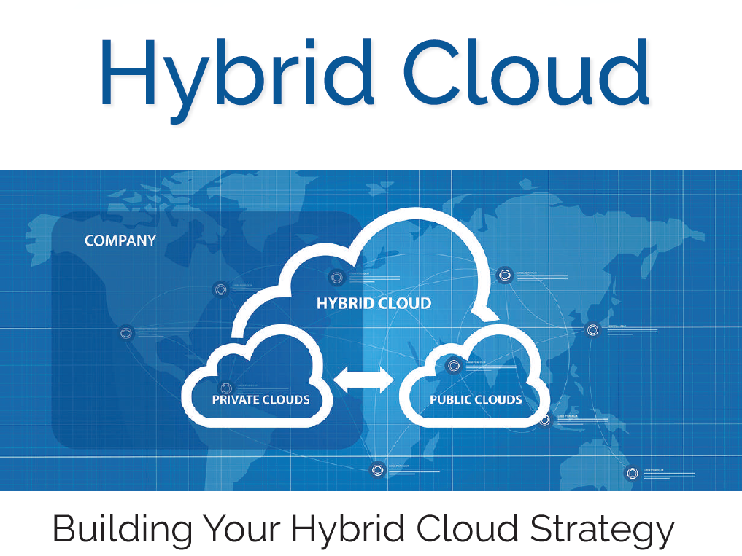

Slide 2

Agenda
Discuss key points on Extending and Optimizing Your Hybrid IT
Mode
Interactive / Story Telling
Target
1 tangible benefit for each Audience
Myself
- 20 Years System Product Development
- Part of Core Team – Storage Essential, Network Authority, Safe Access
- Currently leading Synectiks Xformation Platform

Slide 3



Public / Private / Hybrid
Public
Private
Hybrid
+
Good for Rapid Application
Development, Scientific Data Processing, and Web-Scale Applications.
Pay As You Go.
-
Weak SLA , Limited Security , Regulatory Compliance, Cost at Scale.
+
Good for Enterprise Security , Regulation , Cost @ scale
-
Slow Innovation, Large Capex/ Opex
+
Hybrid Cloud lays the foundation for embracing new technologies
such as containerization , serverless, platform as a service (PaaS), IoT and edge computing — all with an eye toward improving business outcomes

Slide 4

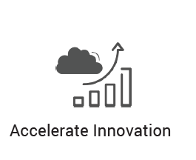
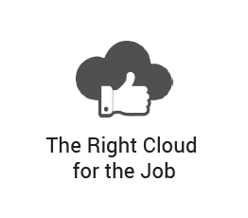
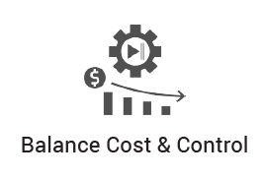
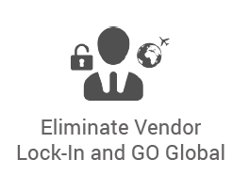
Key Drivers
Break 6-18 months Dev Cycle
Test New stuff , bring back
On Prem Regulation
Dev / Test / HPC / Burst
Low/ Mid scale save CAPEX/ OPEX
High Scale – 6 months ROI
Reduce dependency proprietary app/service /tools/ providers
Go local

Slide 5
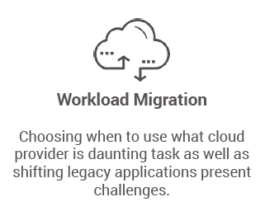
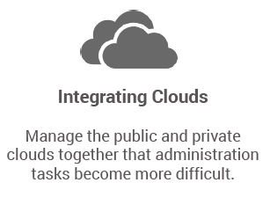
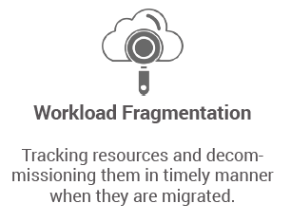
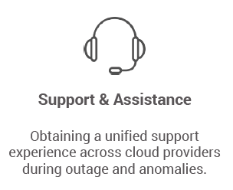
Challenges

Slide 6
Mostly Used Use Cases
Disaster Recovery/Backup
Application Development and Testing
Web Servers
Data Extract, Transform, and Load (ETL) processes
Machine learning and other analysis tasks
HR, Payroll, Productivity Applications
Supporting Local Data Regulations
Go Global and edge computing

Slide 7
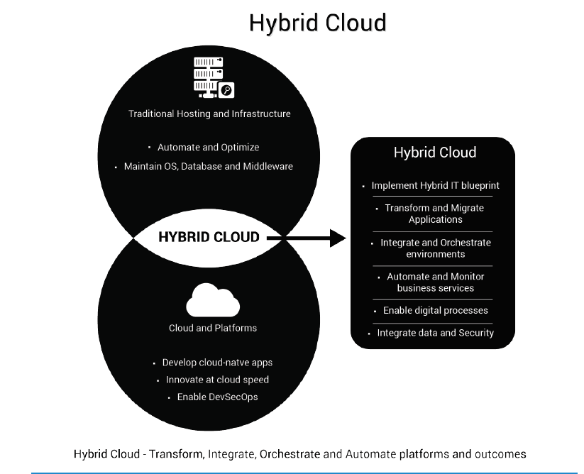
Getting Started

Slide 8
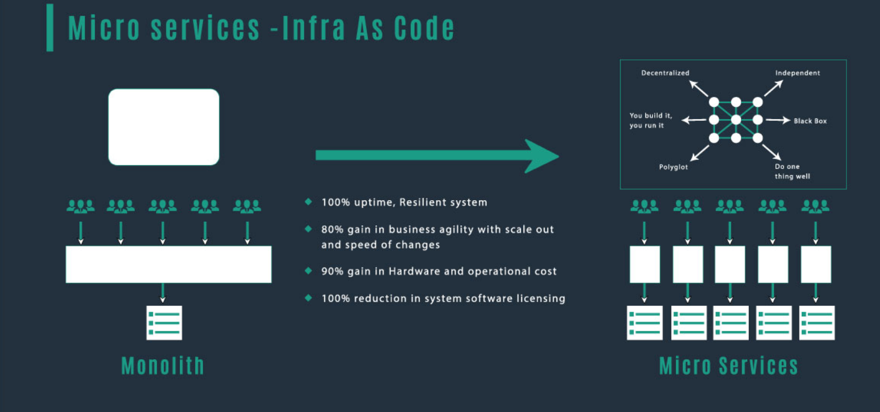
Key Technology Drivers

Slide 9
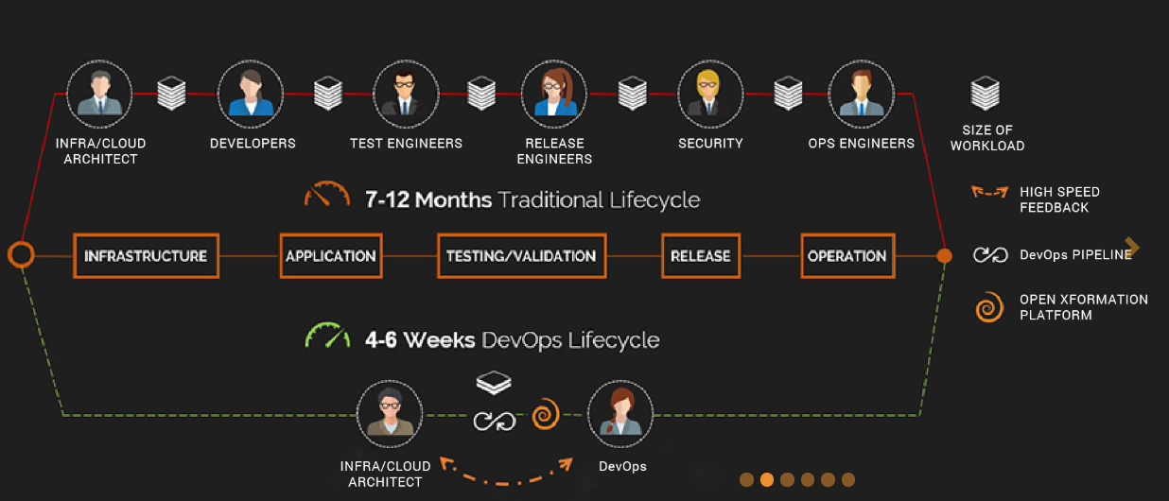
Key Technology Drivers (DevOps)

Slide 10





Key Strategic Drivers

Slide 11
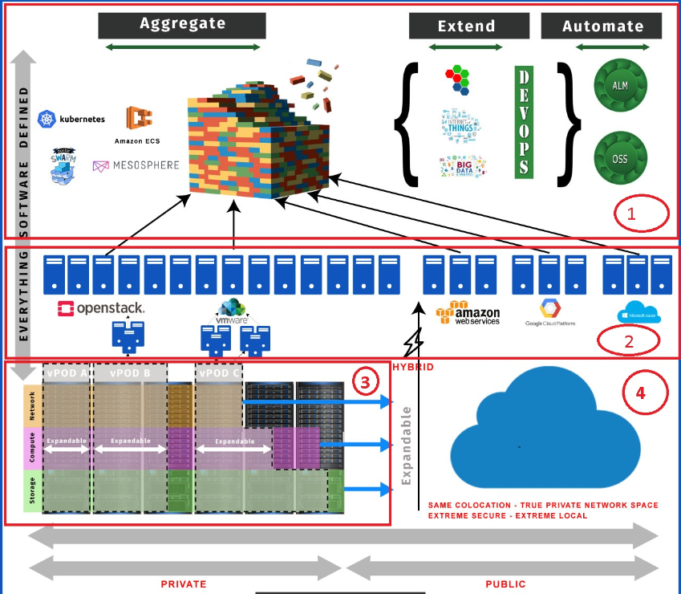
Aggregate -> Extend -> Automate

