Slide 1

Discovering XXXX Transformation
Keep it simple…
© 2018 Synectiks. All rights reserved. Proprietary and confidential.

Slide 2
today
SOME KEY FACTS TODAY

➔


3
10
21
563
Workload Types
Major Use Cases
Server Sets
Servers
© 2018 Synectiks. All rights reserved. Proprietary and confidential.

Slide 3

Current Approach
Challenges
Servers
Heterogenous
n-tier monolith
Multiple Delivery
Agile
Private
Difficult to manage
Purchased for peaks
Inconsistent end-user experience
Long mean time to repair
Release
Skillsets
TCO
Scale (TXN)
21 Server Sets
563 servers & OS
Multiple middleware(web/app/j2ee,jse)
Multiple Mgmt. Interface (Ambari, middleware, servers, databases)
Multiple Databases (HBase/mongo/oracle)
© 2018 Synectiks. All rights reserved. Proprietary and confidential.
Notes:
In order to deliver these services today, most IT departments focus on things such as
Servers
Virtualization
Network
Storage
Backups
Disaster Recovery
The challenges that come with traditionally built infrastructure include:
Complex
Costly
Purchased for peaks
Difficult to manage
Long mean time to repair
Inconsistent end-user experience
IT tool and functionality overlap
Interoperability issues

Slide 4
Key Transformation
SOME AREAS WE SEE A OPPURTUNITY TO IMPROVE


⬧
✴
INFRA
DISCRETE ->AGGREGATE
APP
MONOLITH->SOA
OPERATION
HARDWARE->CLUSTER
CULTURE
DEVOPS

Slide 5
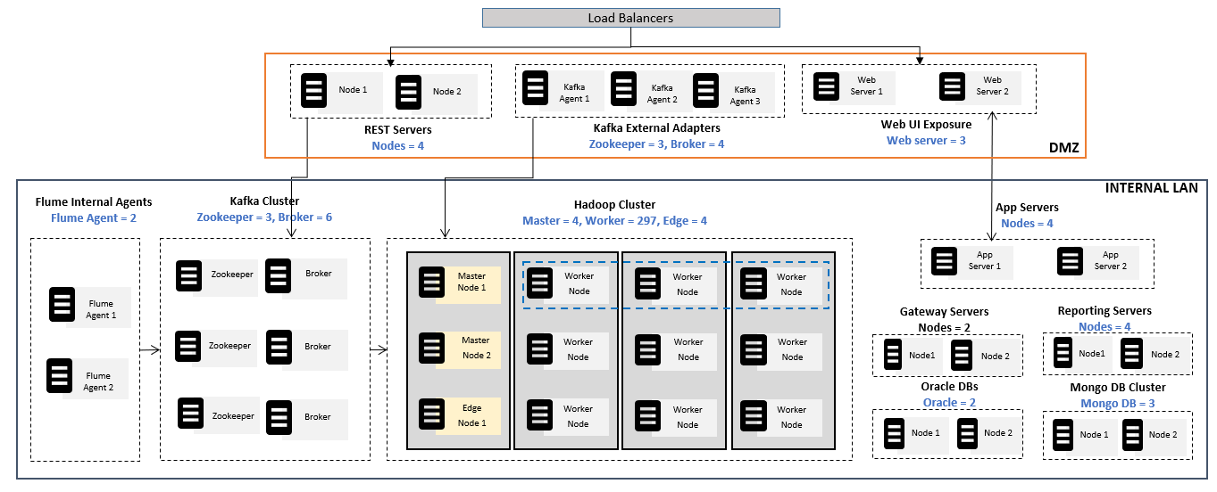
/INFRA/CURRENT

Slide 6
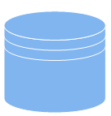
/INFRA/proposed
Manage 3 clusters from 1 console Vs 21 Server Sets,563 servers, 563 OS, Multiple middleware, Multiple Mgmt Interface, Multiple Databases

SDDC
Multi Cloud / Hybrid / Spans geographically
1 unified way to deliver all
Internal Api
Reporting
Gateway
App Service
Provisioning
Ingestions
Flume

Kafka
Spark
Mongo
Hbase
Hadoop
CONSOLIDATION
Everything software defined
BATCH/TRANSACTION
ANALYTIC
Etiam vitae dui congue, semper quam vitae, luctus ligula. Sed posuere nunc in leo commod else cuprum less. Etiam vitae dui congue, semper quam vitae, luctus.
MAINCLUSTER
Micro
Services
1 single skill set – python programming + Spring boot service
Producers
Web
Servers
External
API
⬅
EDGE CLUSTER
HYBRID
Elasticity @(cluster + Service)
MGMT
Oracle RAC

Slide 7
/APPS/CURRENT

Slide 8
/APPS/batch/proposed
Manage all types of jobs from 1 console in 1 pool VS 10+ jobs in 20 different edge nodes, 10+ upgrade process

Batch3 Project featured
Batch4g
Elastic
DMaster
gn
concept
Elastic Scheduling
Batch2ather information
Realtime visibility + Diagnostics
Batch14 Web development
Batch5rking site
Batch6sting product

Time Series DB
Real Time
Resilience
Agility
⬅
MGMT(Visibility)
Resilient
Reliability / Manageability / Extension

Slide 9
/Apps/batch/transform
MAIN STEP OF PROCESS
CLUSTER PROVISIONING

STEP ONE
Provision cluster with best practices of storage/ compute / network /security
AUTOMATION ENGINE

STEP TWO
Setup elastic automation engine into the cluster

Slide 10
TRANSFORMATION
STEP THREE

Containerize existing jobs and hook into automation engine
ANALYTIC AND OPEARTIONS

STEP FOUR
Establish real time monitoring , Continuous delivery mechanism, Diagnostics, Resilience

Slide 11




/Apps/batch/challenges
Key Challenges we may face


⬧
Networking
Source ->>Dest1/Dest2 …Visibility
Persistence
Local Storage of inbound data
OPERATION
DEVELOPERS TRAINING ON OPERATIONS -- DEVOPS
Zoning
CEPH?
DevSecOps

Slide 12
/APPS/TXN/CURRENT
Load Balancers
Web UI Exposure
Site Forge
Web server = 4
Web Server 1
Web Server 1
Web Server 2
Web Server 1
Web Server 2
Web UI Exposure
Fore Sight
Web server = 4
DMZ
INTERNAL LAN
App Servers
Nodes = 4
Novelvox App Servers
Nodes = 3
App Server 1
App Server 2
App Server 1
App Server 2
App Server 2
App Server 1
App Server 2
App Server 1
App Server 2
Gateway Servers
Nodes = 4
Reporting Servers
Nodes = 4
Oracle RAC
Oracle = 5
Node1
Node 2
Node1
Node 2
Node 1
Node 2
Node 3
Node 4
Node 5
Oracle DBs
Oracle = 2
Mongo DB Cluster
Mongo DB = 4
Node 1
Node 2
Node 1
Node 2

Slide 13
/APPS/FSight/proposed
Raw Naïve Go & Plugin Based web UI

Elastic
SOA driven , independent services with their DB
WORKFLOW
GATEWAY
Elasticity & Consolidation
BPMS
REPORT

Task
SOA
Resilience
Agility
⬅
MGMT(Visibility)
Scale Out
Reliability / Manageability / Extension

Slide 14
/Apps/FSight/transform
MAIN STEP OF PROCESS
AS-IS CONTAINERIZED

STEP ONE
Containerize As is the Appserver / Gateway / Reporting and deploy in cluster
SERVICE REFACTORING

STEP TWO
Refactor Services with independent microservices layer

Slide 15
CONTINOUS DELIVERY
STEP THREE

Put continuous delivery & quality gates in place
WEB LAYER TRANSFORMATION

STEP FOUR
Put a modern webserver agnostic fast go based web layer with existing web assets in place

Slide 16
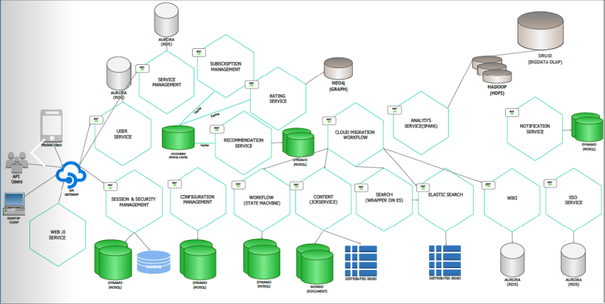
/SFORGE/proposed
Cater Heavy Transactions & Massive Contents driven application

Elastic
De-facto standard use case for Reliance
Bigdata / Graphs / TXN @ same layer simplify management & Integration

CONTENTS
⬅
TXNS
MGMT(Visibility)

Slide 17
/APPS/BIGD/CURRENT
Load Balancers
Node 1
Node 2
Kafka Agent 1
Kafka Agent 2
Kafka Agent 3
REST Servers
Nodes = 4
Kafka External Adapters
Zookeeper = 3, Broker = 4
DMZ
INTERNAL LAN
Flume Internal Agents
Flume Agent = 2
Kafka Cluster
Zookeeper = 3, Broker = 6
Hadoop Cluster
Master = 4, Worker = 297, Edge = 4
Zookeeper
Broker
Master Node 1
Worker
Node
Worker
Node
Worker
Node
Flume Agent 1
Zookeeper
Broker
Master
Node 2
Worker
Node
Worker
Node
Worker
Node
Flume Agent 2
Zookeeper
Broker
Edge
Node 1
Worker
Node
Worker
Node
Worker
Node

Slide 18
/APPS/BIGD/PROPOSED1-Horton-Consolidate
Load Balancers
Node 1
Node 2
Kafka Agent 1
Kafka Agent 2
Kafka Agent 3
REST Servers
Nodes = 4
Kafka External Adapters
Zookeeper = 3, Broker = 4
DMZ
INTERNAL LAN
Flume Internal Agents
Flume Agent = 2
Kafka Cluster
Zookeeper = 3, Broker = 6
Hadoop Cluster
Master = 4, Worker = 297, Edge = 4
Zookeeper
Broker
Master Node 1
Worker
Node
Worker
Node
Worker
Node
Flume Agent 1
Zookeeper
Broker
Master
Node 2
Worker
Node
Worker
Node
Worker
Node
Flume Agent 2
Zookeeper
Broker
Edge
Node 1
Worker
Node
Worker
Node
Worker
Node

Slide 19
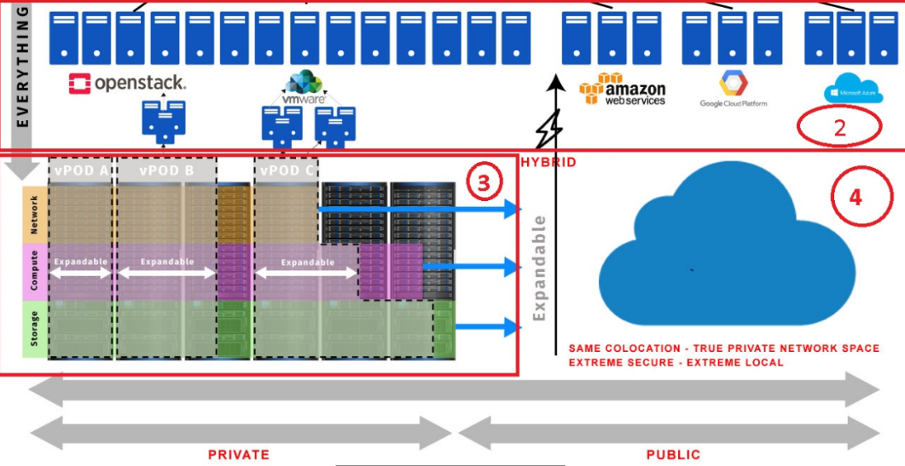
/APPS/BIGD/PROPOSED1+-Horton-Hybrid cloud

Slide 20
/APPS/BIGD/PROPOSED1+-Horton-Storage

Slide 21
/APPS/BIGD/PROPOSED2-DCOS
BATCH
BATCH
BATCH
TXN
TXN
TXN
BIGD
BIGD
BIGD

Slide 22
/APPS/BIGD/PROPOSED2+-DCOS
BATCH
TXN
BIGD

Slide 23
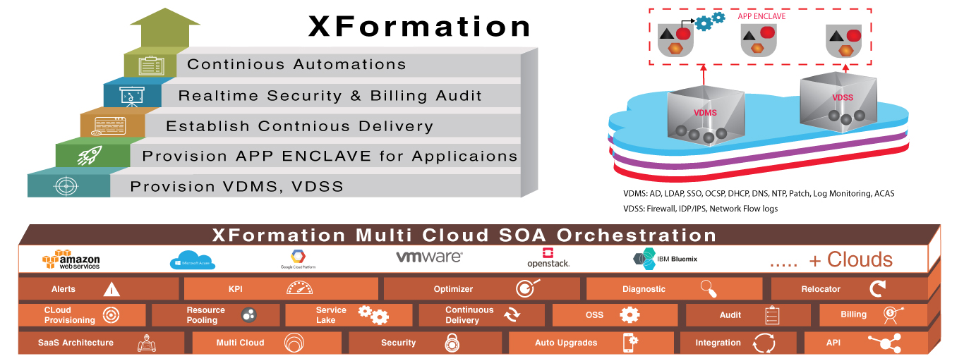
/OPERATION/Flexibility

Slide 24

+
TIME
FOR
BREAK

