Slide 1
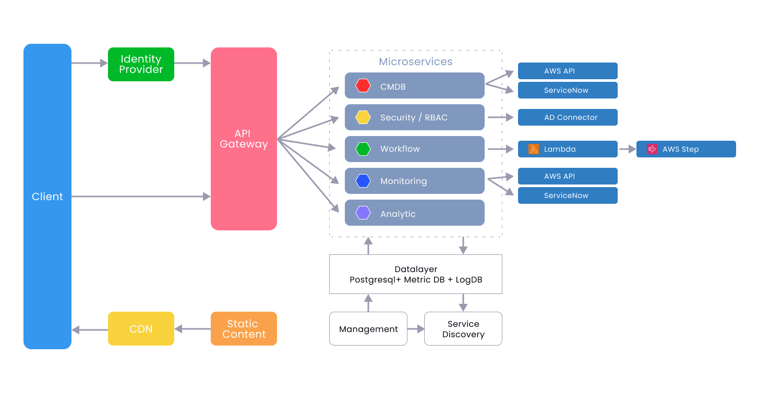

Slide 2
Frontend
Backend
UX designs & Prototyping
Figma
API Development
Golang / Node.Js / Springboot /
Lambda
Core Web UI
HTML5 / CSS3 / Javascript
Tests
Junit5 / Cucumber BDD /
Gatling / Postman
Web Framework
React.js / Redux
Data Bases
Postgres, OpenSearch, metric DB,
LogDB, GraphDB

Slide 3
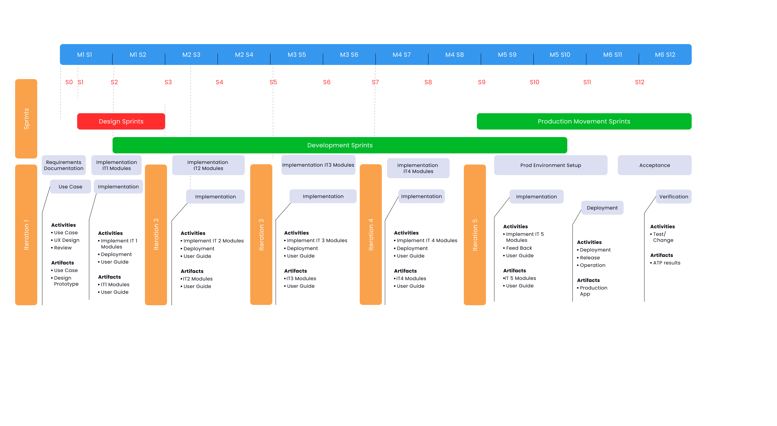

Slide 4
Proposed Team
SCRUM
Scrum Master
Team Size – 3 Engineers
UX Lead
UX TEAM
UX Senior
Engineer
UX Senior
Engineer
BACKEND – Team Size 10 Engineers
FRONTEND – Team Size 3 Engineers
PRODUCT TEAM
Api-Lead Developer
Api-Lead Developer
UI-Lead Developer
DEV TEAM
4 Api Senior
Developer
4 Api Senior
Developer
2 UI Senior
Developer
TEST TEAM
Team Size – 2 Engineers
Test
Engineer
Test
Engineer
DEVSECOPS
DevSecOps Engineer

Slide 5
Backend Bandwidth Allocation
Modules | Api Engineer | Key Activities
CMDB | 2 | Open Api specification / Data Design + Spring Boot Api’s + GitOps
Security/RBAC | 1 | User/Role/Group/Transaction/ Session / Authentication/ MFA / Activity Logs
Workflow | 3 | Automation flows using Aws steps and lambdas (Golang / node / python)
Monitoring | 2 | Write routines for continuous data collection and implements algorithms deduce SLA’s
Analytics | 2 | Write Reports and Analytics

