Slide 1

Web-app design presentation.
Yuchen Xiao
(Shawn)

Slide 2
agenda
Introduce the concept
Introduce the use case
Introduce the wireframes
Show the webpage Demo
What I learn
What to do later

Slide 3
What is blog
Definition
Purpose
An online journal or informational website display information in the reverse chronological order
With latest post appearing first
To rank your website higher in Google SERPs (to increase your visibility)

Slide 4
The blog
The blog I design this time is for individuals, the owner of the website is the blogger himself.
He can write blog on the website and others can read and if they register and login they can leave the comments.

Slide 5
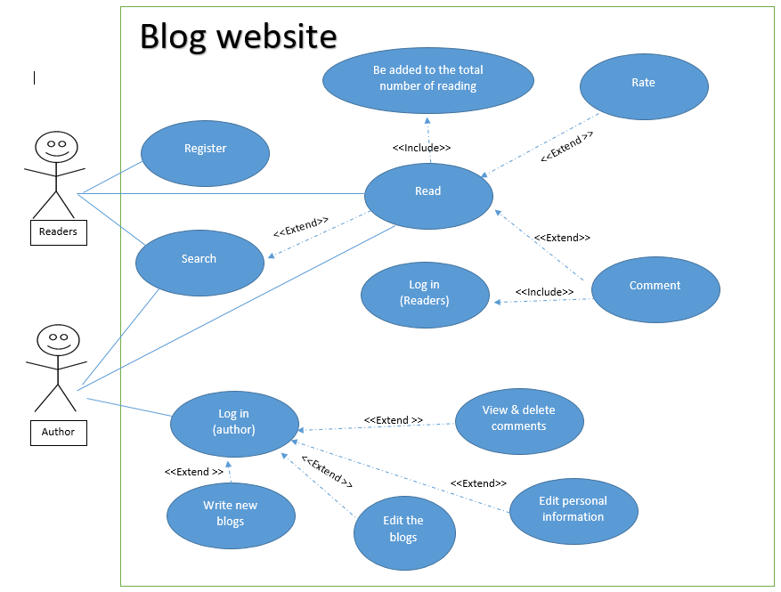
Use case
System name: Blog Website
Two actors: Readers; Author
11 functions
<<extend>>

Slide 6
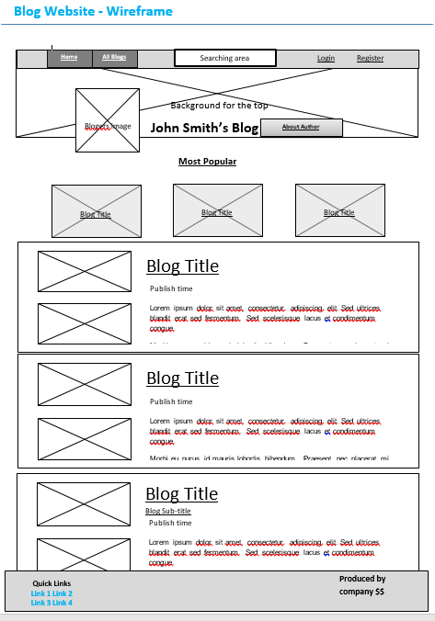
Desktop wireframe
Change the order on the top
Delete the “Most popular” “Most Recent” button
Change the “Most popular” section position
Delete the “Most Recent” section
Add a new button “All blogs”
Add a searching area
Add a button “About author”
Change the blogger's image into a button.
Add more information in the footer
Notes:
Part of the Z pattern, miller’s law,
Tesler’s law, simplify as possible
Accessibility and usefulness
No need, Tesler’s law,
For navigable Information of the Architecture
For searchable
Credibility
Credibility, accessibility
Credibility

Slide 7
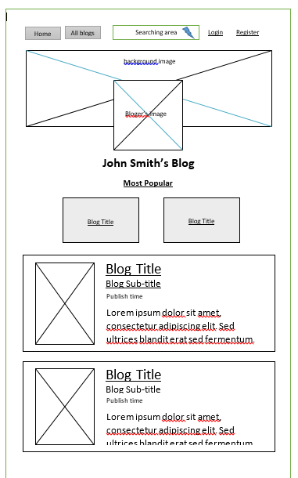
Mobile Wireframe
Few options
Narrow top menu bar
Middle the information image and name
Notes:
Small screen, so few options
Small screen, so narrow top menu bar
For accessibility reason, move it to the middle, so that it is easier to point,

Slide 8
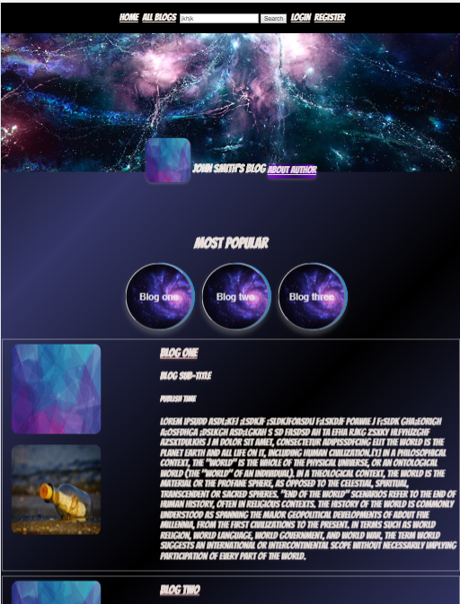
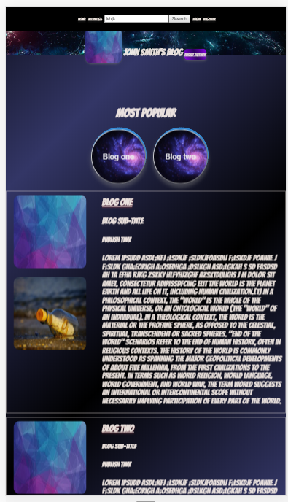
Demo

Slide 9
What I learn
HTML & CSS
BUILIDNG WEBSITE
How to debug a website
The syntax of the HTML and CSS, how to code them
The process of building a website
things we need to pay attention to when we design the website:
For example: UX, IA, 3 Laws, user stories,
When design the website, using the CSS to positon the elements and transform the element and it doesn’t work out.
Start to debug the code from the element itself to the element’s parents’ setting. Like a Russian Doll, pay attention the overwrite rule.

Slide 10
Future work
There are still a lot to do:
Other pages,
The layout could be more complex
Adding more animations
The media query can be divided into more detailed ones.

Slide 11
Thanks for listening
Any questions?

