Slide 1
Runtime Terrors
Team Members:
Diego Acosta, Miguel Padilla

Slide 2
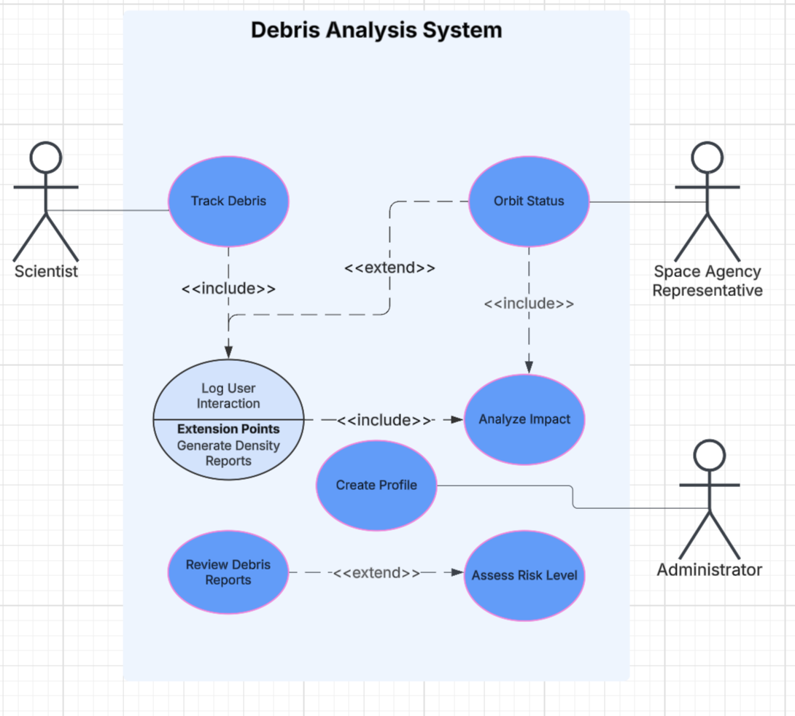
UML Use Case Diagram

Slide 3
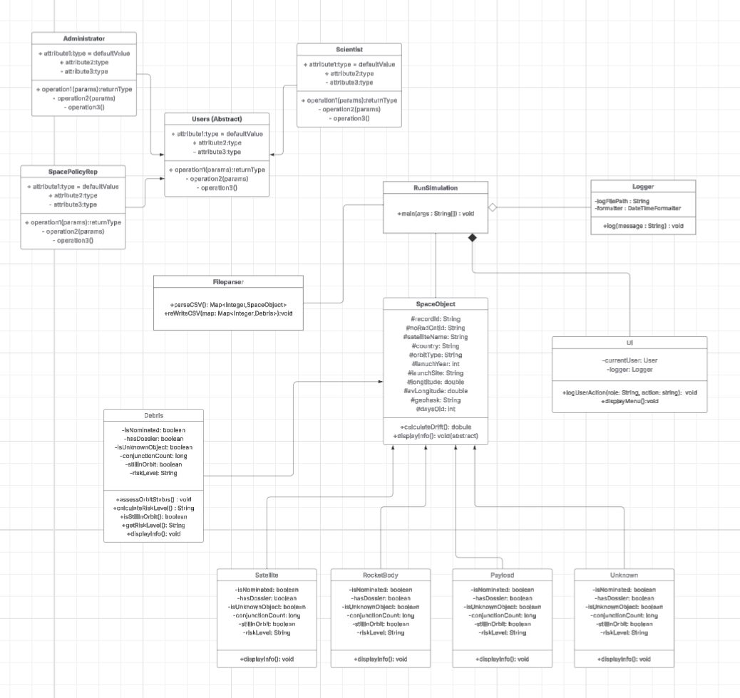
UML Class Diagram

Slide 4
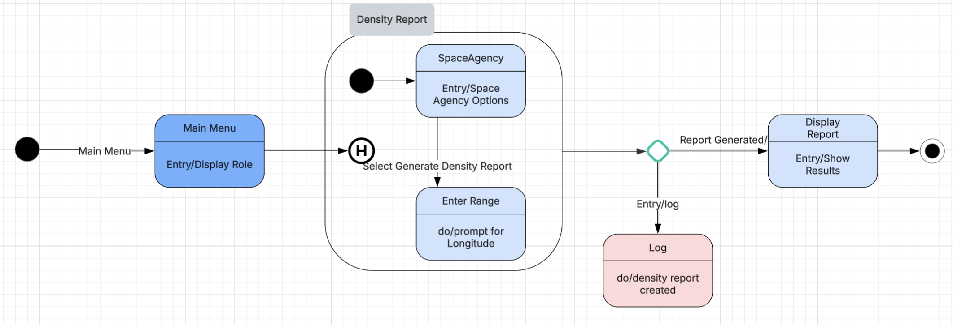
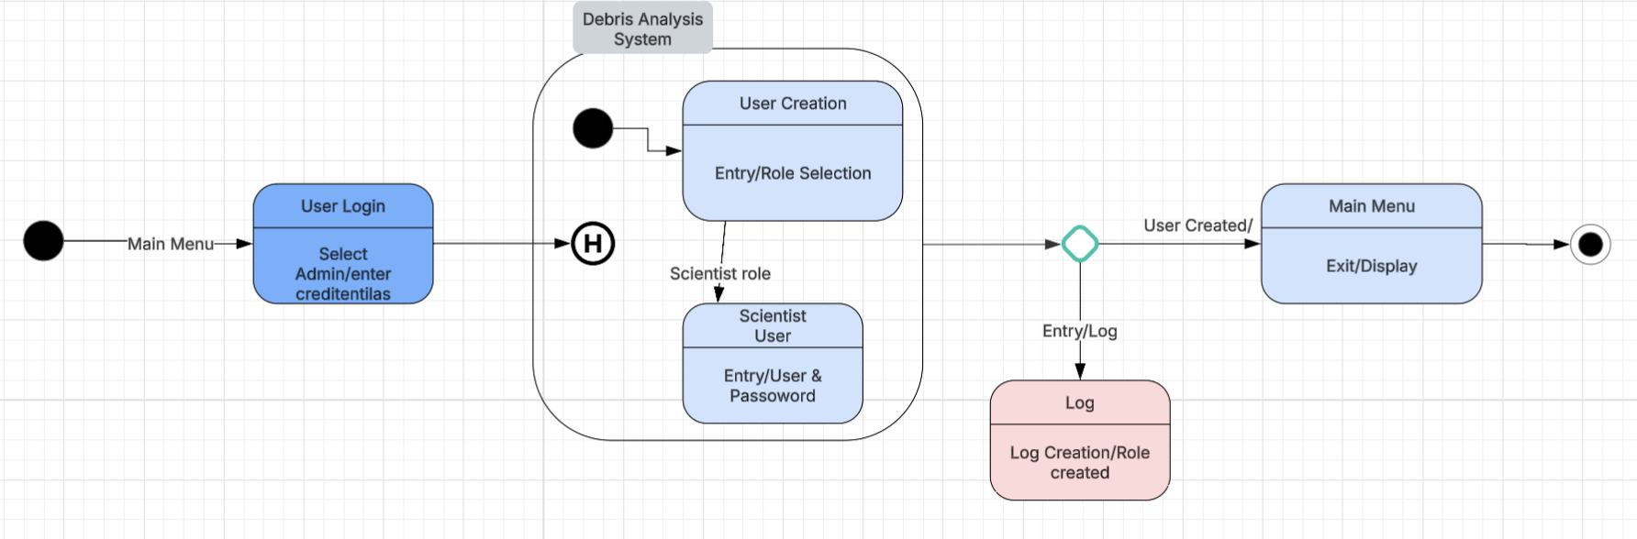
UML State Diagram

Slide 5
How did we use Object-Oriented Programming?
Our approach of using OO Programing
Abstraction: We defined a generalized User abstract class that represents any system user. This allows us to focus on shared behavior (getUsername(), displayMenu()) without worrying about implementation details in subclasses.
Encapsulation: All class data (e.g., username, role, recordId, conjunctionCount) was made private, with public getters/setters to control access. This prevents external classes from directly modifying internal object state.
Polymorphism: We used polymorphism when storing User references to different subclasses like Scientist, Administrator, and SpaceAgencyRep. This allows calling displayMenu() on a User reference and executing the correct method dynamically.
Inheritance: The classes Scientist, Administrator, and SpaceAgencyRep all extend the abstract User class. This structure lets each role customize behavior while reusing shared logic.

Slide 6
How did we use Design Patterns?
Factory Pattern: Used to create different user roles (Scientist, Admin, etc.) dynamically in UserExt.
Why: To simplify user creation logic and allow for easy extension of new roles.
How: UserExt.createUser() returns the correct subclass of User based on the input role.
MVC Pattern:
Model: SpaceObject, Database
View: Console via UI
Controller: RunSimulation

Slide 7
JUnit
For the Unauthorized user test, we wanted to make sure each role has access to their functionality.
We also want to test if the Logger functionality works, since we cannot move forward to generating, creating, and keeping track of users access.
For debris calculation, we wanted to ensure that the output is correct and accurate.
We also wanted to ensure our program can handle the information correctly and accurately, this ensures that the data is correct.

Slide 8

Reflections
What did we learn with this assignments?
We learned how to design scalable, object-oriented systems using patterns like MVC and Factory.
How did we grow as a student?
We grew by learning to divide responsibilities and integrate our individual work into a cohesive program.
How did we break up the problem to complete this task?
We split the project into front-end (UI), core logic (models), and utilities (Logger, Database).
How did you all grow in this course?
We gained confidence in using abstraction, inheritance, and testing to structure real-world software.
What are implementation challenges faced by the team?
One key challenge was debugging cross-role user interaction and handling input validation.
How did the team overcome the challenges?
We overcame challenges by adding custom exceptions and working iteratively with version control.

