Slide 1
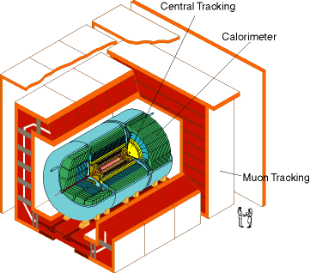
DØ Fact Sheet
DØ is one of two large particle physics experiments at Fermilab. Its dimensions are 30 x 30 x 50’ and it weighs about 5,000 tons.
The first meeting envisioning its design occurred at Stony Brook in 1983. Construction was completed in February 1992 and DØ took data from 1992 – 1996. The experiment was upgraded from 1996 – 2001 and has been running nearly continuously since.
Technical Highlights
Inner silicon detector, 700,000 channels
Scintillating fiber tracker & preshower 100,000 channels
Uranium/liquid argon calorimeter, 50,000 channels
Muon system (wire chambers and scintillator), 70,000 channels
Accomplishments
> 250 papers & > 250 Ph.D. theses to date
Discovery of the top quark.
Observation of B-meson mixing that might shed light on the lack of observed antimatter in the universe.
Discovered exotic baryons (Ξ_{b}, Ω_{b})
Personnel Facts
550 scientists
150 graduate students
89 institutions (38 in the US)
18 countries
Second largest national contingent: Russian
Data Facts
Inspects 1.7 million collisions/second
Records ≈100 events/second
Data flow is 20 Megabytes/second
300,000 giga bytes of data recorded/year
4.5 billion events recorded to date
Future
Will run through 2010
Expect to increase current data set by 50 - 100% by fall of 2010
Can provide evidence for Higgs boson in the range of 115-125 GeV & 140-180 GeV (or rule out all expected masses.)
Trivia
DØ event displays were shown in the Keanu Reeves movie “Chain Reaction”
Fictional physicist Larry Fleinhart joined “DØ team” in season 4 of TV show NUMB3RS.
Current spokespersons: Dmitri Denisov (Fermilab) & Darien Wood (Northeastern University)
http://www-d0.fnal.gov/
Information valid as of November 2008.

