Slide 1
MSU Extension and Housing Education/Counseling
Constance T. Costner
Children Youth Families & Communities
Michigan State University Extension
Wednesday, November 19, 2008
AFCPE Annual Conference November 19, 2008 Hyatt Regency Orange County

Slide 2
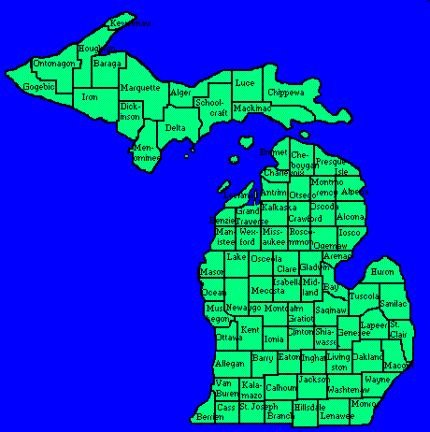

Slide 3
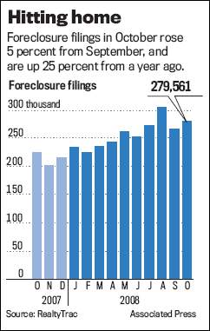
Foreclosure in Michigan and MSUExtension’s Role in helping Consumers

Slide 4

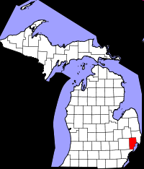
Macomb County Housing Programs
Affordable Housing Seminar
Home Ownership Seminar
Home Maintenance and Repair Workshop
Individual Counseling
Money Management for Home Ownership Seminar

Slide 5
Affordable Housing Seminar
Housing programs that build or renovate homes and then sell them to people with low-moderate income
Individual development account programs that match people’s savings for home ownership
Lender programs that provide down payments, better loan-to-income ratios and lower interest rates
Money management strategies to help people with low – moderate income become eligible for a mortgage

Slide 6
Home Ownership Seminar
Prepares consumers to make wise decisions and benefits people buying new, expensive homes as well as people looking for smaller, affordable homes
A real estate agent, lawyer, banker and inspector will be available to answer questions
Consumer protection and saving money is emphasized
Staff and guest speakers cover practical information about house hunting, home inspection, purchase offers, mortgages, down payments and the closing

Slide 7
Home Maintenance and Repair Workshop
Designed for renters and homeowners who have little home repair experience, but want to learn basic skills
The emphasis is on identifying potential trouble spots in a home and doing routine maintenance and minor repairs before costly problems develop
Deciding when the job is too big and how to hire a contractor is covered along with topics such as:
Home Systems: Electrical, Heating and Cooling, Plumbing
Inside Care: Doors, Floors, Walls, Windows
Outside Care: Cement, Roofing, Sheds and Decks, Landscaping, Pest Control

Slide 8
Individual Counseling
People applying for certain mortgages or housing programs are required to receive home ownership counseling before the mortgage or down payment assistance is granted
The counseling covers the mortgage payment, escrow, closing documents, financial strategies and home maintenance
MSUE housing counselors are certified by the Michigan State Housing Development Authority and the U.S. Department of Housing and Urban Development

Slide 9
Money Management for Home Ownership Seminar
Goal-setting, budgeting, using credit wisely, saving and investing money, protecting assets and organizing documents
The emphasis is on breaking old habits, applying basic skills and getting results

Slide 10
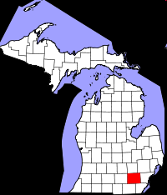
Washtenaw County Housing Programs
Pre-Purchase Home Buyer Readiness
Financial Management and Credit Repairs
Down Payment Assistance and Affordable Housing
Post-Purchase Home Maintenance and Repair
Mortgage and Tax Foreclosure Intervention
Post-Foreclosure Transitions
Partner Opportunities for Housing and Financial Professionals

Slide 11
Pre-Purchase Home Buyer Readiness
Finding the right house for you
How to finance your home
Working with lenders and realtors
Home inspections
Property taxes and insurance

Slide 12
Financial Management and Credit Repairs
Programs and Resources Offered:
Family Financial Academy – POWER, Inc.
Financial management classes and individual counseling – MSU Extension
MSU Extension Financial Matters
Free Annual Credit Report
U.S. Financial Literacy and Education Commission
Consumer.gov Money Resource
State of Michigan Office of Financial and Insurance Regulation: Consumer Services

Slide 13
Down Payment Assistance and Affordable Housing
Local Homebuyer Assistance Programs:
Affordable homeownership properties
Community Housing Alternatives – Down payment and home ownership assistance programs and the HYPER program
Washtenaw County Office of Community Development – Down payment assistance for city of Ann Arbor
POWER, Inc. – Michigan $ave$ Individual Development Account
Habitat for Humanity of Huron Valley – Affordable mortgage product for Habitat Homes
Statewide Homebuyer Assistance Programs:
Michigan State Housing Development Authority (MSHDA) – Down payment assistance, affordable mortgage products, recent graduate purchase assistance
Federal Homebuyer Assistance Programs:
USDA Rural Development Programs
US Dept of HUD: Federal Housing Administration (FHA) – federally insured mortgage products

Slide 14
Post - Purchase Home Maintenance and Repair
WHEP Post-Purchase Home Maintenance and Repair Classes
Washtenaw County Housing Rehabilitation Program
Washtenaw County Employment Training and Community Services
(ETCS) Weatherization Program
Michigan State Housing Development Authority (MSHDA) Property Improvement Program
Tool Borrowing Services
Habitat for Humanity Huron Valley Restore

Slide 15
Mortgage and Tax Foreclosure Intervention
The Washtenaw Housing Education Partners provides housing counseling and group education sessions regarding mortgage and tax delinquency prevention and foreclosure intervention.
They currently have five housing counselors available to assist homeowners that are worried about becoming delinquent in their mortgage or tax obligations or for those who are facing imminent foreclosure

Slide 16
Partner Opportunities for Housing and Financial Professionals
Three-hour required training session for lenders and realtors interested in working with low-to moderate income, first time homebuyers in Washtenaw Count. Through participating in this training session and agreeing to abide by the ethical guidelines, lenders and realtors will gain the following:
A thorough knowledge of the Down Payment Assistance and Homeownership Assistance programs in Washtenaw County
A complete understanding of the WHEP Ethics Agreement and the responsibilities of those who sign it
Addition of their name and agency to the list of WHEP partners, lenders and realtors that is distributed to WHEP clients who have completed the homebuyer education program and are ready to purchase a home

Slide 17
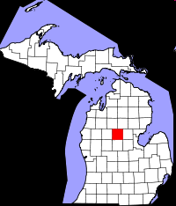
Clare County Housing Programs
Homebuyer Education Classes
Home Improvements Loans and Grants – 504 Program
Foreclosure Prevention

Slide 18
Homebuyer Education Classes
Topics Covered:
Can you really afford to buy a house?
How expensive a house can you afford?
Finding the right house
Shopping and applying for a mortgage
Understanding and improving your credit source

Slide 19
Home Improvements Loans and Grants – 504 Program
Home improvement loans are available to improve or modernize your existing home.
Grants may be available to pay the cost of repairs and improvements to remove identified health and safety hazards.
Home improvement funds can be used for installation and repair of sanitary water and waste disposal systems, including related plumbing and fixtures.
Payment of reasonable connection fees for utilities is also an eligible expense. Various energy conservation measures including installation of insulation and storm windows can be financed.
Other improvements such as repair or replacement of heating systems and electrical wiring are eligible.
Funds can be used for structural improvements to your home, including repair of, or provision for structural supports; repair or replacement of the roof; and replacement of severely deteriorated siding.

Slide 20
Foreclosure Prevention
Contact Clare County MSU Extension as soon as you experience financial hardship to make an appointment to review your situation, strategize your budget, and develop a recovery plan
Seek support from community agencies such as Michigan Works! that can help you look for work and provide supportive counseling services

Slide 21







Community Partners

