Slide 1
StarGazers Predictor: GitHub Stars Prediction Pipeline
A machine learning pipeline to predict GitHub star counts using repository metadata and advanced regression models.
By group 2

Slide 2
Team Introduction
Team Composition
Project Goal
Tech Stack
Shaheryar
End-to-end ML pipeline predicting GitHub stars
Python, Flask
Feruz
Docker
Rick
scikit-learn, LightGBM
Lu
GitHub API
Linjia

Slide 3




Project Objective
Data Collection
Feature Engineering
Gather GitHub repository metadata via API
Clean and transform repository data
Model Training
Deployment
Train regression models for star prediction
Serve predictions through an API endpoint

Slide 4
Pipeline Overview
Serving
Model Training
Flask prediction endpoint (in progress)
Feature Engineering
Evaluate multiple ML regressors
Collector
GitHub API data ingestion with pagination
Metadata cleaning and feature derivation

Slide 5
Data Collection
Data Sources
Metadata Fields
GitHub REST API with pagination
Name, star count
Collected 1000 repositories
Forks, watchers, language
Saved raw JSON data

Slide 6



Feature Engineering
Derived Features
2
Repository age (days)
Commit velocity
Extracted Features
Number of topics
Size
1
Primary language
Creation and update dates
Data Cleaning
Dropped empty fields like subscribers
3
Output saved in Parquet format

Slide 7
Model Training
Target Variable
Models Tested
Performance
Log-transformed star count for stability
Linear Regression
R² scores ranged from 0.51 to 0.61
Ridge Regression
Random Forest
XGBoost
LightGBM

Slide 8
Key Features Driving Accuracy
Top Predictors
Results with Linear Regression
Watchers count
R² score approximately 0.99 using two features
Forks count
Strong correlation with star counts
Trade-off: High accuracy but poor generalization

Slide 9
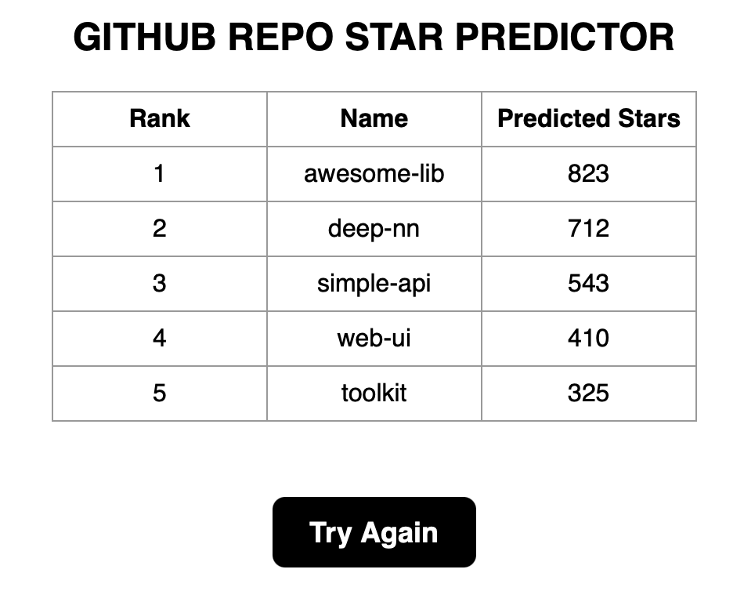
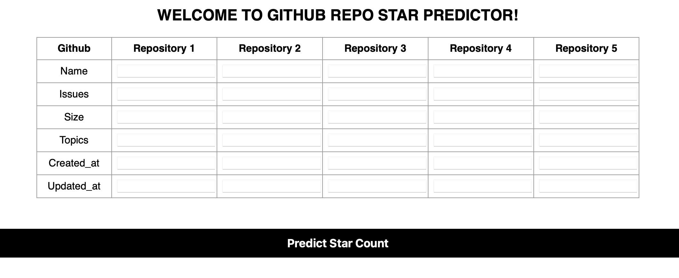
Flask Application Overview
Built with Flask
Load ML model, give real-time predictions from user-entered metadata
Provides a full user flow
Input form → POST request → result display
HTML templates
Input & Result

Slide 10
Current Project Status
Completed
Upcoming
Feature engineering pipeline
Dockerization of Flask app
Model training and evaluation
API serving and deployment
Flask application implementation

Slide 11
Next Steps
Containerization
Dockerize Flask application
CI/CD Integration
Implement Git-based deployment pipeline using Git Hooks
Provision Infrastructure
Set up dev/prod VMs via Ansible
Deployment
Deploy and test prediction API
Reporting
Prepare final report and evaluation

