Slide 1
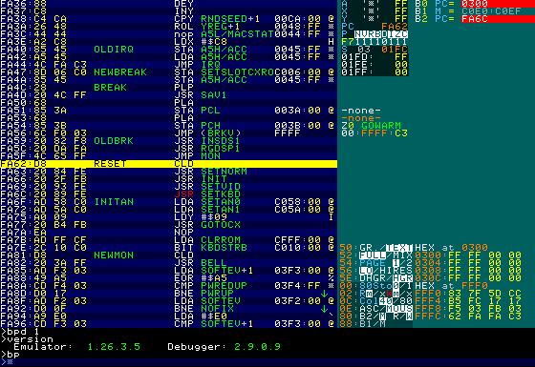
Registers and stack
Symbolic disassembly
Breakpoints
Current instruction
Zero-page watches
Breakpoint
Soft-switches
Memory
Command prompt

