Slide 1
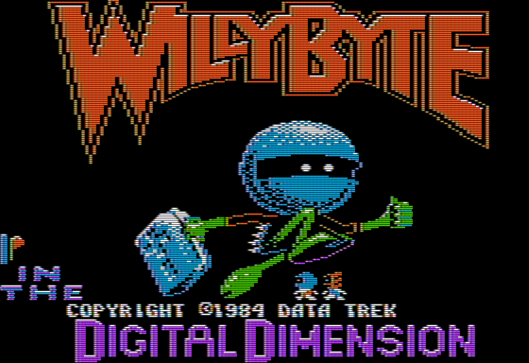
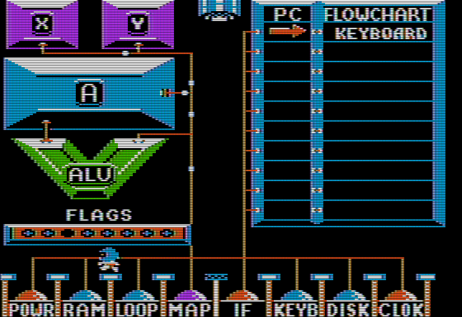
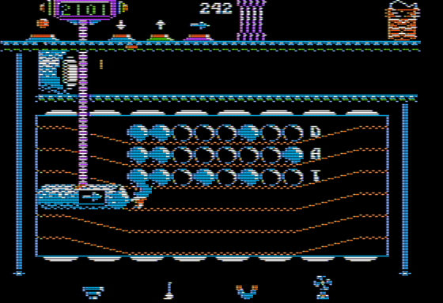
Willy Byte and the infinite IRQ investigation!

Slide 2
Session details
Very occasionally a bug manifests that proves very tough to conquer, and when you do the intricacies of it are subtly brilliant. This is one of those…
Tom Charlesworth will discuss a subtle bug in:
‘Willy Byte in the Digital Dimension’ (Data Trek, 1984)
and a bunch in AppleWin (Apple II emulator for Windows) that meant getting to the bottom of this took a painful 13+ years and included nuances of the 6502, 6522 and Mockingboard design!
Notes:
Good morning everyone.
I’m Tom Charlesworth, and I will spend the next 15 minutes describing a curious latent bug in the Willy Byte game.
Over the past 20 years of emulator development, I’ve come across all manner of interesting bugs, but this one is a particular standout for me.
So this morning let me share with you… all the gory details!

Slide 3
AppleWin intro
Apple II, II+, //e, Enhanced //e & clones emulator for Windows
In open-source development since 1994
Originally by Mike O’Brien, then Oliver Schmidt
Currently lead by me (Tom Charlesworth), but with many other contributors globally:
Michael Pohoreski, Nick Westgate, and many others (including people in the audience today!)
Windows only
but active ports on Linux (LinApple & another AppleWin fork)
USP:
Simple OOTB experience
Great built-in debugger!
Supports all the Deater & French Touch demos!
Support for the Mockingboard’s SSI263 speech chip…
Notes:
Before I dig into details of the bug, here’s a quick overview of AppleWin:
AppleWin emulates 8-bit machines from the Apple II line, along with some clones.
It’s been in open-source from the beginning, currently residing in GitHub.
I’m the lead, with contributions from Michael and Nick; but also many more!
It’s Windows only, but others have forked it for other OS’s.
OOTB: just unzip & go!
Great debugger: symbolic address resolution, instruction traces, beam positions… the list goes on!
Supports all Deater & FT demos: so cycle-accuracy for beam-racing.
And it’s MB support includes simple SSI263 speech chip emulation

Slide 4
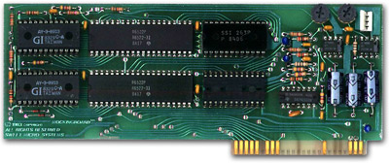
Mockingboard-C primer
2x 6522 (VIA) and 2x AY-3-8913 (PSG)
1x SSI263 (Speech)… actually sockets for 2, but never supported
No firmware, no DEVICE SELECT’ I/O at $C080+n*$10
5 interrupt sources: Timer1/2 (each 6522) & SSI263 phoneme complete
Memory map
$Cn00: 6522-A (with 1st AY-3-8910 accessed via ports A & B)
$Cn40: SSI263 (connected to 6522-B for interrupt)
$Cn80: 6522-B (with 2nd AY-3-8910 accessed via ports A & B)
Notes:
I won’t go into details about all of this…
At a high-level, Mockingboard is a sound-card for the Apple II series.

Slide 5
Mockingboard-C primer
2x 6522 (VIA) and 2x AY-3-8913 (PSG)
1x SSI263 (Speech)… actually sockets for 2, but never supported
No firmware, no DEVICE SELECT’ I/O at $C080+n*$10
5 2 interrupt sources: Timer1/2 (each 6522) & SSI263 phoneme complete
Memory map
$Cn00: 6522-A (with 1st AY-3-8910 accessed via ports A & B)
$Cn40: SSI263 (connected to 6522-B for interrupt)
$Cn80: 6522-B (with 2nd AY-3-8910 accessed via ports A & B)
Notes:
But for the purpose of this talk, there’s a 6522 interface chip and a SSI263 speech chip, both capable of generating interrupts to the 6502.

Slide 6
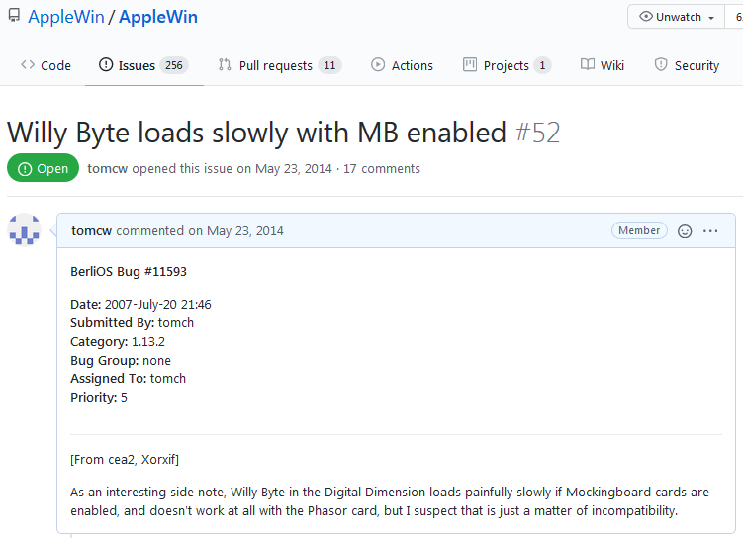
Willy Byte bug from 2007
https://github.com/AppleWin/AppleWin/issues/52
Notes:
OK, here’s where it started for me in 2007 after a report in comp.emulators.apple2

Slide 7
The Willy Byte emulation issue
Emulator: Willy Byte + Mockingboard (without Speech chip) = OK
OK on real h/w (6502 and 65C02)
Emulator: Willy Byte + Mockingboard with Speech chip = NG
OK on real h/w! (6502 and 65C02)
Notes:
In a nutshell, the emulation bug is simply that the game works without the speech chip, but hangs with the speech chip installed.

Slide 8
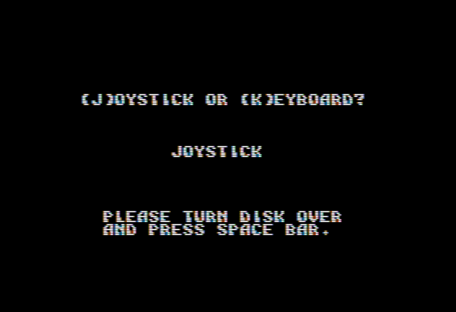
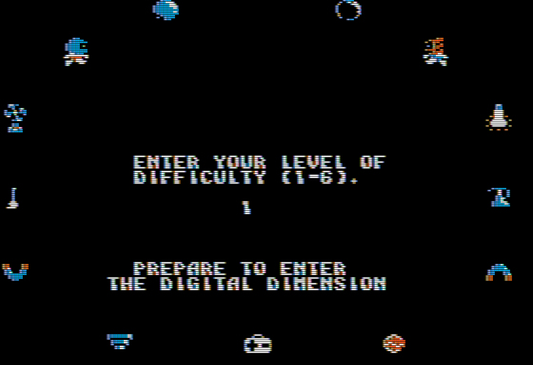
The Willy Byte emulation issue (2)
Start intro sequence
Speech chip says “Willy Byte in the Digital Dimension”
Uses Interrupt Service Routine to play each phoneme in turn
Play tune
Use 60Hz 6522 Timer1 (periodic mode) IRQ to playback the AY-3-8913 tune
Any key to exit intro sequence
Turn disk over
.
Speech chip should say “Prepare to enter the Digital Dimension”
But instead, on enabling 6502 interrupts (CLI) it gets stuck with infinite Timer1 interrupts!
Notes:
OK, so let’s drill down a level & walk through the details…

Slide 9
The Willy Byte emulation issue (3)
The Timer1 interrupt comes from exiting the tune, and not clearing the Timer1 interrupt flag:
SEI ; disable 6502 interrupts
Set Timer1/ACR = One-shot mode ($02)
Timer1 underflows, and 6522 is now asserting IRQ (but interrupts are disabled…)
Then later when the “Prepare to enter…” speech is cued up:
CLI ; enable 6502 interrupts
Timer1 interrupt is still asserted, so generates a 6502 interrupt
but the interrupt handler assumes a speech interrupt
so only clears the 6522 speech interrupt flag… not Timer1
So on RTI, the interrupt fires again… infinitely! ☹
Notes:
(laser pointer)

Slide 10
The Willy Byte emulation issue (4)
My emulation fix for a long time (before I got access to a real Mockingboard to experiment) was:
When 6522 Timer1 = One shot mode
On Timer1 underflow then assert interrupt
On a 2nd Timer1 underflow, then de-assert interrupt
But when I eventually tested on real h/w there is no de-assert ☹

Slide 11
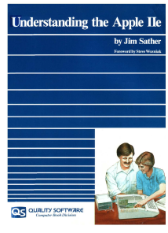
A NUANCE of the 6502
Firstly, lets throw in a bit of 6502/65C02 nuance…
From Understanding the Apple //e (Sather) (page 4-23):
the 6502’s and 65C02’s STA abs,X does a false-read of abs+X
.
Put another way…
STA abs,X:
Cycle | Operation
1 | Fetch opcode
2 | Fetch addr_low
3 | Fetch addr_high
4 | False read addr+X
5 | Write addr+X
Notes:
In order to explain this Willy Byte latent bug, first of all we need to understand a bit of nuanced behaviour of the 65-02.
So from Jim Sather's Understanding the Apple //E, we can see that for the opcode: store absolute with x index, on the 4th cycle (shown here in yellow) there is a false-read of absolute address plus X.
Put another way:
. the 1st cycle does the opcode fetch
. then the 2nd & 3rd fetch the low & high bytes of the address respectively
. on the 4th cycle it does this false read of absolute address + the X register
. and the finally on the 5th cycle it will do the write to address + X
This false-read is well understood, and Woz even exploits it in the Disk ][ logical state sequencer interface with the 65-02.
It’s harmless for regular memory access, but care needs to be taken when used with I/O memory.

Slide 12
Overlapping chip select
6522-B.ChipSelect = CS1 • CS2 = A7 • IO_SELECT
$Cn80…$CnFF
16 registers decoded using A3…A0
6522-A.ChipSelect = CS1 • CS2 = A7 • IO_SELECT
$Cn00…$Cn7F
16 registers decoded using A3…A0
SSI263.ChipSelect = CS0 • CS1 = A6 • IO_SELECT
$Cn40…$Cn7F; $CnC0…$CnFF
4 registers decoded using (A2=0),A1,A0
and the 5th register by: A2=1,(A1,A0=don’t care)
Both chips selected for $Cn40
Notes:
Another key point that we need to understand, in order to make sense of this Willy Byte issue is the subtlety of the Mockingboard memory map.
The 65-22 is selected when address-line-7 is low, meaning any address in the low 128 bytes;
. This chip mapping is repeated every 16 bytes due to the 4 address line decode
The speech chip is selected then address-line-6 is high, so from Cn40 for 64 bytes.
. repeated every 8 bytes due to the 3 address line decode
(click) From the chip select logic you can see that both chips get selected at Cn40

Slide 13
A subtlety of the SSI263
Writes to the SSI263 also get written to 6522-A:
Mockingboard Memory Map
$CnF0…F | 6522-B
: | 6522-B
: | 6522-B
$Cn80…F | 6522-B
: | 6522-A
$Cn40…F | 6522-A | SSI263 (5 regs)
: | 6522-A
$Cn00…F | 6522-A
So what 6522 registers do SSI263-writes actually stomp on?
6522.Reg0-3: not interesting (PortA/B & PortA/B direction bits)
6522.Reg4: “Timer1 low (8bit) count” …equally writes are not interesting, but…
Notes:
So here we've got a simplified version of the memory map, where N is the slot number.
And again you can see, mapped in at Cn40, not only have we got the speech chip (and its 5 registers) but also the peripheral chip as well.
So what 65-22 registers does a speech chip write actually stomp on?
. well the 1st four registers aren't interesting - these are just ports A&B and their direction bits
. and register-4: this is just timer-1 low... and writes to it aren't interesting
... but what about reads?
---
Writes to SSI263 also write to 6522-A:
* This explains why Sweet Micro Systems hooked up 6522-B at $Cn80 to support the SSI263 IRQ (as the 6522-A gets stomped on).
NB. Reads from SSI263 are not supported by Mockingboard.

Slide 14
The reveal…
!
But reads from the 6522 “Timer1 low (8bit) count” will clear the interrupt
The ISR for the speech playback does this:
for x = 4 to 0
LDA (zp),y ; y=0
(zp).w += 1
STA $Cn40,x ; Speech chip mapped
; to [$Cn40..$Cn47]
Recall from Sather (UTAIIe 4-23): the 6502’s STA abs,X does a false-read of $Cn40+X
.
So STA abs,X to $Cn44 will also false-read (then write) to 6522 register-4

Slide 15
Let’s recap that…
STA abs,X to $Cn44 (SSI263) will also false-read (then write) to 6522 register-4
So a write to chip-B (SSI263) to clear an interrupt from chip-A (6522)!
Specifically…
It’s not the ‘STA abs,X’ opcode’s write
…but actually its false-read that clears the interrupt!
Notes:
Now lets take a moment to recap this.
Store absolute + X to Cn44 (of our speech chip) will do a false-read to register-4 (of our peripheral chip), and clear an interrupt.
Generalised a write to chip-B clears an interrupt on chip-A!
And specifically...
It's not the store-opcode's write
but actually it's false-read which is clearing this interrupt!

Slide 16
Putting it all together, here’s what happens…
Intro tune playing via 6522 Timer1 periodic interrupt
Any key to start game
SEI ; disable 6502 interrupt
Timer1 interrupt pending in 6522
…”Turn over disk”… “Enter difficulty level”
The 2nd speech phrase (“Prepare to enter…”) is cued up
CLI ; enable 6502 interrupt
Immediate 6502 IRQ (due to Timer1)
ISR for speech does a STA abs,X, where address=$Cn44
This does an accidental false-read from 6522 Timer1-L (register-4) and clears the Timer1 interrupt!
(and also does a write to SSI263 reg4 & 6522 Timer1-L)
No more Timer1 interrupts, and speech phrase completes correctly…

Slide 17
Wrapping up
The emulator didn’t support:
Mockingboard/SSI263 writes ($Cn4x) duplicated to 6522 at $Cn0x
STA abs,X false-read
Willy Byte’s bug:
Immediately after intro tune
A0F4: $C40E/IER = $02… was this just a typo back in 1984?
There’s no reason to clear this bit on this 6522
Surely should be…
A0F4: $C40E/IER = $40 ; clear Timer1 Enable
ISR not checking interrupt source (assumes speech IRQ!)
Unknowingly relied on the false-read to an unrelated chip to run correctly!
But don’t you all agree that this is a delightful 36 year-old bug?!
Notes:
OK, so lets wrap all of this up.
On the emulator side:
. it wasn't supporting Mockingboard speech chip writes and duplicating them to the peripheral chip
. and also it wasn't supporting store absolute+X false-reads
And on the Willy Byte game side:
. immediately on exiting the intro tune we've got this curious code here (laser)
. why is it writing 2 to the interrupt enable register
... it doesn't make any sense - surely it should be 40
. where 40 means clear timer-1 enable
There's also the speech interrupt service routine, which isn't checking the interrupt source
. and so assumes the timer-1 interrupt is actually a speech interrupt
. if this were more robust then the bug would've been found during development
So unknowingly the game was relying on a false-read to an unrelated chip to clear an unexpected interrupt to run correctly!
Hopefully you can see why this stumped me for so long
...and you all agree what a delightfully subtle 36 year old bug this is?!

