Slide 1
Mobile/VR/AR WG/RG/CG 1st Meeting
By: Ronaldson Bellande
PhD Student
Founder/CEO/CTO/COO Bellande Technologies Corporation Inc
Founder of Bellande Research Organizations

Slide 2
Meeting Agenda
Introduction
Overview
Evolution of Robotics
Enhanced Human-Machine Interaction
Healthcare Applications
Electronics Industry Advancements
Engineering Innovations
Education and Training Benefits
Industrial Automation Advantages
Telepresence and Remote Work
Safety and Risk Reduction
Accessibility and Inclusivity
Future Trends and Opportunities

Slide 3
Introduction
Name
Background
Current Role
Personal Interests

Slide 4
Overview
Mobile, AR, and VR technologies have revolutionized robotics by enhancing human-machine interaction and expanding possibilities.
These technologies bridge the gap between physical and digital realms, offering immersive experiences and real-time data visualization in various fields like healthcare, electronics, and engineering.

Slide 5
Evolution of Robotics
Robotics has evolved from conventional machinery to intelligent systems capable of autonomous decision-making.
Mobile, AR, and VR technologies have accelerated this evolution by providing tools for remote operation, simulation, and training.

Slide 6
Enhanced Human-Machine Interaction
Mobile devices enable users to control robots remotely, facilitating tasks in hazardous or inaccessible environments.
AR and VR technologies offer immersive interfaces, allowing users to visualize and interact with virtual objects in real-world settings, enhancing collaboration and training.

Slide 7
Healthcare Applications
In healthcare, mobile robots equipped with AR and VR interfaces assist in surgeries by providing real-time data visualization and guidance to surgeons.
AR technology enhances medical training by simulating surgical procedures and anatomical structures, improving the skills of healthcare professionals.

Slide 8
Electronics Industry Advancements
Mobile-controlled robots streamline manufacturing processes in the electronics industry, increasing efficiency and precision.
AR-enabled maintenance and repair procedures reduce downtime by providing technicians with step-by-step instructions and real-time data overlays.

Slide 9
Engineering Innovations
AR and VR technologies revolutionize engineering design and prototyping by offering virtual simulations and 3D modeling tools.
Mobile-controlled robotic systems aid in construction projects by performing tasks with greater accuracy and safety under human supervision.

Slide 10
Education and Training Benefits
Mobile applications combined with AR and VR technologies provide immersive learning experiences, enhancing student engagement and knowledge retention.
Virtual simulations offer a safe environment for training personnel in high-risk scenarios, such as emergency response and military operations.

Slide 11
Industrial Automation Advantages
Mobile-controlled robotic arms equipped with AR interfaces optimize warehouse operations by facilitating inventory management and order fulfillment.
VR-based training programs for industrial robots reduce training costs and minimize the risk of accidents in manufacturing environments.

Slide 12
Telepresence and Remote Work
Mobile-controlled telepresence robots allow remote workers to participate in meetings and interact with colleagues, fostering collaboration and inclusivity.
AR and VR technologies enable remote technicians to troubleshoot and repair machinery by overlaying digital instructions and diagnostics onto physical equipment.

Slide 13
Safety and Risk Reduction
Mobile-controlled robots equipped with AR and VR interfaces enhance workplace safety by performing hazardous tasks in place of humans.
VR simulations provide training for emergency responders, helping them develop skills and decision-making abilities in realistic scenarios without risking lives.

Slide 14
Accessibility and Inclusivity
Mobile, AR, and VR technologies make robotics more accessible to people with disabilities by offering customizable interfaces and adaptive controls.
VR experiences enable individuals with mobility impairments to explore virtual environments and participate in activities they may not access physically.

Slide 15
Future Trends and Opportunities
The integration of mobile, AR, and VR technologies with robotics will continue to drive innovation across various industries, unlocking new possibilities for automation and human-machine interaction.
Advancements in artificial intelligence and sensor technology will further enhance the capabilities of mobile-controlled robots, making them indispensable in fields ranging from healthcare to entertainment.

Slide 16

Mobile/AR/VR Robots Control
Controlling Robots/Multi-Robotics
Systems for individuals Interact

Slide 17
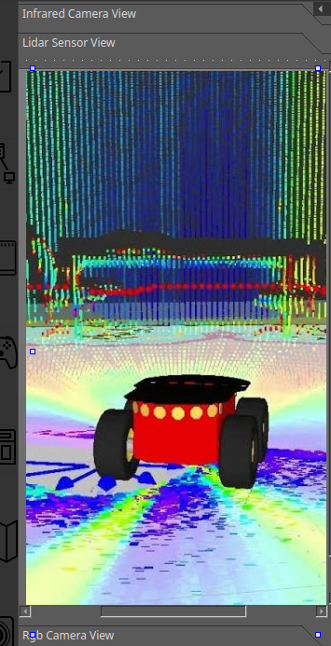
Mobile/AR/VR Robot Visualization
Visualizing Robot Sensors
Simulation View
Real-Wold View
Camera View

Slide 18
Collaboration Opportunities & Next Steps & Networking & Resources
GitHub Working Group Repository Information: https://github.com/Application-UI-UX/BAI-XRI-Mobile-AR-VR-Community-Group
GitHub Organization: https://github.com/Application-UI-UX
Discord Group: https://discord.gg/KBwqcPdx2H
Google Group: https://groups.google.com/g/mobilevrar-application-uiux-community-group
Email Group: mobilevrar-application-uiux-community-group@googlegroups.com
Github Profile: https://github.com/RonaldsonBellande

