Slide 1
GIT Overview
burt.walsh@ast.myflorida.com

Slide 2
GIT
Distributed version control system
You work in a local repository
You push changes to a remote/shared repository
Repositories contain branches (which have a series of changes/commits)
Branches are groups of changes/commits

Slide 3
Creating a Local Repository
Determine a directory in which you will work
Create the directory and change directory to that directory
Perform (git init) in the directory to create a new “local” repository
The creation of a repository results in a .git directory being created

Slide 4
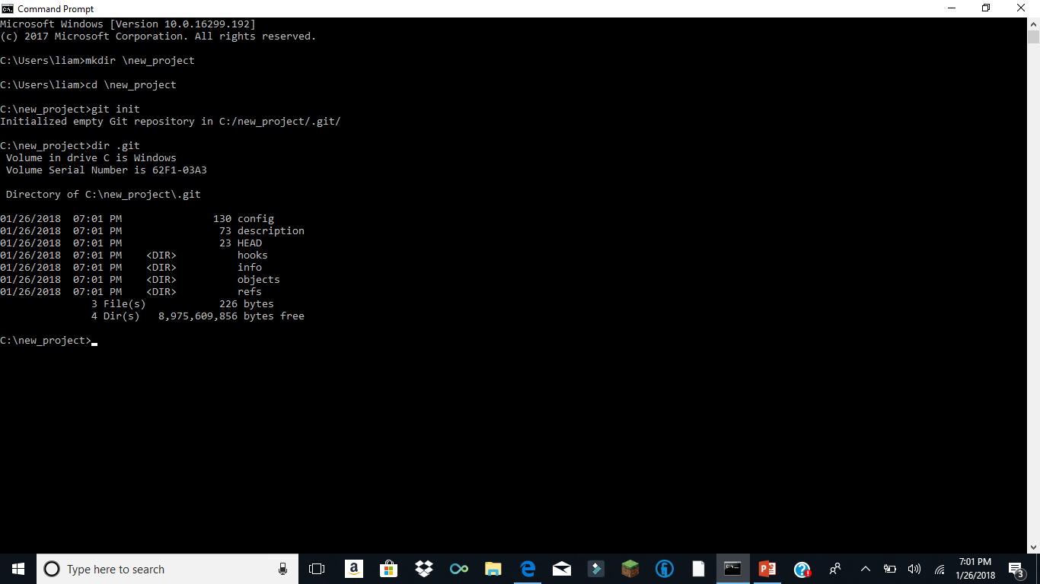

Slide 5
Creating branch and your first commit
Create a branch in the local repository
(git checkout –b myfirstbranch)
Create and edit a new file (Ok.txt in our case with one line of text)
Do a git status to see what file changes have not been committed to the branch (git status)
Add the file to the next commit (git add Ok.txt)
Commit the file (git commit –m “my first commit”)
See the commit with (git log)

Slide 6
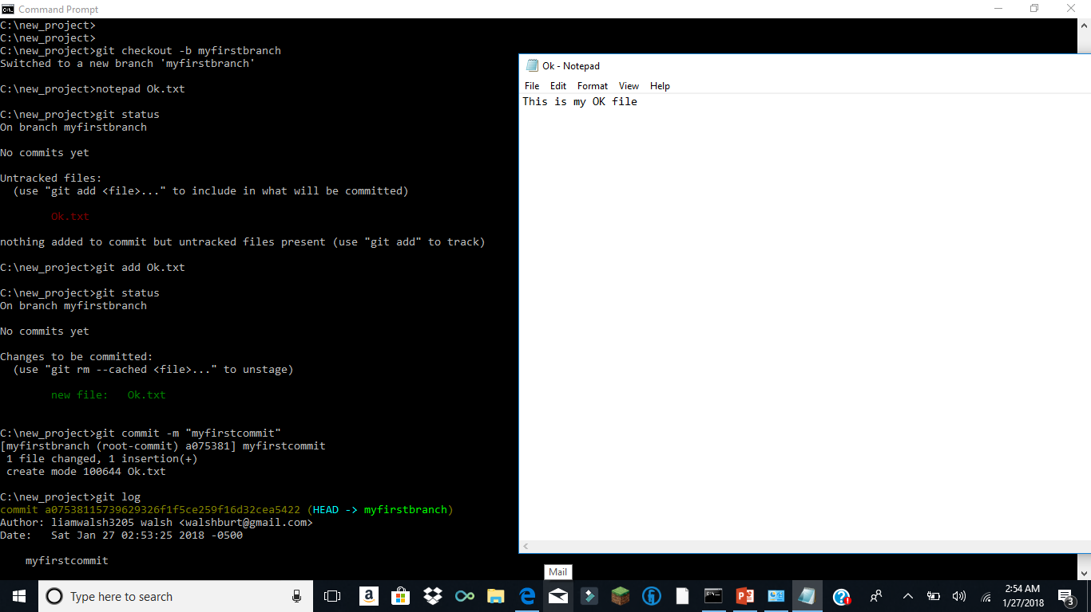

Slide 7
What is a branch? what is a commit?
A branch is a series of commits
A commit is a delta of the “added” changed files or removed files from the last (commit) state of the branch
We add files to or remove files from the perspective commit (stage for the next commit)
We then execute the commit against the branch (git commit –m “message”)
(git log –p) all commits and the actual file changes

Slide 8
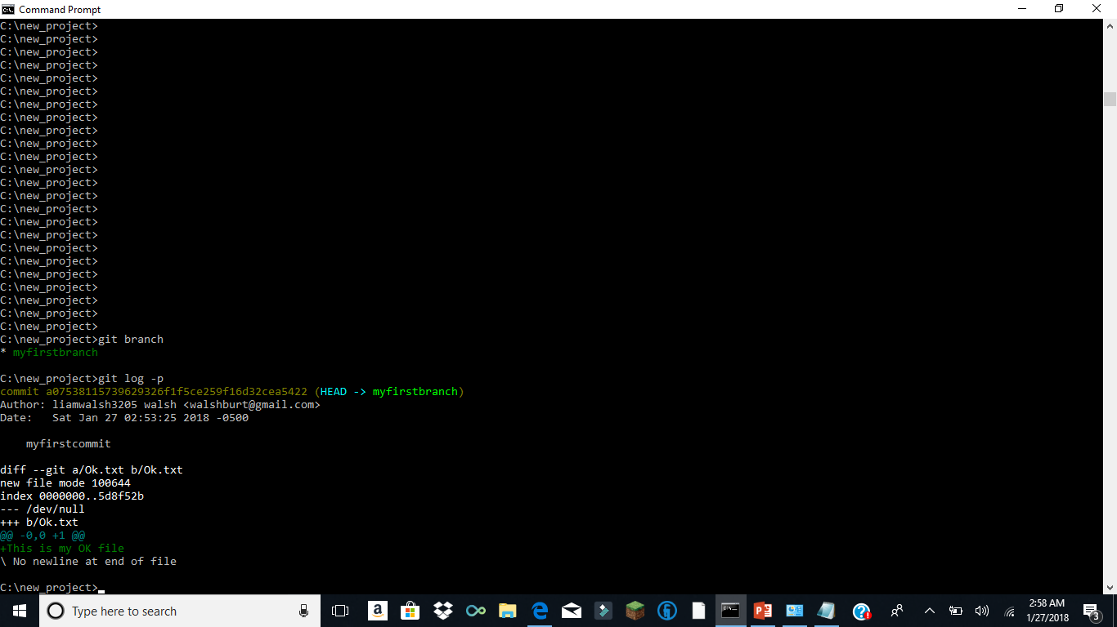

Slide 9
Review
A branch is a series of commits
A commit is a delta of the added, removed or just changed files from the last (commit) state of the branch
We add or remove files from the perspective commit (stage for the next commit)
We then execute the commit against the branch

Slide 10
Adding a second commit to the branch
We create a new branch mysecondbranch (git checkout –b mysecondbranch)
We remove the Ok.txt file from the commit (git rm Ok.txt)
We create a Y.txt file
We add the Y.txt file to the commit (git add Y.txt)
We execute the commit against the branch (git commit –m “commit against second branch”)

Slide 11
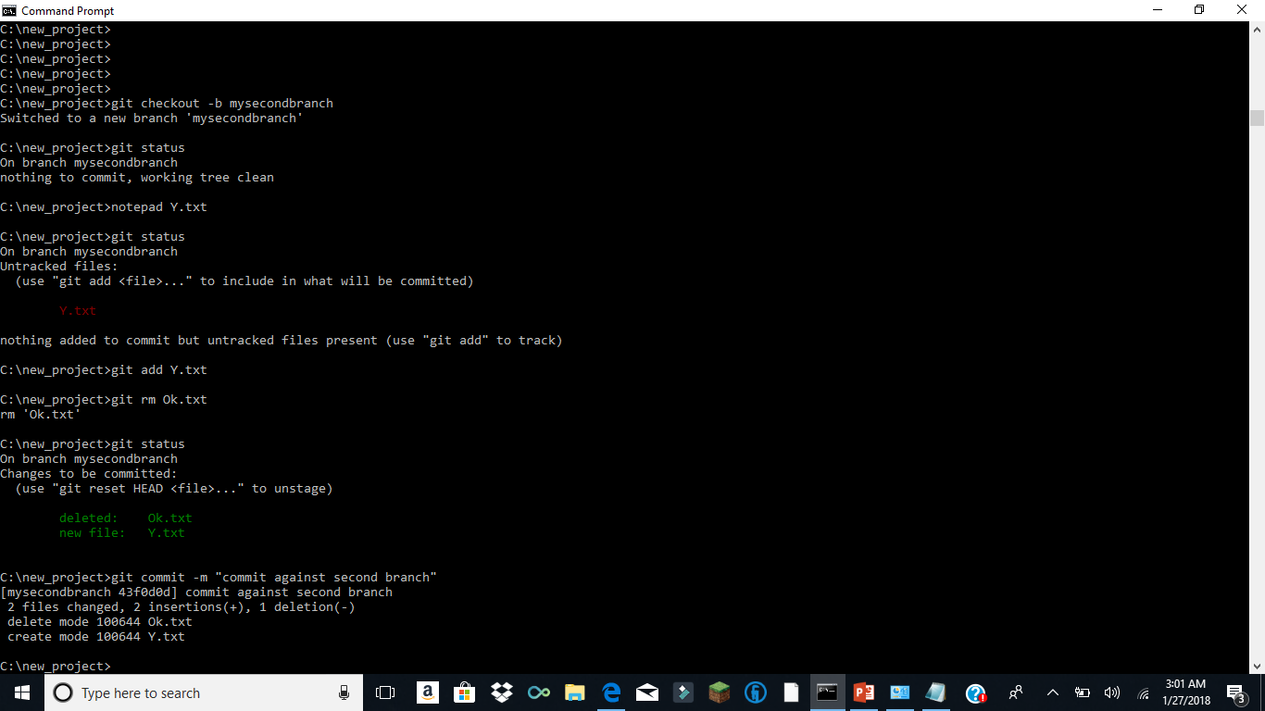

Slide 12
Switching between branches
Branch is normally a work product such as a fix or enhancement
We will have a current branch
We can switch between branches (git checkout <branch>)
The switch results in the files being displayed in the directory in accordance with the branches commits

Slide 13
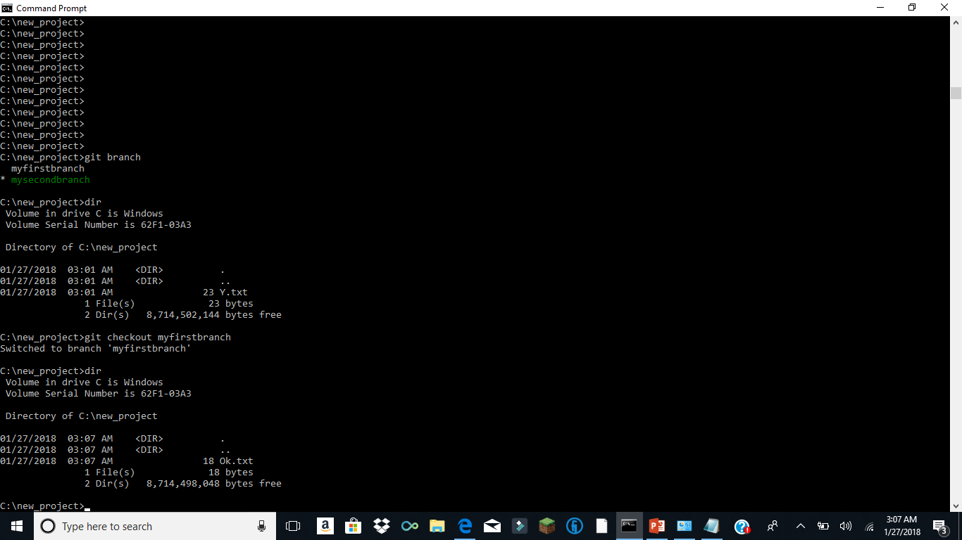

Slide 14
Each group of changes requires a commit
We update files and then do a (git add <file name>)
If we have to remove a file we do a (git rm <file name>)
git add is for a change to a file including the creation of a new file
Again these changes delta are committed against the current state of the branch

Slide 15
Adding a second commit
We add text to our Ok.txt file
We (git add Ok.txt) to stage the file changes to the commit
We commit the staged changes to the branch (git commit –m “the second commit on my branch myfirstbranch”

Slide 16
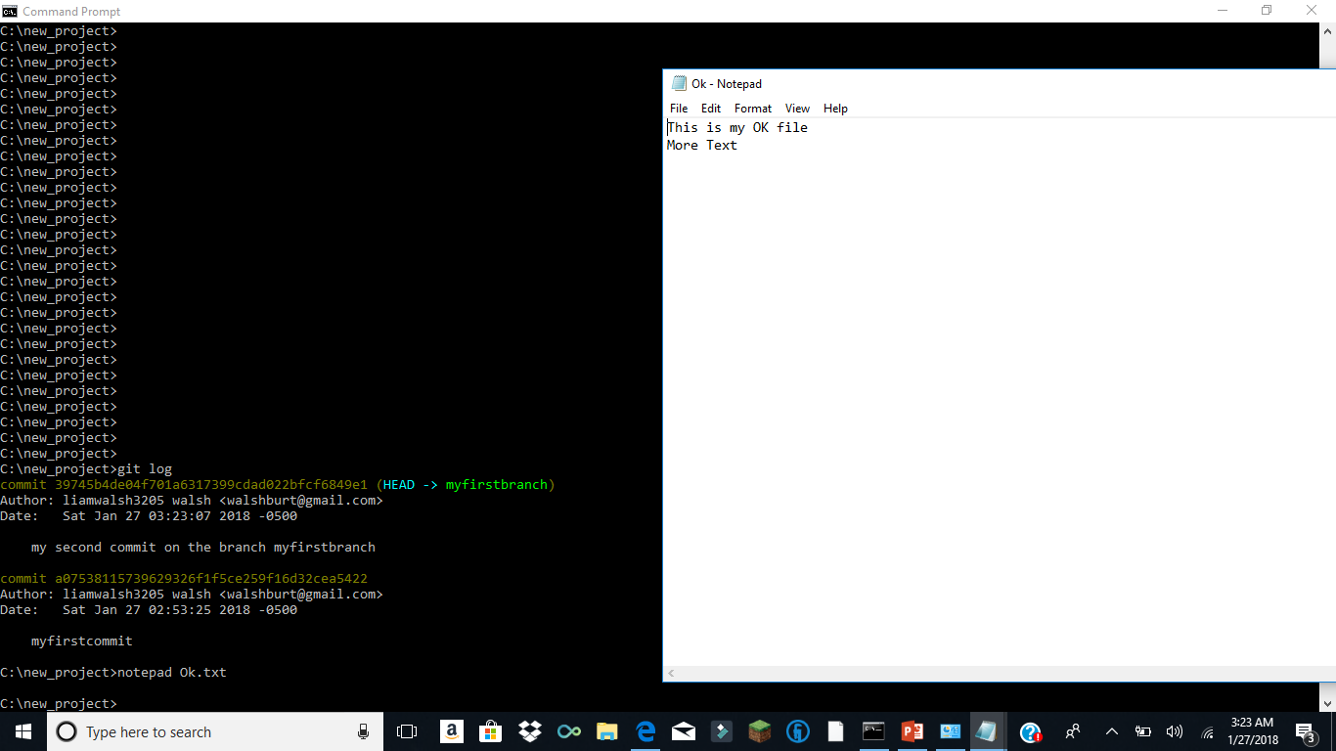

Slide 17
Viewing the actual changes
(git log –p) shows the actual file changes

Slide 18
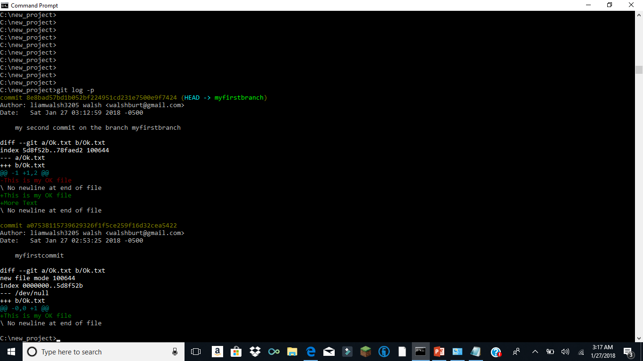

Slide 19
Rolling back a change
(git log) will show the commits
(git reset <commit>) will put the HEAD pointer of the current branch at the indicated commit
The HEAD pointer just indicates which commit is the most recent

Slide 20
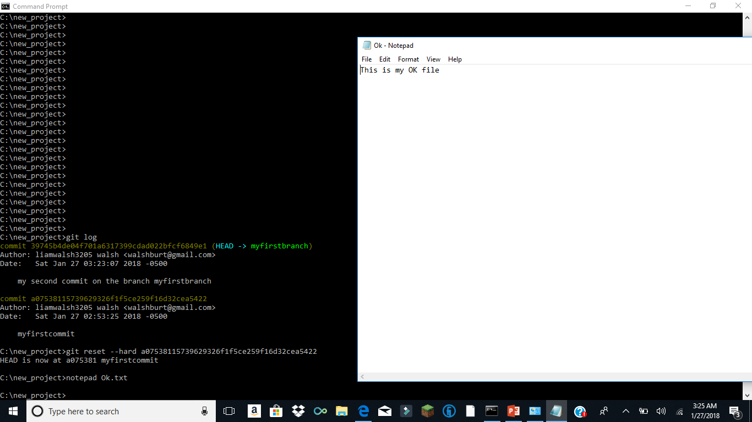

Slide 21
Review
Repositories contain branches (git init creates a repo in a directory)
Branches contain commits
The HEAD of a branch is the most recent commit
You can create branches (git checkout –b <branch name>)
You can switch between branches (git checkout <branch name>)
You add (stage) changed files, removed file to a commit and execute the commit against the branch (git commit –m “ my message” )
Commits store deltas against the branch

Slide 22
Remotes and Using GIT with a team
A remote repo is just a repository that your local repo knows about
Normally the master code for the group is stored on the remote server in a remote repo
You fetch code/branches/commits from the remote
You push you local changes to the remote
Merges (merge pull request) occur on the remote

Slide 23
Remote repo
Let us assume an admin created a remote repo (project) for us
The repo has a master branch
In our case the branch has one commit which added two files

Slide 24
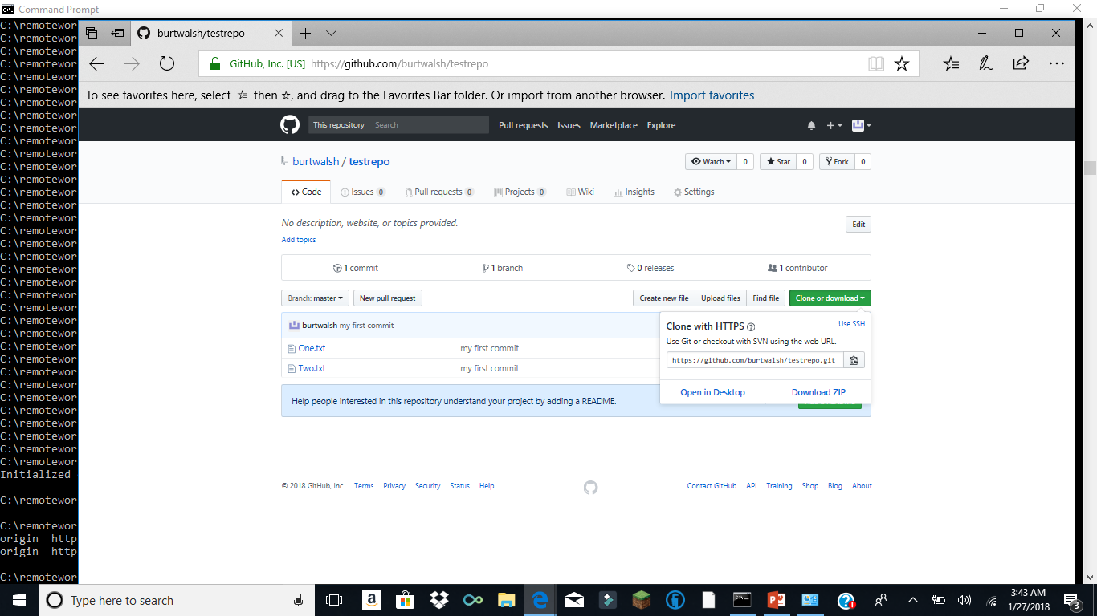

Slide 25
Working Locally with the Remote
We need to create a local repository (repo)
We need to set the remote repo with which we will exchange changes (commits) branches (git remote add origin https://github.com/burtwalsh/testrepo)
We need to clone (copy all code, branches and associated commits) from the remote to our local repo (https://github.com/burtwalsh/testrepo)
No (git init) needed in this case!

Slide 26
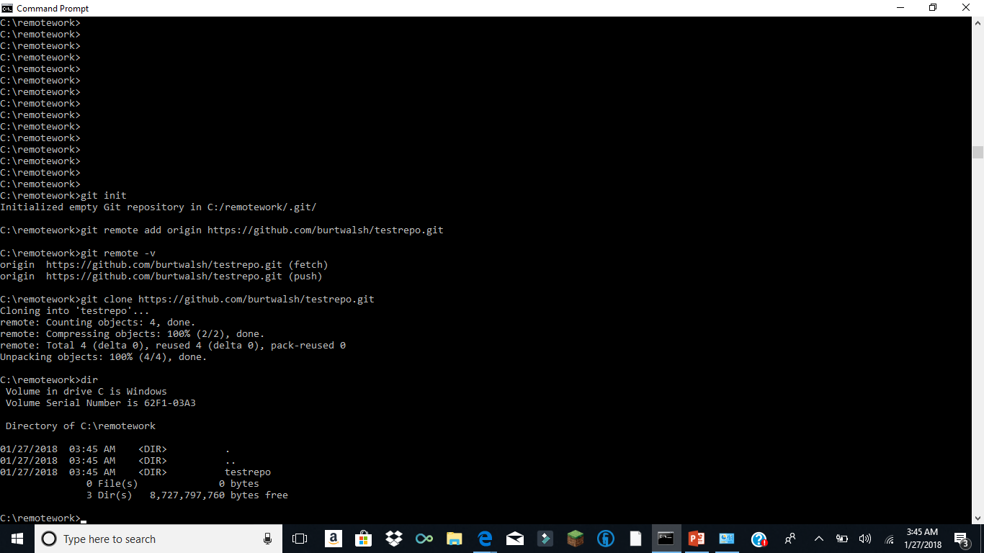

Slide 27
Looking at the remote
We see a subdirectory called testrepo
This directory has a .git subdirectory
Checkout the origin/master which is a branch from the remote that we now have locally
HEAD is at the most recent commit (that we know about) for the remote master branch

Slide 28
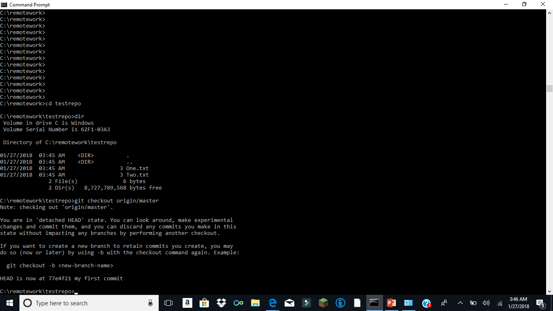

Slide 29
Create a Local Working branch
(git branch) now shows the remote branches
(git checkout –b myfix) creates a local branch called myfix

Slide 30
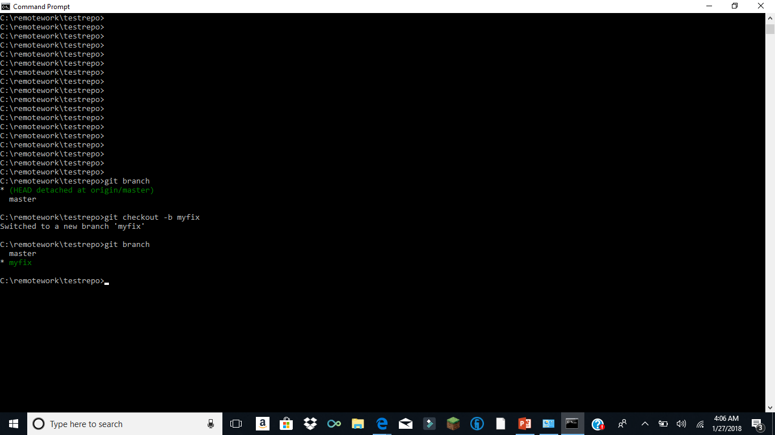

Slide 31
Updating and pushing changes
We will update the fetched One.txt file
We will (git add One.txt) the changes
We will commit (git commit –m “add some code”) to our LOCAL myfix branch
We will push the changes to the remote (origin) as a remote branch myfix
If the branch does not exist it will be created

Slide 32
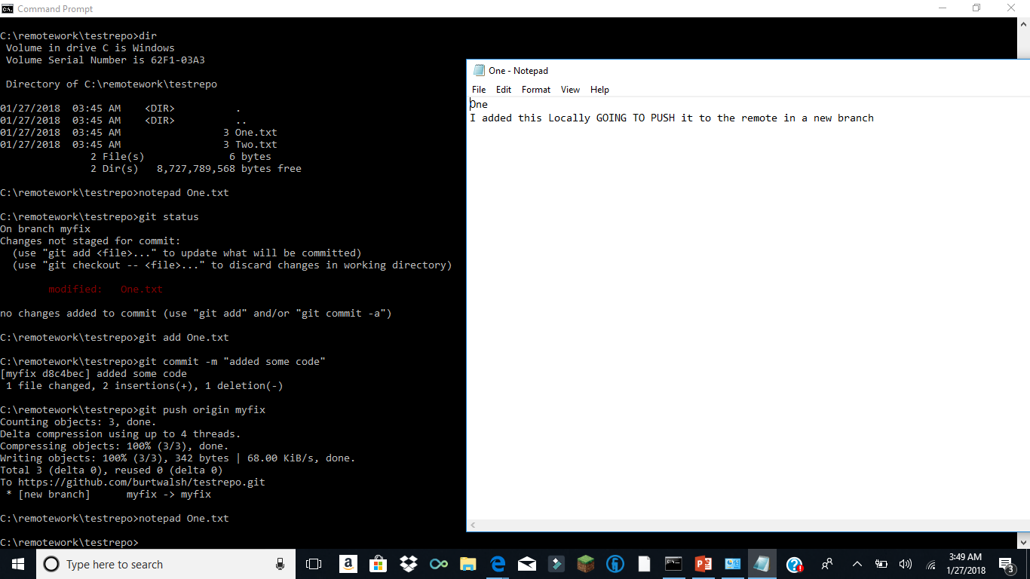

Slide 33
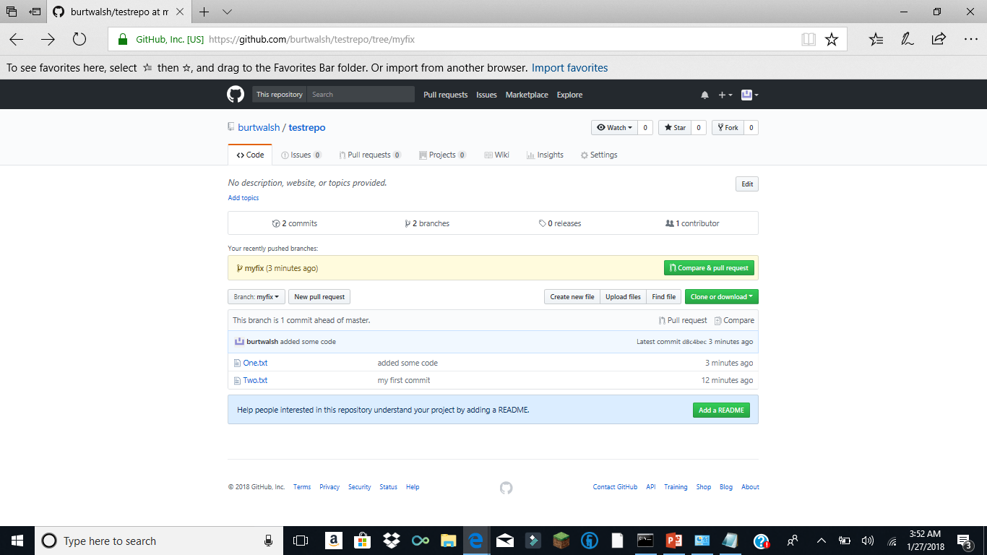
New branch on the remote

Slide 34
A Merge Pull Request
A merge pull request is associated with a merge between two branches
You select the base branch (on the remote) that you are going to merge your changes into
Your changes came up from the Local when you did the (git push)

Slide 35
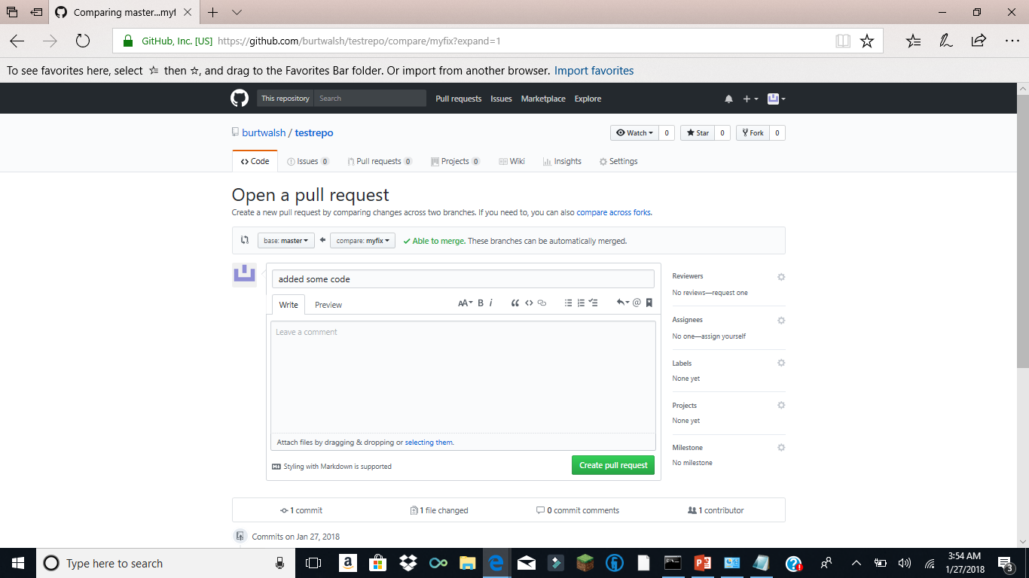
Click Compare and Pull

Slide 36
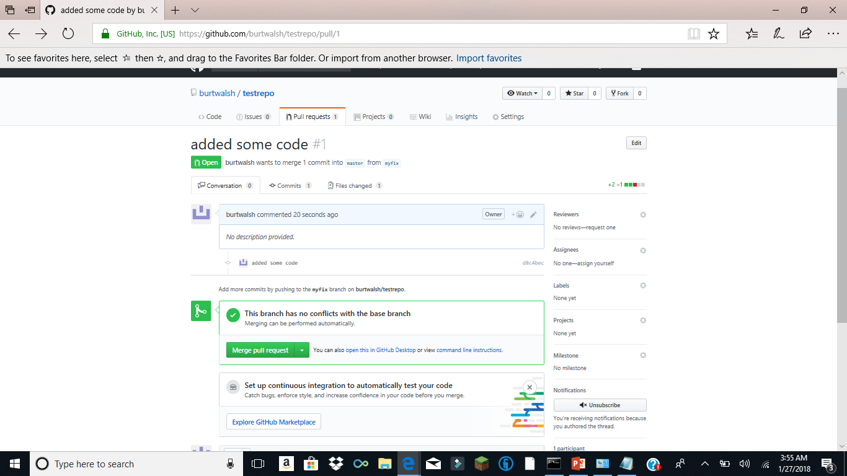
Click Create Merge pull Request

Slide 37
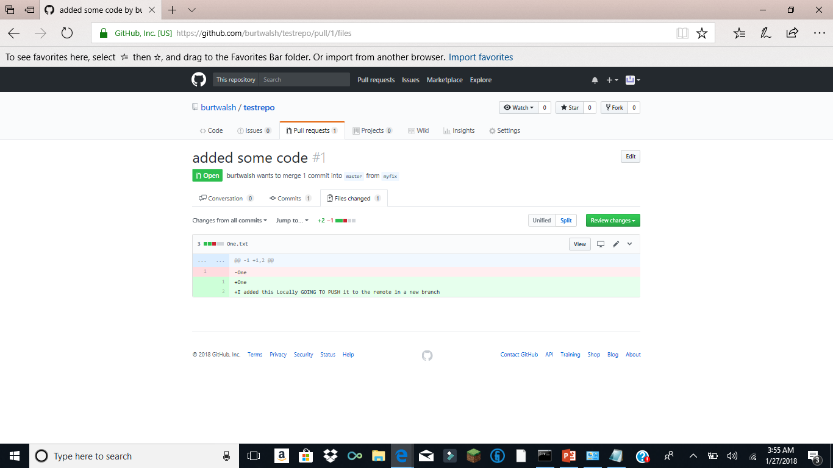
Looking at What is to be Merged

Slide 38
Back at the Local Repo
On the remote we have not merged YET
You could (git fetch)
(git reset –hard origin/master) to see the current state of the remote master branch
Look at the One.txt file and see it has not yet been merged at the remote
REMEMBER THIS WHOLE PROCESS STARTED FROM THE REMOTE MASTER

Slide 39
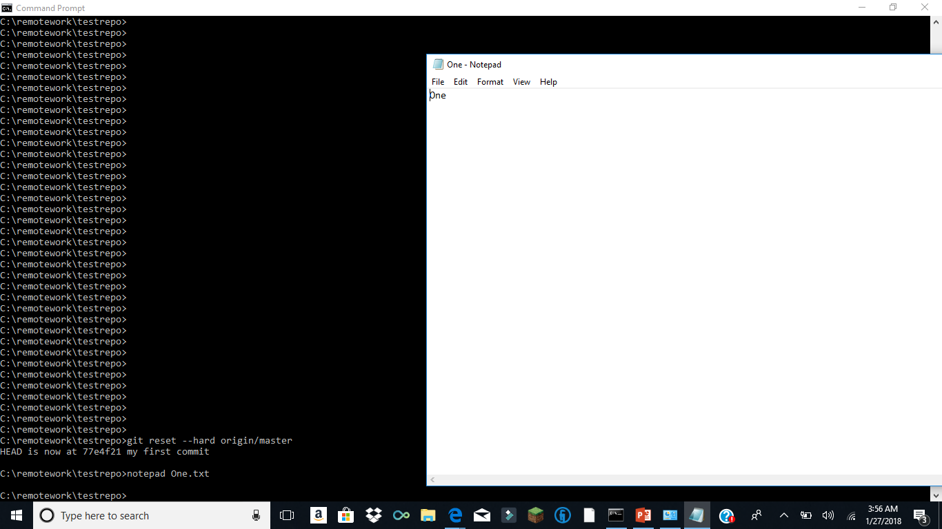

Slide 40
Back at the Remote
Another user will review and hopefully MERGE my changes!

Slide 41
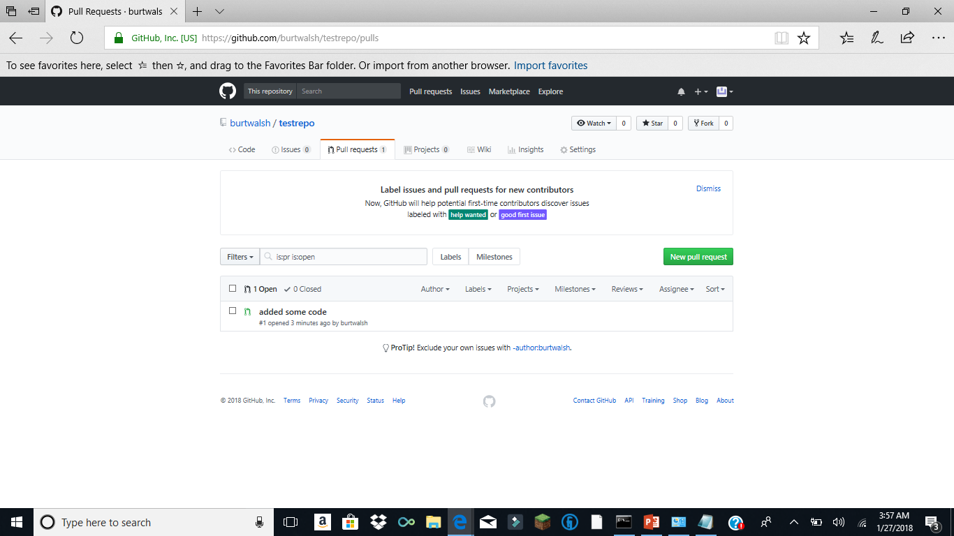
At the Remote Click Pull Requests

Slide 42
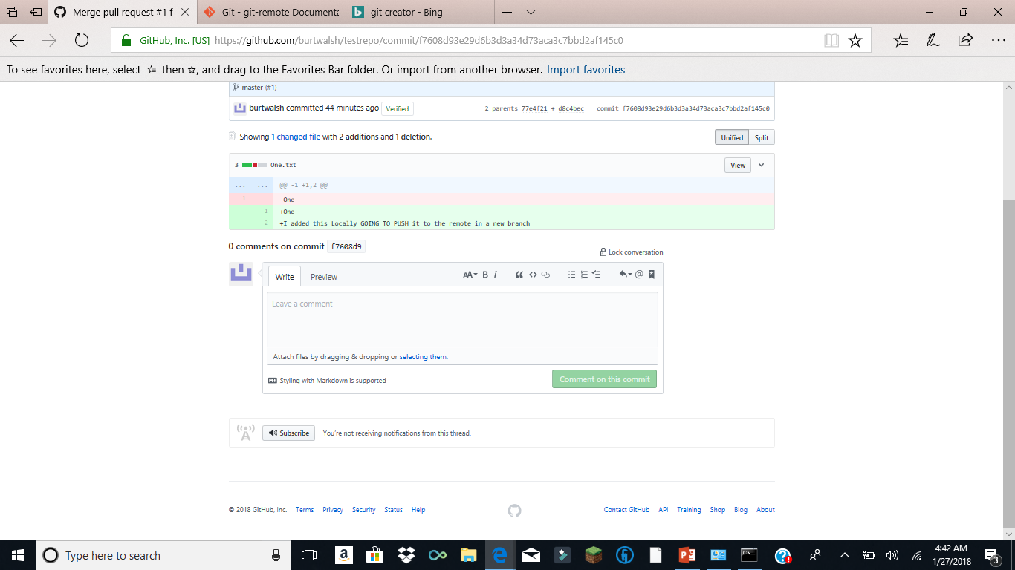
Review Code

Slide 43
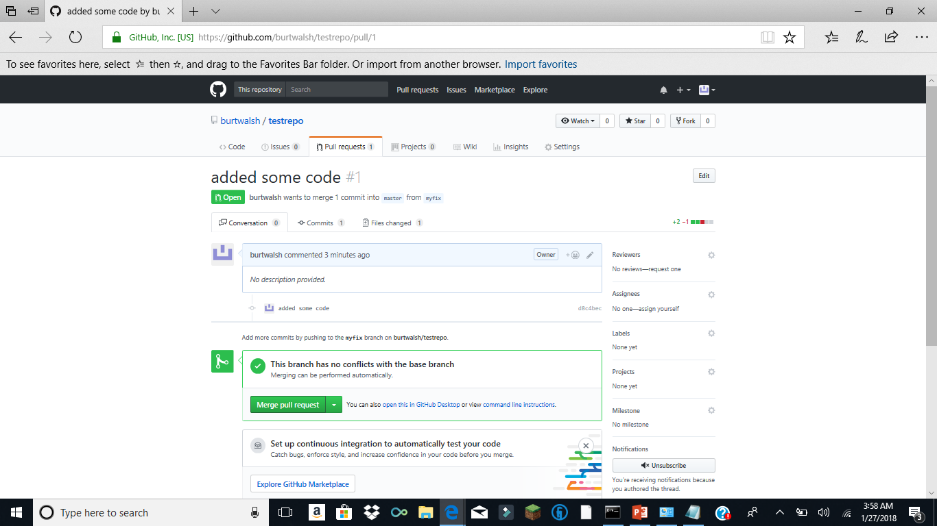
Merge Pull Request

Slide 44
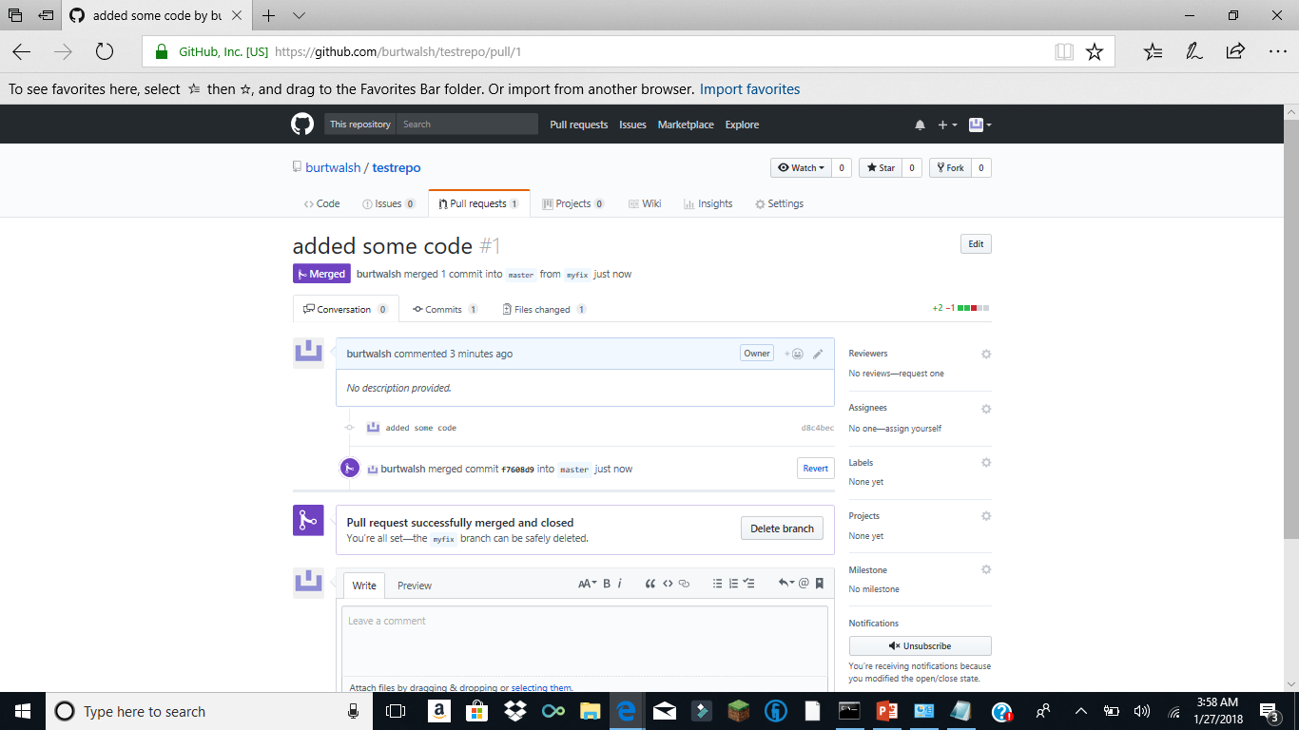
Merged State

Slide 45
Fetch all Changes to the Local Repo
When working with the remote you need to (git fetch) to ensure all changes that have occurred at the remote are brought down to the local repo
MANY PEOPLE WILL BE UPDATING THE REMOTE FROM THEIR LOCAL REPOS
After the FETCH you have a copy of all the code, branches and associated commits locally (You are in sync!)
(git checkout origin/master)
View the updated and merged One.txt file

Slide 46
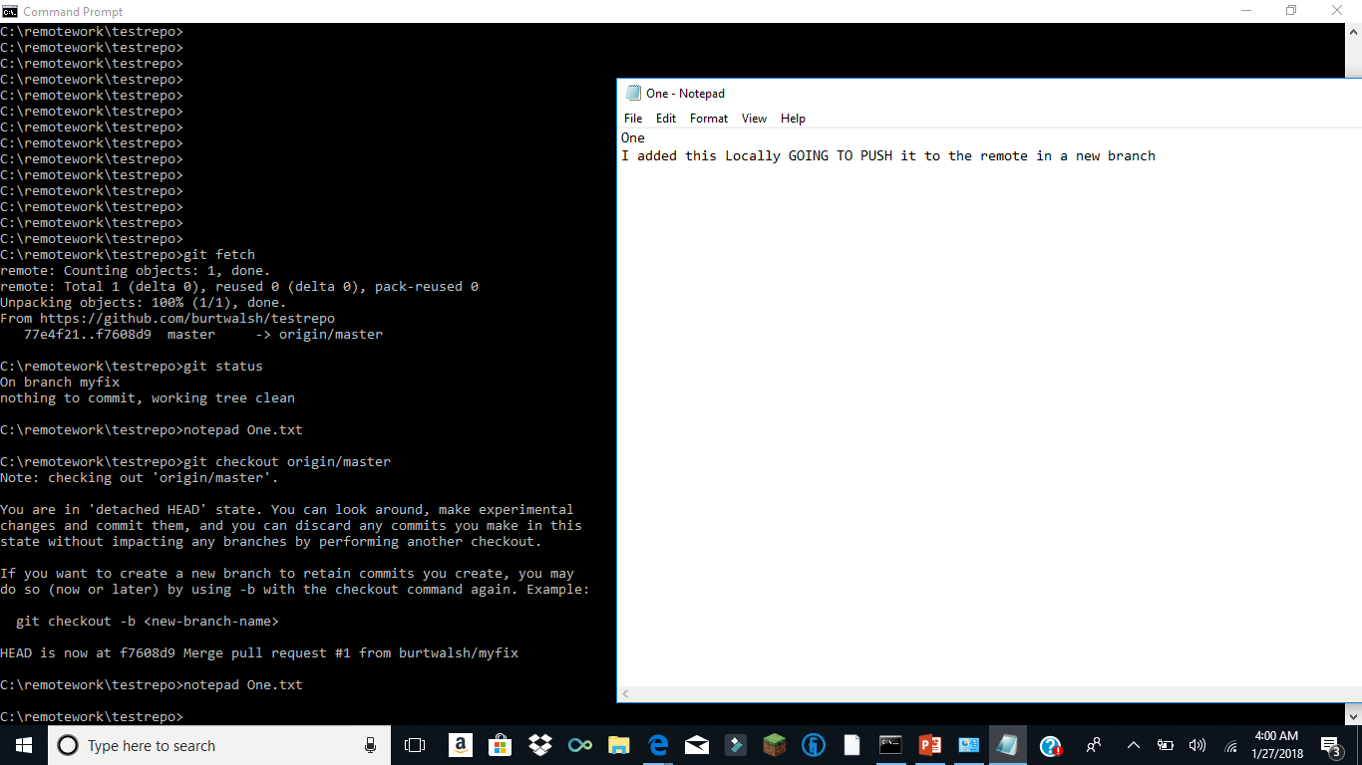

Slide 47
Why use GIT
Git was created by Linus Torvalds in 2005
Linus created Linux (from Unix)
Need to support distributed updates and collaboration of big projects
Hard to keep deltas consistent so based upon diffs

