Slide 1
Introduction to Docker
burt.walsh@ast.myflorida.com

Slide 2
Docker Approach

Slide 3

Where to Get Docker

Slide 4

Starting the Docker Machine

Slide 5

What no containers? Lets start one and log on!

Slide 6

Lets install some software
apt-get update -y (updates all current packages)
apt-get install -y nodejs (installs nodejs)
apt-get install -y npm. (installs package manager)
mkdir myweb (creates a new directory)
cd myweb (changes directory)
npm init (create a node project)
npm install -y express —save (install web software)

Slide 7

Now that we are in the container… lets load some software

Slide 8
Create a WebServer Host and Run it
Create a source file with instructions to start a web server (SampleServer.js)
Start the server under nodejs (container port 3000)
Save the running container as an image so we can reuse it

Slide 9

Accessing the WebServer

Slide 10

Site is not accessible

Slide 11

Inspecting the Container

Slide 12
Looking at Networks

Slide 13

Running with Network Address Translation (NAT)
Bridge Network

Slide 14
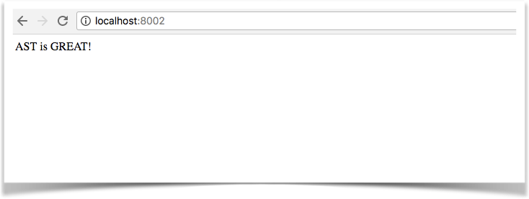
NAT in Action

Slide 15
Docker Files
Descriptive instructions for creation of a docker image
Install software
Start processes
Expose ports

Slide 16

Example Dockerfile

Slide 17

Building the Image

Slide 18

Running the Image

Slide 19

Netstat to see the WebServer

Slide 20

Accessing the WebServer

Slide 21
Docker Compose
Docker compose lets you define a group of containers and relationships between them
You can bring up the group, restart the group, stop the group as a unit
This is defined in a simple YAML file

Slide 22


Architecture
NAT
Border of created my network
Nginx (load balancer)
WebServer1
WebServer2

Slide 23

WebServer Code

Slide 24
Nginx
Will be a container like our webservers
Acts as a load balancer (reverse proxy)
Will shift requests between our two web servers
Note: A proxy hides the client. Servers think they are talking with the proxy not the client; the proxy makes requests on behalf of the client.
A reverse proxy hides servers the client talks to a server though the reverse proxy. The true server fielding the request is hidden from the client.

Slide 25

Directory for Nginx Resources

Slide 26

Nginx Config

Slide 27

Docker Compose File

Slide 28

Created Network

Slide 29

The containers

Slide 30

Mounted Volumes

Slide 31


Alternation between WebServers

Slide 32
MicroServices
In short, the microservice architectural style is an approach to developing a single application as a suite of small services, each running in its own process and communicating with lightweight mechanisms, often an HTTP resource API. These services are built around business capabilities and independently deployable by fully automated deployment machinery. There is a bare minimum of centralized management of these services, which may be written in different programming languages and use different data storage technologies.
https://martinfowler.com/articles/microservices.html

Slide 33
New Architecture
NAT
Border of created my network
Nginx (load balancer)
WebServer1
WebServer2
API Gateway

Slide 34

Changes to docker-compose.yaml

Slide 35

Definition of Service

Slide 36

Change to WebServer

Slide 37

Running the new solution

Slide 38
Calling the Business Layer through the WebServer

Slide 39
References
Three tier web application with docker compose (https://serversforhackers.com/dockerized-app/docker-compose)
Great tutorial for around $10 (https://www.udemy.com/docker-mastery/)
Main docker site (https://www.docker.com/)
Docker hub for publishing and pulling (https://hub.docker.com/)

Slide 40
Other Things to Look At
Docker Swarm (https://docs.docker.com/engine/swarm/)
Nodejs (https://nodejs.org/en/)
Source code and slides (https://github.com/burtwalsh/dockertutorial)
https://moleculer.services/

