Slide 1





WULS-
SGGW
WARSAW UNIVERSITY OF LIFE SCIENCES - SGGW

Slide 2

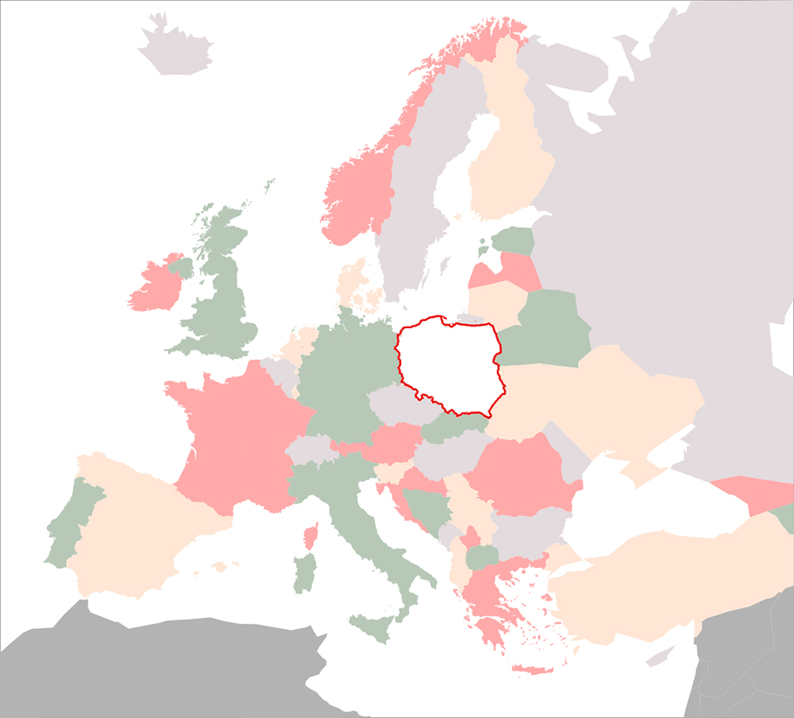


POLAND in brief
Some geographical data
Capital city: Warszawa
Population: 38 million citizens
Area: 312, 685 km²
Official language: Polish
National flag: top-white bottom-red
National emblem: white eagle with a crown on a red setting
Neighbors: Belarus, Czech Republic, Germany, Lithuania, Slovakia, Russia, Ukraine
POLAND
Polish emblem & flag

Slide 3
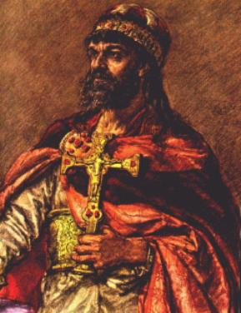
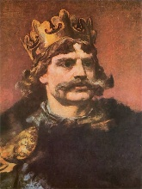
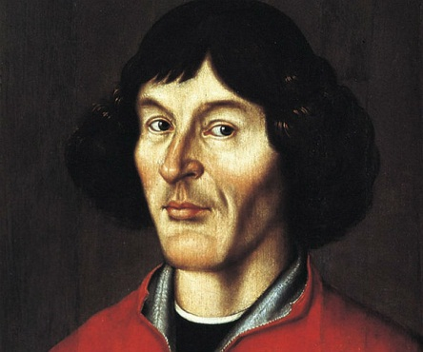
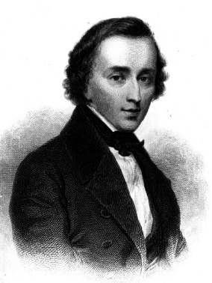
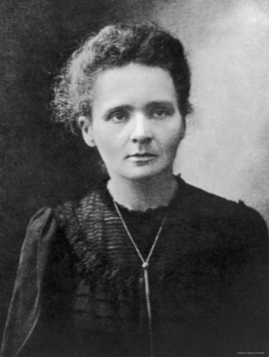
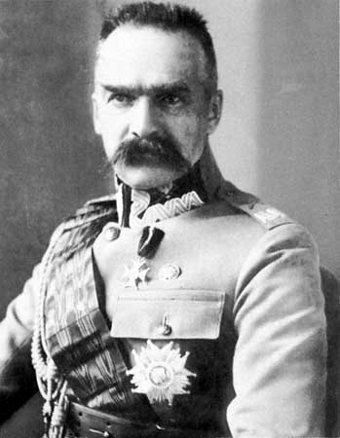
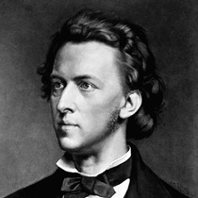
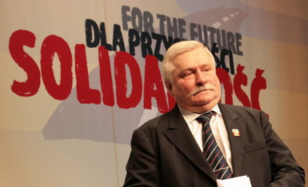
POLAND in brief
Some historical data
966 Poland accepts Christianity
1025 Coronation of the fist Polish King – Bolesław Chrobry
1569 Poland-Lithuania; first Union in Europe
1772, 1793, 1795 Partition of Poland (between Russia, Austria and Prussia)
1918 Regaining of independence

Slide 4
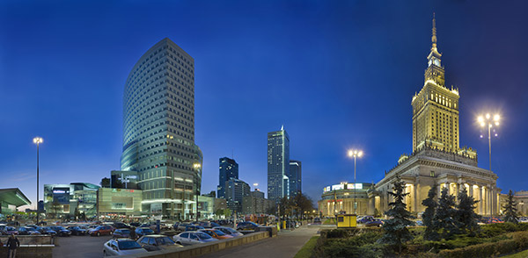
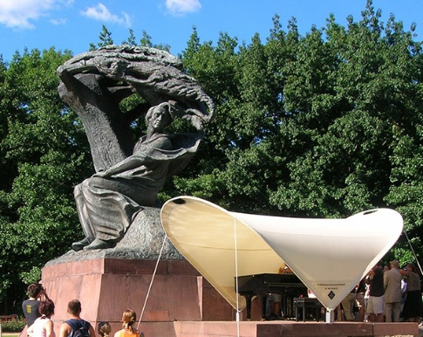
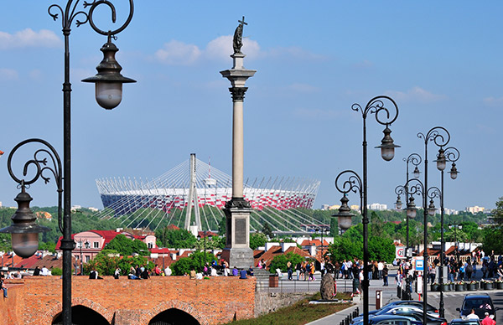
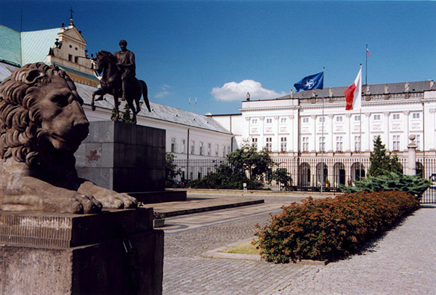
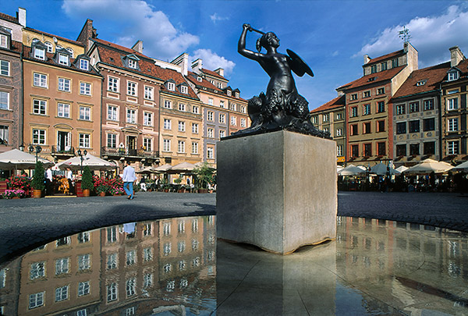
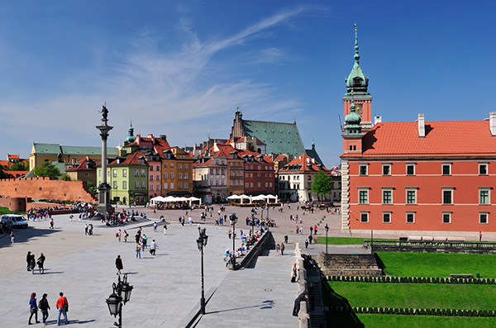
WULS –
SGGW
Warsaw University of Life Sciences - SGGW
Warsaw is the capital and the biggest city of Poland, located in the central-eastern part of the country, in Mazovia, on the banks of Vistula (Wisła).
Warsaw is a scientific, cultural, political and economic centre on European scale.
Warsaw is a modern city with many touristic attractions, large shopping centers, sport centers, restaurants, cafes, clubs and cinemas.
Warsaw is a city where everyone can find something for herself/himself
Warsaw was one of the eight cities hosting the 2012 UEFA European Football Championship known as EURO 2012™ – the world’s third biggest sports event.
Zdjęcia udostępniło MISTO STOŁECZNE WARSZAWA, www.um.warszawa.pl; foto. PZ Studio

Slide 5
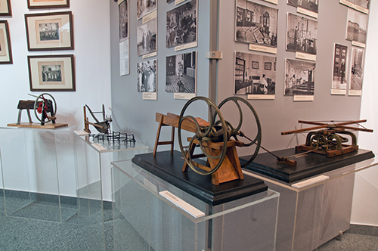
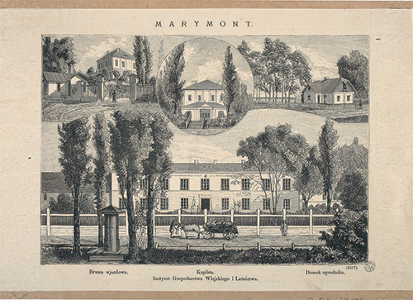
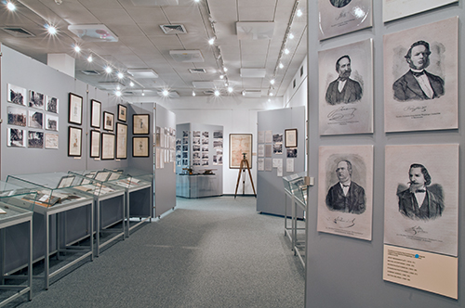
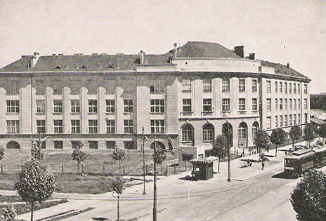
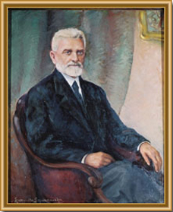
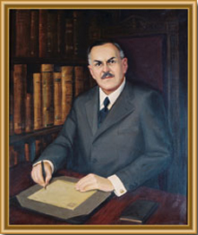
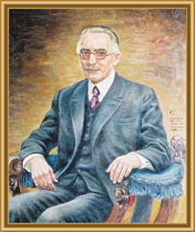
WULS-
SGGW
A MODERN UNIVERSITY WITH 200-YEAR TRADITION
PROMINENT SCHOLARS RELATED TO THE UNIVERSITY
Józef Mikułowski-Pomorski
First rector of the University 1918-20 and 1928-29
Minister for Agriculture
Minister for Religion
Władysław Grabski
Rector of WULS-SGGW in 1926-28
Prime Minister
Author of the Polish currency reform
Zdzisław Ludkiewicz
Rector of WULS-SGGW in 1925-26
Creator of the Polish Bank
Minister of Agricultural Reforms

Slide 6
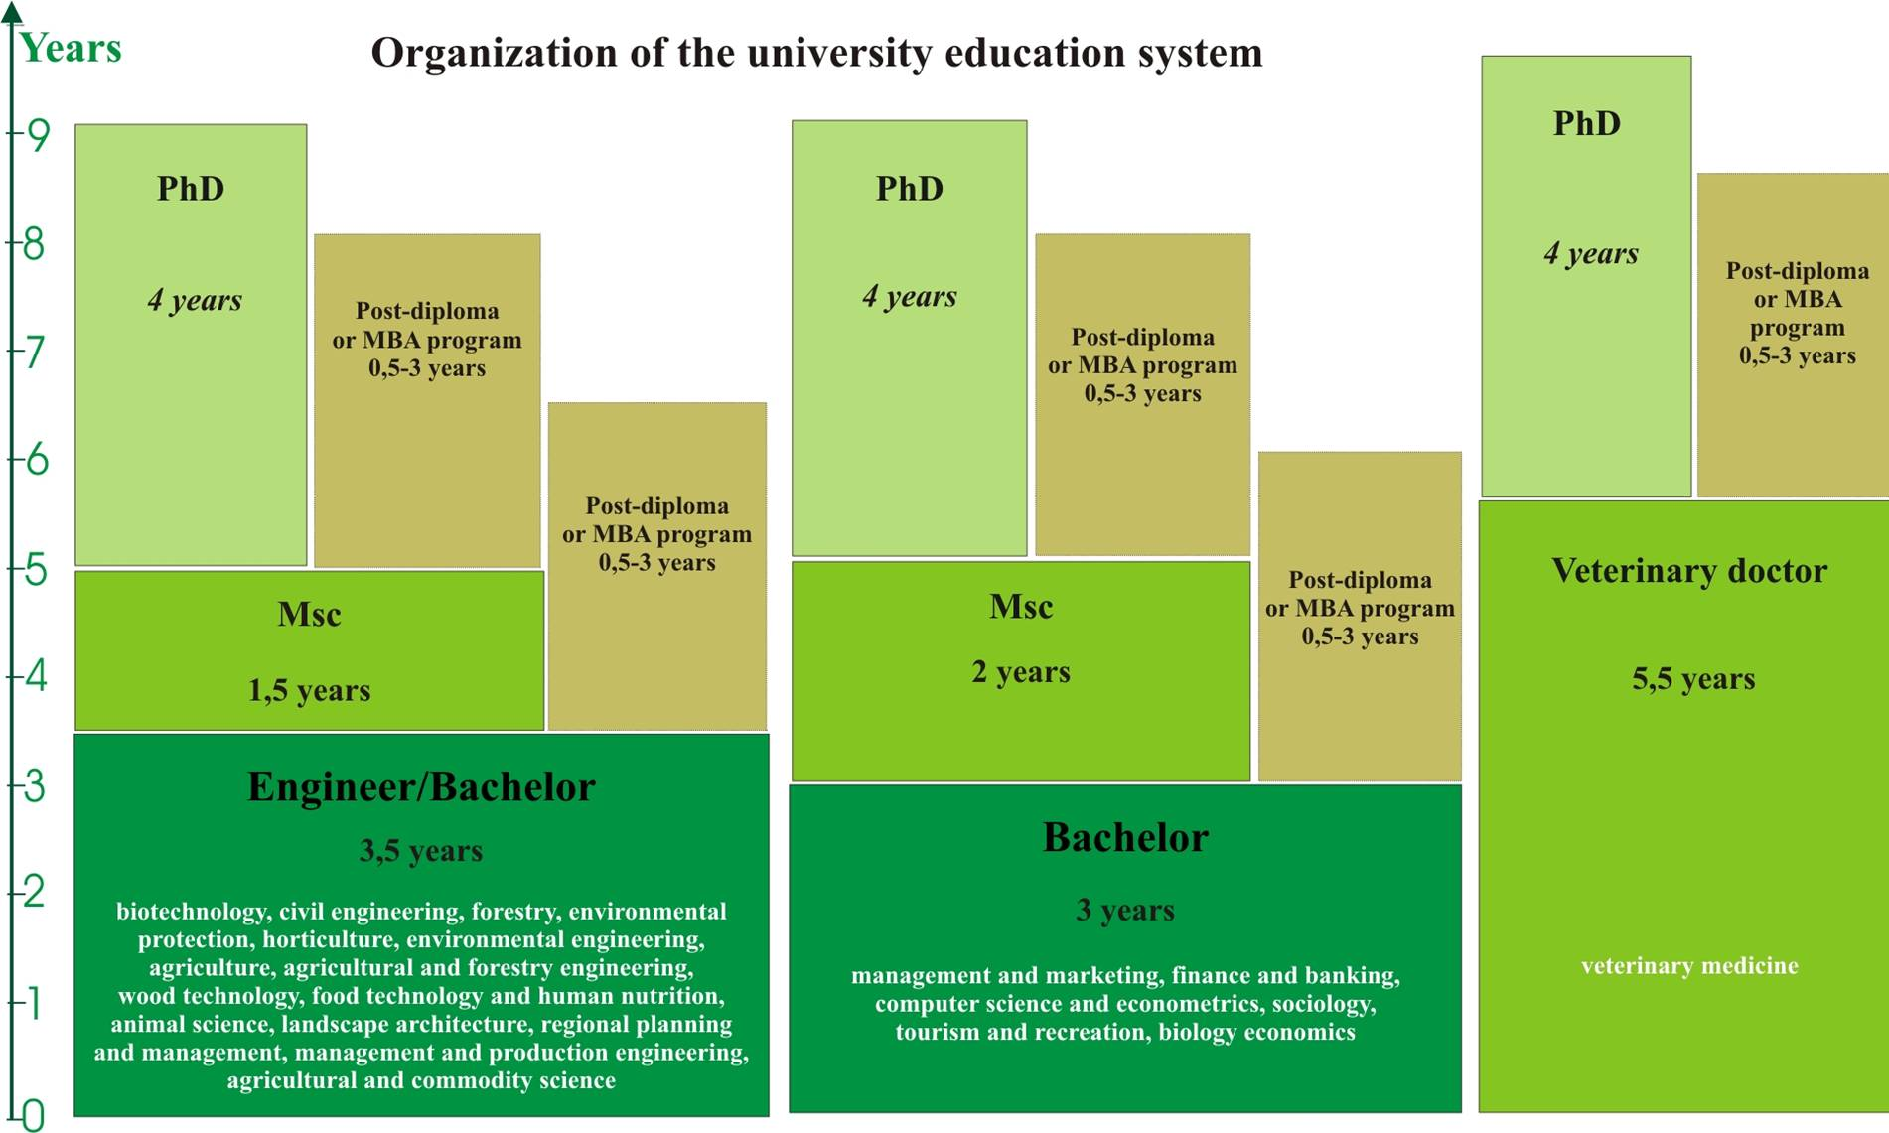
ORGANIZATION OF THE UNIVERSITY EDUCATIONAL SYSTEM
MSc
MSc

Slide 7
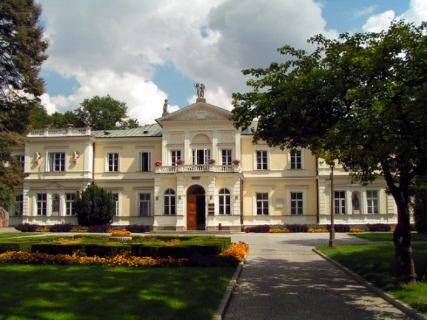

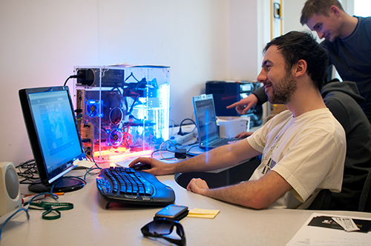
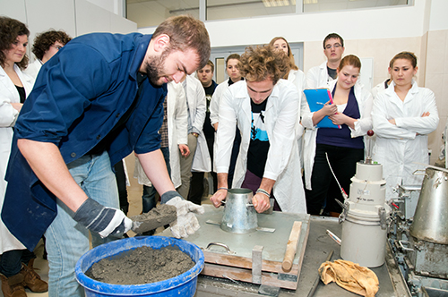
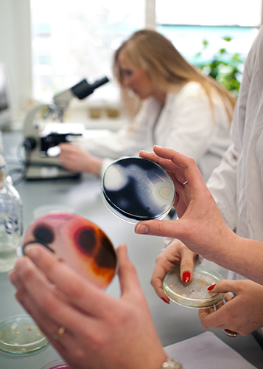
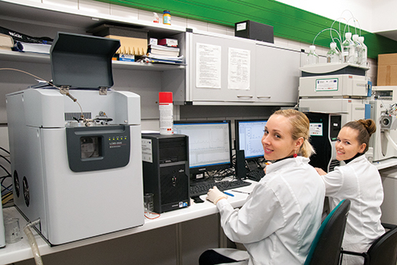
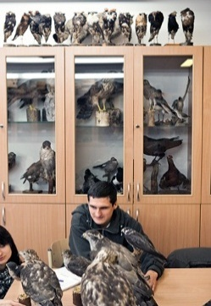

WULS-
SGGW
13 FACULTIES + 16 INSTITUTES
7 DEGREE PROGRAMS IN ENGLISH +
2 DEGREE PROGRAMS IN ENGLISH JOINTLY WITH EU UNIVERSITIES
≈ 20 000 STUDENTS
1 300 ACADEMIC STAFF
≈ 400 AGREEMENTS FOR INTERNATIONAL COOPERATION
WEBOMETRICS
17 – POLAND
1425 - WORLD
QS WORLD UNIVERSITY RANKING
27 – AGRICULTURE & FORESTRY

Slide 8


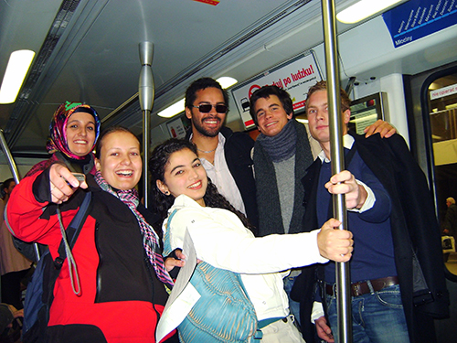
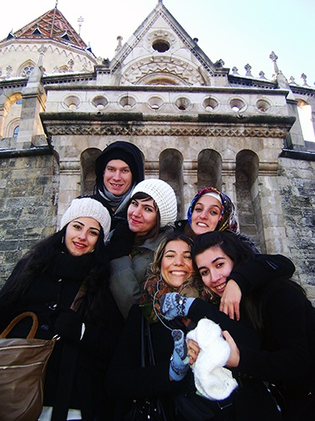
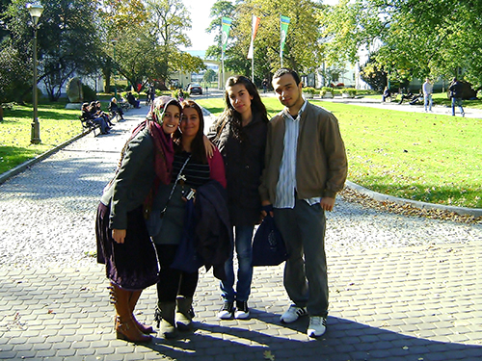
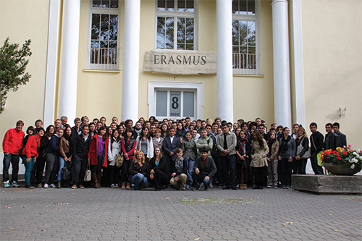

INTERNATIONAL COOPERATION
NETWORKS
- ELLS
Euroleague for Life Sciences
- ICA
Association for European Life Science Universities
- CASEE
The ICA Regional Organization for Central and South Eastern Europe
INTERNATIONAL PROJECTS
≈ 28 EDUCATIONAL PROJECTS
Erasmus +, CEEPUS, NAWA
≈ 94 RESEARCH PROJECTS
Horizon2020, ERA-NET COFUND, INTERREG, COST, Bonus on the Horizon, Bilateral Cooperation Programme, Norwegian Research Council, European Space Agency, commissioned research work
HR LOGO

Slide 9

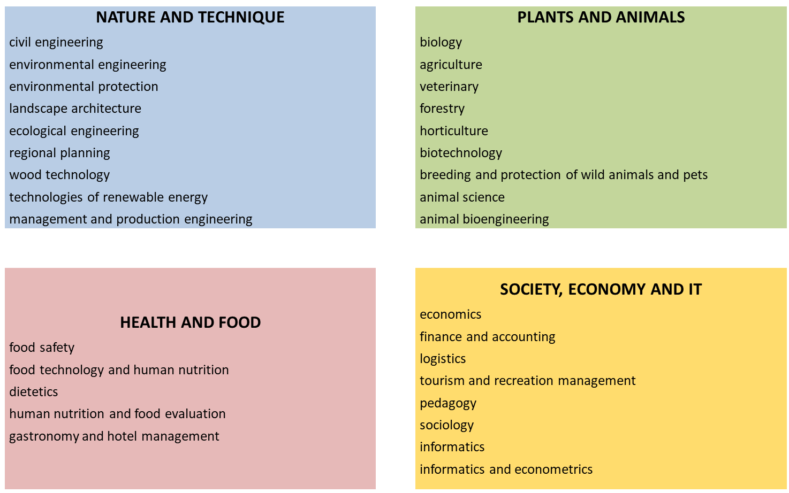


WULS-SGGW STUDY PROGRAMS
SOCIET ECONOMY AND IT
economy ,
finance and accounting, logistics, tourism and recreation management,
pedagogy, sociology,
informatics
informatics and econometry

Slide 10


BSC DEGREE PROGRAMS
B.Sc. in Organic Agriculture and Food Production
MSC DEGREE PROGRAMS
M.Sc. in Environmental Protection
specialization: Restoration and Management of Environment
M.Sc. in Civil Engineering
specialization: Engineering Infrastructure
M.Sc. in Horticulture
specialization: Horticulture
M.Sc. in Economics and Organization of Enterprises
specialization: Economics and Organisation of Enterprises
M.Sc. in Informatics and Econometrics
specialization: Big Data Analysis
Veterinary Medicine
DEGREE STUDIES PROVIDED JOINTLY WITH EU INSTITUTIONS
M.Sc. in Forestry
specialization: Forest Information Technology
M.Sc. in Food Technology and Human Nutrition
specialization: Organic Food Quality and Marketing
STUDY PROGRAMS IN ENGLISH

Slide 11

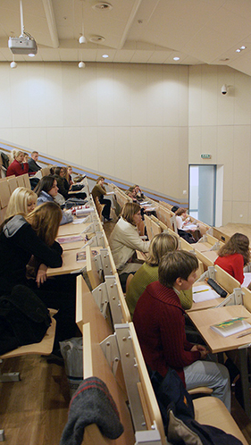
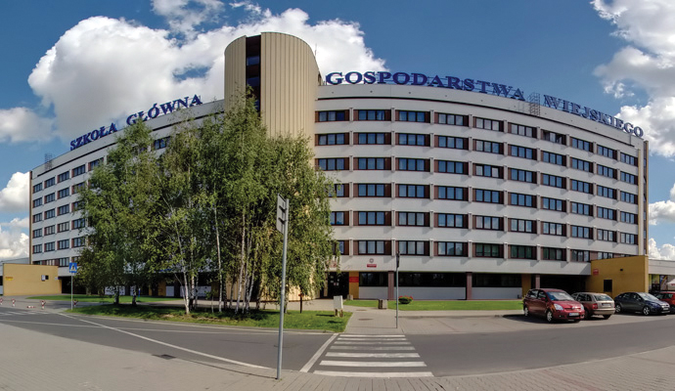
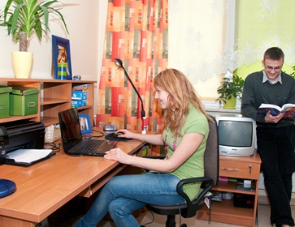
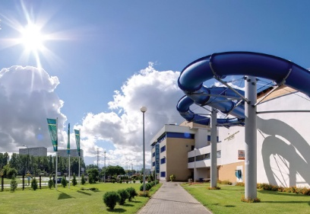
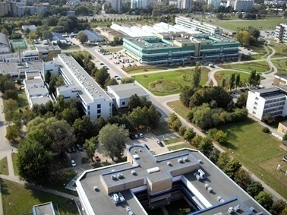
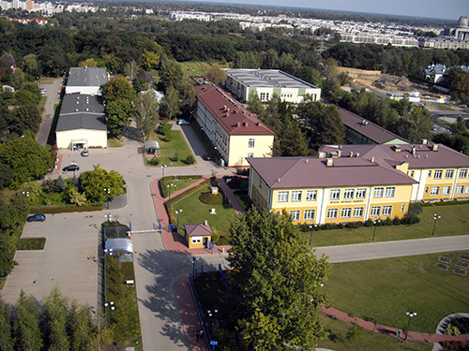
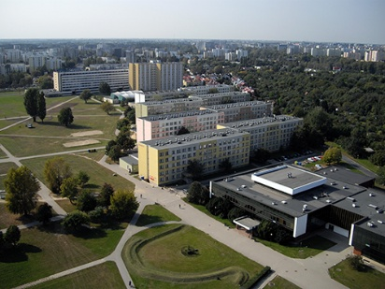
INFRASTRUCTURE
72 ha CAMPUS AREA
SPORTS FACILITIES
300 LECTURE HALLS
1 600 DIDACTIC ROOMS
4 000 PLACES IN
12 STUDENT DORMITORIES
≈ 80 - 100 EUR / MONTH

Slide 12
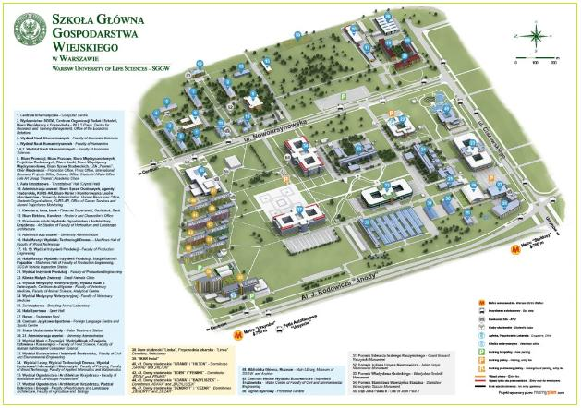
CAMPUS of Warsaw University of Life Sciences

Slide 13
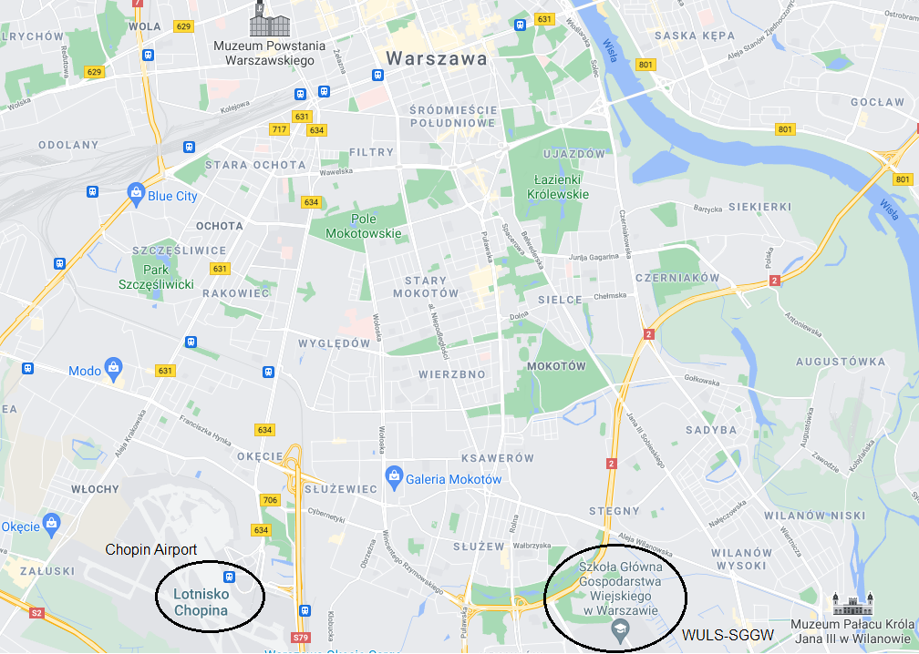
Warsaw, map

Slide 14


WULS-
SGGW
LOOKING FORWARD TO SEEING YOU
IN WARSAW!

