Slide 1
Tx (LINQ to Traces)
Georgis, Emeijer

Slide 2
Agenda
The problem – many formats
Trace Playback Extensions
Time, Order, Causality
Differences between causality and time order
Why Rx is the adequate runtime
What exists in Rx about time
Adding one piece: TimeSource<T>
System Topologies

Slide 3
Trace Playback Extensions
Solving the “Event Normalization” problem – turning all events to C#

Slide 4
In this chapter:
Examples of raw trace/log formats
Files
Real-Time feeds
Insight: Envelope Types
Explicit type layer
Playback
Type occurrence statistics
Order and Time Invariants

Slide 5
Read & Transform
Bridging real-world events and C#

Slide 6
Reading raw traces/logs
Event Tracing for Windows (ETW)
IObservable<EtwNativeEvent> etl = EtwObservable.FromFiles(
@"..\..\..\HTTP_Server.etl");
Windows Event Logs
IEnumerable<EventRecord> evtx = EvtxEnumerable.FromFiles(
@"..\..\..\HTTP_Server.evtx");
SQL Extended Events (XEvent)
IObservable<PublishedEvent> xe = XeObservable.FromFiles(
@"..\..\gatewaysample*.xel");

Slide 7
Listening in Real-Time
Event Tracing for Windows (ETW)
IObservable<EtwNativeEvent> session = EtwObservable.FromSession(
"TCP");
Windows Event Logs: TODO
SQL Extended Events (XEvent)
[XETarget("mytarget", "")] class MyTarget : XeSubject{ ... }
IObservable<PublishedEvent> = playback.AddXeTarget<MyTarget>();

Slide 8
Often, events come in envelopes
Implicit Type definition
Types
class Add_Enter
{
public DateTime T { get; set; }
public int X { get; set; }
public int Y { get; set; }
}
"{0} Entering function Add with x={1} and y={2}"
class Add_Leave
{
public DateTime T { get; set; }
public int ReturnValue { get; set; }
}
"{0} Leaving function Add, return value={1}"
new Add_Enter
{
T =...,
X = 5,
Y = 3
};
"10:00:00 Entering function Add with x=5 and y=3"
new Add_Leave
{
T =...,
ReturnValue = 8
}
"10:00:03 Leaving function Add, return value=8"
Events in envelope
Instances

Slide 9
Popular Envelopes
String
printf
System.Diagnostics
ULS (used in Office 365)
Dictionary
System.Diagnostics.Eventing.Reader.EventRecord
PublishedEvent in XEvent
byte[]
ETW (many sub-nuances)

Slide 10
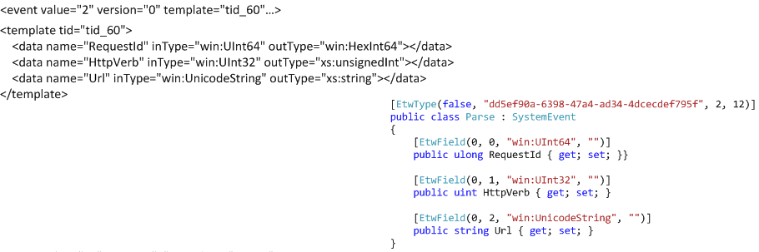
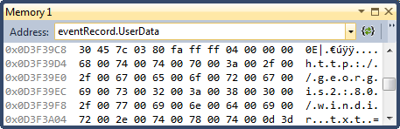
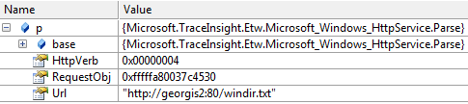
Removing the Envelopes
1) “Metadata” becomes C# type
2) Occurrences becomes C# instances

Slide 11
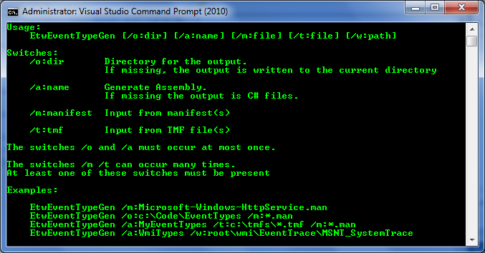
EtwTypeGen.exe

Slide 12
Playback
Playback playback = new Playback();
playback.AddEtlFiles(@"..\..\..\HTTP_Server.etl");
IObservable<Deliver> starts = playback.GetObservable<Parse>();
starts.Subscribe(s => Console.WriteLine(s.Url));
IObservable<FastSend> ends = playback.GetObservable<FastSend>();
ends=> Console.WriteLine(e.StatusCode));
playback.Run();

Slide 13
Playback: multiple formats
Playback playback = new Playback();
playback.AddEtlFiles(@"..\..\..\HTTP_Server.etl");
playback.AddLogFiles(@"..\..\..\HTTP_Server.evtx");
IObservable<SystemEvent> all = playback.GetObservable<SystemEvent>();
all.Count().Subscribe(Console.WriteLine);
playback.Run();

Slide 14
Playback: Real-Time
Playback playback = new Playback();
playback.AddRealTimeSession("tcp");
var recv = from req in playback.GetObservable<KNetEvt_RecvIPV4>()
select new
{
Time = req.OccurenceTime,
Size = req.size,
Address = new IPAddress(req.daddr)
};
recv.Subscribe(e=>Console.WriteLine(
"{0} : Received {1,5} bytes from {2}",
e.Time, e.Size, e.Address));
playback.Start();

Slide 15
TypeOccurenceStatistics
var stat = new TypeOccurenceStatistics(
Assembly.GetExecutingAssembly().GetTypes());
stat.AddEtlFiles(@"..\..\..\HTTP_Server.etl");
stat.Run();
foreach (KeyValuePair<Type, long> pair in stat.Statistics)
{
Console.WriteLine("{0,-15} {1}",
pair.Key.Name, pair.Value);
}

Slide 16
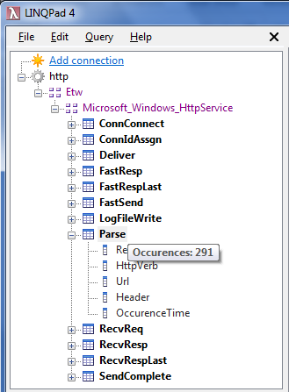
Example usage of type statistics

Slide 17
Playback component layers
Playback
Type
Occurrence
Statistics
Strongly Typed Layer
TimeSource
EtwObservable
EvtxObservable
XeObservable
…
Envelope Type Layer

Slide 18
Inside the Playback
Deserializers
IO<EtwNativeEvent>
Demux
EtwObservable
Man
GetObservable<T>
Classic
class Parse { …Url }
class FastSend{ …Status }
IO<EventRecord>
Man
Merge
Time
Source
EvtxObservable
IScheduler
Classic
IO<PublishedEvent>
IO<Timestamped<object>>
XeObservable
Xe
Playback

Slide 19
Extensibility
Read traces and decide what to “un-envelope”
Implement:
Reader (Enumerable or Observable)
Type-Map that tells Playback
How to recognize the type from the envelope
How to fetch timestamp
How to transform to un-enveloped type
Extension method
AddMyFiles or AddMyRealTimeFeed

Slide 20
Type Map interfaces
public interface ITypeMap<TInput>
{
Func<TInput, DateTimeOffset> TimeFunction { get; }
Func<TInput, object> GetTransform(Type outputType);
}
public interface IRootTypeMap<TInput, TOutputBase> : ITypeMap<TInput>
{
}
public interface IPartitionableTypeMap<TInput, TKey> : ITypeMap<TInput>
{
IEqualityComparer<TKey> Comparer { get; }
TKey GetTypeKey(Type outputType);
TKey GetInputKey(TInput evt);
}

Slide 21
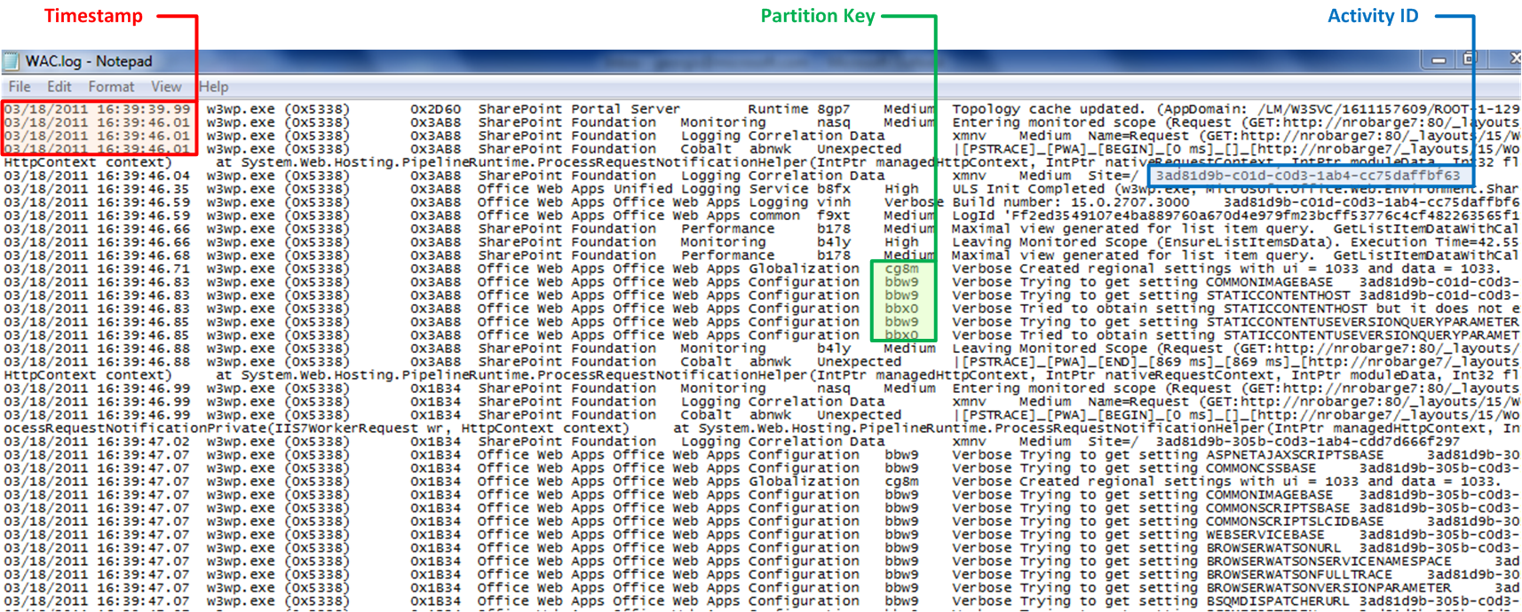
Example: Office ULS format

Slide 22
Explicit classes + parsing instructions
[UlsEvent("nasq", "^Entering monitored scope \\((.*)\\)$")]
public class EnteringMonitoredScope
{
public string Scope;
}
[UlsEvent("b4ly",
"^Leaving Monitored Scope \\((.*)\\). Execution Time=(.*)$")]
public class LeavingMonitoredScope
{
public string Scope;
public double ExecutionTime;
}
Classes like this can be manually written, or generated
See the reader and type-map implementation in the samples

Slide 23
Time, Order, Causality
Even if everyone traced the same way, we must account for time & space

Slide 24
In this chapter
Two notions of order: Time and Causality
Following causality with Rx sequence queries
Rx has 90 % of what is necessary to answer temporal queries
Extending Rx with Virtual Time obtained from the event timestamps

Slide 25
Two notions of “order”
Machine1
Machine2
Machine3
Time
Bomb
B1
{a}
{g}
B2
{x}
{t}
{q}
B1E
B2E
Causality Order: Is there a path from A to B? (partial order)
Time Order: Is B lower than A? (illusion of global order)

Slide 26
Classes of questions
About Sequences
Follow the events from explosion back to the bomb
About Time
Total # of events on all machines for 5 sec
Mixed
Use interval of {startTime, endTime} as restriction while following path to the bomb

Slide 27
Sequence queries: Causality Navigation
Machine1
Machine2
Machine3
Filter only “Bomb Exploded”
{B1E}
Get 30 events before B1E
{…r{q}…B1E}
Get 30, before you send {q}
{…r{x}…s{q}}
Get 30, before you send {x}
{…r{a}…s{x}}
Get 30, before you send {a}
B1
Root cause found!

Slide 28
Retrieving 30 events before message was sent
static void BeforeSend(StringBuilder sb, string messageId)
{
Playback pb = new Playback();
pb.AddEtlFiles(LocalTrace);
var all = pb.GetObservable<TracedEvent>();
string pattern = "send message " + messageId;
var send = all.Where(e => e.Message.Contains(pattern));
var before = all.TakeUntil(send);
var output = before.Merge(send);
output.TakeLast(linesPerPage).Subscribe(e => sb.AppendLine(Format(e.Message)));
pb.Run();
}

Slide 29
Existing Rx primitives about Time
IScheduler
Temporal primitives
Timer
Interval
Usage
Buffer
Window(
TestScheduler as example of “virtual time”

Slide 30
Creating Virtual Time from event timestamps
Scheduler
IScheduler
Now
Schedule<s>
(T->DateTimeOffset)
TimeSource<T>
IObserver<T>
OnNext
OnError
OnCompleted
IObservable<T>
Subscribe

Slide 31
Using TimeSource<T>
IObservable<EtwNativeEvent> etl = EtwObservable.FromFiles(
@"..\..\..\HTTP_Server.etl");
var timeSource = new TimeSource<EtwNativeEvent>(etl,
e => e.TimeStamp);
var countPerWindow =
from window in timeSource.Window(
TimeSpan.FromSeconds(5),
timeSource.Scheduler)
from Count in window.Count()
select Count;

Slide 32
Distributed Topologies
From flying blind in the cloud to being the leader

Slide 33
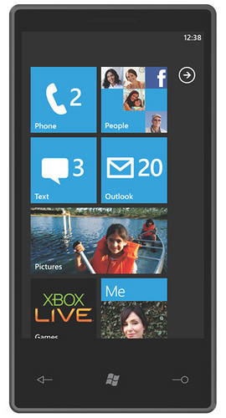
Low-Latency Monitoring
Hundreds of Thousands
Failover Cluster
Received
Rx
Send
Rx
Trace Playback
Trace Playback
ETW
Playback is useful if there are multiple protocols (see Fogo)
Kernel-Network
US China EU
class KNetEvt_RecvIPV4
{ uint dadr; uint size; }
Network Bandwidth per region (1 sec latency)
class KNetEvt_SendIPV4
{ uint dadr; uint size; }

Slide 34
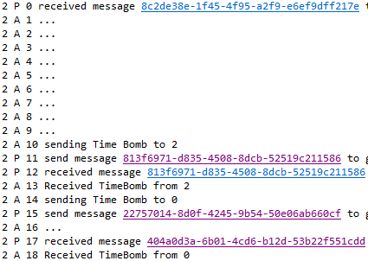
Troubleshooting on the go
Hundreds of Thousands
Rx
Trace Playback
ETW
The root is only necessary at the first handshake – e.g. to broadcast query to find entry point for navigation
Causality Navigation

Slide 35
Tx LINQPad Driver
Extract the sample traces, manifests and .linq queries from LINQPad.zip into c:\TxSamples

Slide 36
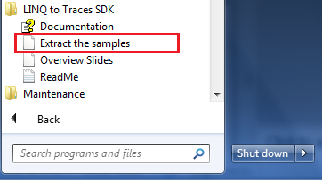
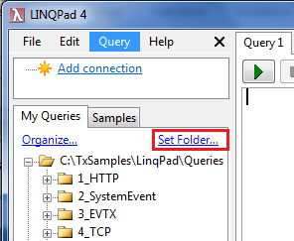

Samples Setup
Install LINQPad for .Net 4.0 from http://www.linqpad.net
1
Extract the samples
3
Set the folder to
c:\TxSamples\LinqPad\Queries
3
2
Real-Time ETW requires Admin

Slide 37
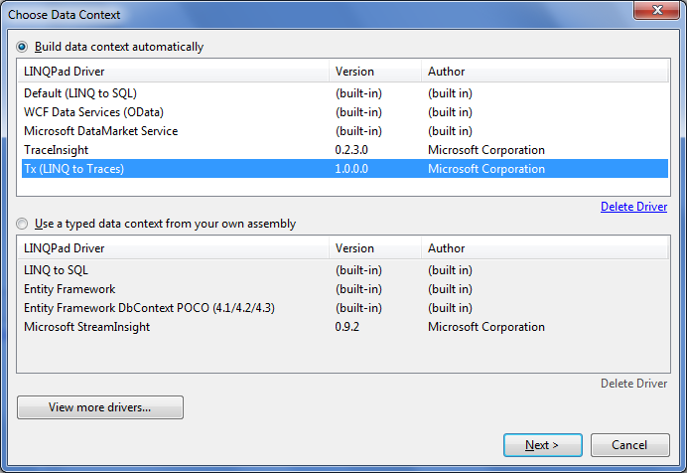
Chose Tx (LINQ to Traces)
Tx runs side-by-side with TraceInsight

Slide 38
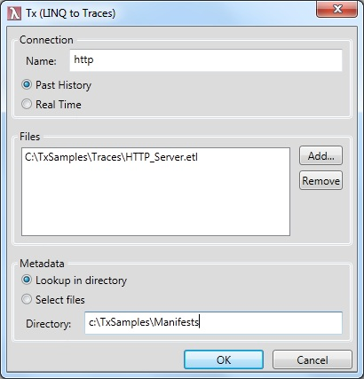
Lookup Manifest from directory
This works the same as TraceInsight,
but it does not need registry key
to find the directory

Slide 39
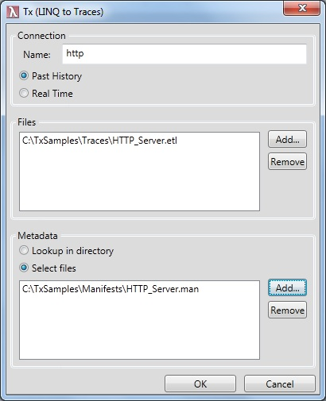
Or choose manifests
In this mode:
You have explicit choice which
manifests to use – e.g. you can point
to different versions
2) It will be a bit more responsive,
as the manifests that are not relevant
are not touched

Slide 40
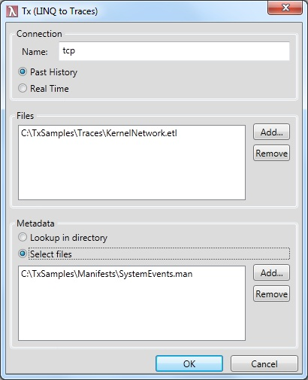
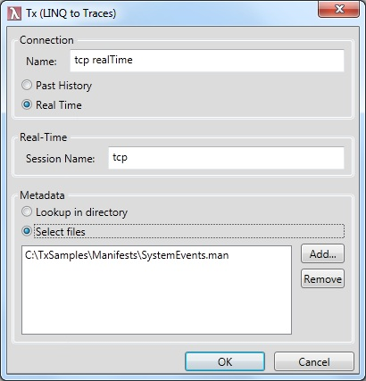
Going Real-Time
1) Make sure your query works on .etl file
2) Switch from Past History to Real Time

Slide 41
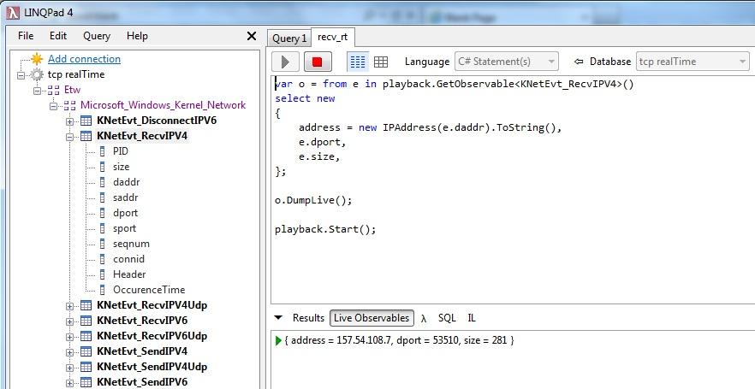
Expected Output
Note .DumpLive() – this is new feature of LINQPad to understand Observable-s

Slide 42
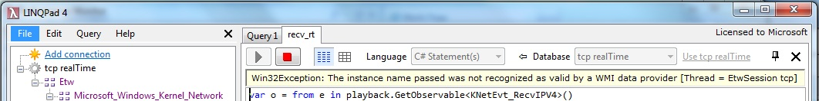
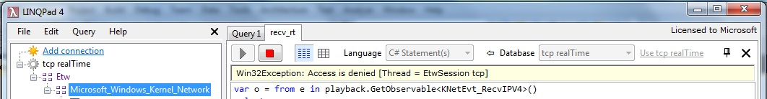
Troubleshooting Real-Time queries
The session “tcp” does not exist
Create this in code or use the system tool (logman, PerfMon etc.)
Close LINQPad and run it as administrator

