Slide 1



Slide 2
Open-source, Cross-platform JavaScript runtime environment

Slide 3
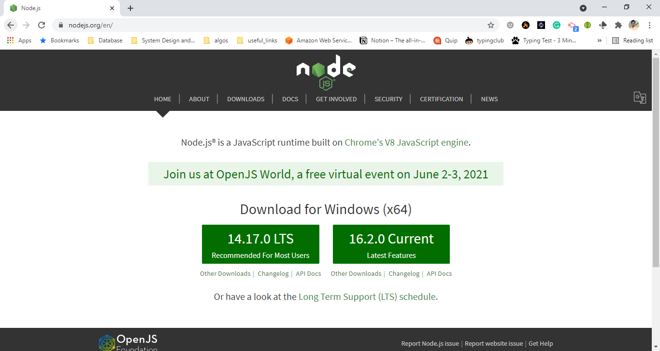

Slide 4
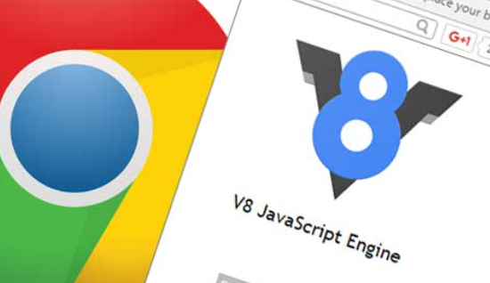
Built on Chrome’s V8 JavaScript engine

Slide 5
Lightweight and efficient
Event-driven
Non-blocking
Single-Threaded

Slide 6



We are here ☺
Client side
Server side

Slide 7






and many more…

Slide 8

1,000,000+

Slide 9
Applied Logics
<
/>

