Slide 1
Using Machine Learning to Predict Fibonacci’s Sequence
Takiya Eastmond,
Deandre Charity,
Donald Davis,
Xavier Johnson,
July 27, 2022

Slide 2

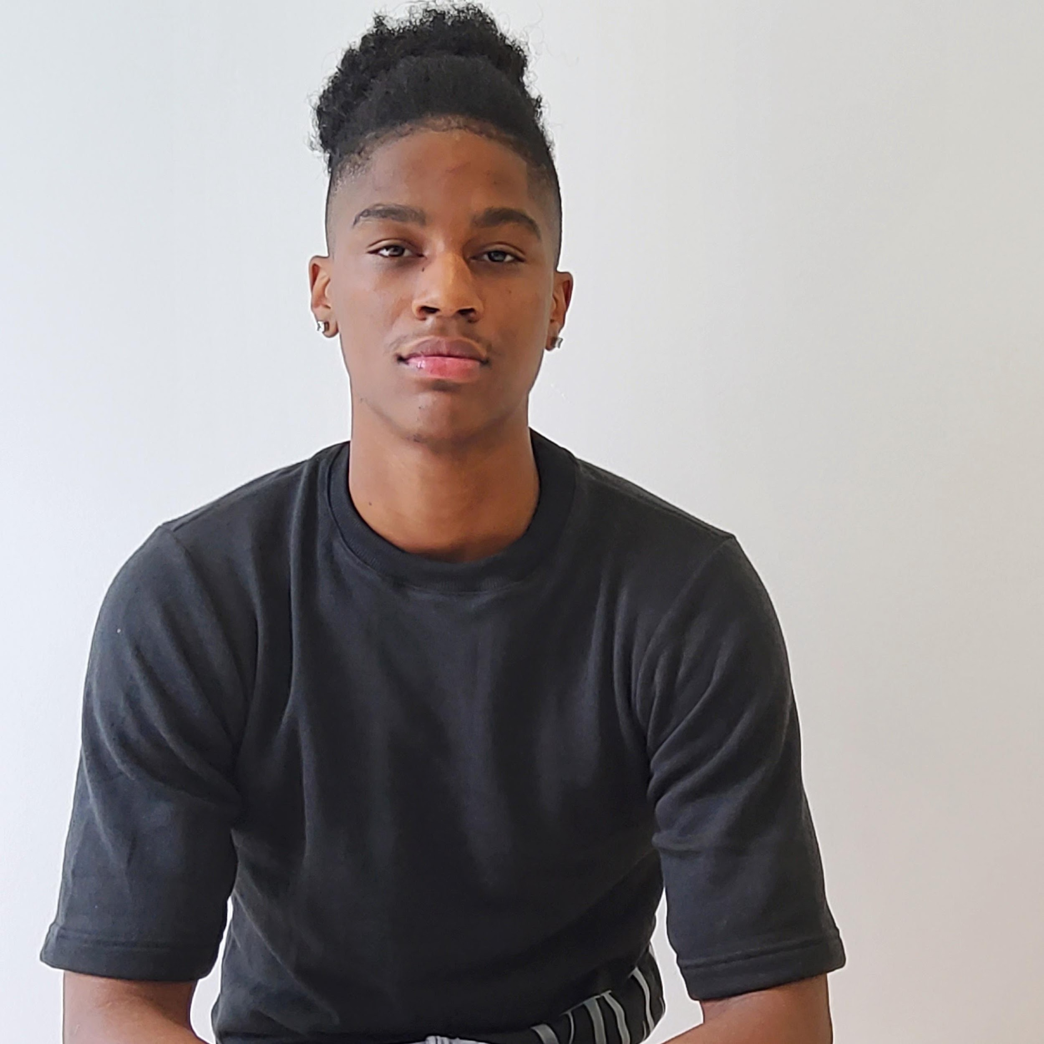


Meet our amazing Team!
Donald Davis
Junior
Computer Science
Xavier Johnson
Sophomore
Civil Engineering
Deandre Charity
Junior
Computer Science
Takiya Eastmond
Junior
Electrical and Computer Engineering

Slide 3
What we will discuss..
What is Fibonacci Sequence?
What is valuable about this structure?
Our goals for this project.
Exploratory Data Analysis
Data Preparation
Models: RNN using Relu
Results
Future Research Implications
References
Questions

Slide 4
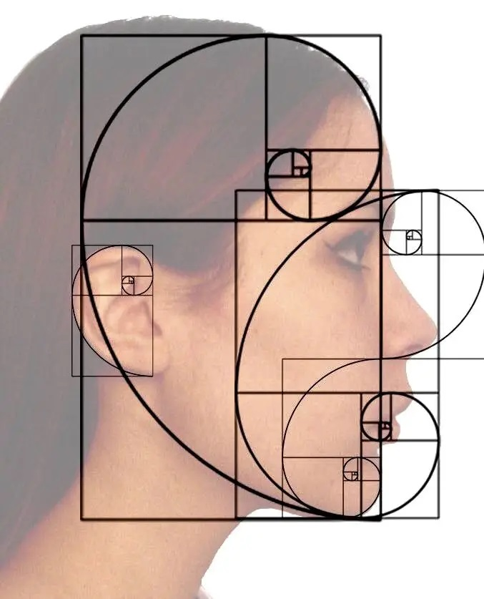
Goal(s) of the Project
The goal of our project is to create a model that determines Fibonacci's sequence quickly, and accurately.
We will construct a recurrent neural network (RNN) model to predict Fibonacci's sequence based on a predetermined sequence of data.

Slide 5
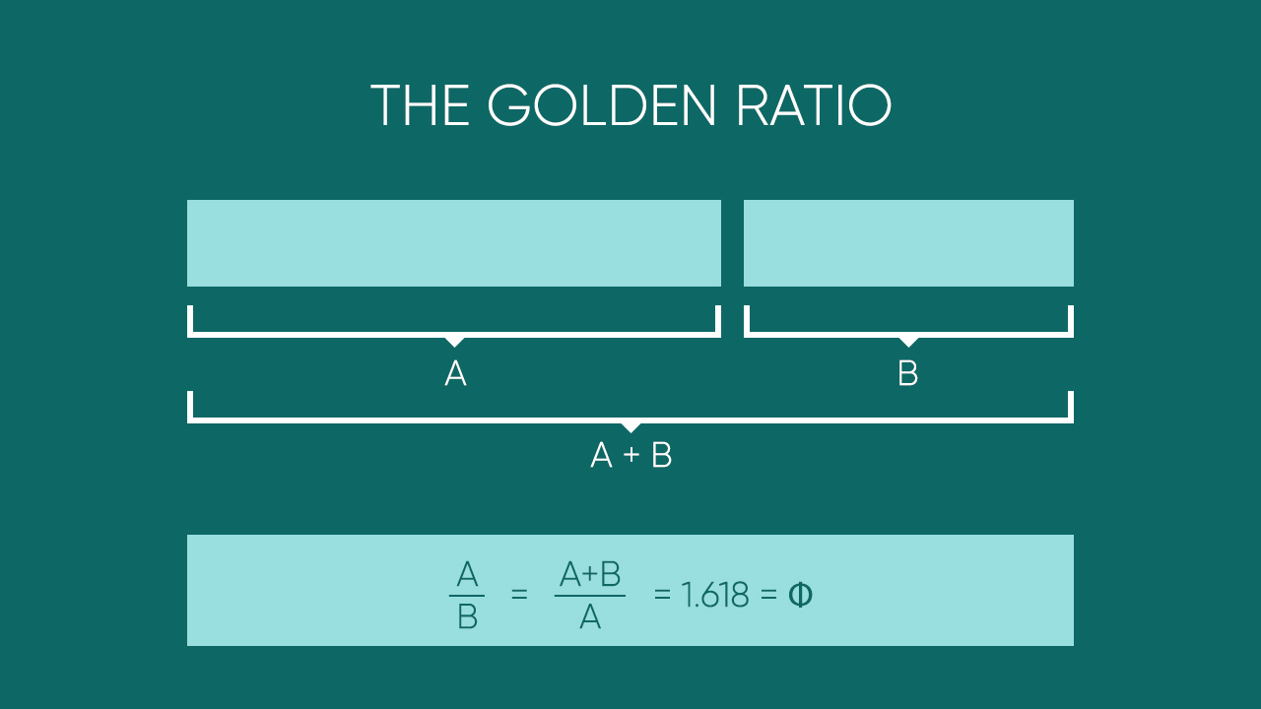
Terminology
Recursion: When the function calls itself and retraces a learned set of data in order to decide the appropriate move forward.
Activation of rectified linear activation function (relu): Takes the weighted output of all positive integers and transforms the node into the output layer.
Loss function: Mean error squared: the difference between our predicted value and our factual value
Phi: The ratio of each pair of numbers is approximately 1.618033.

Slide 6
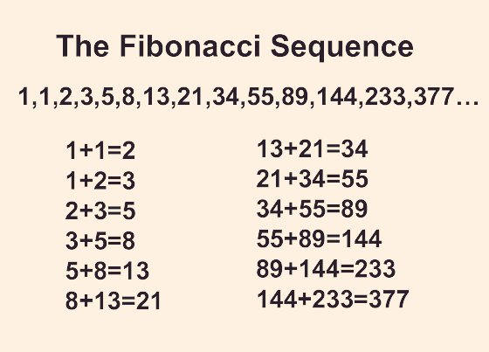
What is Fibonacci Sequence?
Fibonacci sequence is a series of whole numbers that when two preceding numbers are added together, provide the next numerical output; starting from 0 and 1.
The sequence derived from his attempt to discover how many rabbits can be produced from a single pair of rabbits in one year under ideal conditions.
Mathematically we can describe this instance as:
X_{n} = X_{n-1} + X_{n-2}

Slide 7
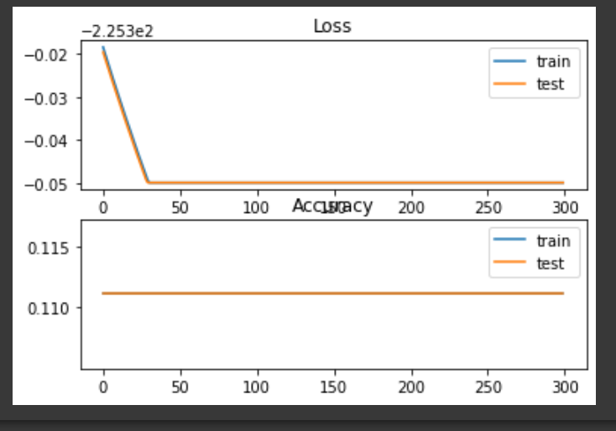
Exploratory Data Analysis (EDA)
During our model creation, we wanted to measure the loss and accuracy.
To do this we create a line graph.
This EDA is performed using matplotlib to create a visual representation.

Slide 8
Data Preparation
The data in our algorithm is prepped using a matrix.
We construct 2 arrays.
X is the index we input into the model, and Y is the Fibonacci sequence that has been trained and learned.
Our y array, is looped through our center x array to create a matrix that retraces its steps back.

Slide 9
Data Preparation (Continued)
This will allow the matrix to determine the previous indices to add to itself to move forward.
The newly created matrix is then reshaped to put Fibonacci sequence in an array.
Our model can now be tested from the data it has accumulated.

Slide 10
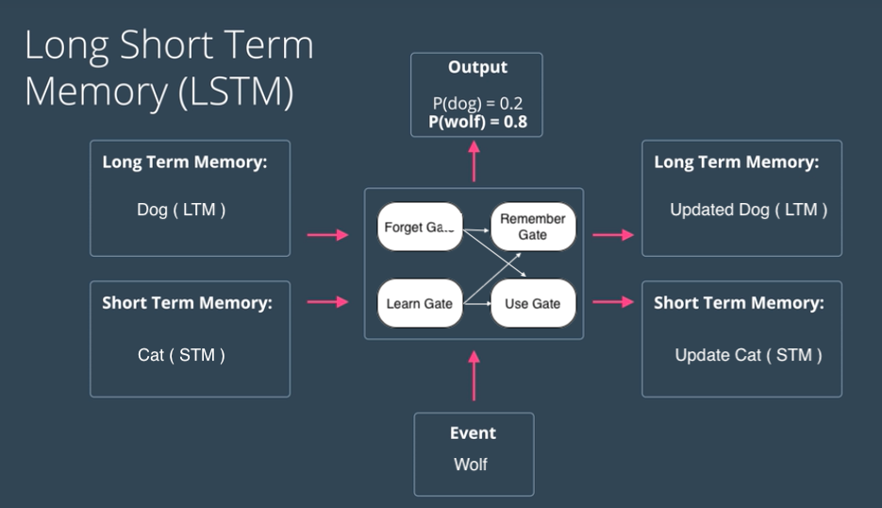
Model
For our model we decided to use Long short-term memory (LSTM) that utilizes a recurrent neural network (RNN) capable of learning order dependence in sequence prediction problems.
LSTM helps the model learn the epoch as it goes through to shorten the running by committing the information already learned to memory

Slide 11
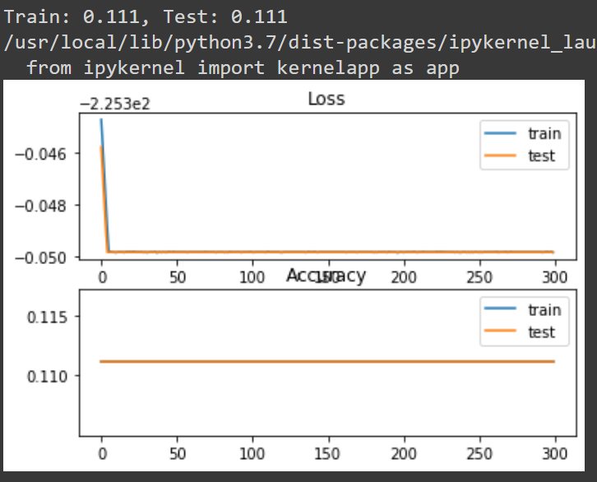
Model 1: Results
Our adam optimized RNN predicted the 12th, 13th, and 14th Fibonacci sequence to be 136, 213, and 338.
Notes:
No tuned hyper parameters. Giving us a baseline to guide our research. Regression based.

Slide 12
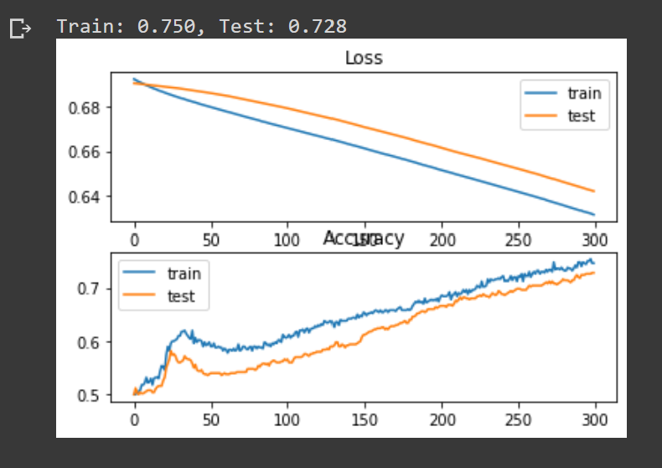
Model 2: Results
Notes:
Then we tuned to standard gradient decent. Able to measure loss.

Slide 13
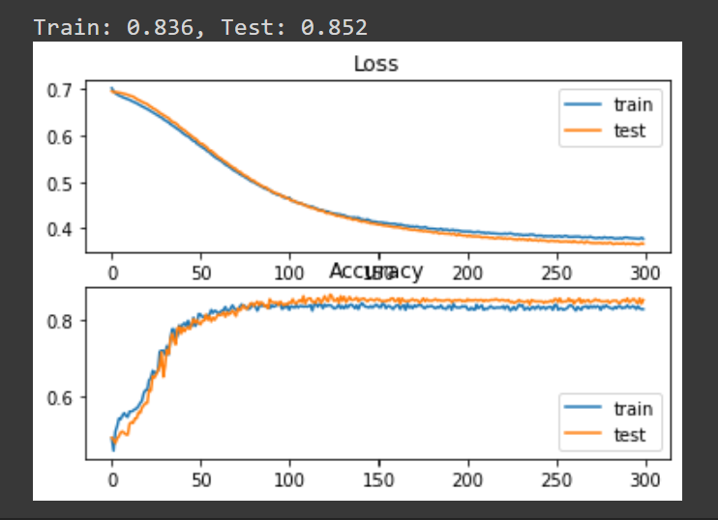
Model 3: Results
Notes:
Adam helps with measuring AOC with more precision than SGD, so we chose this method.

Slide 14

Future Research Implications
Companies like Wrike implement Fibonacci sequence using Agile Release Planning
A project roadmap is created by giving each task a number based on importance.
Agile release planning main objective is to identify the next batch of minimal market features (MMF) and establish a release date that is monetizing.

Slide 15
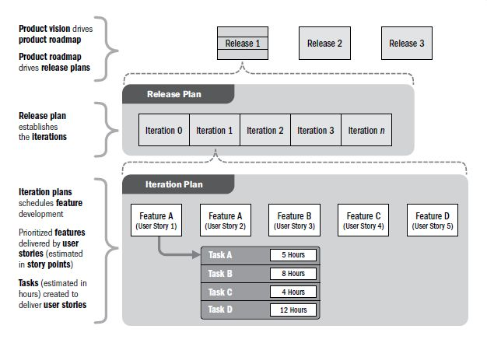
Future Research Implications (Continued)
MMF is the when the software you release to your customer should provide some added benefit and allow your customer to accomplish something they weren’t able to before.

Slide 16
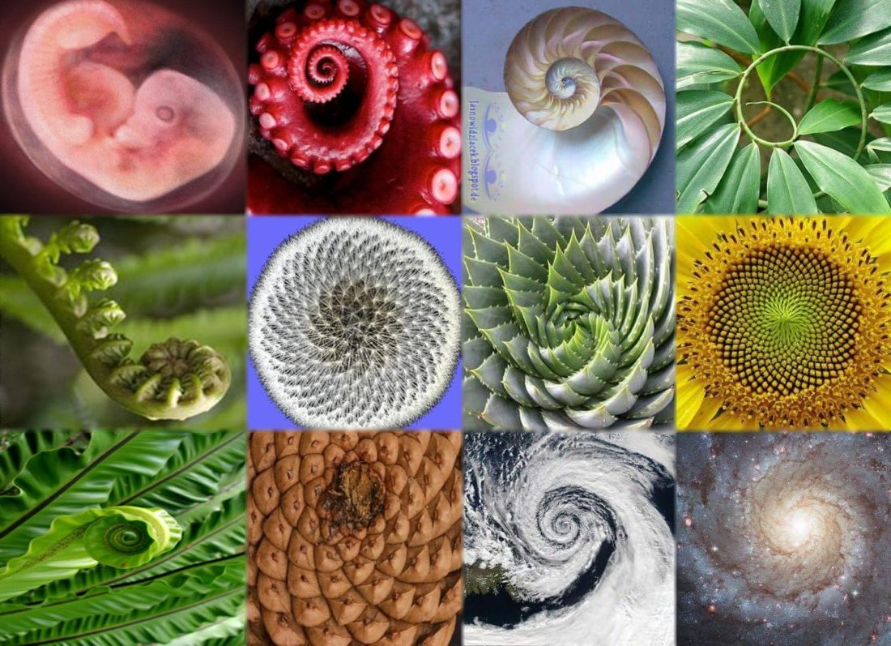
The Importance
The discovery of Hindu Arabic numbers. (1, 2, 3, etc.)
The creation of the golden ratio.
Is used in nature (flowers, seashells, ocean waves), as well as art (paintings, drawings, sculptures)

Slide 17

Our Take-away
As a team we learned how to maneuver in a fast-paced setting under pressure.
We learned how to produce a Fibonacci sequence using LSTM in an RNN.

Slide 18
Works Cited
Brownlee, Jason. “A Gentle Introduction to Long Short-Term Memory Networks by the Experts.” Machine Learning Mastery, 6 July 2021, machinelearningmastery.com/gentle-introduction-long-short-term-memory-networks-experts.
“The Fibonacci Sequence.” Imagination Station, www.imaginationstationtoledo.org/about/blog/the-fibonacci-sequence. Accessed 15 July 2022.
https:\/\/www.agilealliance.org\/author\/12#author. “What Is a Minimum Marketable Feature (MMF)? | Agile Alliance.” Agile Alliance |, 26 Mar. 2021, www.agilealliance.org/glossary/mmf/#q=%7E(infinite%7Efalse%7Efilters%7E(postType%7E(%7E’post%7E’aa_book%7E’aa_event_session%7E’aa_experience_report%7E’aa_glossary%7E’aa_research_paper%7E’aa_video)%7Etags%7E(%7E’mmf))%7EsearchTerm%7E’%7Esort%7Efalse%7EsortDirection%7E’asc%7Epage%7E1).
Science ABC. “What Is the Fibonacci Sequence and the Golden Ratio? Simple Explanation and Examples in Everyday Life.” YouTube, uploaded by Science ABC, 23 Apr. 2021, www.youtube.com/watch?v=2tv6Ej6JVho.
Velasquez, Robert. “What Is The Fibonacci Sequence? And How It Applies To Agile Development.” eLearning Industry, 12 May 2021, elearningindustry.com/fibonacci-sequence-what-is-and-how-applies-agile-development.
“What Is an Agile Release Plan? | Wrike.” Wrike, www.wrike.com/blog/what-is-agile-release-planning. Accessed 15 July 2022.

Slide 19
Thank You for Your Attention!
Our team would like to extend a thank you to the organizations of:
Google
National Action Council for Minorities in Engineering (NACME)
Morgan State University
We would also like to say thank you to the faculty and staff across all campuses as well as a special thanks to Morgan State faculty:
Morgan State University’s SOE Dean, Dr. Oscar Barton
Dr. Monica Poindexter
Teacher’s Assistants:
Dr. Babatunde Olubando
Kayla Thames

Slide 20


