Slide 1
Applied Machine Learning Intensive 2022 Capstone Project
Detecting the most commonly used words in a newsgroup
Presented by: Tobi Owolabi, Laila Amin, Jaden Robinson, & Brianna Murel
July 27, 2022

Slide 2
Table of Contents
Team Introduction
Part 1 Overview
Part 1 In-depth
K-Means, Lemmatization and Topic Modeling
Part 2 Overview
Part 2 In-depth
Biases and Negative Impact
Positive Impact
Project Challenges
Lessons Learned
Future Applications
Special Thanks
Questions

Slide 3




Meet the Team
Tobi Owolabi
Junior
Electrical
Engineering
Jaden Robinson
Junior
Electrical Engineering
Laila Amin
Junior
Industrial Engineering
Brianna Murel
Junior
Computer
science major

Slide 4
Part 1: The Top 100 Words in a Subset
The main objective of part 1 is displaying the top 100 words in specific topics.
The topics used are:
· sci.electronics
· talk.religion.misc
· rec.motorcycles

Slide 5
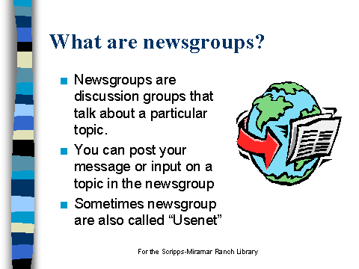
Imports
Begin by importing all functions needed
Import the 20 Newsgroups
Encapsulate the data by setting a features & targets with the 20 Newsgroups.
Perform Exploratory Data Analysis on the newsgroups

Slide 6
Targets
After data encapsulation, isolate the 3 subsets from the 20 Newsgroups.
Target the 3 Newsgroups using np.where
Create a new target including all 3 newsgroups using np.append

Slide 7
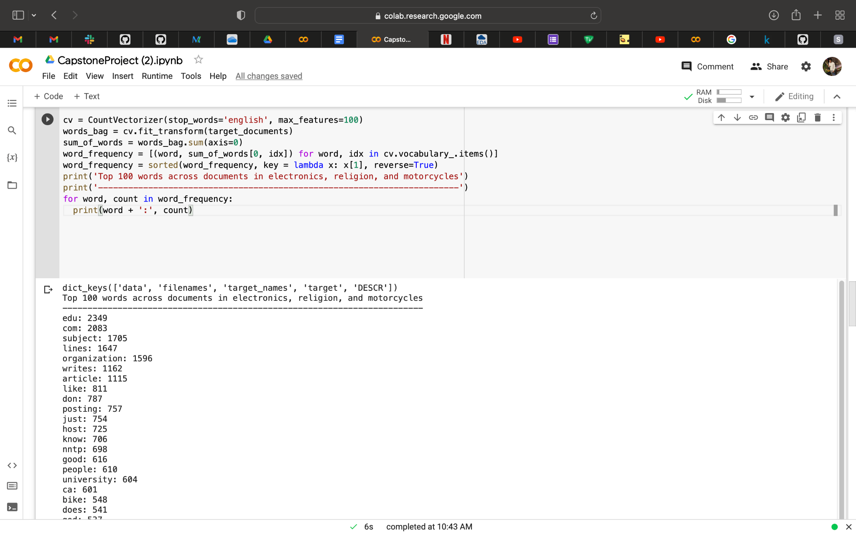
Displaying the top 100 words
Using CountVectorizer, train the new target from the last step.
Take the output, used the sorted function to arrange the words.
Lastly, print the top 100 word list.

Slide 8
Part 2

Slide 9
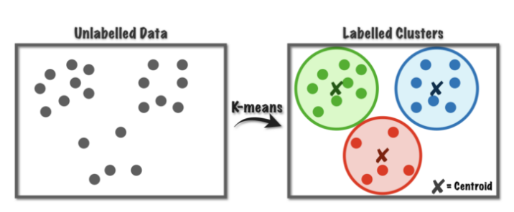
What is K-Means Clustering?
K-Means Clustering is a method used for clustering analysis.
K-Means is used to find out which group a certain object belongs to.
An example of K-Means Clustering is grouping different demographics of people into certain groups.

Slide 10
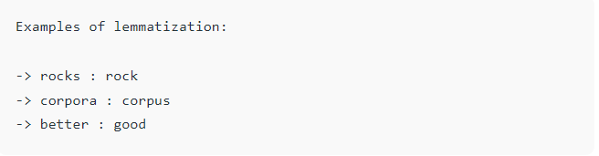
What is Lemmatization?
Lemmatization is the process of linking words with similar meanings (Synonyms) into one word.

Slide 11
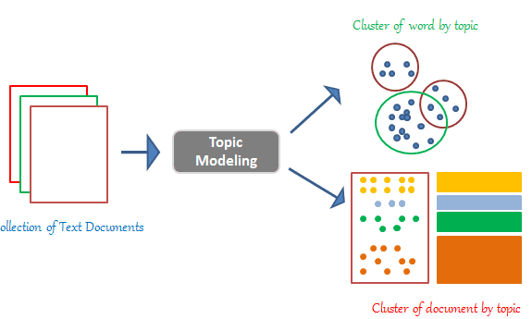
What is Topic Modeling?
Topic Modeling reads large volumes of text data by clustering the documents into groups.
An example of topic modeling is clustering a large number of newspaper articles that belong to the same category.

Slide 12
Part 2 Overview: Lemmatization & K-Means Clustering
The main objective is to Cluster Documents & Discover Topics using K-Means Clustering & Lemmatization.
We will begin by stripping words out of given topics and apply lemmatization.
After lemmatization, begin K-Means Clustering with values of K ranging from 1 to 15.
Lastly, display the top 3 sets associated with each cluster.

Slide 13
Lemmatization
Strip the words out the given topic & begin to apply Lemmatization.
Synonyms within topics are grouped together so they can be analyzed as a single item.
Begin the process of the process of linking words with similar meanings into one word.

Slide 14
K-Means Clustering Process
The K is set to a range of 1 to 16, which covers the 15 required values.
The K Means is set to the number of clusters
The K-Means is also trained by the Sum of squared distance.
Lastly, plot the K-Cluster.

Slide 15
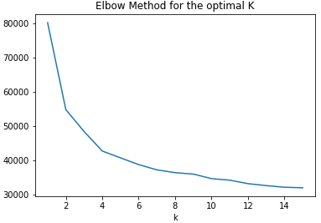
Plotting the K-Means Clustering
With the K-Means cluster graph, we conclude that as K increases the cluster gets closer to the center.

Slide 16
Topic Modeling
Begin by creating a K-Means cluster
Set K to a specific number i.e (K = 7)
Set K-Means to the number of clusters.
Create a for loop that takes the Lemmatized topics, group them based off the words that have similar meanings.

Slide 17
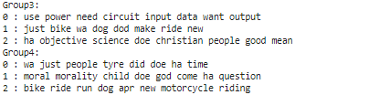
Topic Modeling
Shown are the top 3 topics associated with each cluster.
Top 3 topics in Group 3 are sci.electronics, rec.motorcycles, & talk.religion.misc
Top 3 topics in Group 4: talk.religion.misc & rec.motorcycles

Slide 18

Biases and negative impact
The race of the author May cause a Lack of diversity in the results.

Slide 19

Positive impact
Avoiding over word usage
Fixing incorrect spelling
Diagnostic systems
Search engines
Plagiarism detector

Slide 20
Project Challenges
Function commands: Training the incorrect function (Part 1)
Properly indexing our 3 newsgroup subsets (Part 1)
Using ‘K’ instead of ‘k’: The entirety of part 2 would not proceed to run due to the use of an uppercase k instead of a lowercase k (Part 2)

Slide 21
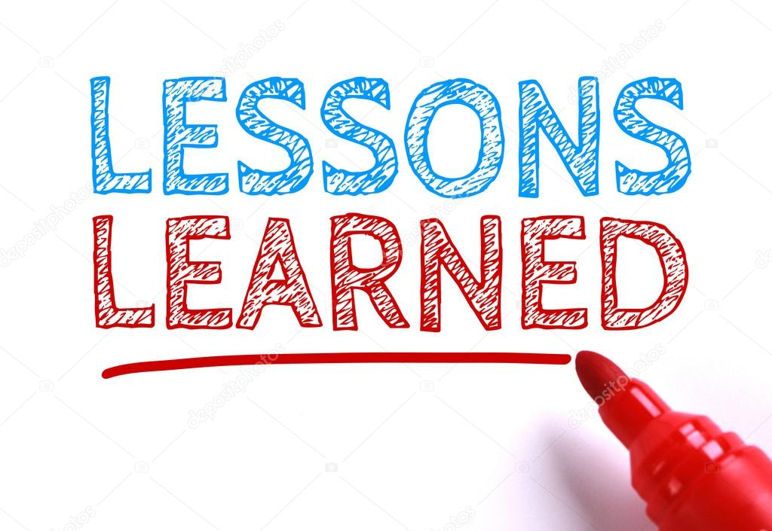
Lessons Learned
Review code line by line as a simple error could impact the code as a whole.
Conduct research from multiple sites to better understand difficult topics.

Slide 22

Future Applications
Our research has potential to be applied to:
Document Clustering
Data Analysis of public transport data.
Clustering of IT Alerts
Identifying crime prone areas
Information retrieval for search engines

Slide 23
References
https://scikit-learn.org/stable/modules/generated/sklearn.datasets.fetch_20newsgroups.html?highlight=#sklearn.datasets.fetch_20newsgroups
https://www.geeksforgeeks.org/python-lemmatization-with-nltk/#:~:text=Lemmatization%20is%20the%20process%20of,similar%20meanings%20to%20one%20word.
https://scikit-learn.org/stable/modules/generated/sklearn.cluster.KMeans.html
https://www.geeksforgeeks.org/numpy-where-in-python/?ref=lbp
https://stackabuse.com/python-for-nlp-topic-modeling/
https://www.dreamstime.com/photos-images/lessons-learned.html

Slide 24

Special Thank You
Nacme
google
Morgan state SOE
Kayla Thames
Dr.Babatunde Olubando
Michele Lemaza
Dr.pondexter
Dr. Baker
The presenters

Slide 25
Questions?

