Slide 1

Notes:
We have talked about machine learning and data science in the abstract. Now it's time to actually start applying our skills. To do this, we will need some sort of development environment. There are a plethora of options in this space.

Slide 2

Notes:
Many data scientists choose to use a traditional development environment for their work. These editors range in complexity from a text editor like Notepad on Windows through large, integrated development environments such PyCharm. With these environments, it is often necessary to install extra software to support your data science work. You'll likely find that data scientists with backgrounds in traditional programming are comfortable in these environments since they have likely already had experience with them. These development environments are also useful for developing code supported by unit tests and code that will be packaged and deployed on server systems.

Slide 3
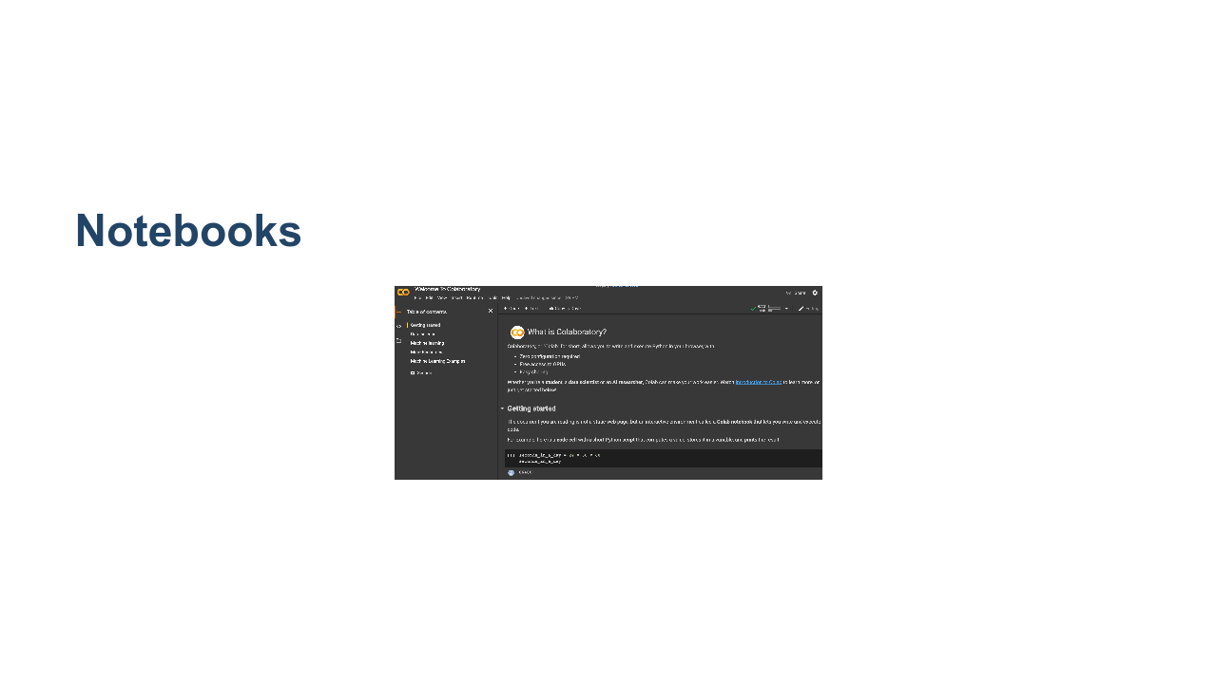
Notes:
Notebooks are another option that you will see regularly, and they are the primary coding environment for this course. When someone mentions a data science notebook, they are typically referring to a Jupyter Notebook. Jupyter Notebooks combine code, output, and supporting documentation in a single structured document. The document can be executed, modified, and iterated on. Though you'll see many Jupyter notebooks that contain Python code, they aren't limited to Python. Jupyter supports many different 'kernels,' which allow users a wide variety of choice in what languages and libraries they use. In this course, we will use Python. * Image name: res/notebook.png * Repo link: https://github.com/google/applied-machine-learning-intensive/tree/master/content/02_data/00_introduction_to_colab/res/notebook.png * Source https://github.com/google/applied-machine-learning-intensive/tree/master/content/02_data/00_introduction_to_colab/res/notebook.png by Author Google LLC under License Copyright [2020] Google LLC.

Slide 4

Notes:
The choice of development environments isn't a binary choice between notebooks and traditional development environments. There is a wide spectrum of tools available, some that blur the lines between traditional environments and notebooks. MATLAB is one of these tools. It can very much be used as a traditional development environment where you write code and then deploy that code. However, it also supports a notebook mode which has a much more Jupyter-like feel. It is important to be aware that not all data scientists develop in the same type of environment. Personal preference, costs, corporate standards, and other factors go into the decision for someone to choose a specific environment. The environment might even change over the course of a project. A data scientist might explore and build a small model using a notebook. Later, once the model is designed, they might then switch over to a more traditional environment to create a deployable package.

Slide 5
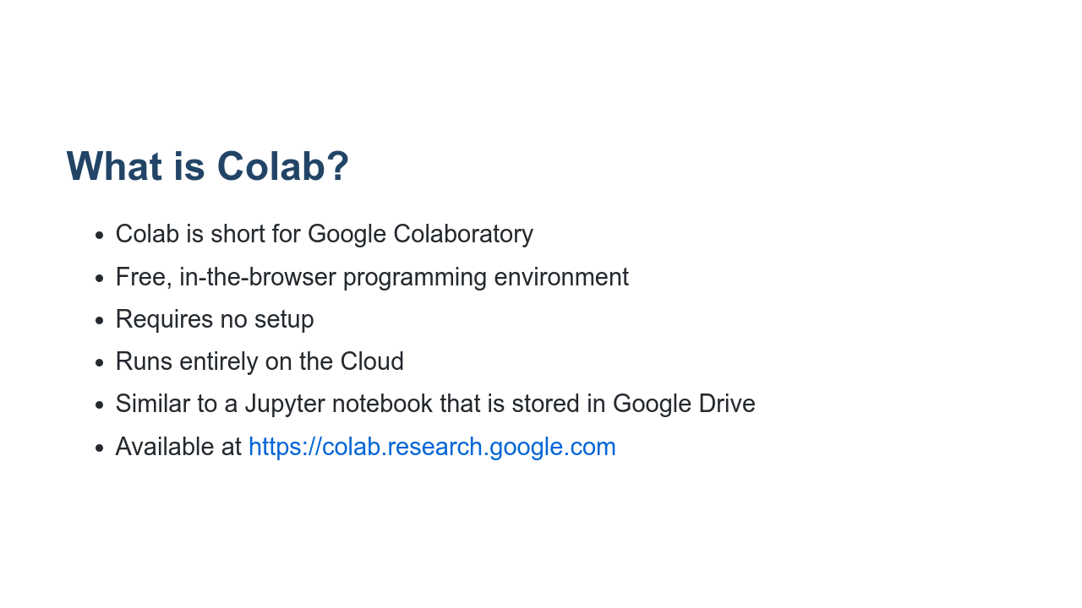
Notes:
Colab notebooks run by connecting to virtual machines that have maximum lifetimes of up to 12 hours. Notebooks will also disconnect from VMs when left idle for too long. Maximum VM lifetime and idle timeout behavior may vary over time, or based on your usage. Colab focuses on supporting Python and its ecosystem of third-party tools. There is not currently support for other Jupyter kernels like R or Scala. More documentation on Colab can be found at https://research.google.com/colaboratory/faq.html A good introductory notebook can be found here https://colab.sandbox.google.com/notebooks/intro.ipynb#scrollTo=GJBs_flRovLc

Slide 6
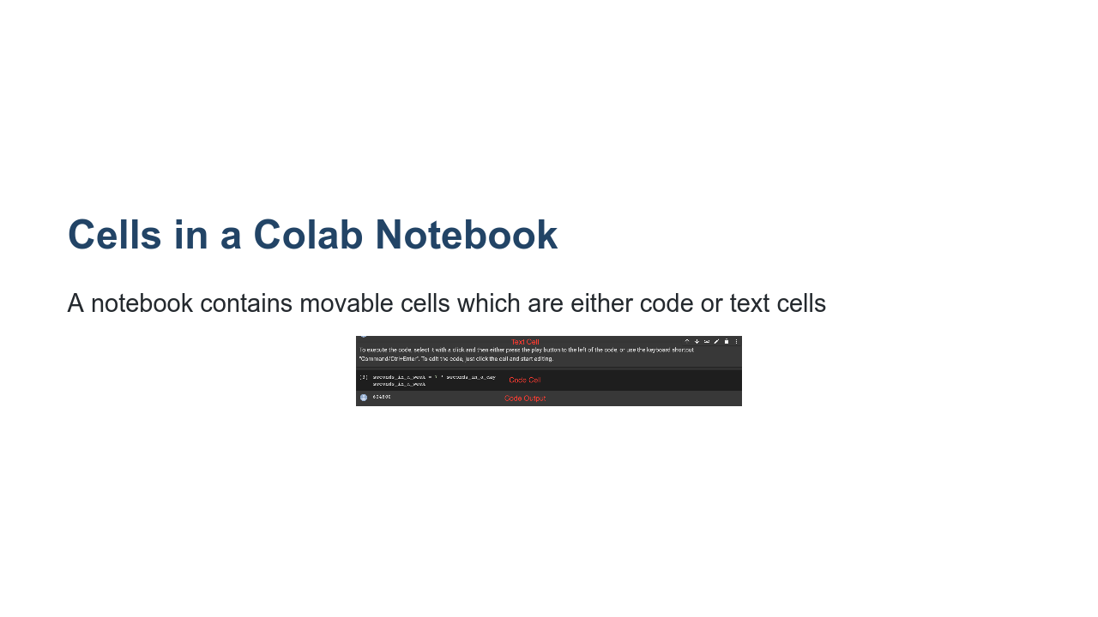
Notes:
Hovering above or below a current cell will bring up the option to add a new code or text cell. You can run code cells and typeset text cells using Shift+Enter. * Image name: res/notebook_cells.png * Repo link: https://github.com/google/applied-machine-learning-intensive/tree/master/content/02_data/00_introduction_to_colab/res/notebook_cells.png * Source https://github.com/google/applied-machine-learning-intensive/tree/master/content/02_data/00_introduction_to_colab/res/notebook_cells.png by Author Google LLC under License Copyright [2020] Google LLC.

Slide 7
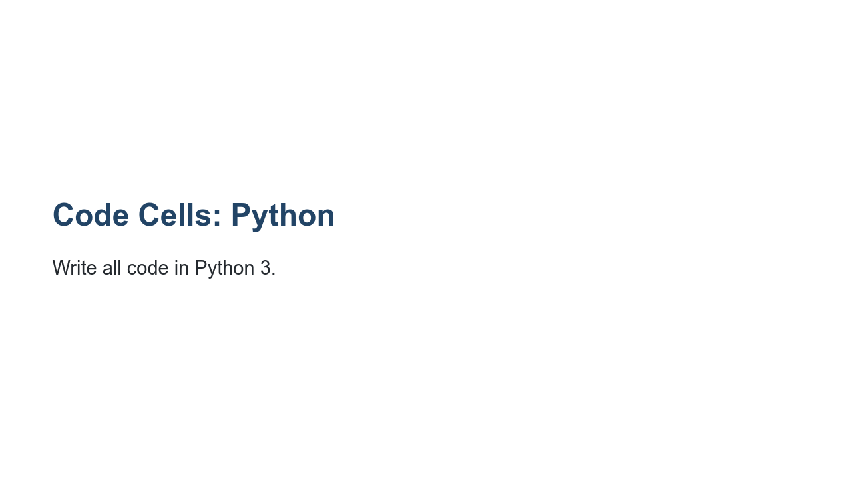
Notes:
As of January 1, 2020, the Python team no longer supports Python 2. And as of the same date, Colab has stopped supporting Python 2 runtimes.

Slide 8
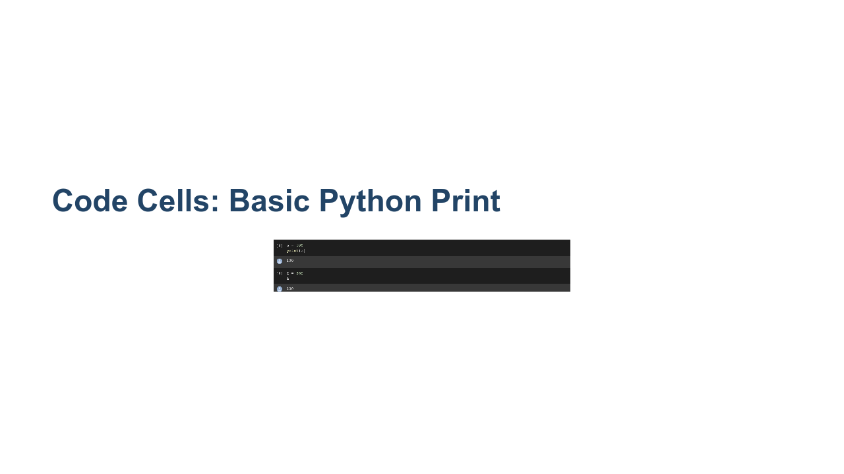
Notes:
Writing Python code in a notebook is just like writing Python code anywhere else. * Image name: res/python_print.png * Repo link: https://github.com/google/applied-machine-learning-intensive/tree/master/content/02_data/00_introduction_to_colab/res/python_print.png * Source https://github.com/google/applied-machine-learning-intensive/tree/master/content/02_data/00_introduction_to_colab/res/python_print.png by Author Google LLC under License Copyright [2020] Google LLC.

Slide 9
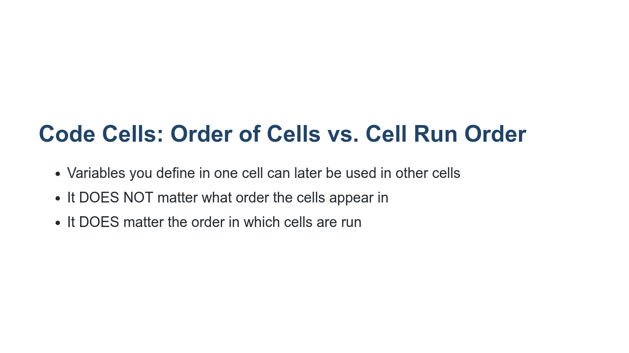
Notes:
It doesn't matter what order the cells appear in. What matters is the order in which they are run. The run-order is captured by the numbers to the left of each cell.

Slide 10
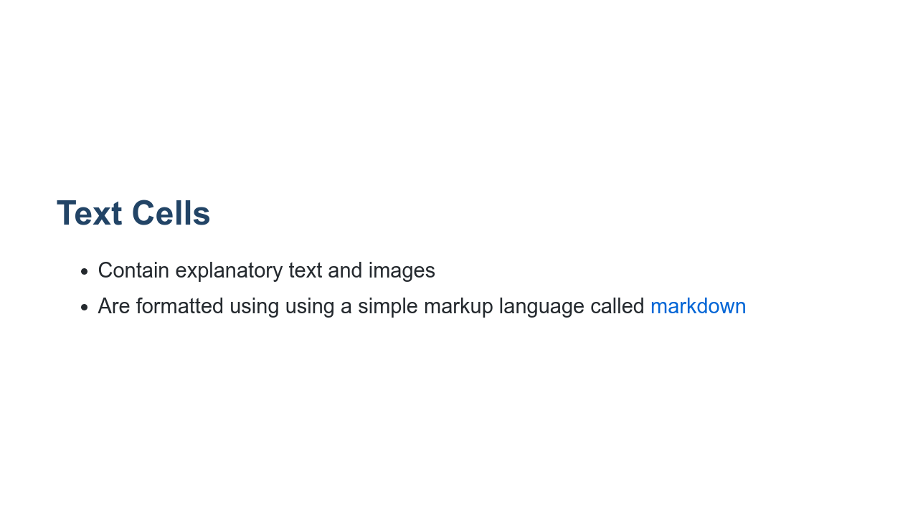
Notes:
Text cells are a great way to explain what you are doing in a notebook. Think of them like high-powered code comments. These cells can look like normal plain text, but you can also format the text in those cells using a markup language called markdown. Markdown allows you to do things like bold and italicize your text. It also allows you to add links, images, tables, and other things to your notebook. We'll look at a few key features of markdown in the next few slides.

Slide 11
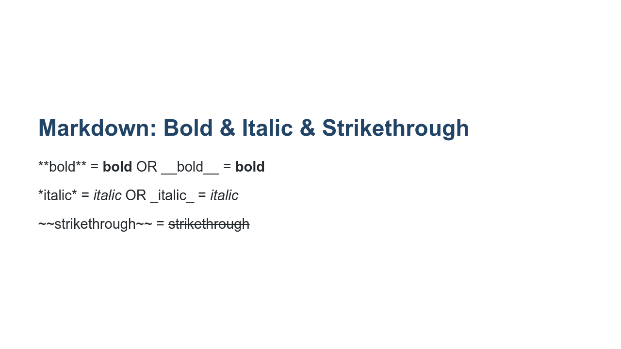
Notes:
You can easily format text with specific markdown syntax.

Slide 12
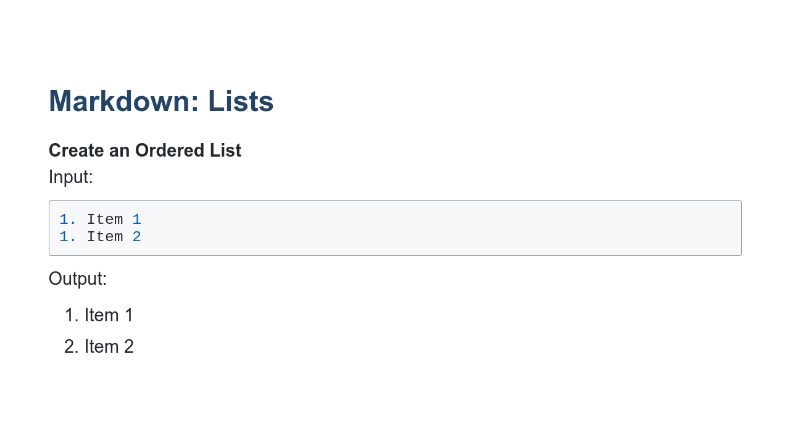

Slide 13
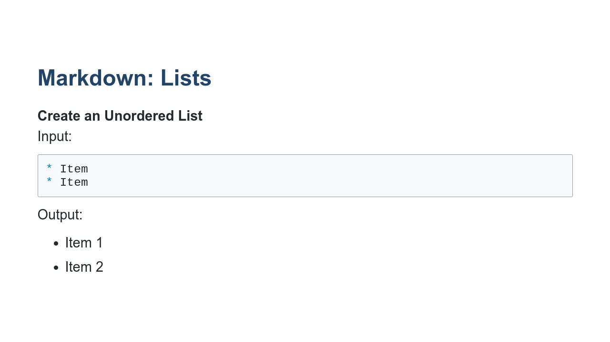
Notes:
You can create numbered and bulleted lists. What is shown here is what the user should type in markdown. To create an ordered list, simply type 1. in front of each item, and the proper numerical ordering will be assigned. You can create numbered and bulleted lists. What is shown here is what the user should type in markdown. The output of an ordered list will contain the correct linear number 1. 2. 3. etc.

Slide 14
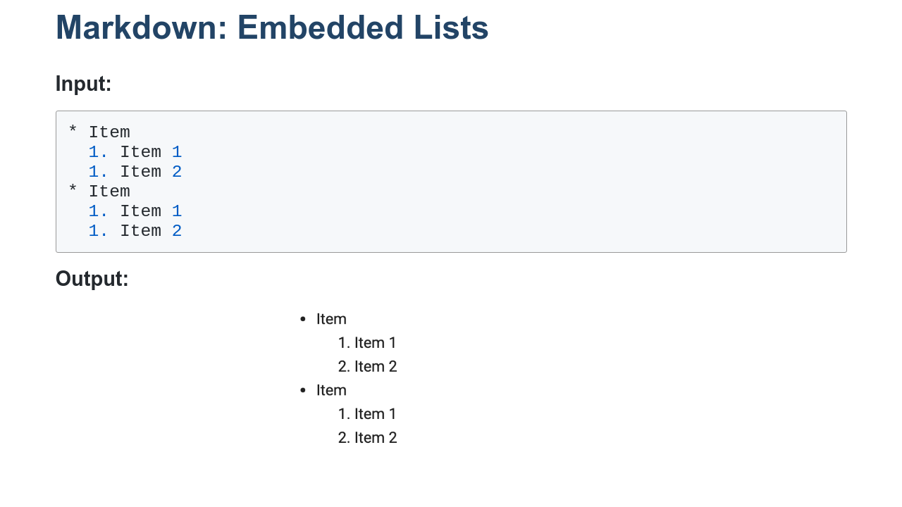
Notes:
You can also easily create sublists. * Image name: res/nested-list.png * Repo link: https://github.com/google/applied-machine-learning-intensive/tree/master/content/02_data/00_introduction_to_colab/res/nested-list.png * Source https://github.com/google/applied-machine-learning-intensive/tree/master/content/02_data/00_introduction_to_colab/res/nested-list.png by Author Google LLC under License Copyright [2020] Google LLC.

Slide 15
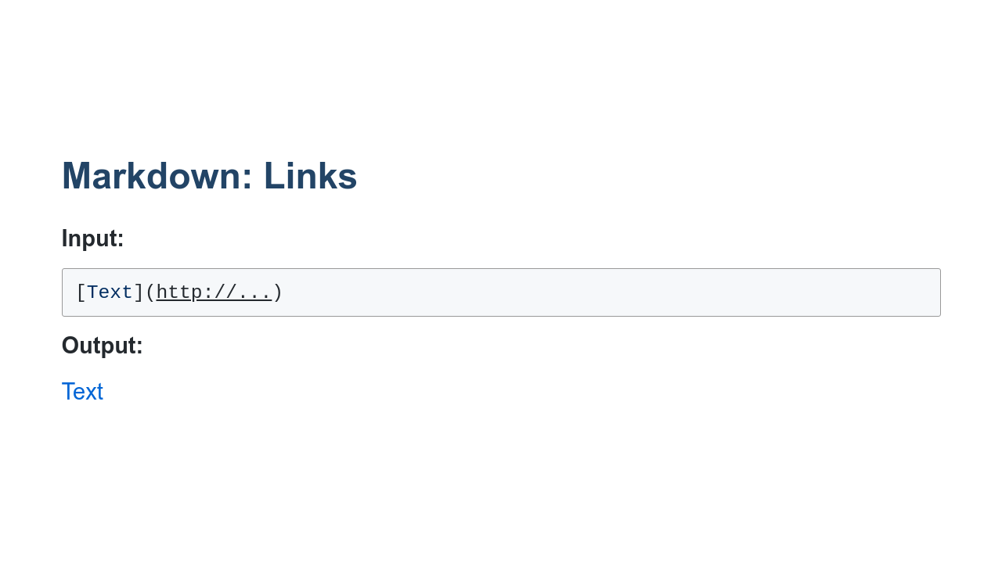
Notes:
The [Text] portion indicates what will appear in your document, and the (http://...) should have the appropriate URL.

Slide 16
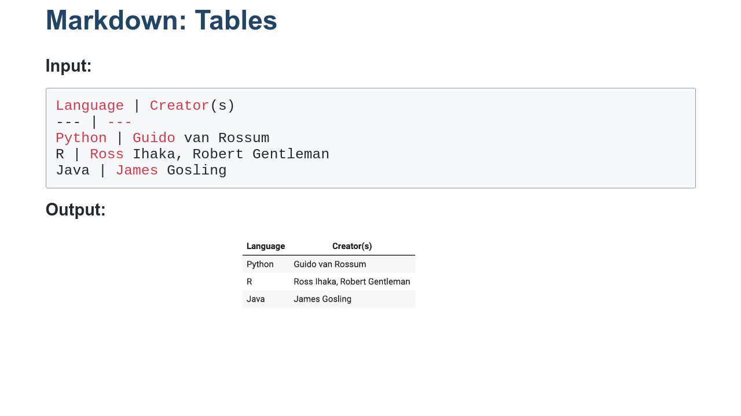
Notes:
Tables are created using | and -. They will be formatted automatically with lines at each delimiter. * Image name: res/table.png * Repo link: https://github.com/google/applied-machine-learning-intensive/tree/master/content/02_data/00_introduction_to_colab/res/table.png * Source https://github.com/google/applied-machine-learning-intensive/tree/master/content/02_data/00_introduction_to_colab/res/table.png by Author Google LLC under License Copyright [2020] Google LLC.

Slide 17
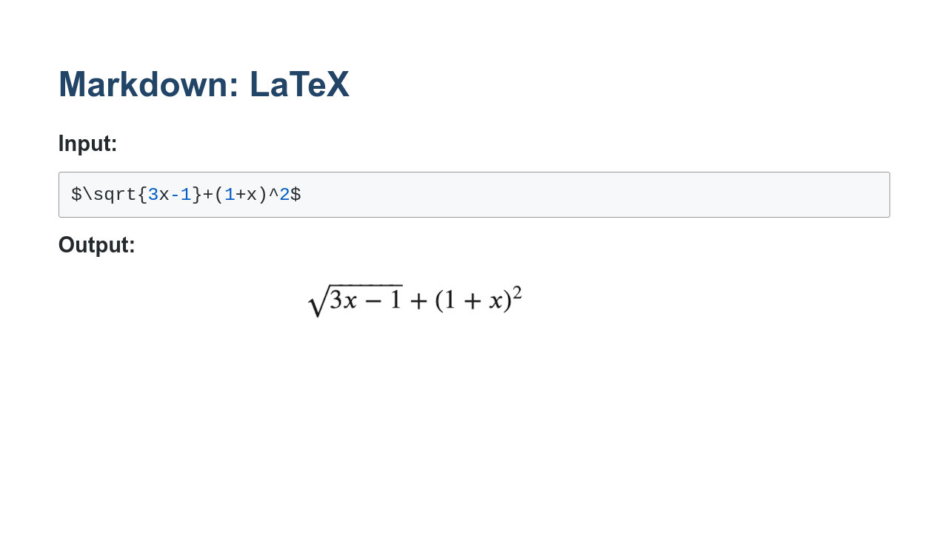
Notes:
LaTeX is a powerful document preparation system for typesetting mathematical equations. Markdown in Colab supports basic LaTeX commands. https://www.latex-project.org/help/documentation/ * Image name: res/latex.png * Repo link: https://github.com/google/applied-machine-learning-intensive/tree/master/content/02_data/00_introduction_to_colab/res/latex.png * Source https://github.com/google/applied-machine-learning-intensive/tree/master/content/02_data/00_introduction_to_colab/res/latex.png by Author Google LLC under License Copyright [2020] Google LLC.

Slide 18
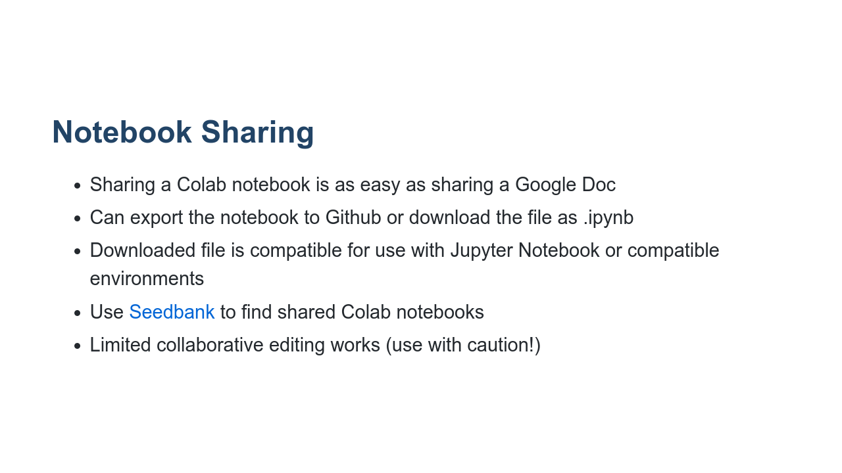
Notes:
Since a Colab notebook is stored in Google Drive, sharing a Colab notebook is as easy as sharing a Google Doc. Just like Google Doc sharing, you decide on the share permissions, eg: view-only or edit privilege. If you prefer, you can export the notebook to a Github repository or download the notebook as a file. The downloaded file is written in standard Jupyter notebook format and can be used in Jupyter Notebook or any other compatible framework. Seedbank is a search engine for Colab notebooks for material for exploration and learning of ML. https://research.google.com/seedbank/guide/faq Some of the collaborative features in Colab are quite limited, and it can be challenging to have two people editing the same lab at the same time. Furthermore, you can open labs in sandbox mode which does not save changes. Use collaborative features with caution.

