Slide 1
Design Pattern Final Project
Luay M. Assidmi
September 29, 2026
Ontology and Intel Analysis
Revised October 17, 2026: proposal re-examined against course material
Presentation 2, November 11, 2026: implemented, tested, extendable
Notes:
[0:20]
Hi, I'm Luay Assidmi. This is my design pattern for the final project: meetings, and the mandates they produce.
This is the deck from my first proposal, revised. I kept the original slides so you can see what I proposed, and then show where the course material changed my thinking: the definitions lecture, Document Acts, and IAO-Intel.

Slide 2
Proposed Final Project Topic
Meeting
Notes:
[0:20]
The topic is meetings. More precisely, the decisions made in meetings, and the documents that carry those decisions afterwards.
The reason this is an intelligence problem: an executive who sets priorities, a lot of information spread across many committee files, and no analytic layer connecting them. That's a strategic intelligence problem. Often nobody knows to ask what's already been said.

Slide 3
Why Meetings?
Meeting presentations and meeting minutes are our main target.
  They are abundance,
  they are engineered knowledge for humans to consume,
  they proved context, and provenance, and traceability
Goal:
  Our aim is to build institutional knowledge extracting pipeline that accumulates future intelligence and connect, archive and retrieve legacy tacit knowledge.
How:
  we want to engineer that presentation and meeting minutes (which concretize meta data and action speak [mandate]) for machines to consume.
Ensuring:
  Data quality while extracting intelligence
  Data interoperability between projects, initiatives, and programs across the organization
Notes:
[0:45]
Why meetings? Three reasons.
First, there are a lot of them. Presentations and minutes are the most abundant knowledge an organization produces.
Second, they're already engineered, for humans. Someone chose what goes on each slide. That gives us context, provenance and traceability for free.
Third, the minutes carry action. A chair says "do this", and that becomes a mandate somebody is accountable for.
The goal is to engineer those same documents for machines, so that what was said in one committee can be connected to what was said in another, without losing data quality.

Slide 4
Design process method
Step 1: My own definition in words (no BFO/CCO lenses)
Step 2: Build BPMN map
Following steps are Co-authored with Design Pattern Assistant(1) (AI)
Step 3: Apply rules of Thumb
Step 4: Lookup BFO/CCO lenses on to build Design pattern
Step 5: Pattern Design workshop Mermaid Draw
(1) Design Pattern Assistant is an agent that is trained on BFO and CCO, it’s job it identify and re-use entity classification and relationships. A sample of their assistant will be provided in markdown files
Notes:
[0:35]
My method has five steps.
Step 1 is my own definition in plain words, with no BFO or CCO lens. Step 2 is a BPMN process map.
Steps 3 to 5 I co-author with a Design Pattern Assistant. That's an AI agent I built that looks up every BFO and CCO term in an index of the actual CCO release, and lints each pattern. Step 3 sorts entities into the seven rules-of-thumb slots, step 4 maps them to BFO and CCO, and step 5 is the workshop where we draw the pattern in Mermaid.
The revision today mostly hits steps 1, 2 and 5.

Slide 5
Step 1: My own definition, tested
v1: A Meeting is a type of human gathering (online/in person) for a determined period of time to address a topic(s) and make decisions (mandates)
Test (Military Intelligence Pt. 1) | Counterexample | Result
Term true, definition false (sl. 5) | A status briefing where nothing is decided | Fails: "make decisions" isn't true of every meeting
Term true, definition false (sl. 5) | An unscheduled 5-minute corridor huddle | Fails: "a determined period of time" isn't either
Definition true, term false (sl. 5) | A family at dinner deciding on a holiday | Too broad: nothing requires a planned act or common purpose
Avoid negative language (sl. 12–27) | — | Passes. Keep it that way: define a subtype, not a "non-decision meeting"
Word-to-world (sl. 30–32) | "make decisions (mandates)" | Conflates an act (deciding) with its output (the mandate)
A definition is a pair <T, E>: T is true of a domain just in case E is (Military Intelligence Part 1, slide 4).
Notes:
[1:15]
Step 1. Here's my original definition: a meeting is a human gathering, online or in person, for a determined period of time, to address topics and make decisions, which I called mandates.
After the Military Intelligence lecture I ran the test from slide 5. A definition is a pair: the term and the expression. Assume the term is true and look for a case where the expression isn't. Then the reverse.
It fails both ways.
Term true, definition false: a status briefing where nothing gets decided is still a meeting. So "make decisions" is too strong. And two directors who settle something in a five-minute corridor conversation, with nothing scheduled, also had a meeting. So "a determined period of time" is too strong.
Definition true, term false: a family at dinner deciding where to go on holiday. Human gathering, a period of time, a topic, a decision. Nobody calls that a meeting. Nothing in my definition rules it out.
It passes on negative language, because there are no "not" clauses.
But it fails the word-to-world test in a quieter way: "make decisions (mandates)" treats an act and its output as the same thing. Deciding is something the chair does. The mandate is what that act produces.

Slide 6
Step 1 revised: v2 definitions
Meeting =def an act of association in which two or more persons, sharing a place or connected through a communication artifact, communicate about one or more topics for a common purpose
Decision meeting =def a meeting that has as part an act of directive communication, by a person bearing an authority role, whose output is a mandate
Mandate =def a process regulation that is the output of an act of directive communication in a meeting
Case | Meeting? | Decision mtg?
Status briefing, nothing decided | ✓ | ✗ (correct)
Corridor huddle that settles an issue | ✓ | ✓
Family dinner deciding a holiday | ✗ | —
Board meeting, chair issues a directive | ✓ | ✓
What changed: genus from CCO Act of Meeting ("…assemble for some common purpose"). "Determined period" dropped: every meeting takes time, but not every one is scheduled. Deciding moved to a subtype, so the class is split from the inside with no negative definition (sl. 21–24).
Open: "common purpose" carries a lot of weight.
Notes:
[1:00]
So here's version 2, as three definitions.
A meeting is an act of association in which two or more persons, sharing a place or connected through a communication artifact, communicate about topics for a common purpose. The genus comes straight from CCO's Act of Meeting.
A decision meeting is a meeting that has, as a part, an act of directive communication by someone with an authority role, whose output is a mandate.
A mandate is the process regulation produced by that act.
Two things to point out. I dropped "determined period": every meeting takes time, but not every meeting is scheduled. And I moved deciding into a subtype instead of the main definition. That splits the class from the inside, "a meeting that…", so I never need a negative class like "non-decision meeting", which the lecture warned is a false bifurcation.
The table re-runs the cases. Briefing: meeting, not a decision meeting, which is correct. Huddle: both. Family dinner: not a meeting.
What's still open: "common purpose" carries a lot of weight. It's CCO's wording, so I've kept it and flagged it.

Slide 7
Step 2: Build BPMN map (two acts, not one)
Speech act
Creates the obligation. Felicity condition: the chair bears the authority (Document Acts, pp. 9–10)
Document act
Makes the obligation official and lasting, beyond the memory of those in the room (Document Acts, pp. 6, 9)
Notes:
[1:00]
Step 2, the BPMN. The map itself hasn't changed, but reading Document Acts changed how I read it.
Look at the accountable lane. There are two tasks: Make Decision, and Document Decisions. My original pattern collapsed them into one node. Barry Smith's paper explains why they're two different kinds of act.
Make Decision is a speech act. It creates the obligation, but only if the felicity conditions hold, and the main one is authority. The chair has to bear the role that makes the directive binding. That's pages 9 to 10.
Document Decisions is a document act. Smith's point is that in a large organization, memory can't carry obligations. Documents extend memory, and they let a deontic power reach people who weren't in the room. On page 6 he traces how "to record" shifted from bearing oral witness to producing a document. The minutes are exactly that shift.

Slide 8
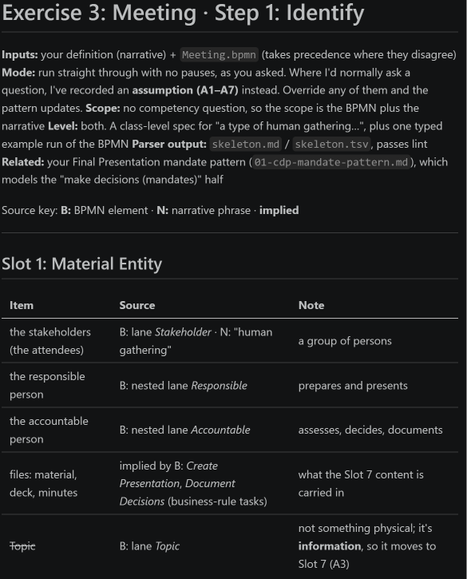
Step 3: Apply rules of Thumb
Slot 1: Material Entity
Slot 2: Quality
Slot 3: Process
Slot 4: Realizable Entity
Slot 5: Where
Slot 6: When
Slot 7: Information
Notes:
[0:25]
Step 3, the rules of thumb. The assistant sorts everything from my definition and the BPMN into seven slots: material entity, quality, process, realizable entity, where, when, and information.
The interesting result here was that the topic is information, not a participant. It's drawn as a lane in the BPMN, but nobody performs it.

Slide 9
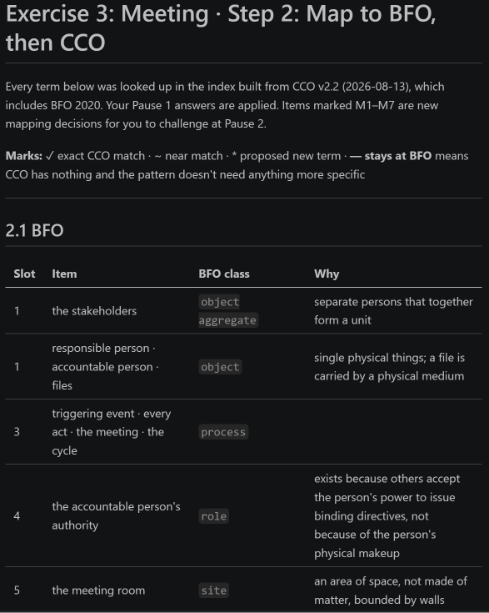
Step 4: Lookup BFO/CCO lenses on to build Design pattern
Every term below was looked up in the index built from CCO v2.2 (2026-08-13), which includes BFO 2020.
Marks: ✓ exact CCO match · ~ near match ·
  proposed new term · — stays at BFO means CCO has nothing and the pattern doesn't need anything more specific
Notes:
[0:25]
Step 4. Every term was looked up in an index built from CCO version 2.2, which includes BFO 2020. Each one is marked: exact match, near match, or proposed new term.
For the meeting pattern, every term is an existing CCO or BFO term. No new classes.

Slide 10
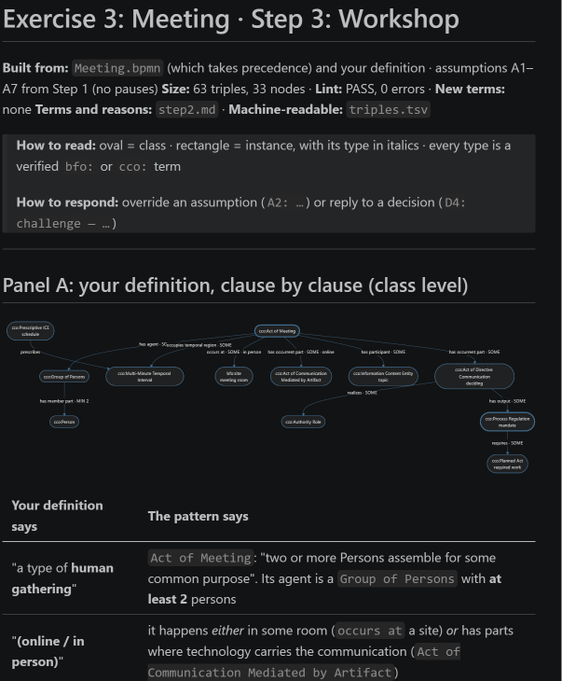
Steps 5 the workshop
We (DPA and I) take the inputs from Steps 3, 4
Conduct a workshop to build the design pattern
Notes:
[0:15]
Step 5 is the workshop. The assistant and I take the slot list and the term mapping, and build the pattern together, with a numbered decision log I can challenge.

Slide 11
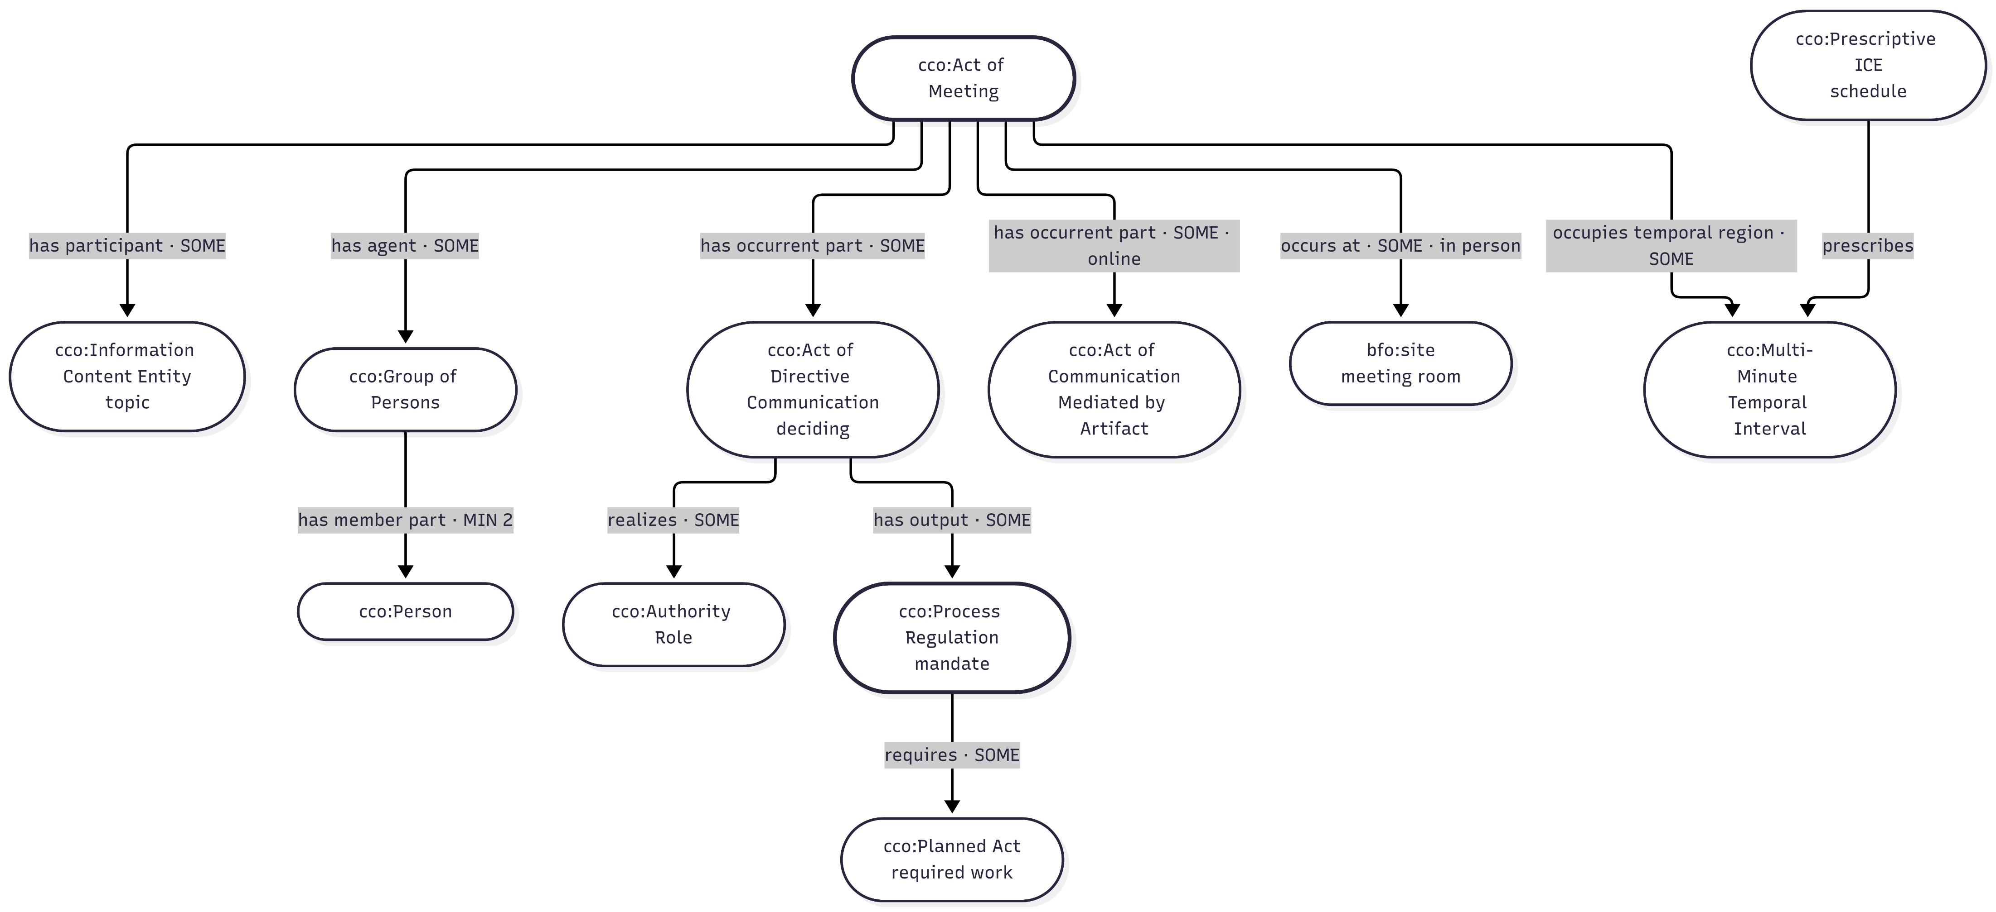
Steps 5 Workshop result: Mermaid (v1)
Notes:
[0:30]
This is the version 1 result I presented. Act of Meeting at the top, with its agent, topic, time and place. In the middle, the act of directive communication, "deciding", which realizes the authority role and outputs the mandate, a process regulation, which requires planned work.
The problem is that middle node. It's doing two jobs, and there's nothing here for the minutes at all. So the pattern can't say where a mandate lives after the meeting ends.

Slide 12
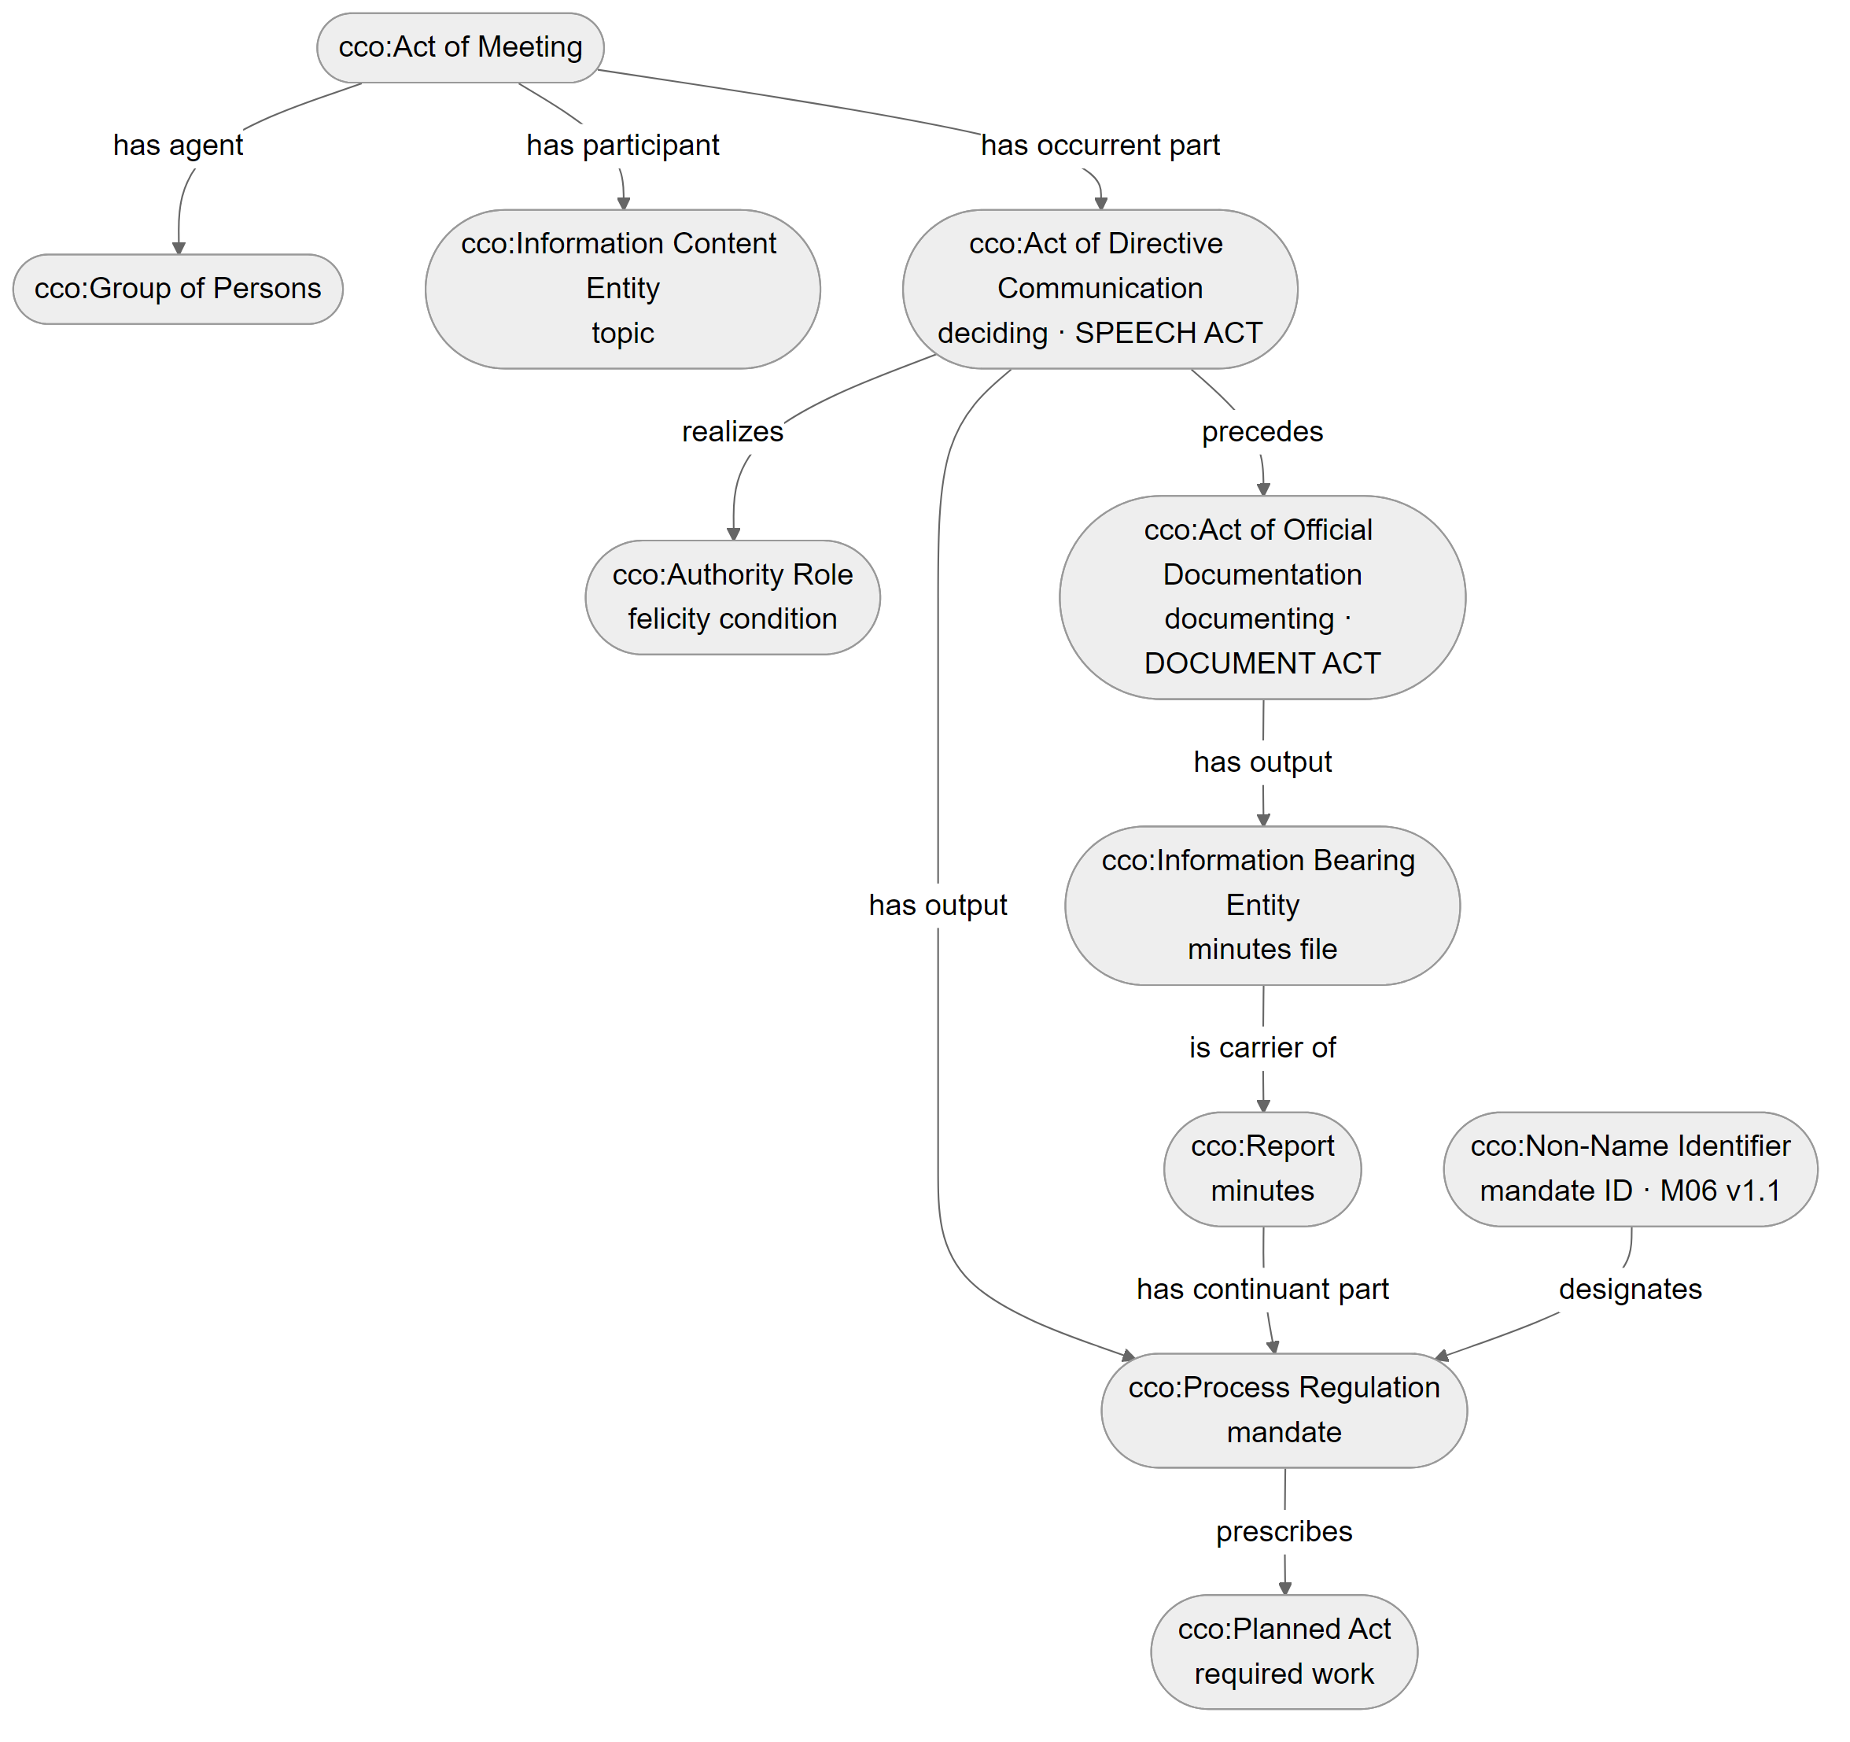
Step 5 revisited: speech act vs. document act
v1 problem: one node, "deciding", did two jobs. The BPMN already had two tasks
Speech act: cco:Act of Directive Communication realizes the Authority Role and outputs the mandate
Document act: cco:Act of Official Documentation outputs the minutes file, which carries the minutes; the mandate is part of them
Identifier: "M06 v1.1" designates the mandate, and the same ID links minutes, letters and trackers (Document Acts, p. 10)
Lint: PASS, 0 errors, 3 warnings (justified)
Notes:
[1:15]
Here's the revision.
Deciding stays as an Act of Directive Communication. That's the speech act. It realizes the authority role and outputs the mandate.
Then a second act, Act of Official Documentation. CCO already has this term, and it's exactly a document act: an agent records information for official use by another agent. My own workshop had used it in step 5; version 1 of the diagram just lost it. I considered Act of Reporting and rejected it, because minutes aren't just a true account. Once recorded, they're what people are held to.
That act outputs the minutes file, which carries the minutes, a CCO Report. And the mandate is part of the minutes, not the same thing. That matters, because the same mandate can also appear in a follow-up letter, or next month's deck.
Last, the identifier. "M06 version 1.1" is a Non-Name Identifier that designates the mandate. More on that next.
I ran the linter on this: 0 errors, 3 warnings. The main warning is that CCO prefers outputs to be physical carriers. I kept the mandate as the output anyway, because CCO's own definition of process regulation says it's the output of an act that realizes an authority role.

Slide 13
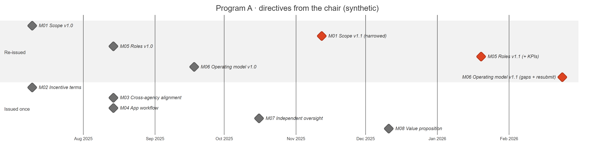
Identifiers reveal recurrence
Document Acts (p. 10) | In this pattern
Tracking numbers and VINs create "virtual attachment between documents via cross-referencing" | A mandate ID (M06) appears in the minutes, a follow-up letter and a tracker: three documents, one mandate
The document's identifiers support knowledge by comparison | Comparing M06 v1.0 with v1.1 shows the chair raised it twice, with more asked the second time. Each version is a distinct mandate, linked by precedes
Synthetic data. The real program file is internal and is not published.
Notes:
[1:00]
Why the identifier matters. Page 10 of Document Acts talks about knowledge by comparison. Tracking numbers and VINs create what Smith calls "virtual attachment" between documents: the same number in many documents ties them to one thing.
Mandate IDs work the same way. M06 appears in the minutes, in a follow-up letter, in a tracker. Three documents, one mandate. No document has to point to another document.
And comparing versions is where the intelligence is. This is synthetic data, but it has the shape of a real file. Three directives were issued twice. M06 version 1.0 asked to see the operating model. Version 1.1 asked for the gaps, the fixes, and a resubmission. The chair had to say it twice, and asked for more the second time.
In the pattern, each version is a separate mandate linked by "precedes". I never overwrite version 1.0, because the fact that it had to be said twice is the signal.

Slide 14
File Engineering aligned to IAO
CCO is imported; IAO is aligned (skos:closeMatch), not imported, so there is never a second "document" class. Following IAO-Intel, each file type is populated downward from IAO.
File element | Source label | IAO class (aligned) | CCO class (used)
Priority file (dossier) | ملف | document IAO_0000310 | Information Content Entity
Meeting presentation | عرض | document IAO_0000310 | Document Content Entity
Minutes | محضر | report IAO_0000088 (exact) | Report
Official letter | خطاب | document IAO_0000310 | Document Content Entity
Directive / mandate | توجيه | directive information entity IAO_0000033 | Process Regulation
Recording the decision | توثيق | documenting IAO_0000572 | Act of Official Documentation
Mandate ID + version | M06 v1.1 | identifier IAO_0020000 | Non-Name Identifier
Executive priority | أولوية | objective specification IAO_0000005 | Objective
People stay in CCO (IAO covers information only). IAO's version number is defined for manufactured products, so versions are part of the identifier instead. Precedent: IAO-Intel sets Intelligence Report under IAO Report (Smith et al., Table 1).
Notes:
[1:00]
Last change: File Engineering, the method I use for real files, aligned to IAO.
The decision is that CCO is the import and IAO is an alignment. IAO and CCO cover the same ground, so importing both would give me two competing "document" classes. Instead, each class gets a skos close-match or exact-match to its IAO counterpart, so IAO-based tools can still find the data.
This follows IAO-Intel. Smith and colleagues populate downward from IAO: Intelligence Report under IAO Report, and so on through the Army report types. I do the same with an executive office's own document types. Minutes, محضر, are an exact match to IAO report, which IAO defines as the output of a documenting process. Letters and presentations sit under IAO document. The directive, توجيه, sits under directive information entity.
Two limits. People stay in CCO, because IAO only covers information. And IAO's version number is defined for manufactured products, so versions live in the identifier instead.

Slide 15
Course material applied in this revision
Beverley, Intelligence Analysis: Military Intelligence Part 1: definitions as <T, E>, two-way counterexample tests, negative language, word-to-world fit → Step 1
Smith, Document Acts (week 3): "to record" (p. 6); felicity conditions and documents as enduring deontic power (pp. 9–10); identifiers and knowledge by comparison (p. 10) → Steps 2 and 5
Smith et al., IAO-Intel (week 3): downward population from document typologies; incremental coverage → File Engineering alignment
CCO v2.2 and IAO: every term checked against the source files, with IRIs in the repository write-up
Done since: the pattern in OWL (v0.1, 17 Oct), HermiT and CQ1–CQ5 pass. Next: sustained extendability, so every new document adds to it
Notes:
To sum up, three readings changed the proposal.
The definitions lecture took my Step 1 apart and gave me three tighter definitions. Document Acts split one act into two, and added the identifier that makes recurrence visible. And IAO-Intel gave me the method for aligning my document types without importing a second ontology.
Since then the pattern is implemented: version 0.1 in OWL, on an extracted BFO and CCO module, with HermiT and five SPARQL competency questions passing. But a pattern for one meeting isn't enough. An office has a meeting every week. So the next question is how each new document makes the base stronger instead of starting a new one.

Slide 16
Next step: sustained extendability
Every new presentation or set of minutes should make the base deeper or wider, and show how the organization itself names what it knows.
Depth
Breadth
Language
New facts about things the base already holds
A new branch, only when a question needs it
The organization's own words for what is already there
D05 re-issues M01, M05, M06. The new acts are preceded by acts from D01 and D02, which are never edited.
D03, the first deck, brings in the objectives and links them to work the minutes already hold.
محضر · MoM → minutes
تكليف · directive → mandate
“KPI” parked as a SKOS concept
Sustained extendability =def a property of a knowledge base built from an organization's documents, such that each new document passes through one fixed loop that links what it contributes to what the base already holds, as depth, breadth or language, while every earlier assertion and every earlier answer is kept.
Synthetic data (Program A). Documents D01–D07 are in final-project/ontology/documents/.
Notes:
[1:00]
The pattern models one meeting. But an executive office produces a meeting every week: a deck before it, minutes after it, letters following up. If I model each document on its own, I get a pile of small graphs that don't know about each other. If I redesign the ontology every time a new kind of document turns up, nothing stays stable.
So the principle I'm adding is sustained extendability: every new presentation or set of minutes makes the base deeper or wider.
There are three ways a document can add. Depth: new facts about things already in the base. Meeting 4 re-issues three mandates, and those new acts link back to acts from the first two sets of minutes, which are never edited. Breadth: a new branch. The first deck brings in the programme objectives. And language: the organization's own words for things the base already has. Mahdar and MoM for minutes, takleef and directive for mandate.
That third one is the point. Every document is evidence of how the organization represents its own knowledge.

Slide 17
Defined and tested like “meeting”
v1: each new document can be added to the base without changing earlier assertions
Test (Military Intelligence Pt. 1) | Counterexample | Result
Definition true, term false | A document store or search index: every file added, nothing earlier changed, nothing integrated | Fails: adding is not extending
Term true, definition false | Later minutes say M06 was re-issued: something new is known, so the base must change | Fails: the problem is overwriting, not changing
Avoid negative language | “without changing” | Restate as what is kept
v2: each new document passes through one fixed loop that links what it contributes to what the base already holds, while every earlier assertion and every earlier answer is kept
“Links” rules out the document store: measured as links into the base
“Every earlier answer” is a test I can run: CQ1–CQ5 re-run after every document
“One fixed loop” is what makes it sustained: document 10 goes through the same steps as document 1
Notes:
[1:00]
I defined it the same way as meeting, as a pair, term and expression, and looked for counterexamples.
My first attempt said: each new document can be added without changing earlier assertions.
Definition true, term false: a document store. Every file is added and nothing changes, but nothing is integrated either. Adding is not extending.
Term true, definition false: a later set of minutes says M06 was re-issued. The base has to change, because something new is known. What mustn't happen is overwriting.
And 'without changing' is negative language, which the lecture warned about.
So version 2 says what is kept: one fixed loop that links what a document contributes to what's already there, while every earlier assertion and every earlier answer to the competency questions is kept. 'Links' rules out the document store. 'Every earlier answer' is a test I can actually run.

Slide 18
One loop per document, after JDO
1
Register
2
Harvest
3
Reconcile
4
Classify
5
Model
6
Assert
7
Compare
8
Test
9
Release
JDO enrichment
JDO regimentation
JDO formalization
one named graph · regression · a person decides
Five rules keep it extendable
1
One named graph per document
nothing merged in a way that loses its source (Sikos)
2
A new class only when a question needs it
otherwise a SKOS concept: “KPI” in D03
3
Never overwrite: add, with a date
M06 v1.0 stays when v1.1 arrives (Document Acts, p. 10)
4
Every new class under a BFO/CCO parent
downward population, genus + differentia (IAO-Intel)
5
No IRI carries a project or file code
a class minted for one file must fit the next
Notes:
[1:15]
Where did the loop come from? Mostly from the Joint Doctrine Ontology reading.
JDO is built incrementally, one joint publication at a time, in three steps. Enrichment: add the terms a publication uses that the glossary doesn't define. Logical regimentation: rewrite the definitions by the rules. Formalization: OWL.
I treat each meeting document as a joint publication. Harvesting and reconciling terms is enrichment. Classifying, with the T-E test, is regimentation. Modelling, only when a question needs it, is formalization. Then four steps JDO doesn't need, because I'm loading facts, not just terms: assert into the document's own named graph, compare, test, and release, which a person decides.
JDO also points out that doctrine stayed consistent because every publication used the same general terms. Minutes have the same property: every set says chair, mandate, minutes.
Underneath are five rules. One named graph per document. A new class only when a question needs it. Never overwrite. Every new class under BFO or CCO. And no IRI carries a project code.

Slide 19
Implemented: one document at a time
Document (synthetic) | Kind | Classes reused | New labels | CQs answered | Regressions
D01 minutes, meeting 1 | base | 0/11 | 0 | 4/5 | —
D02 minutes, meeting 2 | depth | 8/8 | 1 | 4/5 | 0
D03 deck, meeting 3 | breadth | 1/3 | 6 | 4/5 | 0
D04 minutes, meeting 3 | depth | 4/5 | 2 | 4/5 | 0
D05 minutes, meeting 4 | depth | 8/8 | 0 | 5/5 (CQ1) | 0
D06 follow-up letter | language | 1/2 | 5 | 5/5 | 0
D07 conflicting note | rejected | — | — | — | —
0
new OWL classes in six documents. “KPI” stayed a SKOS concept
0
regressions. After D06, CQ1–CQ5 equal the one-shot v0.1 answers
1
document rejected by HermiT. The base stays at D06
python ingest.py: merge base + accepted documents + new one → HermiT → CQ1–CQ5 → every earlier answer must still hold → count what was added. Log: final-project/ontology/results/extendability/ingest-log.md
Notes:
[1:15]
This is implemented. The same synthetic Program A as in version 0.1, but now split into seven documents and loaded one at a time, in meeting order. After each one, a script merges it onto everything accepted before, reasons with HermiT, and re-runs the five competency questions.
Read the table top to bottom. The first minutes found the base: 11 classes, all CCO or mine from the pattern. The second minutes reuse 8 of 8: pure depth. The deck is breadth: objectives and presentations appear for the first time, and the word KPI is parked in the vocabulary because no question needs it. Meeting 4's minutes are where CQ1 first returns anything. Recurrence can't be seen in any single document; it only appears when a later document is linked to earlier ones. And the letter is mostly language.
Three results. No document needed a new OWL class. Nothing broke: zero regressions, and after the sixth document the answers are identical to loading everything at once. And document 7 was rejected by the reasoner.

Slide 20
Named graphs, and a rejected document
Question (named graphs) | Program A answer
X01: which documents is each mandate known from? | M06 v1.1: minutes D05 and letter D06. All others: one set of minutes
X04: which mandates rest on one source? | 6 of 7. Only M06 v1.1 is corroborated
X02: what did D05 add to what was known? | 6 facts on old nodes: 3 × precedes, 3 × prescribes. Nothing overwritten
V04: which words did each document add? | 14 labels, Arabic and English, across D02, D03, D04, D06
D07 says: “M06 v1.1 is a Planned Act”
minutes_4 has continuant part M06 v1.1
→ M06 v1.1 is a continuant (range)
Planned Act ⊑ Act ⊑ process ⊑ occurrent
continuant disjointWith occurrent (BFO)
→ inconsistent: rejected
The mandate was confused with the work it requires. The base stays at D06.
CQ1 first answers at D05. Recurrence is invisible inside any one document. It appears only when a later document is linked to earlier ones, which is why the documents have to extend one base.
Notes:
[1:00]
Keeping one named graph per document gives me questions about the documents themselves.
Provenance: M06 version 1.1 is known from two documents, the minutes and the letter. Every other mandate rests on a single set of minutes, which for an analyst is a confidence signal. What changed: D05 added six facts to things the base already knew, three precedes links and three links from the deck's objectives. Nothing was overwritten. And which words each document brought in.
On the right, the rejection. Document 7 says M06 version 1.1 is a planned act. That's the most common mistake in real minutes: confusing the mandate with the work it requires. HermiT finds it inconsistent: the minutes have M06 as a continuant part, so it's a continuant; a planned act is a process, so an occurrent; and BFO makes those disjoint. The document is rejected and the base stays as it was. The upper ontology is doing quality control.

Slide 21
Course material applied to extendability
Joint Doctrine Ontology (week 7, §IX.C): built incrementally, one publication at a time; enrichment → regimentation → formalization → the loop
Ontology for the Intelligence Analyst (week 1): terms keep their place “even when … whole new branches are added”; one preferred label per type → language goes to labels
IAO-Intel (week 3, §V): coverage “determined incrementally” from requests and document terms → a class only when a question needs it
Document Acts (week 3): identifiers create virtual attachment → D06 links to M06 v1.1 without pointing at D05
C3O (week 11) and Sikos, Cybersecurity Knowledge Graphs (week 11): domain modules under CCO; one named graph per source
Falsehoods Programmers Believe About Names (week 13): names are not unique or stable → محضر, محضر اجتماع, MoM: one concept
Limits: synthetic and small, so it shows the mechanism, not a trend · provenance stops at the document (real minutes need page + quote) · the regression test protects only what the CQs ask
Next: the final project packet; run the same loop on a real file, where the rate of new terms per document should fall as the vocabulary matures
Notes:
[1:00]
To close: where each idea came from. Joint Doctrine Ontology gave the loop: incremental, one publication at a time, enrichment, regimentation, formalization. Ontology for the Intelligence Analyst gave the stability requirement: terms keep their place even when whole new branches are added, and one preferred label per type, which is why new words go into labels and not new classes. IAO-Intel: coverage determined incrementally, from requests and from the terms in the documents. C3O: breadth arrives as modules under CCO. Sikos: one named graph per data source. And Falsehoods About Names: names aren't unique or stable, and neither are an organization's terms.
The limits. The data is synthetic and small, so this shows the mechanism, not a trend. Provenance stops at the document; real minutes need a page and a quote for every assertion. And the regression test protects only what the questions ask.
Next is the final project packet, and running this loop on a real file.
Thank you.

