Slide 1
電腦視覺與深度學習 (Computer Vision and Deep Learning) Homework 1
TA:
真禎: nckubot65904@gmail.com
Office Hour: 14:00~16:00, Mon.
10:00~12:00, Fri.
At CSIE 9F Robotics Lab.

Slide 2
Notice (1/2)
Copying homework is strictly prohibited!! Penalty: Score will be zero for both persons!!
Due date => 09:00:00, 2022/11/03 (Thu.)
No delay. Penalties for late homework:
Up to 7 days late, loss of 50% of the score awarded
After 7 days, the score will be marked as 0.
You must attend the demonstration, or your score will be 0. The demonstration schedule will be announced on NCKU moodle.
You must make a GUI and follow the format, or you will get some penalties.
Upload to => 140.116.154.1 -> Upload/Homework/Hw1_04
Upload/Homework/Hw1_05
User ID: cvdl2022 Password: cvdl2022
Format
Filename: Hw1_04_StudentID_Name_Version.rar
Hw1_05_StudentID_Name_Version.rar
Ex: Hw1_04_F71234567_林小明_V1.rar
If you want to update your file, you should update your version to be V2.
Ex: Hw1_04_F71234567_林小明_V2.rar
Content: project folder*( excluding the pictures, only source code ) *note: remove your “Debug” folder to reduce file size
2

Slide 3
Notice (2/2)
Python
Python 3.7 (https://www.python.org/downloads/)
opencv-contrib-python (3.4.2.17)
Matplotlib 3.1.1
UI framework: pyqt5 (5.15.1)
Pytorch
Tensorflow
3

Slide 4
Assignment scoring (Total: 100%)
1. (20%) Camera Calibration
1.1 (4%) Corner detection
1.2 (4%) Find the intrinsic matrix
1.3 (4%) Find the extrinsic matrix
1.4 (4%) Find the distortion matrix
1.5 (4%) Show the undistorted result
2. (20%) Augmented Reality
2.1 (10%) Show words on board
2.2 (10%) Show words vertically
3. (20%) Stereo Disparity Map
3.1 (10%) Stereo Disparity Map
3.2 (10%) Checking the Disparity Value
4. (20%) SIFT
4.1 (10%) Keypoints
4.2 (10%) Matched Keypoints
5. (20%) Training Cifar10 Classifier Using VGG19
5.1 (2%) Load Image and Show 9 Training Images with Different Label
5.2 (2%) Show Model Structure
5.3 (2%) Show Data Augmentation Result
5.4 (2%) Show Accuracy and Loss
5.5 (12%) Inference
(出題：Jessica)
(出題：Ming)
(出題：Maton)
(出題：Mei)
Question 4 or 5 need to upload separately.
(出題：Wen)

Slide 5
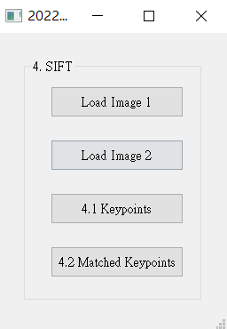
4. (20%) SIFT (Scale-invariant Feature Transform)
(出題：Mei)
4.1 (10%) Keypoints
4.2 (10%) Matched Keypoints

Slide 6
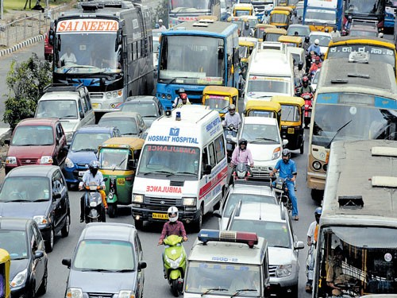
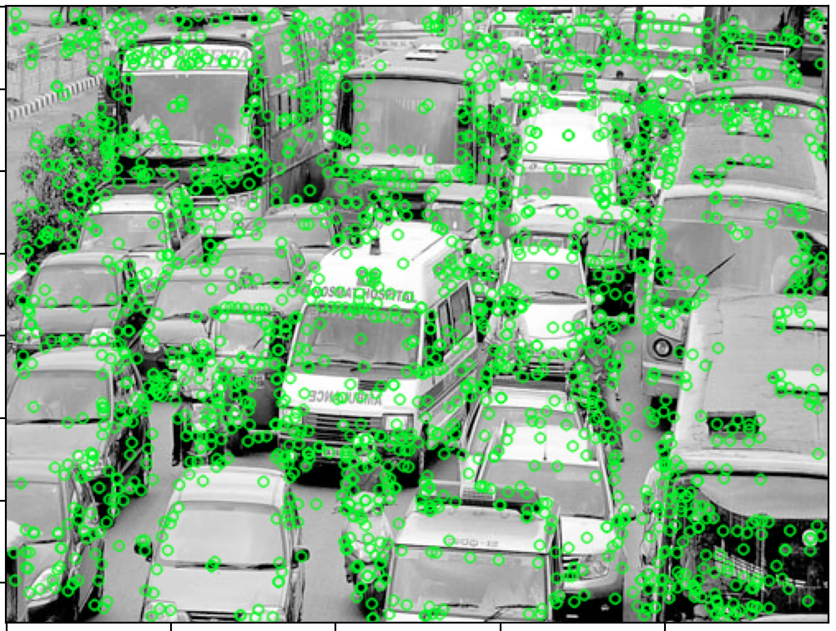
4.1 (10%) Keypoints
(出題：Mei)
Click button “4.1 Keypoints” to show:
Load image 1 traffics.png (click “Load Image 1”)
Based on SIFT algorithm, find keypoints on traffics.png.
Hint: Use OpenCV SIFT detector to detect keypoints and descriptors.
sift = cv.SIFT_create() # Create a SIFT detector
sift.detectAndCompute(image,None)
3. Then save and draw the keypoints of traffics.png as figure 1.
Hint: cv.drawMatchesKnn
Input:
Output:
traffics.png
Figure 1
Reference : OpenCV Textbook SIFT, p321, 464, 524

Slide 7
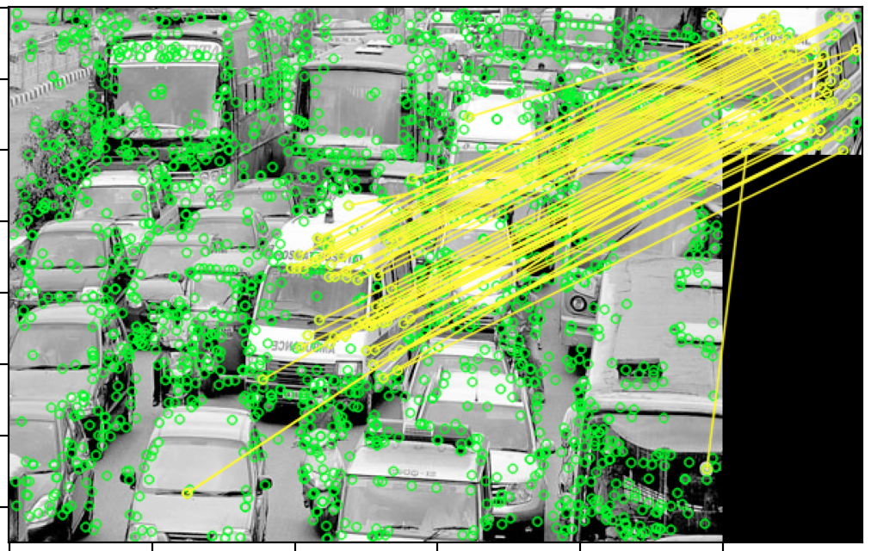

4.2 (10%) Matched Keypoints
(出題：Mei)
Click button “4.2 Matched Keypoints”,
Load Image 1 (traffics.png) and Image 2 (ambulance.png)
Based on SIFT algorithm, find the keypoints and descriptors at Image 1 and Image 2 (same as question 1) and match the most related between descriptors 1 and descriptors 2. Hint: Use OpencCV DescriptorMatcher.knnMatch(descriptors 1, descriptors 2) to locate the matched keypoints.
Save and draw the matched feature points between two image, traffics.png and ambulance.png, show the results as figure 2. Hint: 12. Use “cv2.drawMatchesKnn()” to draw the matches
Input:
Output:
ambulance.png
traffics.png
figure 2
Reference: OpenCV Textbook SIFT, p321, 464, 524

Slide 8
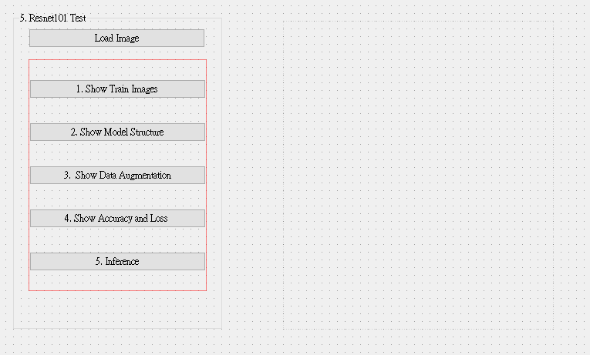
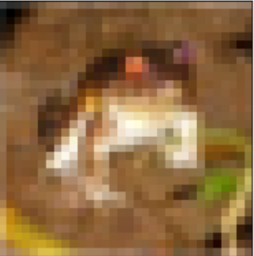
5. Training Cifar10 Classifier Using VGG19 (20%)
5.1 Load Cifar10 and Random Show 9 Images with Label(4%)
5.2 Load Model and Show Model Structure (4%)
5.3 Show Data Augmentation Result (4%)
5.4 Show Accuracy and Loss (4%)
5.5 Inference (4%)

Slide 9

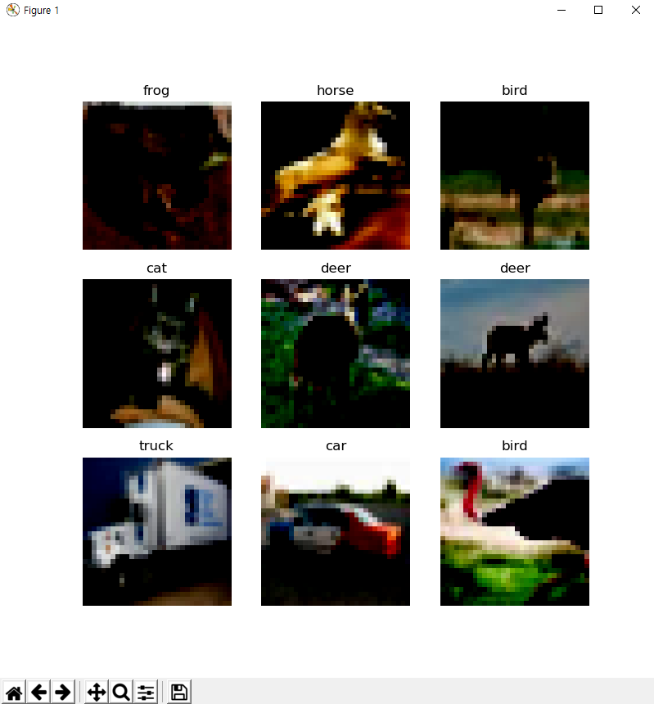
5.1 Load Cifar10 training dataset, and then Randomly show 9 Images and Labels respectively (4%)
Load Cifar10.
Tensorflow: tf.keras.datasets.cifar10.load_data()
Click Button to Random show 9 Images with Labels.
10 Class of CIFAR 10 Dataset
0 airplane
1 automobile
2 bird
3 cat
4 deer
5 dog
6 frog
7 horse
8 ship
9 truck
Class
Label
Image
◆ Hint
Use Matplotlib 4 function
figure()
title()
Axis()
imshow()
Can refer by tutorial at the Matplotlib library official web-site
https://matplotlib.org/stable/tutorials/index.html

Slide 10
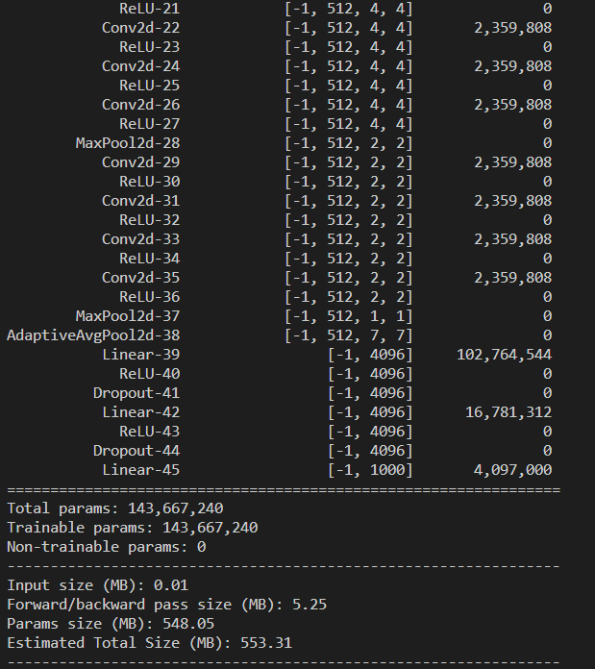
5.2 Load Model and Show Model Structure(4%)
Load Model
When Training:
Tensorflow: tf.keras.applications.VGG19()
When Demo:
1)Tensorflow: tf.keras.models.load_model(model_name)
2. Click Button to Show Model Structure on terminal.
◆ Hint(when call model)
Input shape should set to 32 x 32.
Classes should to set 10.
◆ Hint
Pytorch API
Use the two option
Summary function
from torchsummary import summary
summary(Model name, (Input Channel, Input Width, Input Height))
Print function
From torchvision import models
model = torchvision.models.vgg19()
Print(Model)
Can refer this web-site https://pypi.org/project/pytorch-model-summary/
Notes:
https://stackoverflow.com/questions/42475381/add-dropout-layers-between-pretrained-dense-layers-in-keras
https://stackoverflow.com/questions/68153637/when-i-train-a-vgg-with-tensorflow-2-0-why-my-accuracy-do-not-increase-and-only

Slide 11
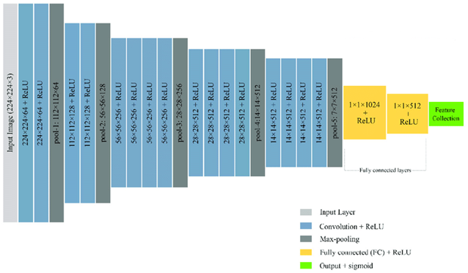
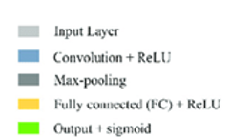
5.2 Load Model and Show Model Structure(4%)
Batch size, channel, H,W
Resize Image 32x32 to 224x224
MaxPool2d window size = 2
All convolution filter size is 3x3
Flatten Here
Layers List of
Model
After processing
each layer
Change of input
data type
Number of
trainable
parameters
The Last Layer:
Fully Connection Layer:
(1*512) to (1*10) classes
Reference
https://pytorch.org/vision/0.12/generated/torchvision.models.vgg19.html(Source Code)
https://www.cs.toronto.edu/~kriz/cifar.html (Cifar10 Dataset)
VGG19 framework

Slide 12
5.3 Show Data Augmentation Result (4%)
When conducting deep learning training, we often need massive amounts of data to ensure that there is no over-fitting during training.
Data augmentation is to modify and deform the existing pictures in the dataset to create more pictures for machine learning to make up for the lack of data.
In this section, we want you to try 3 kinds of augmentation methods.
The methods of transforms on PIL Image and torch.*Tensor
CenterCrop(size) | Crops the given image at the center.
ColorJitter([brightness, contrast, …]) | Randomly change the brightness, contrast, saturation and hue of an image.
FiveCrop(size) | Crop the given image into four corners and the central crop.
Grayscale([num_output_channels]) | Convert image to grayscale.
Pad(padding[, fill, padding_mode]) | Pad the given image on all sides with the given “pad” value.
RandomAffine(degrees[, translate, scale, …]) | Random affine transformation of the image keeping center invariant.
RandomApply(transforms[, p]) | Apply randomly a list of transformations with a given probability.
RandomCrop(size[, padding, pad_if_needed, …]) | Crop the given image at a random location.
RandomGrayscale([p]) | Randomly convert image to grayscale with a probability of p (default 0.1).
RandomHorizontalFlip([p]) | Horizontally flip the given image randomly with a given probability.
RandomPerspective([distortion_scale, p, …]) | Performs a random perspective transformation of the given image with a given probability.

Slide 13
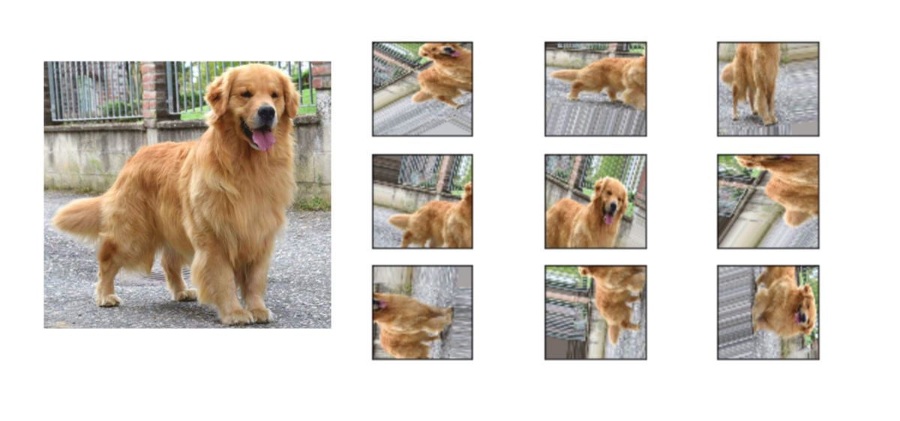

5.3 Show Data Augmentation Result (4%)
Load Image to select an image file.
2. Click Button to Show Augmentation Data. Concatenate 3 figures of the augmentation results and show it.
GUI example
Transforms on PIL Image and torch.*Tensor
Function:
RandomRotation()
RandomResizedCrop()
RandomHorizontalFlip()
Can refer by tutorial at the Matplotlib library official web-site
https://matplotlib.org/stable/tutorials/index.html

Slide 14
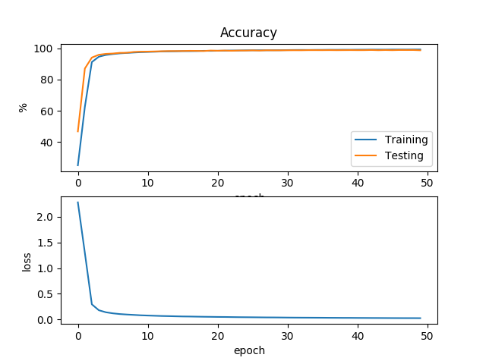
5.4 Training your model at least 30 epochs at home and record the accuracy and loss in each epoch. Show the Figure of your training loss and accuracy when demo time. (4%)
Do in your home:
tesnsorflow: model.fit()
You should set the parameter:
Epoch to 30
Loss: Crossentropy
Optimizer: Adam
Show the accuracy and loss via plt and get a screen shoot to store this image.
When Demo :
1. Click button to the image
◆ Hint
model which is called form 5.2.
model.fit() returns the accuracy and loss.
model.save() to save your trained model.
Notice
Please save your weighted file during training
Record each training result (accuracy, loss) and draw it as the picture on the right

Slide 15
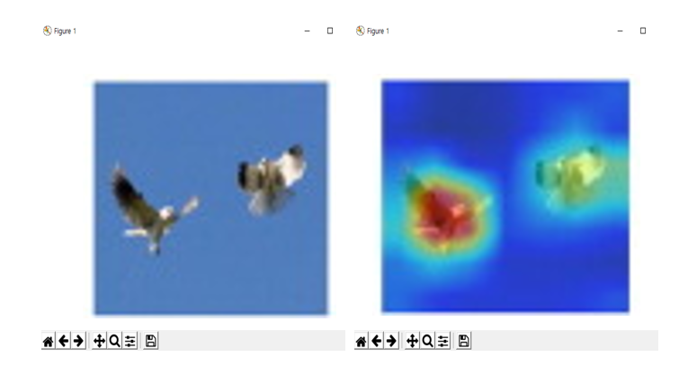


5.5 Load the image and inference them with your weighted file (.pth), and show the result image and class (4%)
1. Choose the any data
2. Run Inference
GUI example
Confidence = 0.98
Prediction Label: bird
Using the model.predict() to classification
Show the result on the UI
Show the prediction label, confidence score
GUI example
◆ Hint
https://towardsdatascience.com/understanding-pytorch-with-an-example-a-step-by-step-tutorial-81fc5f8c4e8e#5017
https://pytorch.org/tutorials/
https://yanwei-liu.medium.com/pytorch-with-grad-cam-6a92a54bfaad

