Slide 1

Predict the house price based on the pre-given samples with linear regression
Assignment 1#

Slide 2
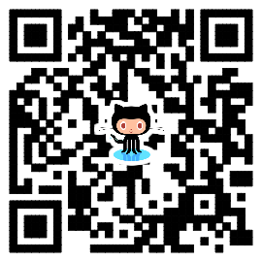
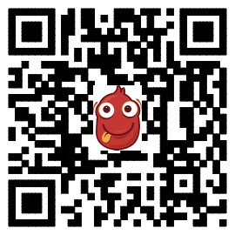
This assignment is actually a re-implementation of predicting house price but with different data and essential model. Some key issues are as following slides.
The project homepage:
https://github.com/sunzuolei/ml
https://git.oschina.net/samuel/ml
The Git repository:
https://github.com/sunzuolei/ml.git
https://git.oschina.net/samuel/ml.git

Slide 3
Data
The data you will use is included in a1.mat. After loading it, you should find two data matrix, samples and newData.
The former involves 120 training samples achieved from the previous house trades. Its first column denotes the feature of house size and the second column indicates the corresponding price.
The latter is the size of three houses whose price you will infer.

Slide 4
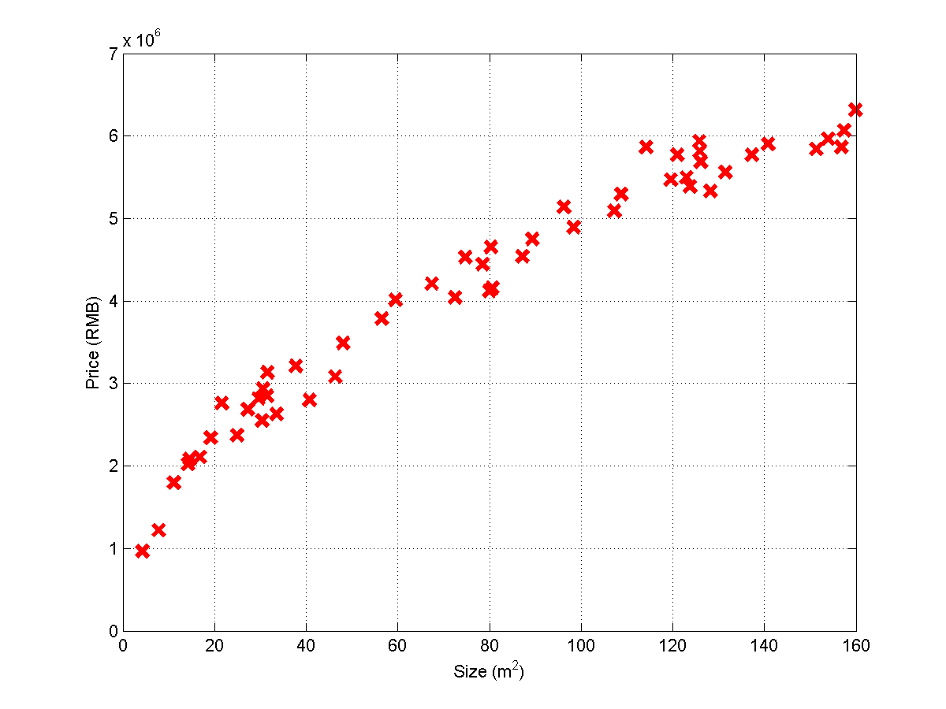

Slide 5
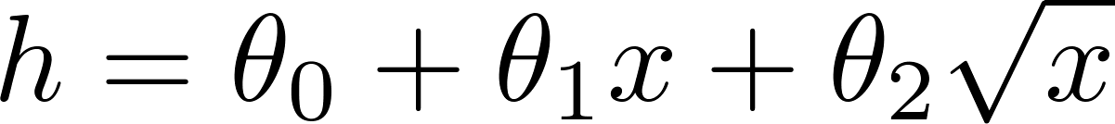
Hypothesis Model

Slide 6
Algorithm
The algorithms, both linear gradient decent and normal equation, addressed in lectures should be demonstrated in your implementation
The predicted outputs inferred with the two algorithms should be same, otherwise, you did something wrong.

Slide 7
Coding issues
Either Matlab or Octave can be used in programming.
Higher grade will be given, if Python or C++ or C or Java or C# is used.
The codes introduced in the classroom lectures could be freely reused in your application.
Any modification on programming style, algorithm routine is preferred.

Slide 8
Documentation
Your understanding of the algorithm, the framework/flow of your result should be involved in your document.
It makes NO sense and ZERO is scored if only codes but without document is submitted.
The file format could be doc, docx, or Tex-based pdf.
No limitation on the document length.

Slide 9
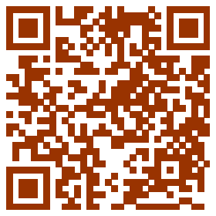
Submission
Package your codes and document in a single compressed file titled as:
ML_ASS1#_your name_your ID, for example:
ML_ASS1#_马伊俐_19970188
Send it as attachment to
assignments.shmtu@gmail.com
The subject of the email should be the same as the title of your attachment.
Any email with mismatched formats will be identified as SPAM.

Slide 10
About Plagiary
NO Tolerance on any plagiary. ZERO score will be given.
DON’T share your source code with others, otherwise ZERO score will be given.
Some criterions on determining plagiary:
With the exactly same codes or documents
If two copies are same, the one sent later is considered as plagiarizer. Here, ‘later’ is judged based on the coming time of its email.
Student will be assigned randomly to present his (her) codes on class.

Slide 11
Deadline
Submitting your assignment later than the following data makes no sense:
18:00 PM
2014/04/15

